Slide 1
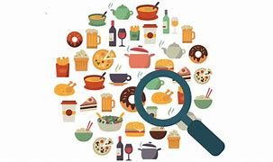
Food Inspection and Preservation Dr. Aseel MH Abed Al-Radah

Slide 2
Food Inspection
Examination of foods to assure wholesome and clean products free from unsafe microbes or chemical contamination, natural or added deleterious substances, and decomposition during production, processing, packaging
Key features and benefits of risk-based food inspection
1-Focuses on points of the food chain or processes that pose highest risk.
2-Minimizes costs to food operators by reducing unnecessary inspection and testing costs.
3-Promotes preventive rather than reactive approach to food control.
4- Optimizes the efficiency of food control and use of inspection resources.

Slide 3
What is Food Preservation?
Food preservation is one of the methods to protect food from unwanted microbial growth or chemical or enzymal spoilage.
After the food is produced, we store and protect by covering with lids to keep away flies and other insects. By this, we are protecting it from any infection caused by them. This is a short-term condition. Food preservation, on the other hand, is done to preserve food for a longer time.
Objectives of Food Preservation
Following are the important objectives of food preservation:
1- To prevent microbial contamination.
2- To kill pathogens.
3- To minimize food spoilage and food poisoning.

Slide 4
Food Preservation Methods
Food preservation started long back in ancient times. Cooling, freezing, fermentation, sun-drying, etc., are few age-old food preservation techniques. With the advent of technology, modern methods of food preservation were developed. Chemicals and other natural substances were used for preservation. These substances are known as preservatives.
Common Methods of Food Preservation
Chilling.
Freezing.
Sugaring.
Salting.
Canning.
Vacuum Packing

Slide 5
Food poisoning
also called foodborne illness, is illness caused by eating contaminated food
1- Infectious organisms including bacteria, viruses and parasites or their toxins
2-toxic chemical (heavy metal)
3-toxic accumulation of agrochemicals, hormones and antibiotics used on farm animals
4- having toxic fish or mashroom
Bacterial in food
1- Bacteria casing food spoilage
2- Pathogenic bacteria ( pathogenic illness transmitted by food or casing food illness)
These microorganisms are odorless and flavourless, and do not change in food texture, odour, or taste (undetectable outside the lab)

Slide 6
Food spoilage
Food spoilage is the process where a food product becomes unsuitable to ingest by the consumer. The cause of such a process is due to many outside factors as a side-effect of the type of product it is, as well as how the product is packaged and stored.
Due to food spoilage, one-third of the world's food produced for the consumption of humans is lost every year. Bacteria and various fungi are the cause of spoilage and can create serious consequences for the consumers, but there are preventive measures that can be taken.
Signs of food spoilage may include an appearance different from the food in its fresh form, such as a change in color, a change in texture, an unpleasant odour, or an undesirable taste. The item may become softer than normal.
. But eating deteriorated food not considered safe due to mycotoxins or microbial wastes.
Food spoilage can be the result of: – insect damage – physical injury – enzymatic degenration – microbial activity
Food that is capable of spoiling is referred to as perishable food.

Slide 7
Perishable foods
Perishable foods are those likely to spoil, decay or become unsafe to consume if not kept refrigerated at 4°C or below, or frozen at 0 °C or below. Examples of foods that must be kept refrigerated for safety include meat, poultry, fish, dairy products, and all cooked leftovers. Refrigeration slows bacterial growth.
Perishable foods are foods like fresh meat, seafood, and ripe fruits.
Semi-perishable foods commodities are those that do not require refrigeration, but still have a limited shelf life. They include things like potatoes, onions, pumpkins and salamis. These items are usually kept on shelves in the store room complex, where they get plenty of air.
While non-perishable foods are items that do not spoil or decay.... for example; canned goods, all pasta types, sugar, flour, curls (and chips if air-sealed), spices are non perishable as well

Slide 8
Type of Food spoilage
a. Microbial spoilage • Growth of microorganisms • Enzyme production
Microbial Spoilage Bacteria ,Yeast and mould
b. Physical spoilage • moisture loss or gain, insect damage – physical injury
c. Chemical spoilage • Oxidation of fat • Browning of fruits and vegetables, enzymatic degradation
Some spoiled foods are harmless to eat, and may simply be diminished in quality. • But foods exhibiting certain types of spoilage may be harmful to consume.
Uncooked or under-cooked animal flesh that spoils is typically quite toxic, and consumption can result in serious illness or death.
• The toxic effects from consuming spoiled food are known as "food poisoning", and more properly as"foodborne illness”.

Slide 9
1 Microbial spoilage
Microbial spoilage is caused by microorganisms like fungi (moulds, yeasts) and bacteria. They spoil food by growing in it and producing substances that change the color, texture and odor of the food. Eventually the food will be unfit for human consumption.
When food is covered with a furry growth and becomes soft and smells bad, the spoilage is caused by the growth of moulds and yeasts .
Microbial spoilage by moulds and yeasts includes souring of milk, growth of mould on bread and rotting of fruit and vegetables.
These organisms are rarely harmful to humans, but bacterial contamination is often more dangerous because the food does not always look bad, even if it is severely infected.
When microorganisms get access to food, they utilise the nutrients found in it and their numbers rapidly increase. They change the food’s flavour and synthesise new compounds that can be harmful to humans.

Slide 10
Food spoilage directly affects the color, taste, odor and consistency or texture of food, and it may become dangerous to eat. The presence of a bad odor or smell coming from food is an indication that it may be unsafe.
But remember that not all unsafe food smells bad.
Fungi are caused by acidifying, fermenting, discoloring and disintegrating processes and can create fuzz, powder and slimes of many different colors, including black, white, red, brown and green.
Yeast also produces at a slower rate than bacteria, therefore being at a disadvantage in environments where bacteria are.
Yeasts can be responsible for the decomposition of food with a high sugar content.
The same effect is useful in the production of various types of food and beverages, such as bread, yogurt, cider, and alcoholic beverages

Slide 11
Routes of microbial contamination of food
Bacteria are a major source of microbial contamination of food, like the undesired presence in food of harmful microorganisms or the harmful substances they produce. Viruses, parasites and fungi are also able to contaminate food and cause foodborne illnesses in humans. Microorganisms can enter food through different routes.
Air and dust microorganisms are found everywhere in our environment. Many types can be found in air and dust, and can contaminate food at any time during food preparation or when food is left uncovered
Soil, water and plants Many microorganisms present in soil and water may contaminate foods. Microorganisms also grow on plants and can contaminate food if care is not taken to remove them by washing or inactivate them by cooking. Soil is a particularly rich source of Clostridium bacteria. Water may be contaminated by faeces. Plants may also be contaminated by faeces if untreated sewage has been used as a fertiliser.

Slide 12
Animal hides and Gastrointestinal tract
The intestines of all humans and animals are full of microorganisms, some of which are beneficial but others are pathogenic. Bacterial pathogens such as Salmonella, Campylobacter and Escherichia coli (O157:H7) are common examples.
Contamination of foods by faecal material is the major cause of food poisoning events. This includes indirect contamination.
Many foodborne microorganisms are present in healthy animals raised for food, usually in their intestines, hides, feathers, etc. Meat and poultry carcasses can be contaminated during slaughter by contact with small amounts of intestinal contents. microorganisms present in the animals’ intestines can easily contaminate the meat.
Animal hides are an important source of contamination of the general environment, the hands of meat workers, and skinned meat carcasses. Hides are a primary source of E.coli O157:H7 and Salmonella species, both of which cause sickness and diarrhoea. Hides become contaminated either because the outside of the hide is dirty, or because once removed from the animal, the inside of the hide is a good breeding place for microorganisms.

Slide 13
Food handlers the term food handler can be applied to anyone who touches or handles food, and this includes people who process, transport, prepare, cook and serve food. The presence of microorganisms on the hands and outer garments of food handlers reflects the standard of hygiene in the environment and the individuals’ personal hygiene The microorganisms transmitted to foods. In food preparation at home, foodborne microorganisms can be introduced from the unwashed hands of people who are infected by bacteria and viruses, and who cook and serve the food to family members.
Food utensils food utensils are cutting boards, knives, spoons, bowls and other equipment used in food preparation, which may become contaminated during food processing and preparation. For example, in families where there is no access to running water, the food utensils may not be properly cleaned, stored and handled, and may become a major route of food contamination.
Cross-contamination the cross-contamination of food is the transfer of harmful microorganisms between food items and food contact surfaces. Prepared food, utensils and surfaces may become contaminated by raw food products and microorganisms. These can be transferred from one food to another by using the same knife, cutting board or other utensil without washing it between uses. A food that is fully cooked can become re-contaminated if it touches raw foods or contaminated surfaces or utensils that contain pathogens. For example, you should never:
* allow raw meat to touch cooked meat
** put cooked meat on a cutting board that has just been used for raw meat without cleaning it first store raw meat on *** a shelf above cooked meat so that it could leak blood and raw juices on to the cooked meat below.

Slide 14
Chemical changes caused by micro organisms
➢ Degradation of carbohydrates
➢ Degradation of N- compounds
➢ Degradation of lipids
➢ Pectin hydrolysis
Common Causes of Food Spoilage
. Inadequate storage temperatures
• Prolonged storage times
• Improper ventilation
• Cross contamination
• Excessive delays between receiving and storing

Slide 15
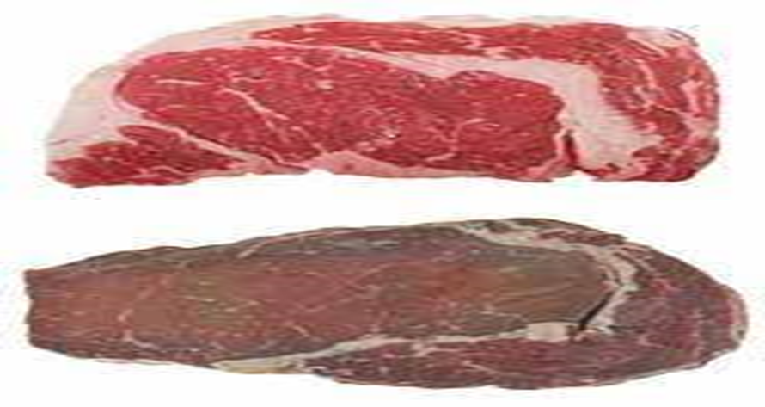
2- Chemical spoilage
Chemical reactions in food are responsible for changes in the colour and flavour of foods during processing and storage. Foods are of best quality when they are fresh, but after fruits and vegetables are harvested, or animals are slaughtered, chemical changes begin automatically within the foods and lead to deterioration in quality. Fats break down and become rancid (smell bad), and naturally-occurring enzymes promote major chemical changes in foods as they age.
1- Enzymic spoilage (autolysis)
2- Enzymic browning
3- Maillard reaction

Slide 16
Enzymes that cause food spoilage
enzyme | food | spoilage action
ascorbic acid oxidase | vegetables | destruction of vitamin C
lipase | cereals | discoloration
 | milk | hydrolytic rancidity
 | oils | hydrolytic rancidity
lipoxygenase | vegetables | destruction of vitamin A, off-flavour
pectic enzyme | citrus juices | destruction of pectic substances
 | fruits | excessive softening
peroxidase | fruits | browning
polyphenoloxidase | fruits, vegetables | browning, off-flavour, vitamin loss
protease | eggs | reduction of shelf life of fresh and dried whole eggs
 | crab, lobster | overtenderization
 | flour | reduction of gluten formation
thiaminase | meats, fish | destruction of thiamin

Slide 17
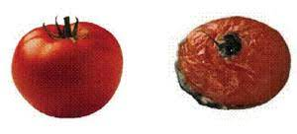
Enzymic spoilage (autolysis)
Every living organism uses specialised proteins called enzymes to drive the chemical reactions in its cells. After death, enzymes play a role in the decomposition of once-living tissue, in a process called autolysis (self-destruction) or enzymic spoilage.
For example, some enzymes in a tomato help it to ripen, but other enzymes cause it to decay . Once enzymic spoilage is under way, it produces damage to the tomato skin, so moulds can begin attack it as well, speeding the process of decay.

Slide 18
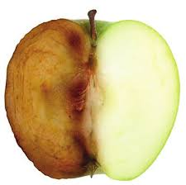
Enzymic browning
When the cells of fruits and vegetables such as apples, potatoes, bananas and avocado are cut and exposed to the air, enzymes present in the cells bring about a chemical reaction in which colourless compounds are converted into brown- colored compounds. This is called enzymic browning. If the food is cooked very soon after cutting, the enzymes are destroyed by heat and the browning does not occur. For example, apples are prone to discolouration if cut open when raw, but when cooked they do not go brown.

Slide 19
Maillard reaction
Another chemical reaction that causes major food spoilage is nonenzymatic browning, also known as the Maillard reaction. This reaction takes place between reducing sugars (simple monosaccharides capable of carrying out reduction reactions) and the amino group of proteins or amino acids present in foods.
The products of the Maillard reaction lead to a darkening of colour, reduced solubility of proteins, development of bitter flavours, and reduced nutritional availability of certain amino acids such as lysine.
The rate of this reaction is influenced by the water activity, temperature, and pH of the food product.
Nonenzymatic browning causes spoilage during the storage of dry milk, dry whole eggs, and breakfast cereals.

Slide 20
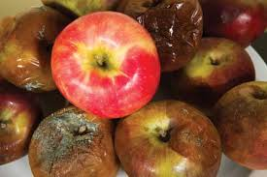
3- Physical spoilage
Physical spoilage indicated by moisture gain or loss.
Also Physical spoilage is due to physical damage to food during harvesting, processing or distribution. The damage increases the chance of chemical or microbial spoilage and contamination because the protective outer layer of the food is bruised or broken and microorganisms can enter the foodstuff more easily. For example you may have noticed that when an apple skin is damaged, the apple rots more quickly.

