Slide 1
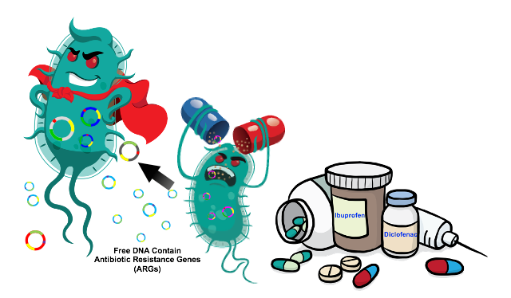
Antimicrobial resistance
Dr. Aseel MH Abd-Alrada

Slide 2
The discovery of antibiotics transformed our world by making previously incurable illnesses treatable and allowing medical procedures like operations and chemotherapy to be performed safely
Antibiotic resistance occurs when bacteria change in response to medicines and develop the ability to defeat drugs. While antibiotic resistance occurs naturally, the overuse and misuse of antibiotics has accelerated the process.
Antibiotic resistance is one of the biggest public health challenges of our time. Each year in the U.S., at least 2.8 million people get an antibiotic-resistant infection, and more than 35,000 people die.
Fighting this threat is a public health priority that requires a collaborative global approach across sectors. CDC is working to combat this threat.
Humans use an estimated 34.8 billion antibiotic doses each year, with global consumption increasing 65% between 2000 and 2015. In the United Kingdom, 1 in 5 antibiotics are prescribed unnecessarily. In the United States, this number rises to 1 in 3. Meanwhile, 17% of the substandard or falsified medicines reported to the World Health Organization are antibiotics, which has further contributed to drug resistance

Slide 3
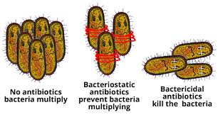
• Antibiotics are medicines for bacterial infections
• Examples of antibiotics:
– Penicillin and Ciprofloxacin
• Penicillin was discovered by Alexander Fleming in 1928
– Introduced as medicine in the 1940’s
• Antibiotics can have “broad” or “narrow” spectrum
– Broad spectrum: Active against many different types of bacteria
– Narrow spectrum: Active against one or a few types of bacteria
Antibiotics can have A bacteriostatic or A bactericidal Activity

Slide 4
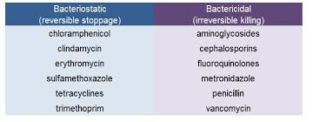
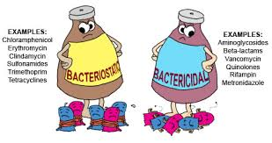

Slide 5
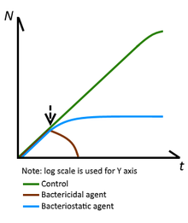
A bacteriostatic agent or bacteriostat, abbreviated Bstatic, is a biological or chemical agent that stops bacteria from reproducing, while not necessarily killing them otherwise. Depending on their application, bacteriostatic antibiotics, disinfectants, antiseptics and preservatives can be distinguished. When bacteriostatic antimicrobials are used, the duration of therapy must be sufficient to allow host defense mechanisms to eradicate the bacteria. Upon removal of the bacteriostat, the bacteria usually start to grow again. This is in contrast to bactericides, which kill bacteria.
A bactericide or bacteriocide, sometimes abbreviated Bcidal, is a substance which kills bacteria. Bactericides are disinfectants, antiseptics, or antibiotics

Slide 6
Antibiotics are effective against bacteria
– However, antibiotics have only marginal effect against some bacterial infections such as uncomplicated sinus infections and ear infections (bacterial otitis)
– The body’s immune system can normally take care of these infections without antibiotics
• But for some bacterial infections antibiotics are life-saving medicines!
– For example for blood stream infections (sepsis) and pneumonia Before antibiotics there was no effective cure for bacterial infections
• Antibiotics were considered “a miracle cure”
Saved countless lives
Made modern medicine possible
• Antibiotics cure infections, prevent infections upon surgery, and make transplantations and cancer treatment safer

Slide 7
Anti Microbial Resistance AMR
Antibiotic resistance happens when germs like bacteria and fungi develop the ability to defeat the drugs designed to kill them. That means the germs are not killed and continue to grow.
Infections caused by antibiotic-resistant germs are difficult, and sometimes impossible, to treat. In most cases, antibiotic-resistant infections require extended hospital stays, additional follow-up doctor visits, and costly and toxic alternatives.
Antibiotic resistance does not mean the body is becoming resistant to antibiotics; it is that bacteria have become resistant to the antibiotics designed to kill them.
Antibiotic resistance could lead to the end of modern medicine as we know it.

Slide 8
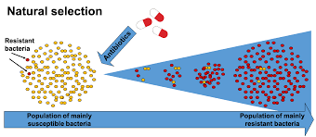
Massive use of antibiotics the past 80 years, both appropriate and inappropriate has lead to antibiotic resistance
Increased occurrence and spread of bacteria that are resistant to antibiotics
ANTIBIOTIC RESISTANCE = The ability of bacteria to protect themselves against the effects of an antibiotic
• Bacteria are experts at surviving in changing environments
• In large bacterial populations there are often a few resistant bacteria

Slide 9
With few exceptions, commercial dairy, egg, meat, and seafood operations prophylactically administer antibiotics to accelerate growth and prevent the spread of bacterial infections among animals living in overcrowded and inevitably unsanitary conditions. (In the United States, 80% of all antibiotics sold each year are administered to animals living on factory farms. Globally, this figure is between 70% and 80%).
The main four types of resistance to antibiotics develops;
1. Natural (Intrensic) resistance (the structural characteristics of bacteria and it is not associated with the use of antibiotics)
2. Acquired resistance (As result of the changes in the genetic characteristics of bacteria)
3. Cross-resistance (resistant to a certain drug, that acts with the same or similar mechanism and also resistant to other drugs like resistance between erythromycin, neomycin-kanamycin or resistance between cephalosporins and penicillins. )
4. Multi-drug resistance and pan-resistance (Multidrug-resistant organisms are usually bacteria that have become resistant to the antibiotics used to treat them).

Slide 10
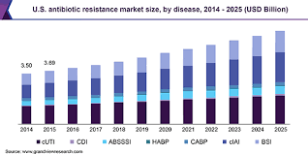
Is antibiotic resistance a problem?
• Antibiotic resistance leads to treatment failures
• Antibiotic resistance threatens our ability to perform modern medical procedures
• Antibiotic resistance imposes a major economic burden on society
• Antibiotic resistant bacteria already cause many deaths around the world

Slide 11
Alteration in the target sites of antibiotics is a common mechanism of resistance. Examples of clinical strains showing resistance can be found for every class of antibiotic, regardless of the mechanism of action.
*Target site changes often result from spontaneous mutation of a bacterial gene on the chromosome and selection in the presence of the antibiotic.
Examples include mutations in RNA polymerase and DNA gyrase, resulting in resistance to the rifamycins and quinolones, respectively.
In other cases, gaining of resistance may involve transfer of resistance genes from other organisms by some form of genetic exchange (conjugation, transduction, or transformation).
Examples of these mechanisms include gaining of the mecA genes encoding methicillin resistance in Staphylococcus aureus and the various van genes in enterococci encoding resistance to glycopeptides.

Slide 12
fundamental mechanisms of antimicrobial resistance are
(1) enzymatic degradation of antibacterial drugs.
(2) alteration of bacterial proteins that are antimicrobial targets.
(3) changes in membrane permeability to antibiotics.
Antibiotic resistance can be either plasmid mediated or maintained on the bacterial chromosome.
The most important mechanism of resistance to the penicillins and cephalosporins is antibiotic hydrolysis mediated by the bacterial enzyme β-lactamase. The expression of chromosomal β-lactamase can either be induced or stably derepressed by exposure to β-lactam drugs.

Slide 13
Antibiotic resistant bacteria each year cause:
• More than 38,000 deaths in Thailanda
• More than 23,000 deaths in the USAb
• 25,000 deaths in the European Unionc
Antibiotic resistance is a global issue
– Exists on all continents
– Affects both low- and high income countries
– Affects both strong and weak health systems
but the consequences of antibiotic resistance are
most severe for the poor.
•For example: In South Asia (India, Pakistan, Afghanistan, Nepal, Bangladesh)
one newborn child dies every 5 minutes from blood stream infections (sepsis) because the antibiotics given are not effective due to bacterial resistance

Slide 14
How did we end up here?
USE & INAPPROPRIATE USE OF ANTIBIOTICS
• Use in human and animal medicine
• Use to increase growth of farm animals
• Use for routine prophylaxis in farm animals
Selection and maintenance of resistance
SPREAD OF RESISTANT BACTERIA
• Poor hygiene and sanitation
• Food and water
• Travel
LACK OF NEW ANTIBIOTICS
• Older antibiotics are rapidly becoming ineffective due to antibiotic resistance

Slide 15
WHAT CAN YOU DO?
• Use antibiotics only when you need it
– Not for a common cold or the flu
• Ask your doctor for advise
– Don’t pressure, Don’t self medicate
• Wash your hands, especially…. Before and after handling and preparing food and After visiting the bathroom
• Teach others about antibiotic resistance.
Veterinarians: Protect Your Patients
Veterinarians are leaders and stewards in preserving the effectiveness of antibiotics for animals and people. Working with animal owners and producers, veterinarians can slow antibiotic resistance by implementing disease prevention strategies and improving the use of antibiotics while also guaranteeing high-quality medical care for animal patients.

Slide 16
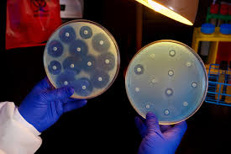
Maintain Accurate Records of Treatment & Outcomes
Document and review diagnostic test results and patient response to therapy. Re-evaluate reason for prescribing, dose, and duration as needed.
Select & Use Antibiotics Appropriately
Follow regulatory requirements (antibiotic use should involve veterinary oversight per U.S. guidance). Use current established guidelines and diagnostic tests to assess the need, selection, dose, frequency, and duration of antibiotics.

Slide 17
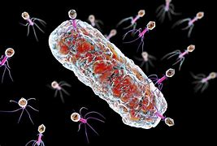
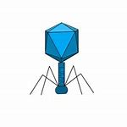
Alternatives to antibiotics
Scientists have speculated what we could do if worst came to worst and we had to make do without any
antibiotics. Researchers are exploring other possibilities. Bacteriophages and
phage therapy
Bacteriophages are viruses that infect bacteria – their name translatesas ‘bacteria eaters’. Until recently,
they received little attention from Western doctors – widely available and effective antibiotics were much easier to use. In the former Soviet Union, however, access to cutting-edge antibiotics was severely limited, and some scientists used bacteriophages to treat many infections
“ Voluntarily letting bacterial viruses into our body is an unpleasant idea” for many of us, even if they kill pathogenic bacteria – this in part is why phage therapy has been slow to take off in Western countries. With antibiotic resistance becoming an ever more real issue, though, the US National Institute of Allergy and infectious Diseases is planning largescale clinical trials of phage-based therapies

Slide 18
Antivirulence drugs
Traditional antibiotics inhibit the growth of bacteria or kill them outright. A novel class of drugs called antivirulence drugs insteaddisables the specific proteins the bacterium uses to attach to our cells,
preventing it from establishing an infection.
Because antivirulence drugs ‘disarm’ rather than kill bacteria, they may not drive development of antibiotic resistance because susceptible organisms can still pass on their genetic material: resistance is not selected for. A study of antivirulence drugs has shown that drug-resistant bacterial strains will not come to dominate susceptible ones; this means that the drug can remain effective.
An antivirulence drug has recently been found to be effective against MRSA infections in mice.
MRSA is a dangerous strain that causes infections in hospitals, care homes and even in gym locker rooms, so to find a drug that is effective against this bacterium is a positive step forward

Slide 19
Bacteriocins
Bacteriocins are proteins produced by bacteria that are toxic to similar or closely related bacteria. Essentially,
they are narrow-spectrum antibiotics that bacteria produce to eliminate competitors.
Bacteriocins that attack pathogens and are produced by bacteria that are harmless to us would make ideal antibiotics.
A number of bacteriocins are now being studied for potential use as antibacterial medication.
They are also increasingly used to
prevent the growth of dangerous bacteria in food.
extending shelf life.
delaying food spoilage.
One example is nisin, which is approved and used in food production and is known as E2

Slide 20
Dr. Aseel MH Abd-Alrada

