Slide 1


Department of Remote Sensing and GIS
The speed of sound by means of resonance tube closed at one end
First class
By Ass. Lect. Marwa Sabah

Slide 2
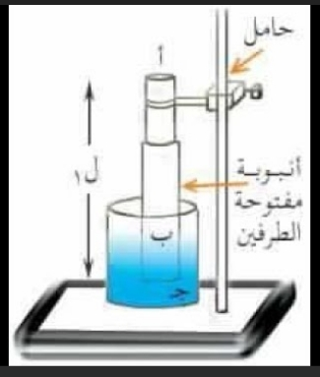
The purpose from experiment:
Determination of the speed of sound by means of resonance tube closed at one end.
Used devices:
Resonance tube about 100cm long and 3 cm in
diameter, set of tuning forks, meter ruler, thermometer.

Slide 3
frequency:
The number of waves emitted by an object per second.
If two objects with the same frequency are placed near each other, and vibration is caused in one of them, the second will be affected by the first and vibrate with the same frequency, this phenomenon known the Resonance

Slide 4
Theory:
L1 + e = ¼ λ ……. (1)
L2 + e = 3/4 λ ..….. (2)
Where (λ) is the wave length
Hence by subtraction
L1 – L2 = λ/2 …..(3)

Slide 5
Now if (C) is the speed of sound, and (f) the frequency of the note, we have :
C = f λ …….(4)
Hence from (3) and (4)
C = 2 f (L2 – L1) …….(5)
The value of the end correction for the tube can be calculated from (1) and (2) above which given by:
(L2 + e)/ (L1 + e) = 3 or e = ½ (L2 – 3L1)
Compare your final mean value for (C) with that calculated from the formula

Slide 6

C = 331 $\sqrt{\frac{(273+t)}{273}}$ meters per second
Where (t): is the temperature in C̊ .

Slide 7
Procedure:
Place the resonance tube well down in the water and gradually raised.

Slide 8
Select the fork of highest frequency, strike it on a solid surface and hold it over the mouth of the tube and when resonance occurs (i.e. when the note of the fork swells out to its loudest volume).
Measure the length of the air in the tube which is the distance between the mouth of the tube and the water surface.
Now find a second and different position of resonance using the same fork but with a much longer length of air and again take the value of (L2)
Obtain different values of (L1) and (L2) by using the other forks.
Record the results in the form of a table:
Plot a graph between (λ) on a vertical axis and (1/f) on a horizontal axis.

