Slide 1


Microbiology Lab. 1st Term
2026-2027
Gram stain
By
A. L. Mohammad Hassan

Slide 2
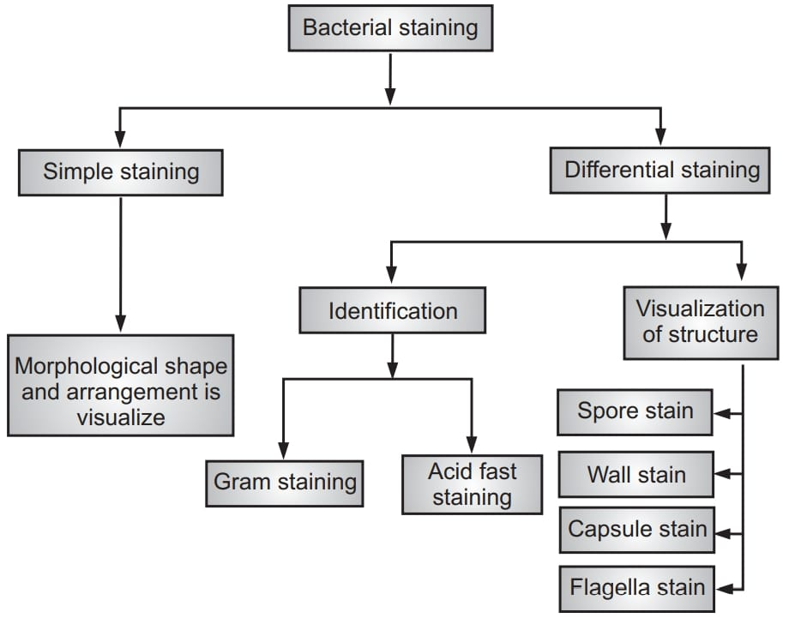
. Staining reaction
Simple stains bring out the best morphology.
Differential and special stains are necessary to bring out characteristics like: gram negative and gram positive bacteria, Acid fast and non acid fast , spirochetes, capsule and Flagella, etc.

Slide 3

a. Gram stain
Gram stain divides the bacteria into Gram positive & Gram negative.
Procedure:
  Take a heat fixed bacterial smear.
  Flood the smear with CRYSTAL VIOLET for 1 minute, then wash with water.
  Flood the smear with IODINE for 1 minute, then wash with water.
  Flood the smear with ETHANOL‐ACETONE, quickly, then wash with water.
  Flood the smear with SAFRANIN for 1 minute, then wash with water.
  Blot the smear, air dry and observe.

Slide 4
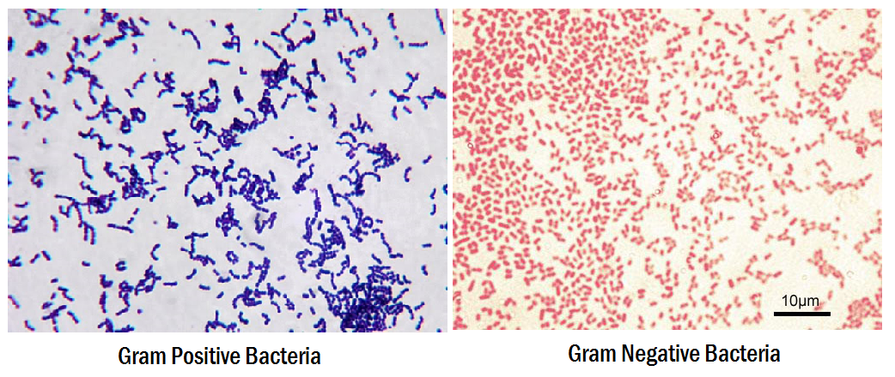

Slide 5
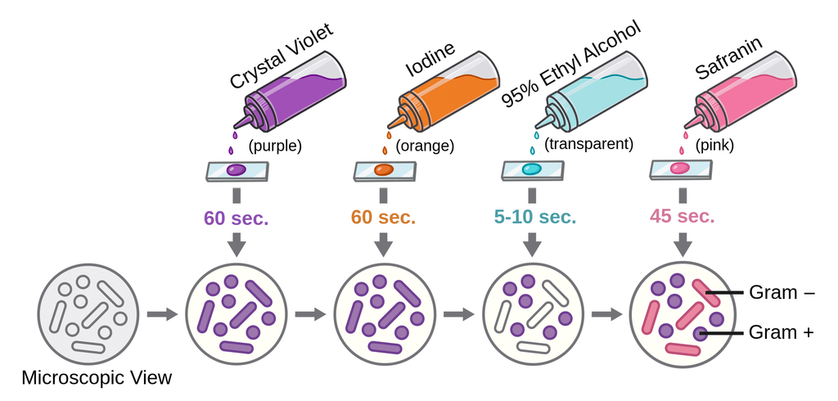
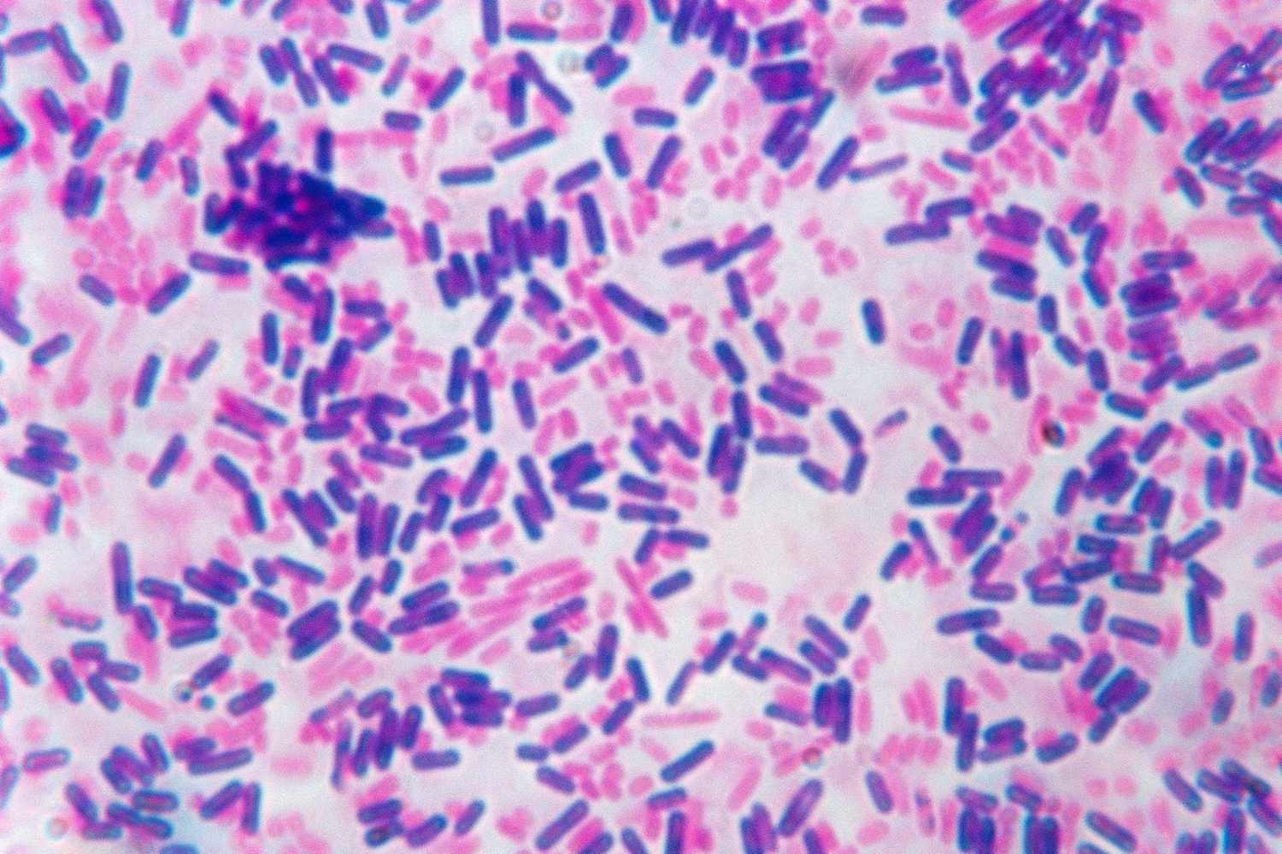

Slide 6

b. Ziehl-Neelsen stain
The Ziehl-Neelsen stain, also known as the acid-fast stain, is a bacteriological staining technique used to identify particularly members of the Mycobacterium genus.
Procedure:
On a clean sterile microscopic slide, make the smear of the sample culture and heat fix the smear over blue heat.
Over the smear, pour and flood the smear with carbol fuschin and heat gently until it produces fumes.
Allow it to stand for 5 minutes and wash it off with gently flowing tap water.
Add 20% sulphuric acid and leave it for 1-2 minutes. Repeat this step until the smear appears pink in color.
Wash off the acid with water.
Flood the smear with methylene blue dye and leave it for 2-3 minutes and wash with water.
Air dry and examine the stain under the oil immersion lens.

Slide 7
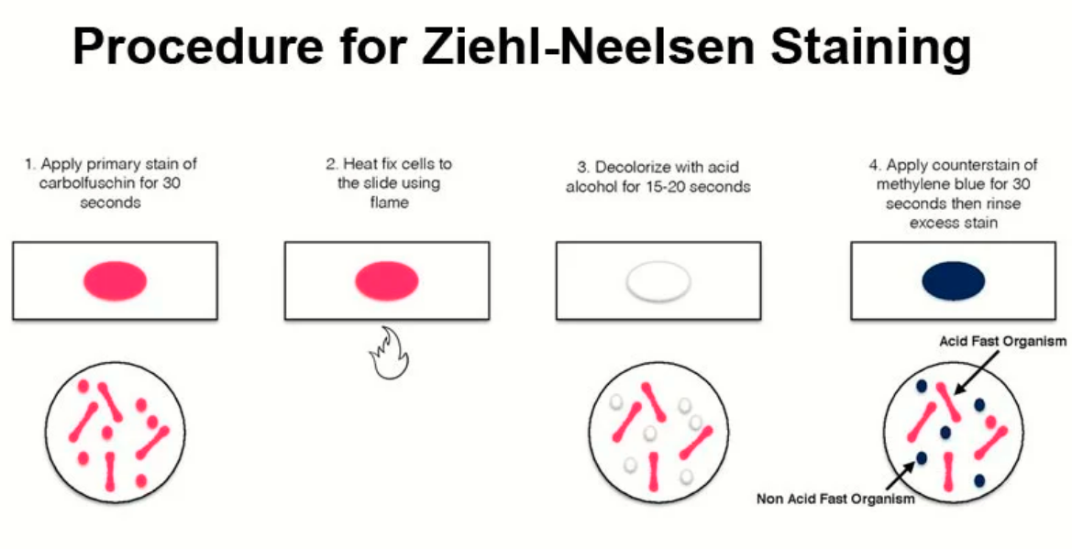

Slide 8
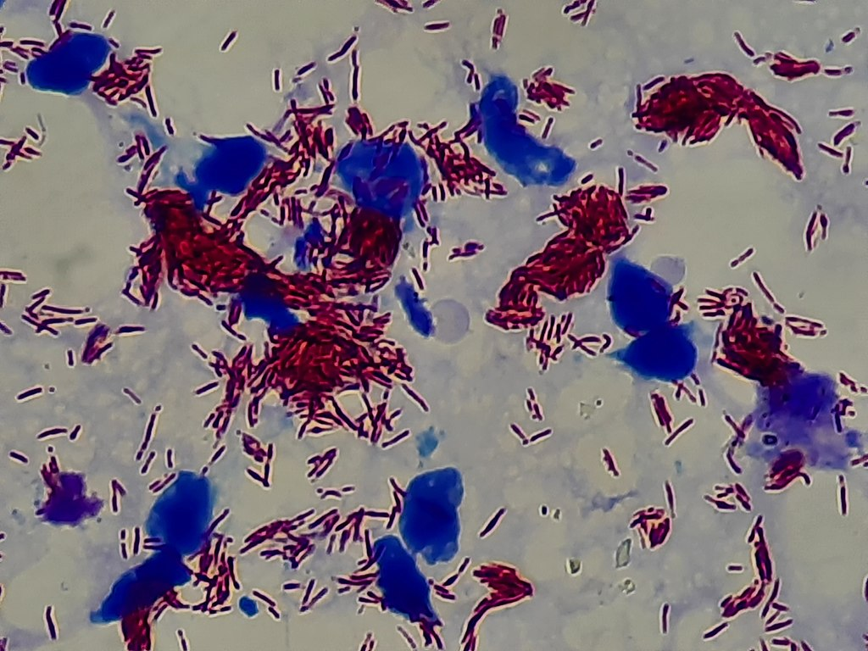
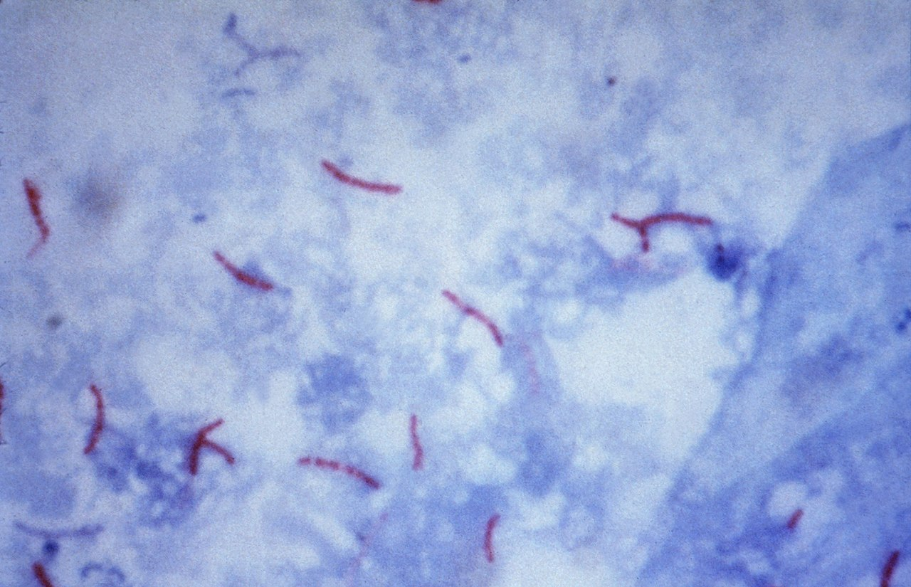
Microscopic visualisation of the acid-fast bacteria Mycobacterium tuberculosis (left) and Mycobacterium leprae (right) and background cellular material in blue using the Ziehl–Neelsen stain

Slide 9



