Slide 1


Microbiology Lab. 1st Term
2026-2027
Indole Test
By
A. L. Mohammad Hassan

Slide 2
6. Indole Test
Property it tests for: This test is performed to help differentiate species of the family Enterobacteriaceae.
Media and Reagents Used: Tryptone broth contains tryptophan. Kovac’s reagent—contains hydrochloric acid, dimethylaminobenzaldehyde, and amyl alcohol—yellow in color.
How to Perform Test: Inoculate Tryptone broth with inoculating loop.
Reading Results: Kovac’s reagent reacts with indole and creates a red color at the top part of the test tube.

Slide 3
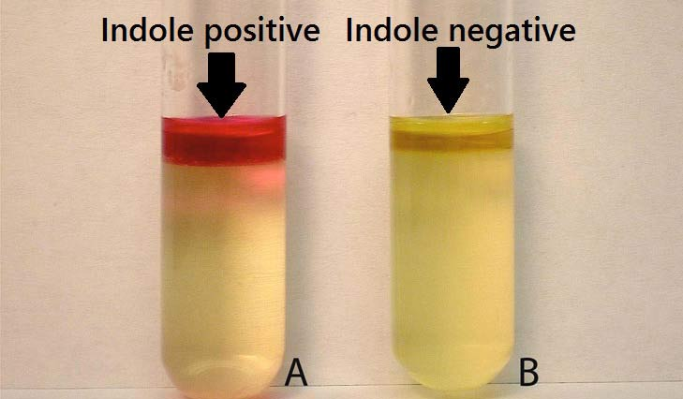


Slide 4
7. Citrate Utilization test
Inoculation method: streak and stab slant with needle Contains: citrate as sole carbon source, ammonium salts as sole nitrogen source,
bromthymol blue pH indicator: neutral pH = green, alkaline = prussian blue.
Media; Simmon’s citrate agar.
Discriminates organisms that can produce citrase to metabolize citrate into oxaloacetate and pyruvate.
These organisms are forced to utilize ammonium salts as the nitrogen source producing alkaline ammonia waste.
Results: Prussian blue slant and or butt = positive for citrase production Green = negative for citrase production

Slide 5
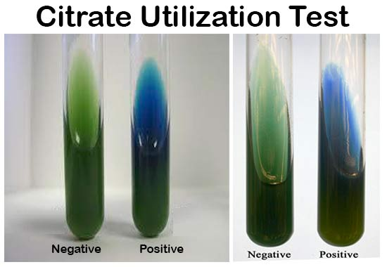


Slide 6
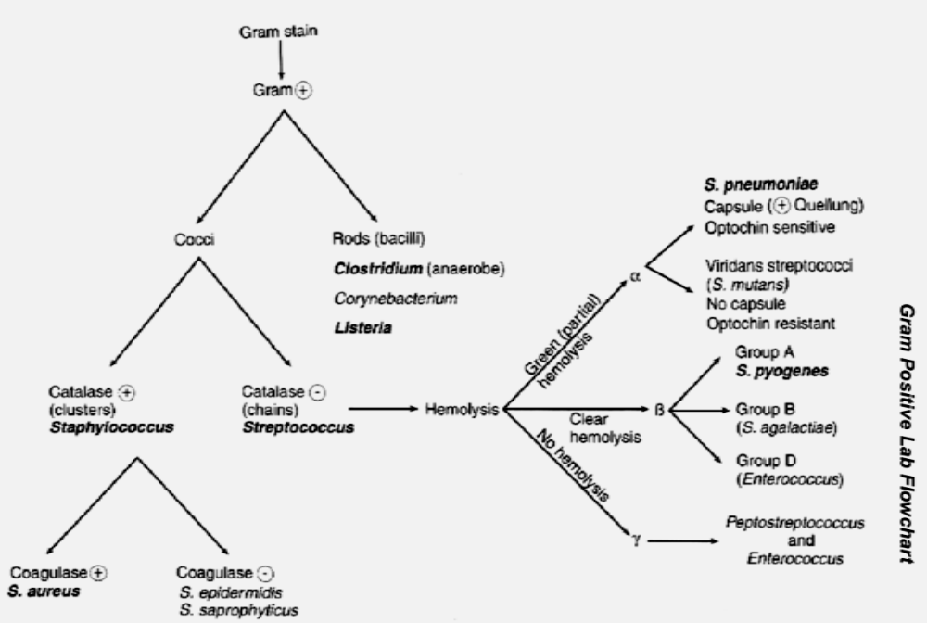
Gram positive flowchart

Slide 7



