Slide 1


Microbiology Lab. 1st Term
2026-2027
Antibiotic sensitivity test
By
A. L. Mohammad Hassan

Slide 2
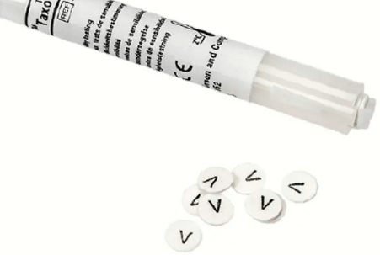
. Antibiotic sensitivity test
Is the measurement of the susceptibility of bacteria to antibiotics.
The method provides a basis for classification of a bacterial strain as “susceptible,” “resistant,” or “intermediate” according to the dimension of the inhibition zone.
The disc diffusion method involves selecting a strain of bacteria, placing it on an agar plate, and observing bacterial growth near antibiotic-impregnated discs.
Why we identify bacteria first before applying antibiotic sensitivity test?

Slide 3

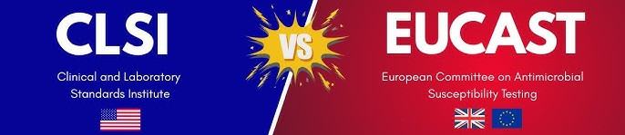
Disk Diffusion Method – Procedure
Inoculate plate: streak Mueller–Hinton agar evenly with sterile swab.
Apply antibiotic disks: place on agar surface with forceps.
Incubate: 35 °C, 16–18 hours (inverted plate).
Measure zones: record diameter (mm) of inhibition around each disk.
Read: compare with CLSI/EUCAST chart → Susceptible (S), Intermediate (I), Resistant (R).

Slide 4
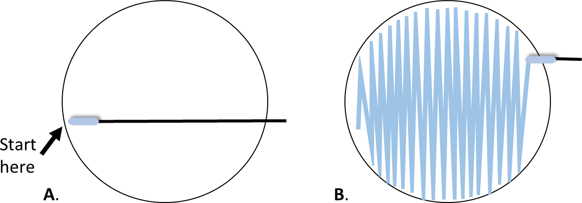
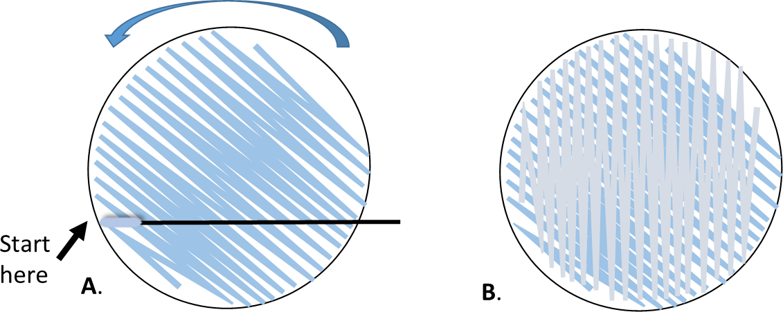
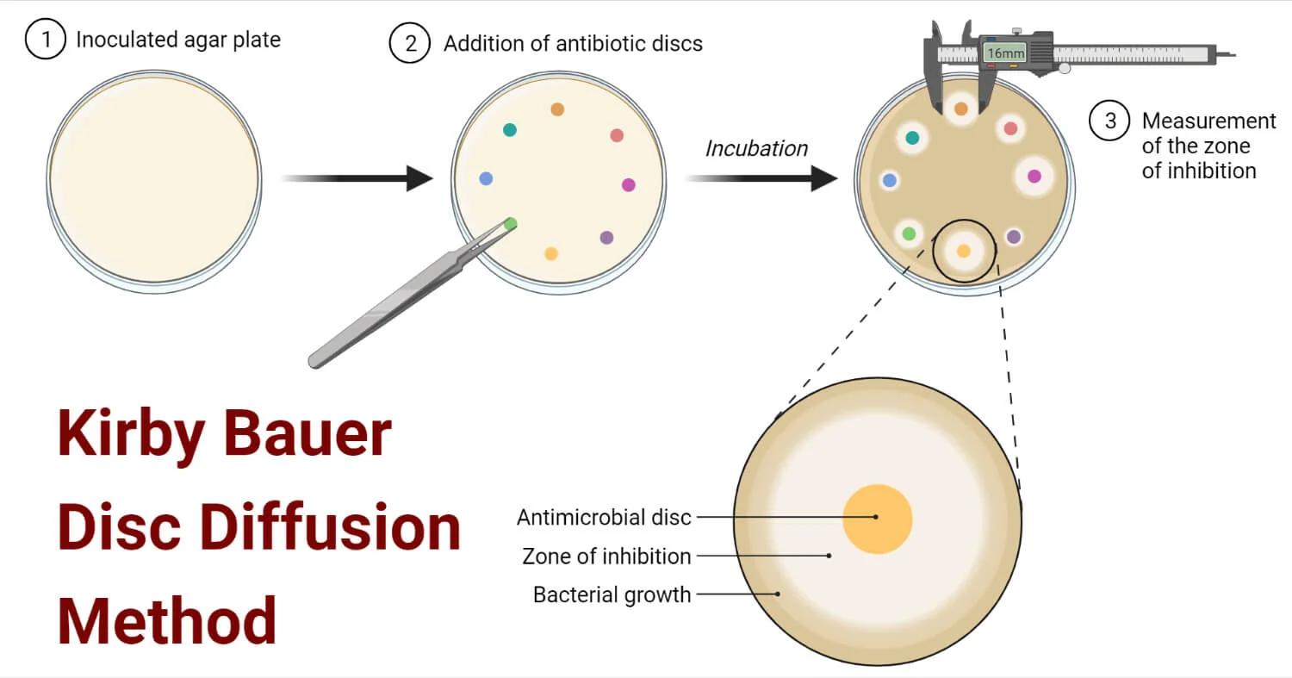

Slide 5
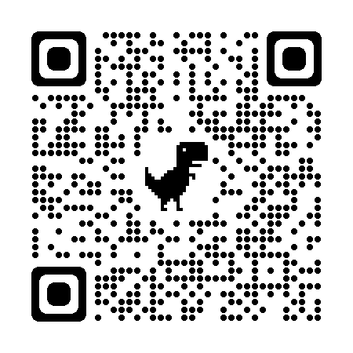
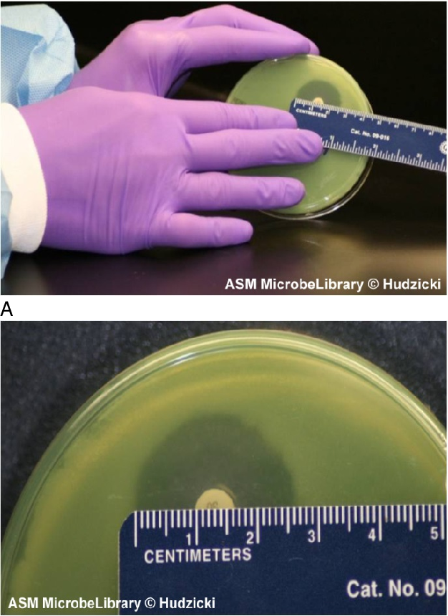
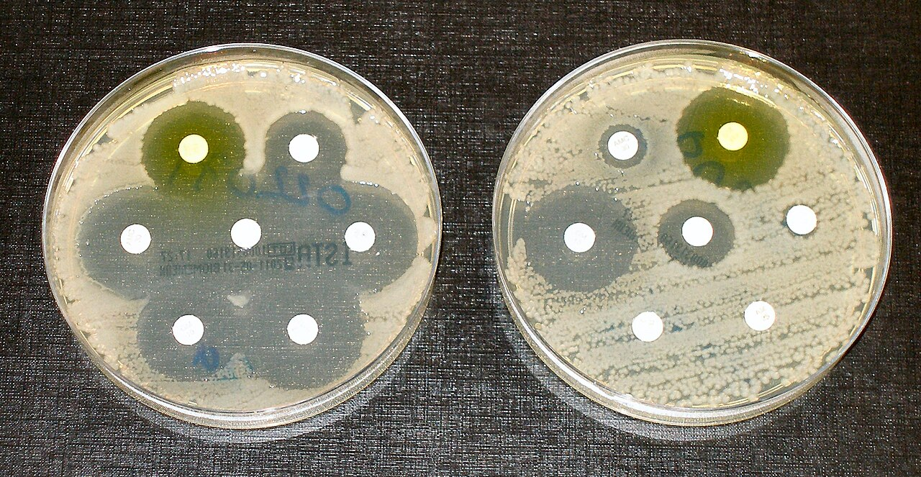
Disc Diffusion Method

Slide 6
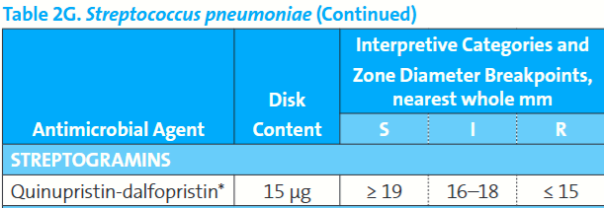
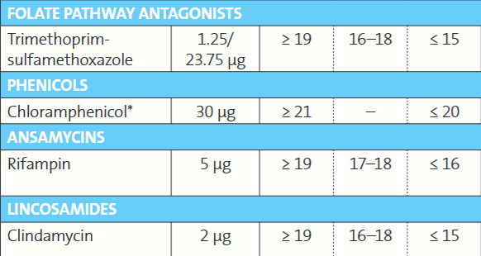
CLSI Guideline

Slide 7
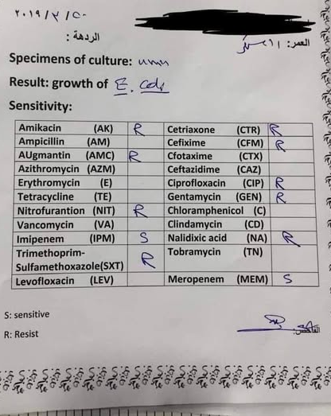
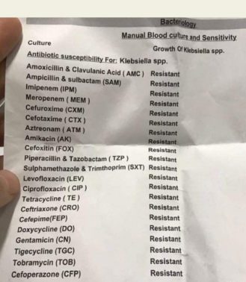

Slide 8

