Slide 1
Avian Chlamydiosis
(Psittacosis, Ornithosis, Parrot Fever)

Slide 2
Definition
Avian chlamydiosis is a systemic, bacterial infection caused by Chlamydia psittaci. Among poultry, turkeys and parrots are more susceptible than chickens.
The disease varies from asymptomatic to high morbidity and mortality.
Clinical signs are nonspecific and include anorexia, debration, drop in egg production, diarrhea, ocular discharge, and respiratory disease.

Slide 3
Etiology and Epidemiology
Chlamydia psittaci is an obligate intracellular bacterium. Eight avian serotypes are recognized, based on binding of monoclonal antibodies to epitopes of the major outer membrane protein.
Each avian serotype/genotype tends to be associated with certain types of birds .
Serotypes A and D are highly virulent for turkeys and can cause mortality of ≥30%.
Serotypes B and E are most frequently recovered from wild birds.
Avian serotypes can infect people (particularly A, B, and E) and other mammals.

Slide 4
Transmission
The main mode of transmission is by the fecal-oral route or by inhalation.
Respiratory discharge or feces from infected birds contain elementary bodies that are resistant to drying and can remain infective for several months when protected by organic debris (eg, litter and feces).
Airborne particles and dust spread the organism.

Slide 5
Possible sources of C psittaci include:
contact with infected sick birds or asymptomatic carriers
vertical transmission from infected birds
infected mammals
infected arthropods
contaminated environments

Slide 6
Clinical Findings and Lesions
Severity of clinical signs and lesions of avian chlamydiosis depends on the virulence of the organism, infectious dose, stress factors, and susceptibility of the bird species; asymptomatic infections are common.

Slide 7
Clinical Signs
nasal and ocular discharge
conjunctivitis
sinusitis
green to yellow-green droppings
fever
inactivity
ruffled feathers
weakness
inappetence
weight loss
drop in egg production

Slide 8
Necropsy findings Or lesion
Necropsy findings in acute infections of avian chlamydiosis include:
(airsacculitis, pericarditis, perihepatitis, peritonitis)
bronchopneumonia
hepatic necrosis
hepatomegaly
splenomegaly

Slide 9
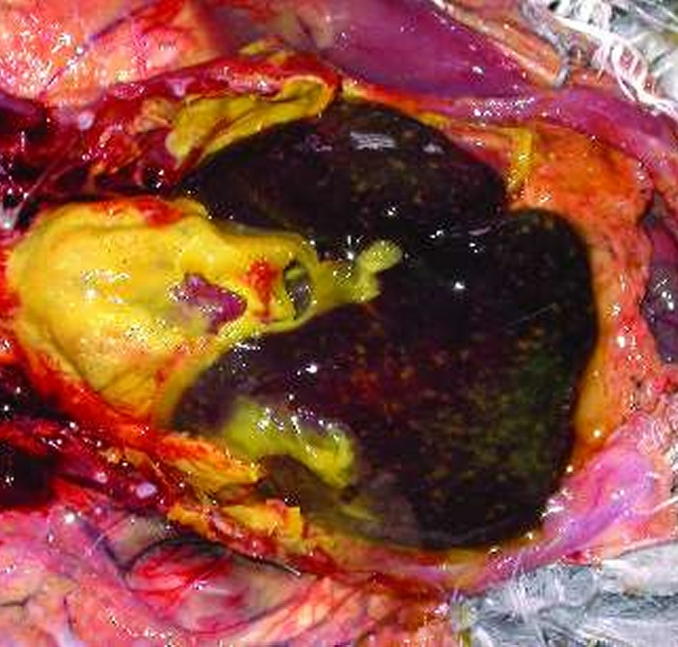
Acute chlamydiosis, pigeon
Severe fibrinous polyserositis and necrotizing hepatitis in a 5-week-old domestic pigeon .

Slide 10
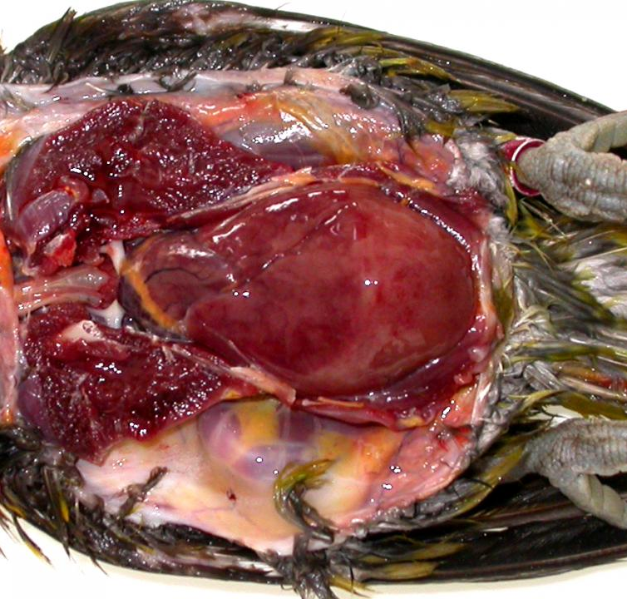
Chlamydiosis, lorikeet
Chlamydiosis, lorikeet
Marked hepatomegaly in an ornate lorikeet

Slide 11
Diagnosis
For flocks, serologic testing, necropsy, and PCR
For individuals, demonstration of shedding of the organism by PCR or culture, a rise in antibody titers, or a combination of serologic test and PCR test or culture

Slide 12
Treatment and Prevention
Tetracyclines
Human and avian chlamydiosis is a reportable disease; state and local governmental regulations should be followed wherever applicable.
No effective vaccine for use in birds is available. Treatment prevents mortality and shedding but cannot be relied on to eliminate latent infection; shedding may recur.

Slide 13
Treatment
Tetracyclines (chlortetracycline, oxytetracycline, doxycycline) are the antibiotics of choice.
When tetracyclines are administered orally, additional sources of dietary calcium (eg, mineral block, supplement, ) should be reduced to minimize interference with drug absorption.

Slide 14

Prevention
Appropriate biosecurity . Minimal biosecurity standards include:
quarantine and examination of all new birds
prevention of exposure to wild birds
traffic control to minimize cross-contamination
isolation and treatment of affected and contact birds
thorough cleaning and disinfection of premises and equipment (preferably with small units managed on an all-in/all-out basis)
provision of uncontaminated feed
maintenance of records on all bird movements
continual monitoring for presence of chlamydial infection

Slide 15
Zoonotic Risk
Avian chlamydiosis is a zoonotic disease that can affect people after exposure to aerosolized organisms shed from the digestive or respiratory tracts of infected live or dead birds or handling of infected birds, tissues (eg, slaughterhouse), or bedding. Human disease most often results from exposure to pet psittacines and can occur even if there is only brief contact with a single infected bird. Other persons in close contact with birds, such as pigeon fanciers, veterinarians, farmers, wildlife rehabilitators, zookeepers, and employees in slaughtering and processing plants or hatcheries, are also at risk. Zoonotic transmission of C psittaci in poultry industry workers is likely underestimated.

Slide 16
Summery
Avian chlamydiosis is a systemic bacterial infection caused by Chlamydia psittaci.
Diagnosis in poultry is by serology, necropsy, and PCR.
Chlortetracycline and doxycycline are used to treat chlamydiosis.
Chlamydiosis is a reportable disease, with human cases most often caused by exposure to pet psittacines.

