Slide 1
Lecture 6
Assistant Prof. Halah Talal Sulaiman

Slide 2
Non- sucrose-based syrups
Diabetic simple syrup
Artificial syrups
Non-nutritive syrups
Used for patient who must control their caloric intake
Substitute for the sucrose
sweetness, artificial sweetener
viscous, viscosity builder
and self preserving at 85% preservative

Slide 3
Formulation
Early formulas contained glycerin and propylene glycol
But they are also glycogenic
Ŗχ
Sodium CMC (medium viscosity) | 1.5% | Viscosity builder
Saccharin | q.s. | Sweetening agent
Methyl paraben | q.s. | Preservative
Purified water | 100 ml

Slide 4
Non- sucrose based syrups
Viscosity builders
Non-glycogenic
Natural
Semi synthetic
Glycogenic
Polyols

Slide 5
viscosity builders
1-Glycogenic (Polyols)
sorbitol (64%),
glycerin,
propylene glycol
2- Non- glycogenic ,
Natural (Gums) Tragacanth, Acacia
Semi synthetic Polymers
Methylcellulose MC (nonionic , exothermic
Hydroxypropyl-methylcellulose HPMC (nonionic)
Sodium Carboxymethylcellulose SodCMC(anionic),
Sod Alginate(anionic) ,

Slide 6
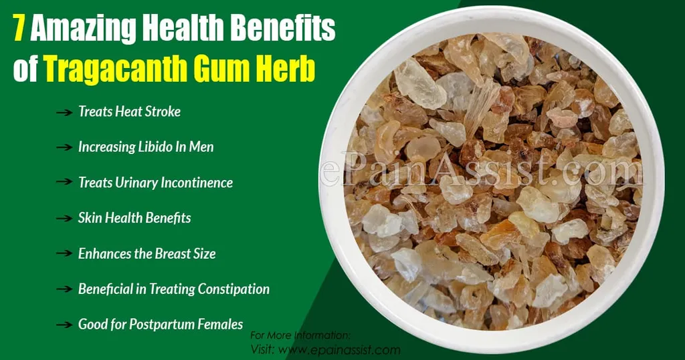
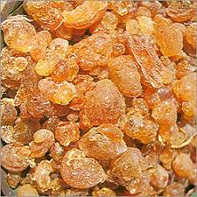
Tragacanth and Acacia
Tragacanth
Naturally occurring dried gum consists of a mixture of water-insoluble and water -soluble polysaccharides.
Bassorin, which is the main water-insoluble portion, while the remainder of the gum consists of the
Tragacanthin. water-soluble material, which on hydrolysis yields
L-arabinose, L-fucose,
D-xylose, D-galactose, and
D-galacturonic acid.
Acacia (Gum Arabic)
Complex, loose aggregate of sugars and hemicelluloses The aggregate consists essentially of an
Arabic acid nucleus to which are connected calcium, magnesium, and potassium along with the sugars;
arabinose,
galactose, and
rhamnose.

Slide 7
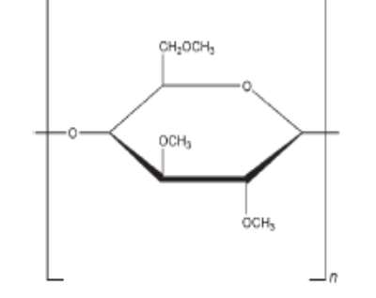
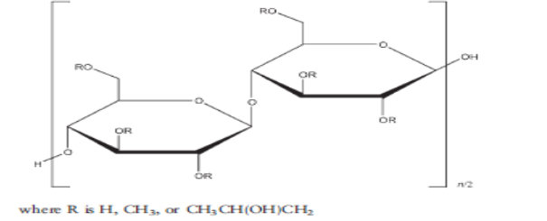
Structures of semisynthetic polymers (nonionic)
Methylcellulose MC
Hydroxpropylmethyl cellulose HPMC

Slide 8
Structures of semisynthetic polymers (anionic)

Slide 9
viscosity builder Types
Natural
Acacia Tragacanth
Semisynthetic
CMC -Alginate
HPMC - MC
Non glycogenic
Opalescent
(not colorless)
Change characteristics upon aging
Differ according to the plant source
Reproducible
colorless

Slide 10
Special precautions
Anionic polymers are incompatible with cationic drugs or other formulation ingredients.
Strong dehydrating agents cause coagulation of aqueous dispersion of both natural or semisynthetic polymers.
Incompatible with excessive amounts of alcohol and electrolytes.

