Slide 1
Lect. 2 CHAPTER 8
Pof. Dr. Halah Talal

Slide 2
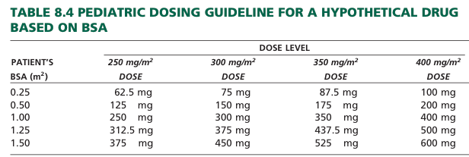
Nomogram
Most BSA calculations use a standard nomogram, which includes both weight and height. monograms for children and adults are shown in Figures 8.1 and 8.2.
The BSA of an individual is determined by drawing a straight line connecting the person’s height and weight. The point at which the line intersects the center column indicates the person’s BSA in square meters.

Slide 3
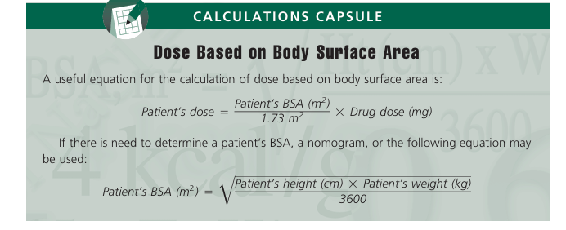
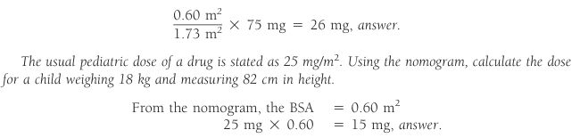
Example shown in Figure 8.1,a child weighing 15 kg and measuring 100 cm in height has a BSA of 0.64 m2. If the adult dose of a drug is 75 mg, what would the dose be for a child weighing 40 lb. and measuring 32 in. In height using the BSA nomogram? From the nomogram, the BSA 0.60m2

Slide 4
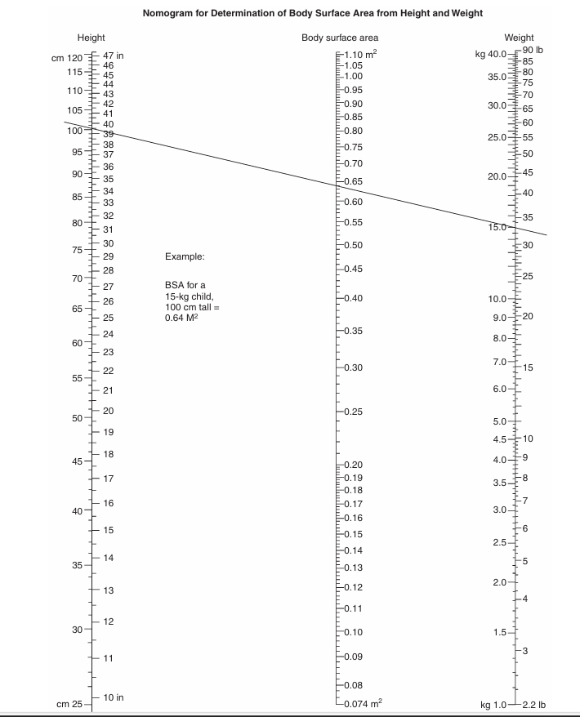

Slide 5
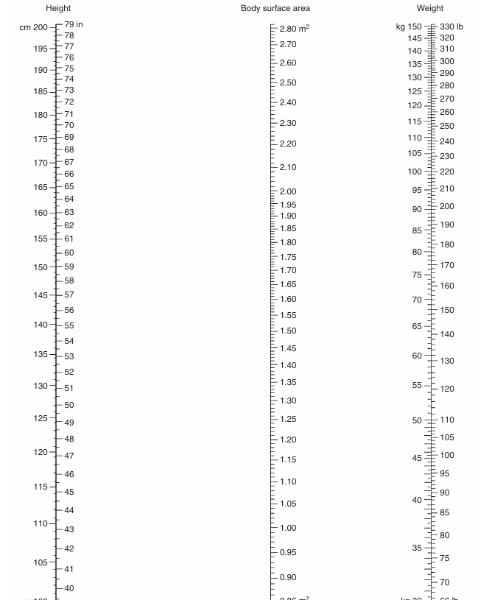

Slide 6
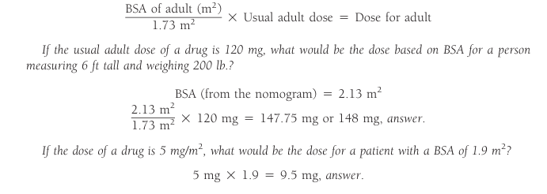
The adult dose is then calculated as follows:

Slide 7
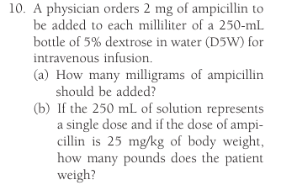

Slide 8
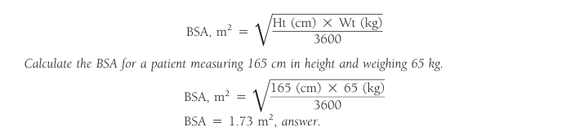
BSA Equation

Slide 9
Dosage based on the medical condition to be treated
The medical condition to be treated and the severity of that condition must also be considered. Calculate the IV drug dose for a 3-pound 3-ounce neonate.
3 pounds =3 X454g =1362g
3 ounces= 3X 28.35g =85g
Weight of neonate 1362g+ 85g= 1447g
1447g/1000 =1.447kg
30mg/kg x1.447kg =43.4mg every 12hours, answer.

Slide 10
Q:8 Cyclosporine is an immunosuppressive agent administered before and after organ transplantation at a single daily dose of 15 mg/kg. How many milliliters of a 50 mL bottle containing 100 mg of cyclosporine per milliliter would be administered to a 140-lb. kidney transplant patient?

Slide 11
Q:43 Calculate the dose for a child 4 years of age, 39 in. in height, and weighing 32 lb. for a drug with an adult dose of 100 mg, using the following: (a) Young’s rule, (b) Cowling’s rule, (c) Clark’s rule, and (d) BSA (use the BSA equation).
Q: 36 If the dose of TAXOL (paclitaxel) in the treatment of metastatic ovarian cancer is 135 mg/m2, what would be the dose for a patient 155 cm tall and weighing 53 kg

