Slide 1
University of Baghdad College of Medicine 2022-2023
Title:IMAGE-GUIDED RADIATION THERAPY (IGRT)
Grade:1
Speaker:Dr. Taghreed Al-sudani

Slide 2
TOPIC OUTLINE ➤
➤ Image-guidance technologies
• Radiographic imaging
• In-room CT scanner
• Kilovoltage cone-beam CT
• Megavoltage cone-beam CT
• Helical tomotherapy
• Ultrasound imaging

Slide 3
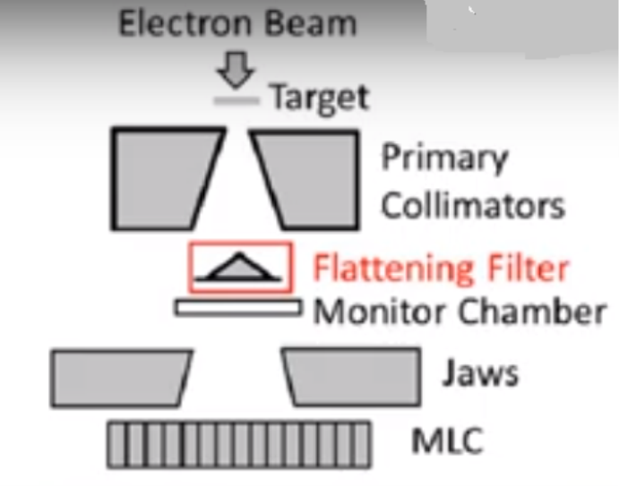
IMAGE-GUIDANCE TECHNOLOGIES
In radiation therapy (also called radiotherapy), high-energy x-ray or other particles are used to damage cancer cells and can stop them from growing and dividing by delivering high dose to the cancer cells and minimum dose to the healthy cells. The beams of high-energy x-ray or electrons produces by using linear accelerator(linac).
(https://www.youtube.com/watch?v=jSgnWfbEx1A )
( https://youtu.be/cEoQTBemyDY?si=BYad59zQf6N0DrKJ )
(Linear accelerator components)

Slide 4
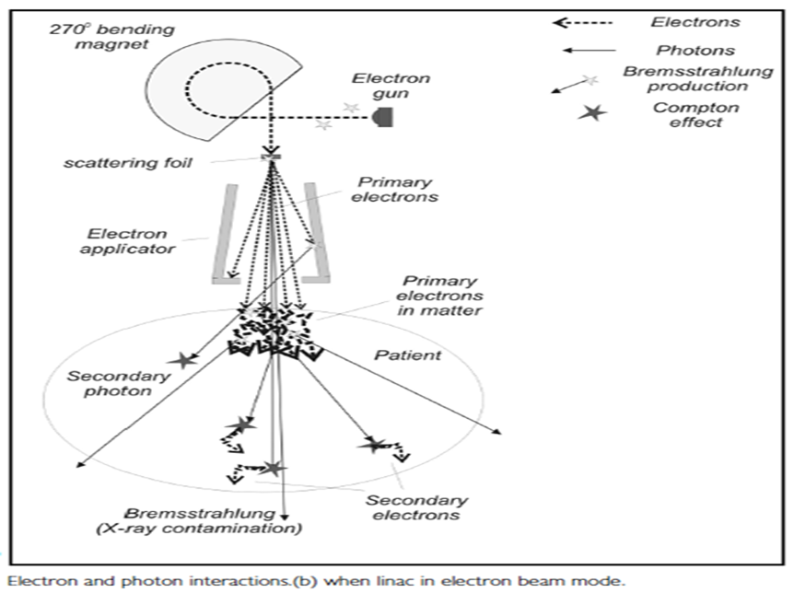
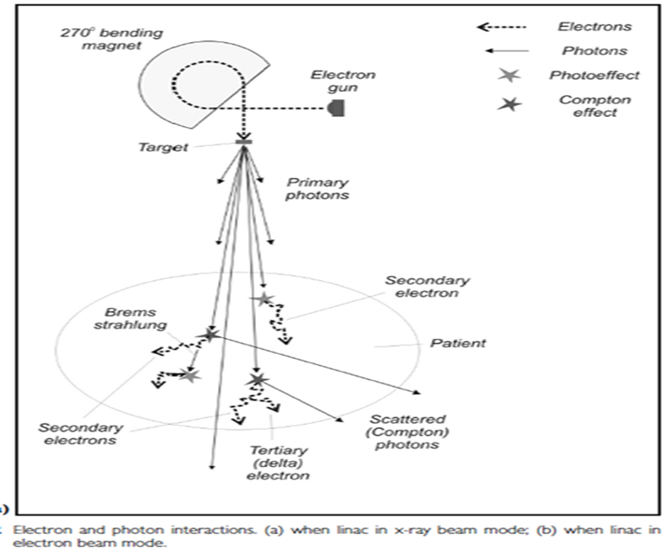

Slide 5
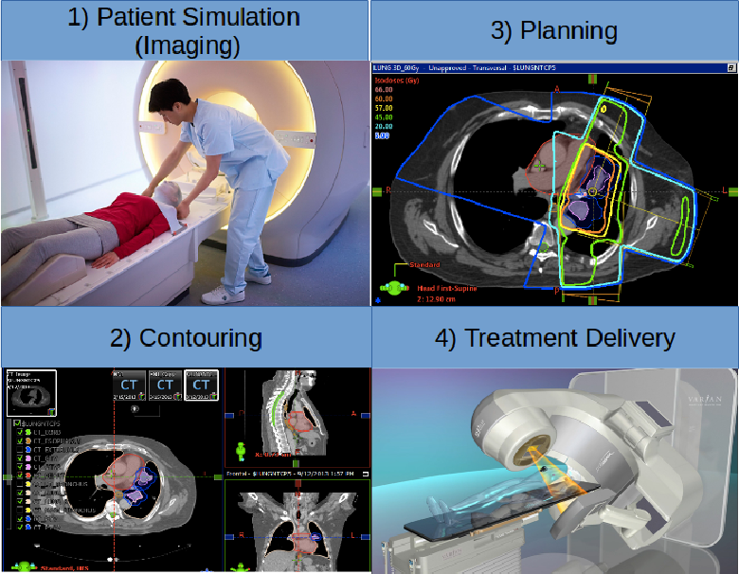
Radiotherapy steps

Slide 6
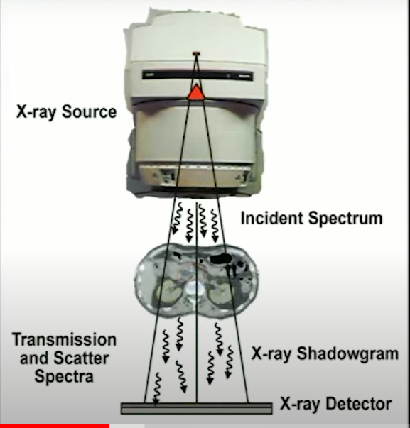
Broadly, image-guided radiation therapy (IGRT) may be defined as a radiation therapy procedure that uses image guidance at various stages of its process: patient data acquisition, treatment planning, treatment simulation, patient setup, and target localization before and during treatment.
IGRT systems currently commercially available are based on direct integration of:
• Kilovoltage or megavoltage imaging system
• CT scanner
• Megavoltage computerized tomography (MVCT) and a Tomotherapy machine (miniature linac mounted on a CT-type gantry).
• ultrasound system
( https://youtu.be/1WtDiFj_E4M?si=gs5Qla4UNHOazVI3
)

Slide 7
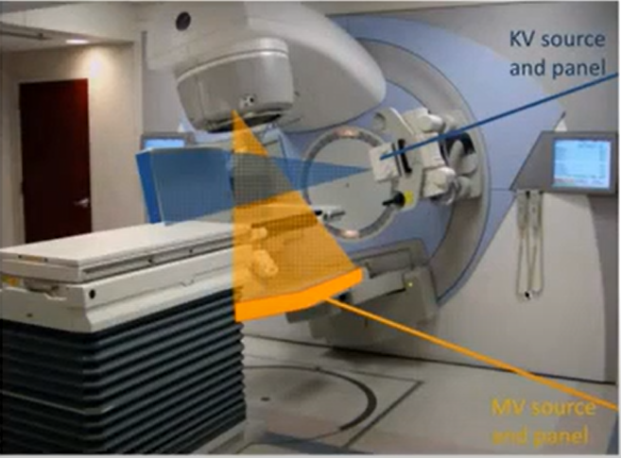
LINAC
KV detector
EPID (Electronic Portal Imaging Device)

Slide 8
IGRT is characterized by the following features:
• Allows reduced treatment margins in the PTV (planning treatment volume)
• Results in fewer treatment complications.
• Allows prescribed dose escalation.
• Reduces the chance of geographical miss of the target.
The ideal IGRT system will:
• Allow the acquisition of soft tissue images at the time of each fraction of radiotherapy.
• Have the ability to deliver a conformal dose through an IMRT (intensity modulated radiation therapy) technique

Slide 9
RADIOGRAPHIC IMAGING
The accelerator-mounted imaging systems are called on-board imagers. Modern accelerators (e.g., Varian’s Trilogy, Elekta’s Synergy, and Siemens ONCOR) are equipped with two kinds of imaging systems:
1) kilovotage x-ray imager in which a conventional x-ray tube is mounted on the gantry with an opposing flat-panel image detector, and
2) megavoltage (MV) electronic portal imaging device with its own flat-panel image detector.

Slide 10
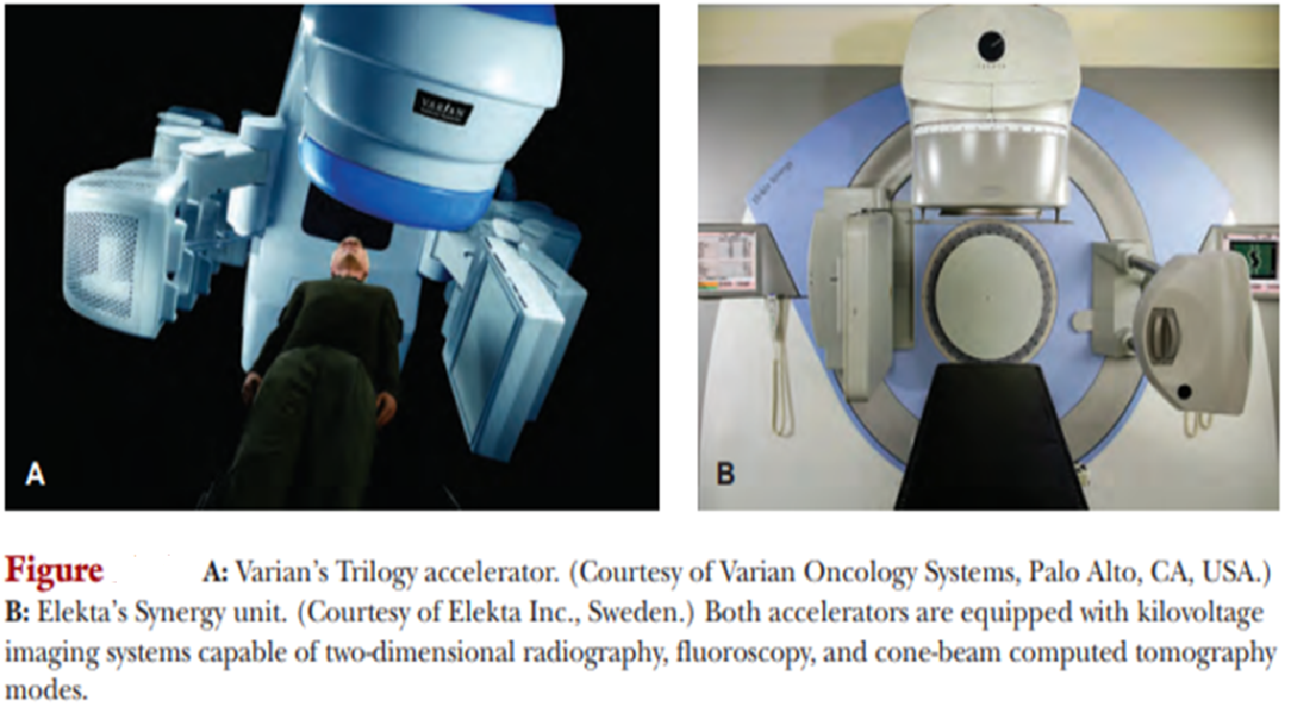

Slide 11
IN-ROOM CT SCANNER
An in-room CT scanner is a conventional CT scanner on rails that is housed in the treatment room and shares the couch with the accelerator.
To acquire a pretreatment CT, the treatment couch is rotated into alignment with the on-rail CT scanner and the scanner is moved in the axial direction relative to the patient for CT scanning.
After acquiring CT data, the couch is rotated back into alignment with the accelerator gantry for treatment. Thus, neither the couch nor the patient is moved relative to the treatment isocenter in this process.
• Advantage of the in-room CT scanner is that it allows acquisition of high-resolution 3D volumetric data of patient anatomy in the treatment coordinates.
• Frequent verification of isodose plans enables one to make setup corrections or modify treatment parameters to minimize variation between the planned and the actual treatment. This procedure falls into the category of what is called the image-guided adaptive radiation therapy

Slide 12
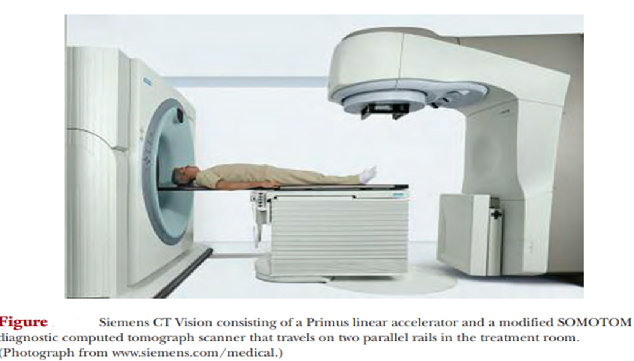

Slide 13
KILOVOLTAGE CONE-BEAM CT
The kilovoltage cone-beam CT (kVCBCT) involves acquiring planar projection images from multiple directions as the gantry is rotated through 180° or more. 3D volumetric images are reconstructed from the multiple planar radiographs by using a filtered back-projection algorithm.
Advantages of a kVCBCT system are its ability to:
- Acquire images in treatment coordinates;
- Produce volumetric CT images with good contrast, submillimeter spatial resolution, and soft tissue visibility at low imaging doses;
- Reconstruct dose distribution compatible with the reference treatment plan; and
- track patient motion online, and allow positional adjustments before and during treatment.

Slide 14
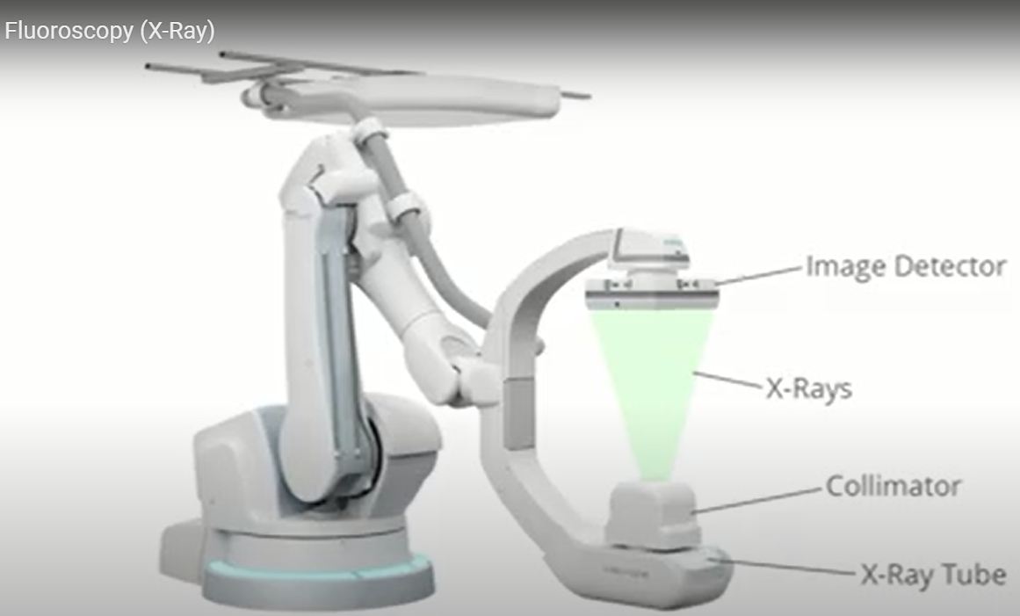

Slide 16
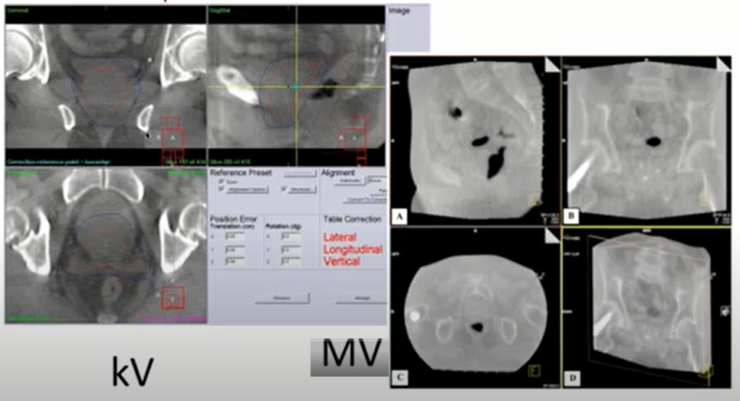

Slide 17
MEGAVOLTAGE CONE-BEAM CT
Megavoltage cone-beam CT (MVCBCT) uses the MV x-ray beam of the linear accelerator and its electronic portal imaging device to reconstruct 3D volumetric images from multidirectional planar images.
MVCBCT is useful for online or pretreatment verification of patient positioning, anatomical matching of planning CT and pretreatment CT, avoidance of critical structures such as spinal cord, and identification of implanted metal markers if used for patient setup.

Slide 19
HELICAL TOMOTHERAPY
Helical tomotherapy is an intensity-modulated radiation therapy (IMRT) delivery technique that combines features of a linear accelerator (linac) and a helical CT scanner.
The linear accelerator (e.g., 6-MV x-ray beam) is mounted on a CT-like gantry and rotates through a full circle. With the simultaneous rotation of the gantry, the treatment couch is translated slowly through the doughnut aperture, thus creating a helical motion of the beam with respect to the patient. A computer-controlled multileaf collimator (a long narrow slit with multi leaves) provides the required intensity modulation of the beam.
Continuous helical motion of the beam around the longitudinal axis of the patient minimizes the problem of interslice match lines
Helical tomotherapy is a unique device capable of delivering both the IMRT and the IGRT in the same treatment geometry.
( https://youtu.be/-sOqKB1BRJ4?si=iWUv_Lyr4b-spUzG )

Slide 20
Because tomotherapy images are reconstructed from the same MV x-ray beam as used for actual treatment, they are called MVCT images.
Compared to the diagnostic CT images, the noise level in MVCT images is higher
The scan dose for MVCT images is in the range of 1 to 2 cGy.
In spite of the poor image quality, these relatively low-dose MVCT images provide sufficient contrast for verifying the patient’s position at the time of treatment.
MVCT images are less susceptible to imaging artifacts caused by high atomic number objects such as surgical clips, hip implants, or dental fillings.

Slide 21
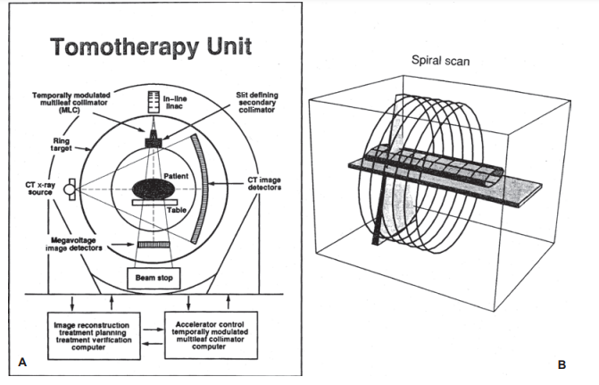
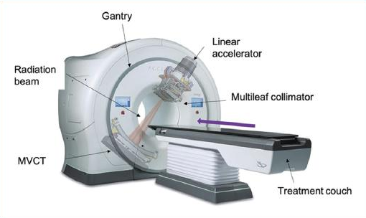
Figure . A, B: Schematic diagram of the tomotherapy unit. (From Mackie TR, Holmes T, Swerdloff S, et al. Tomotherapy: a new concept for the delivery of conformal radiotherapy using dynamic collimation. Med Phys. 1993; 20:1709–1719, with permission.) C: Photograph of tomotherapy unit (Tomotherapy Inc., Madison, WI, USA) at the University of Minnesota.

Slide 22
ULTRASOUND IMAGING
Ultrasound is a noninvasive, non radiographic real-time imaging technique for localizing soft tissue structures and tumors, primarily in the abdomen, pelvis, and breast. EXAMPLES:
BAT System by Nomos (B-Mode Acquisition and Targeting): The system consists of a cart based ultrasound unit positioned next to a linac treatment table and is used by a radiotherapist to image the target volume prior to each fraction of a patient’s radiotherapy.
ExacTrac ultrasonic module: BrainLab has also developed an ultrasound based system for IGRT to be used in conjunction with an isocentric linac. This system can be used with any ultrasound unit, and is comprised of a reflective marker array attached to an ultrasound probe. In principle, the system works similarly to the BAT system described above, and allows fine adjustment of the patient’s position to compensate for target movement and set-up inaccuracies.

Slide 24
In the end of this lecture you can answer the questions
Q1)Define the following:
- IGRT
- Helical Tomotherapy
Q2)Compare between KV and MV imaging?

