Slide 1
Isolation of pure culture

Slide 2
Pure culture:-
Growth of single strain, free from mixture and free contamination with other bacteria
Most studies and tests of the physiological, serological and other characters of bacteria are depend only when made of pure culture.
The bacteria found in nature in mixed population such as soil, air, organic materials, an food, also from specimens isolated from patients such as urine and stool

Slide 3
Mixed culture:
Is a culture containing growth of more than one type of bacteria.

Slide 4
Streak plate technique

Slide 5
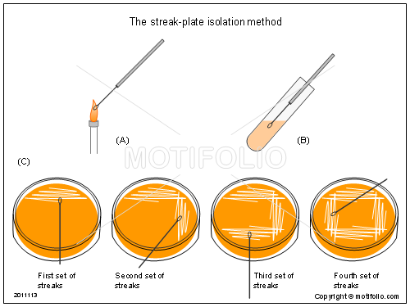
Isolated pure colonies can be obtained by the streak – plate technique. In this technique, the bacterial mixture transferred to the edge of an agar plate with an inoculating loop and then streaked out over the surface in one of several patterns.

Slide 6
- The key principle of this method is that by streaking a dilution gradient is established on the surface of the plate as cells are deposited on the agar surfaces.
Colonies can be seen with the naked eye.
- Cells form the new colony transferred to agar slant or other suitable medium for maintenance of pure culture.

Slide 7
Procedure

Slide 9
1. The loop must sterilize and left to cool, the inoculum is smeared thoroughly over area A.
2. To give a well inoculum, the loop is re- sterilized and then drawn from the inoculum area A two or three lines on to fresh surface of the medium (B), this process is repeated as shown, also the loop must be sterilized again before make another parallel lines (C) until reach to step (D).

Slide 10
Bacterial colony (pure) characteristics on agar media a seen with naked eye depend upon:

Slide 11
Elevation

Slide 12
Margin

Slide 13
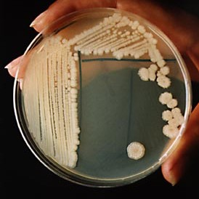
Bacillus subtilis (G+)

Slide 14
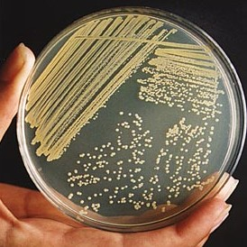
Staphylococcus aureus

Slide 15
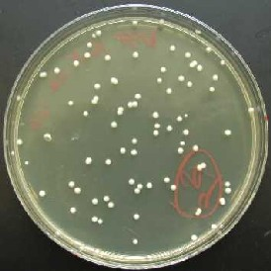
Round yeast colonies

Slide 16
Method for examining bacteria
Contents
Shapes
Structure by microscope

Slide 17
A) Wet mount and hanging drop technique
To study
Motility of bacteria
- Cytological changes during division
- Unviable content (storage food)

Slide 18
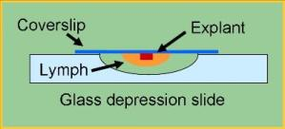
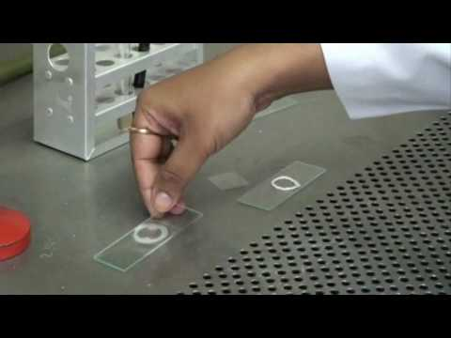
For obtaining wet mount from bacteria we took drop from bacteria suspension and put it on class and examine directly by microscopy

Slide 19
B) Fixed slid preparation for staining
For studying
Bacterial morphology
Characters
- Appear more clearly and to differentiate bacterial species by using differential dyes

Slide 20
Fixed dry bacterial film can stain by
1- Simple stain: Using single stain
2- Differential stain: Using more than one stain e.g gram’s stain and acid fast stain
3- Negative stain: Do not stain the bacteria, but background is stained

