Slide 1
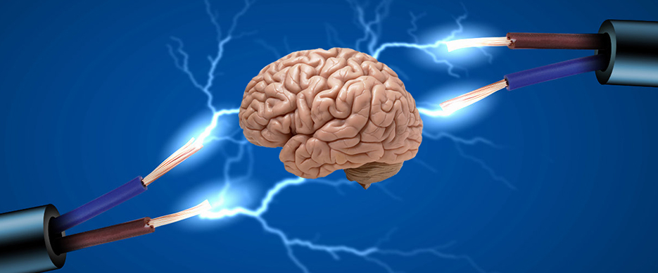
Membrane potentials and action potentials
Dr. Ban Hassan

Slide 2
Electricity within the body
All functions in the body, voluntary and involuntary electricity is involved.
So all movements are related to electrical movement.
There are 2 aspects of electricity and magnetism in medicine:
1-Electrical and magnetic effects generated inside the body.
2-We use electricity and magnetism to measure some of body functions.
The electricity generated inside the body surface for the control and operation of nerves, muscles, and other organs.
The nervous system plays an important rule in every part of the body, the brain receives internal and external signals and usually makes proper

Slide 3
Nervous system and the Neuron
Nervous system can be divided into two parts
1-central nervous system: consist of brain, spinal cord and the peripheral nervous. Nerve fibers that transmit sensory information to brain or spinal cord are (afferent nerves). And those that transmit information from brain spinal cord to the muscles and glands (efferent nervous).
2- Autonomic nervous system: controls various internal organs such as heart, intestines and glands (the control of the autonomic nervous system is essentially involuntary)
Neuron: is the basic structure unit of nervous system. Which is specialized for reception and transmission of electrical signals.

Slide 4
Contents of neuron (nerve cell)
1-cell body: receives electrical messages from another neuron through contacts called (synapses), which are located on the (dendrites)
Dendrites: are the part of the neuron specialized for receiving information from other cells or stimuli.
2- Axon (or nerve fibers): this carries the electrical signal to muscles, gland, or other neurons. It’s usually covered by myelin sheath, except some parts called (Nodes of Ranvier)
3-synaps permit the transparent of a signal on one direction and prevent it from going back.

Slide 5
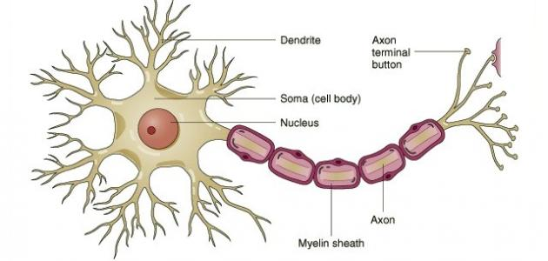

Slide 6
Membrane potentials and action potentials
Electrical potentials exist across the membrane of essentially all cells of the body. During rest or inactivity, the electrical potentials across the membranes is called (resting membrane potential) which is vary between (-90 mv to -40 mv) on the inside relative to the outside of the membrane depending on the type and size of tissue. This mean an excess of negative icons (anions) accumulates immediately inside the cell membrane along its inner surface and excess of positive ions (actions) accumulates immediately outside the membrane.

Slide 7
The genesis of resting membrane potential:
In humans the genesis of the normal resting membrane potential is mainly due to
Passive outward diffusion of K ions which contribute far more to the membrane potential than will the inward diffusion of Na ions. This is because the permeability of the membrane to K ions is far more than for Na ions (100 times more). This outward diffusion will create a state of electropositivity outside the membrane and electronegativity on the inside (because of negative anions that remain behind)

Slide 8
The excitable cell and tissue:
Define as those cells and tissues that are capable of generation action potential by themselves at their membranes and / or transmit these impulses along their membrane such as nerves and muscles.

Slide 9
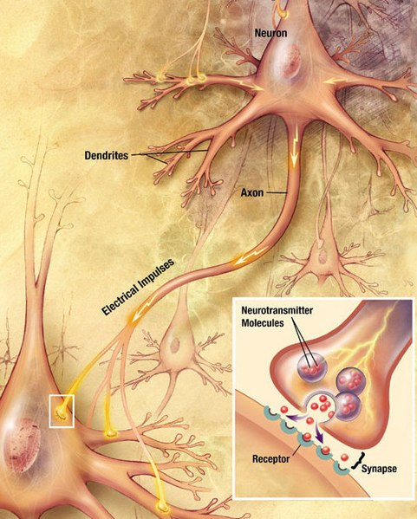
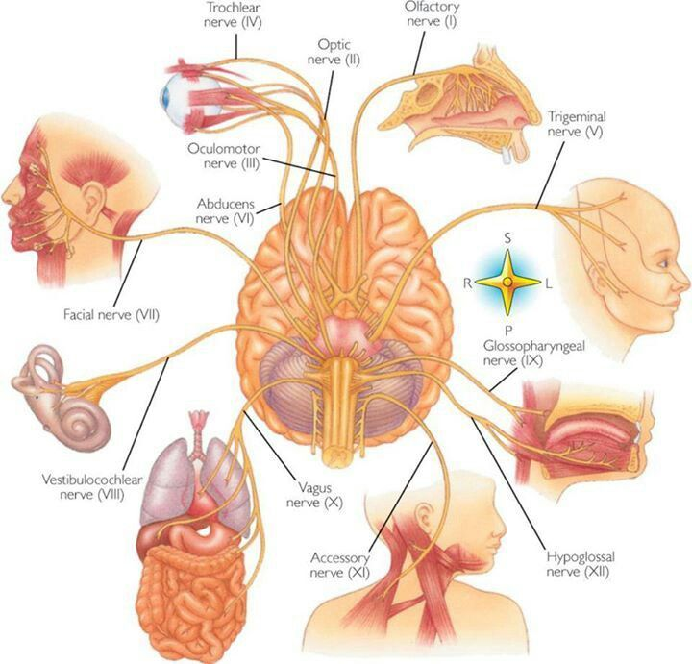

Slide 10
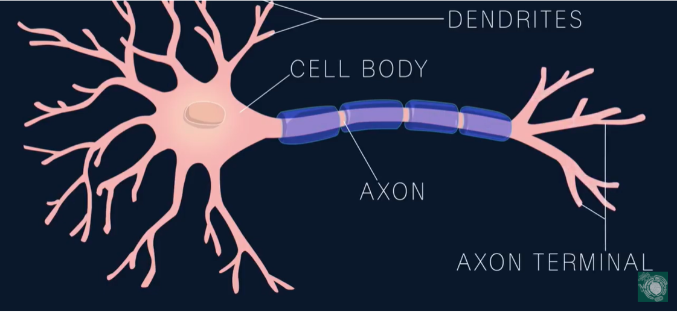

Slide 11
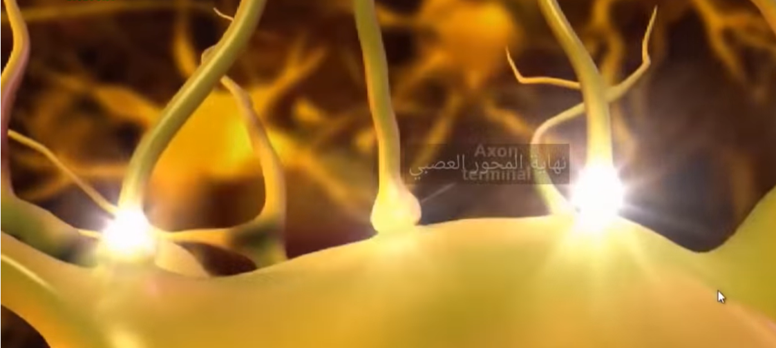

Slide 12
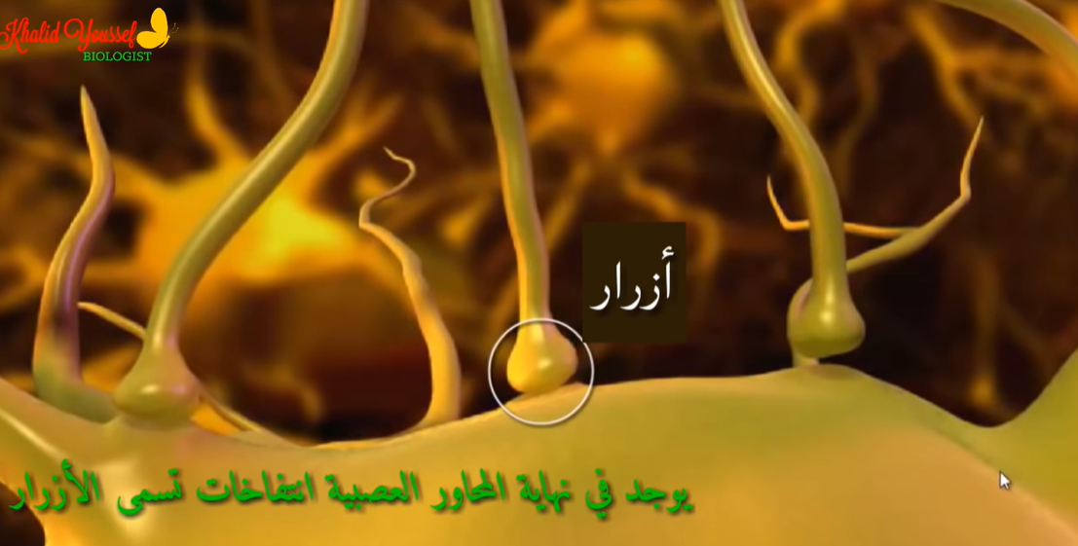

Slide 13
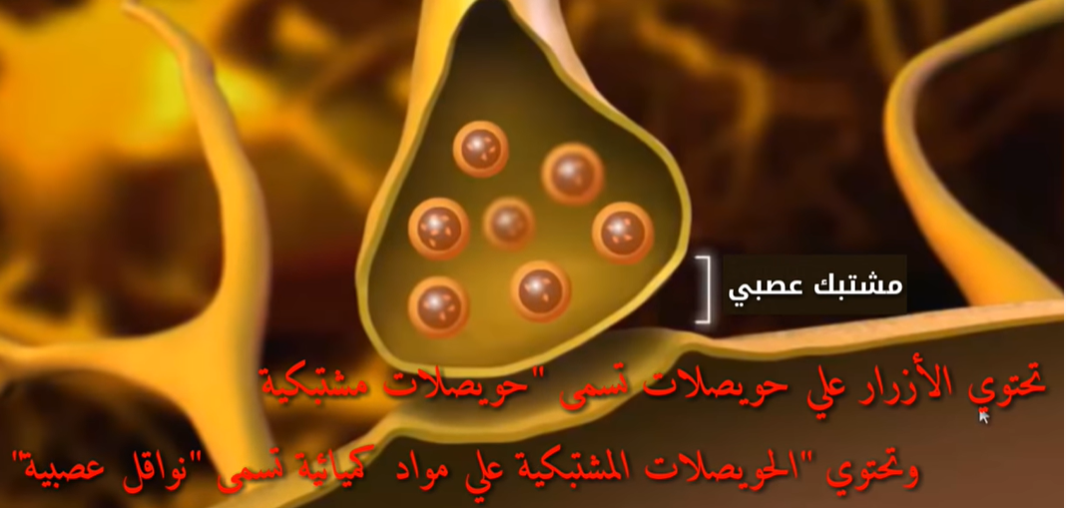

Slide 14
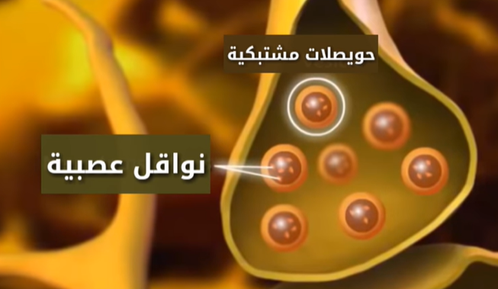

Slide 15
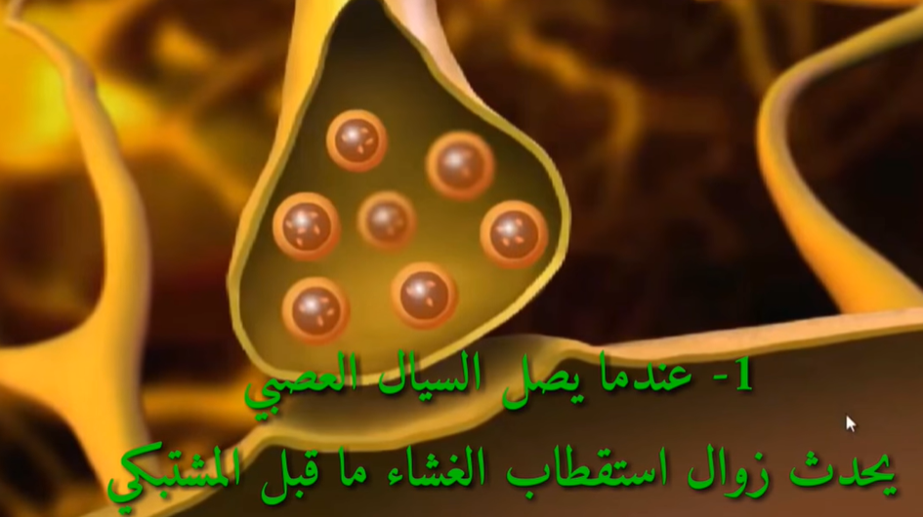

Slide 16
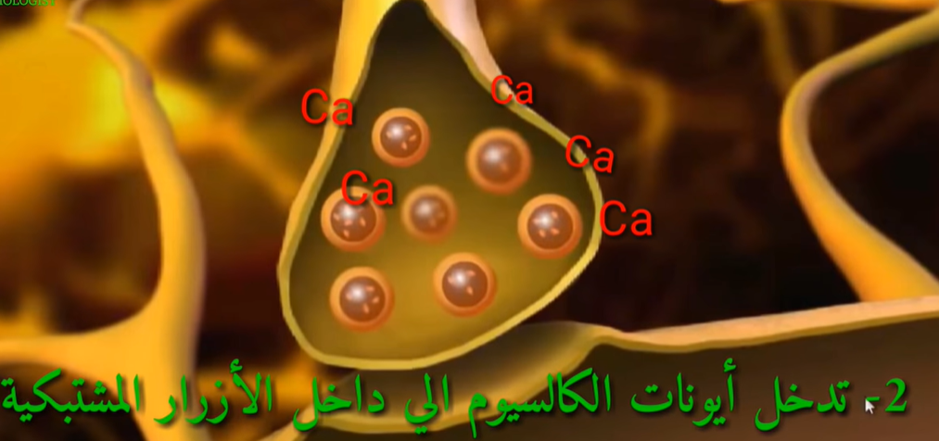

Slide 17
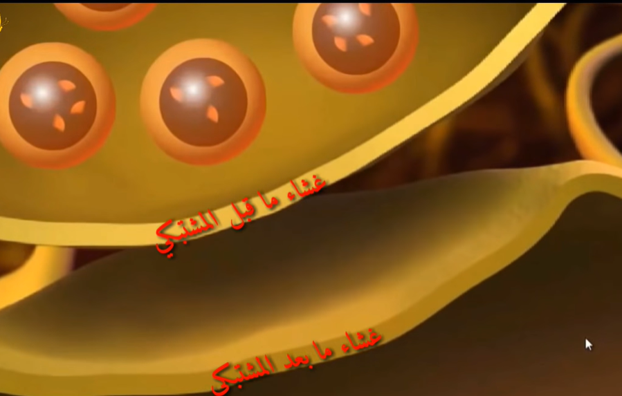

Slide 18
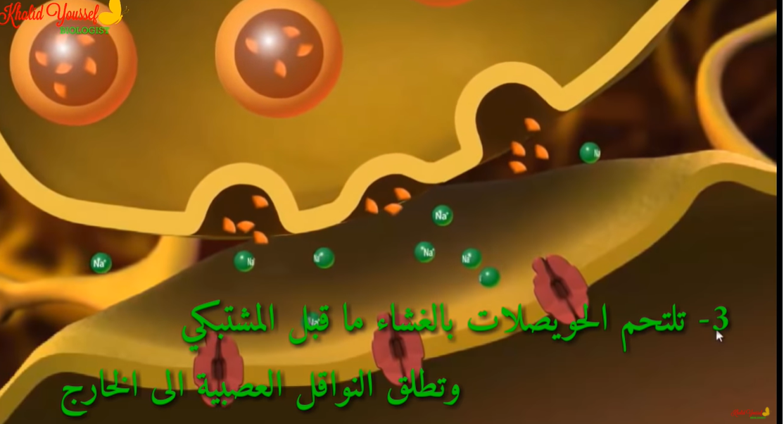

Slide 19
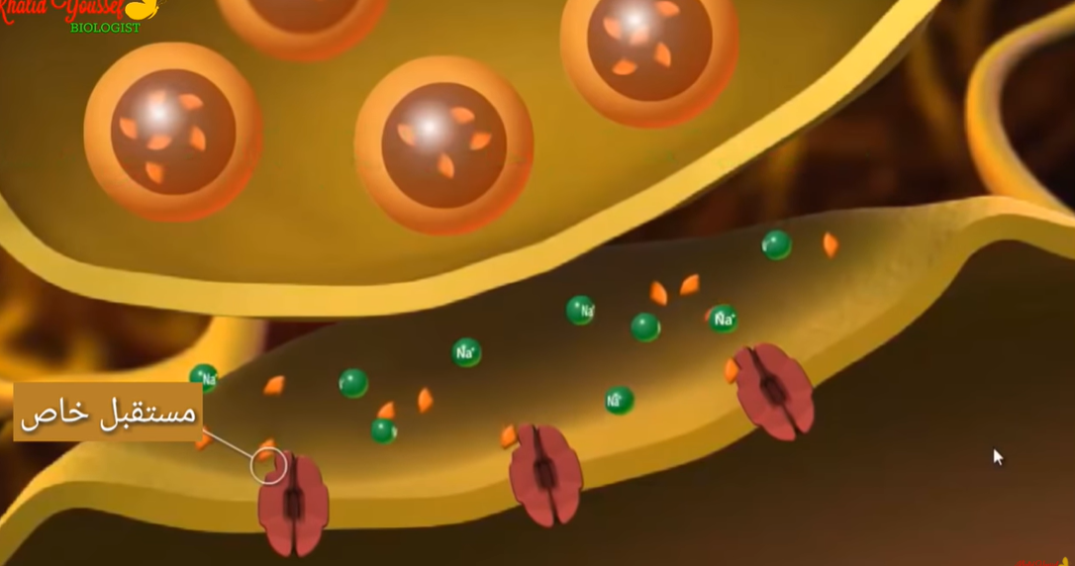

Slide 20


Slide 21


Slide 22
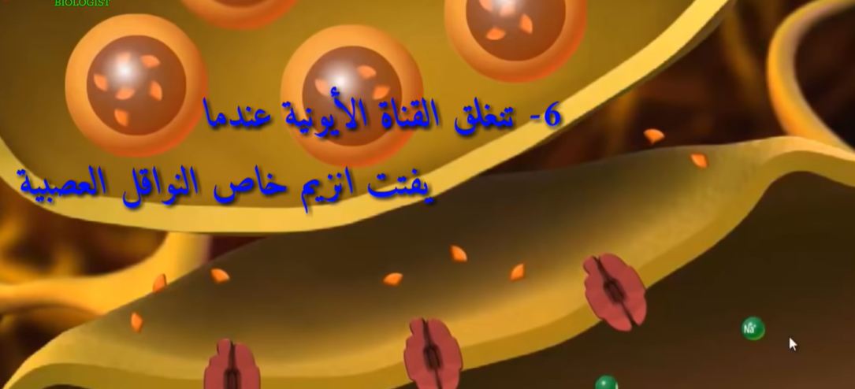

Slide 23
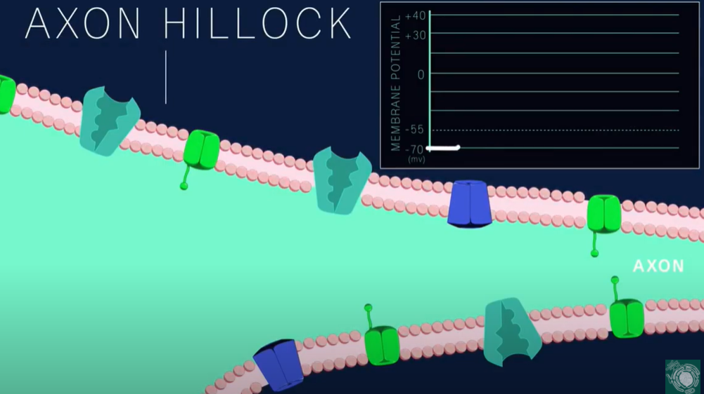

Slide 24
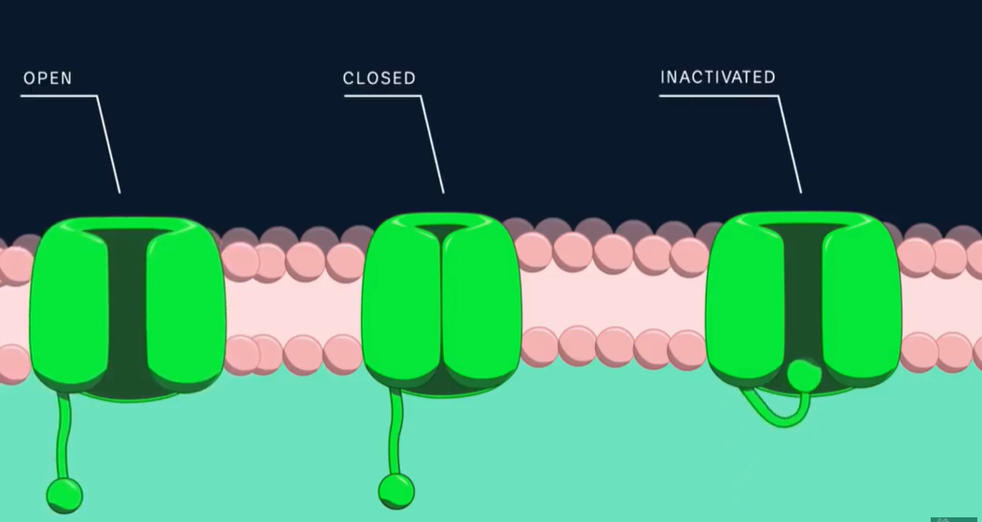

Slide 25
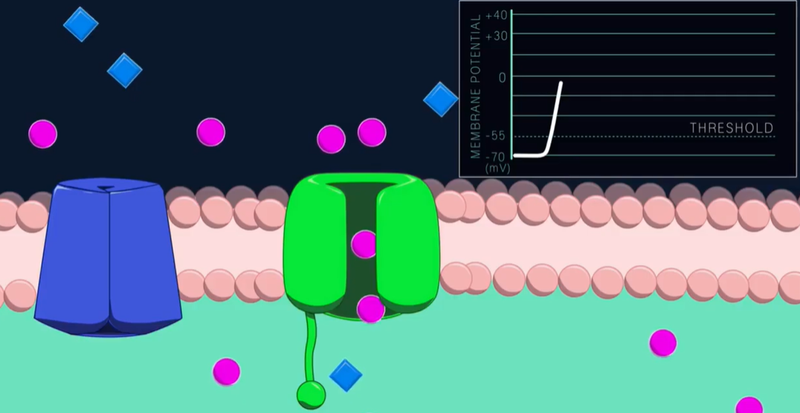

Slide 26
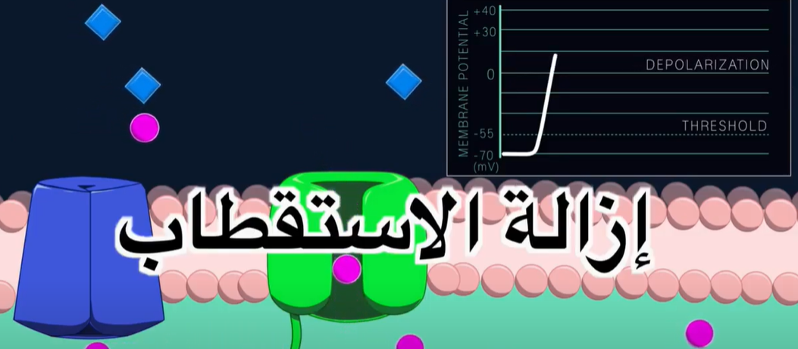

Slide 27
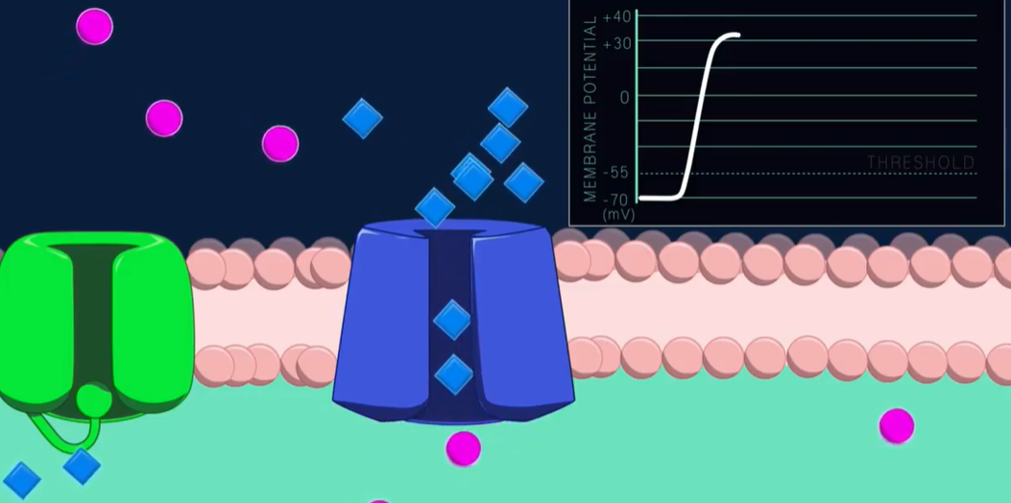

Slide 28
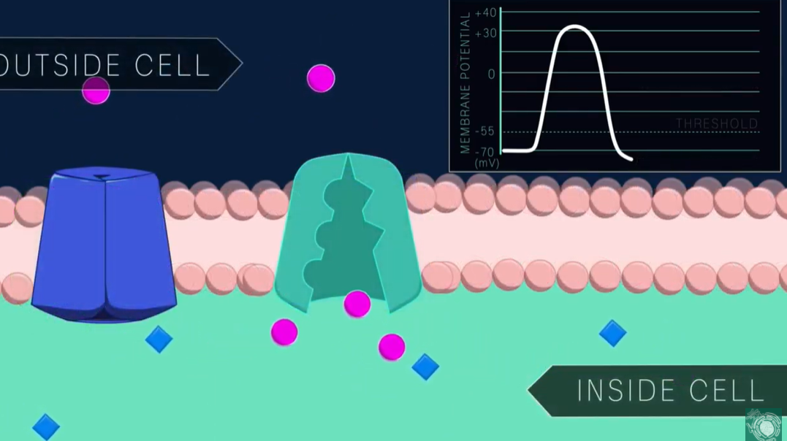

Slide 29
The nerve action potential:
The action potential is also called impulse which is rapid changes in the membrane potential that can be transmitted across the surface of an excitable tissue. Series of action potentials transmitted along the nerve to its ends is called nerve signal. The nerve signal is somehow similar to electrical signal except the nerve signal is transmitted through nerve fibers (i.e. the axon of the nerve cell) or enough the membrane of an excitable tissue while electrical signal is transmitted through usual wires, in addition, the nerve signal is actually a flow of ions across the membrane of an excitable tissue, while the electrical signal is a flow of electrons. Energy has to spend by the excitable tissue in order to generate and transmitted the nerve signal, while wire does not need to provide the energy for the transmitted the electrical signal through it. Similar to the electrical signal, nerve signal also consist of waves. Each wave of it can be recorded and called action potential. Each action potential begins with a sudden change from normal resting negative potentials to positive membrane potential and then ends with an almost equally rapid change back again to the negative potential. The stages of an action potential are as follow:

Slide 30
1- resting stages
2-initiation of an action potential.
3-depolarizion stage: when the membrane potential reach the threshold level, the potential across the membrane rises suddenly and rapidly in the positive direction approaching zero or may overshoot and become positive and normal polarized state -90mv is lost. This is initial very large sudden rapid change in membrane potential is also called depolarization.
4-repolarizition stage: in which the normal resting membrane polarizing state is re-established.

