Slide 1
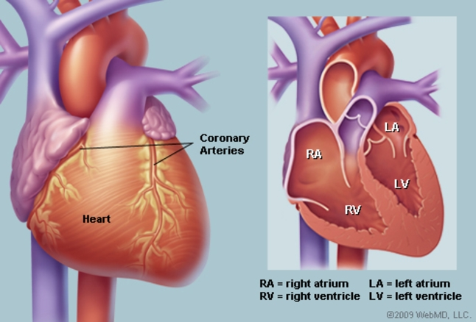
Heart –Le1-
ا.م.د. بان حسن عادل

Slide 2
Physics of the Cardiovascular System
(Cardiovascular system (CVS): blood, vessels, heart)
Cardiovascular system
blood
heart
vessels

Slide 3
The cells of the body act like individual engines. In order for them to function they must have:
Transportation
Regulation
hormonal
immune
respiratory
nutritive
excretory
temperature
protection
O2,CO2
Carry absorbed digestion products to liver and to tissue
Carry metabolic wastes to kidneys to be excreted
Divert blood to cool or warm the body
Carry hormones to target tissue
Complement act against pathogens
Blood clotting

Slide 4
Component of circulatory system
Blood vessels
Heart
Lymphatic system
Arteries
veins
capillaries

Slide 5
The blood and its supply of O₂ are so important to the body that the heart is the first major to develop in the embryo.
* Fetal heart
1. Start blood circulation at the eighth week after conception
2. Obtain oxygenated blood from mother via umbilical cord
3. An opening between RA and LA
90% of blood flows from RA to LA through the opening
10% circulates through fetal lungs
Within minutes after birth, the opening is closed in effect
Complete closure takes several months
Blue baby: inadequate closure of the opening, requires a surgery

Slide 6
The blood
The red color is caused by red blood cells (erythrocytes), flat disks about 7µm in diameter, which is represent 45% of the volume of blood.
White blood cells (leukocytes), present in small amounts. White blood cells (∼9 to 15µm in diameter), play an important role in combating disease. There are about 8000 white blood cells/mm³ of blood. When there is an infection in the body the number of white blood cells (white count) increase. (In one type of blood cancer, leukemia, there is an excessive production of white blood cells).
Platelets (∼1 to 4µm in diameter) are involved in the clotting function of blood. There are about 3×10³ platelets/mm³ of blood.
Plasma is clear fluid, accounts for the other 55%. The combination of red blood cells and plasma causes blood to have flow properties different from those of a fluid like water.

Slide 7
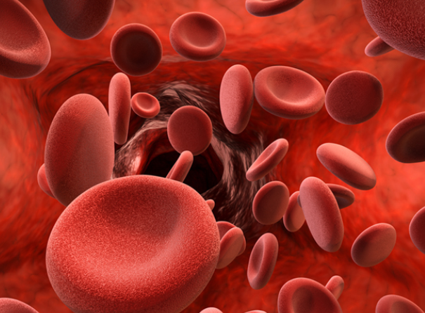
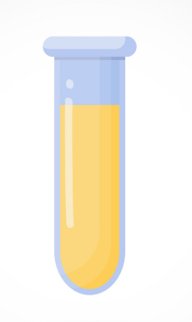
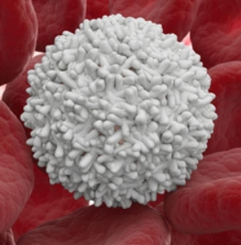
The blood
erythrocytes
Plasma
leukocytes
Platelets

Slide 8
Major components of the cardiovascular system
l. Pulmonary circulation
2. Systemic circulation in the rest of the body
The blood is pumped by the contraction of the heart muscles from the left ventricle at a pressure of about 125mmHg into a system of arteries that Subdivided into smaller arteries (arterioles) and to capillary bed. During the a few seconds it is in the capillary bed the blood supplies O² to the cells and picks up CO₂ from the cells.
After passing through the capillary bed the blood collects in small veins that gradually combine into larger veins before inters the right side of the heart. The returning blood is momentarily stored in the reservoir (the right atrium), and during a weak contraction (5 to 6mmHg) the blood flows into right ventricle. On the next ventricular contraction this blood is pumped at a pressure of about 25mmHg. Via the pulmonary arteries to the capillary system in the lungs, where it receives more O₂ and where some of the CO² diffuses into the air in the lungs to be exhaled. The freshly oxygenated left reservoir of the heart (left atrium): during weak contraction (7 to 8mmHg), the blood flows into the left ventricle. On the next ventricular contraction
this blood is again pumped from the left side of the heart into the general circulation.

Slide 9
How fast dose your blood flow
The blood goes from the aorta into the smaller arteries and arterioles with greater total-cross sectional areas the velocity of the blood decreases:
The velocity= flow rate/ cross —sectional
The average velocity in the aorta 30cm/s; that in a capillary is only about 1mm/s, this low velocity allows time for diffusion of gases to occur
The flow rate due to Poiseuilles law = ∆P (π/8) (1/𝛈) (R⁴/L)

Slide 10
The factors affect the flows of blood in the vessel are.
1. Viscosity (𝛈), the cgs unit used to measure viscosity is Poise, the SI unit for viscosity is Pascal second (Pas), which equals 10 poises.
The viscosity of blood is typically 3×10⁻³ to 4×10⁻⁴ pas.
2. Pressure difference (∆P). If ∆P is doubled, the flow rate also doubles.
3. The length (L), the flow varies inversely with the length
4. The radius (R), if the radius is doubled the flow rate increases by 2⁴ or factor 16.

Slide 11
Work done by the heart
Each contraction of the heart muscles forces about 80ml of blood through the lungs from the right ventricle and a similar volume from the left ventricle. In the process the heart does work.
The pressure in two pumps of the heart are not the same. In the pulmonary system the pressure is low because of low resistance of the blood vessels in the lungs. The maximum pressure (systole) about 25mmHg. In order to circulate the blood through the much larger systemic net work the left side of the heart muscle produce pressure about 120mmHg at the peak (systole) of each cardiac cycle.
The work W done by a pump working at a constant pressure P is equal to the product of pressure and volume pumped ∆V or W = P ∆V
Average P = 10cmHg
∆V = 80ml
W= pgh ∆V
= 13.6 g/cm³ × 980 cm/s² × 10cm × 80cm³ = 1.1×107 ergs

Slide 12
Cardiac Contraction
As mentioned above, a series of events occur in a specific order during a normal heartbeat. This process is called the cardiac cycle. The cardiac cycle can be broken down into two components, systole- and diastole. Diastole occurs when the heart muscle is relaxed and begins to fill with venous blood_ in the right atrium and oxygenated blood in the left atrium. Systole is the time when the heart contracts. During systole, the heart forces oxygenated blood out of the left ventricle and deoxygenated blood to the lungs through the right ventricle.

Slide 13
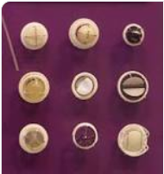
The human heart contains four valves: tricuspid valve, pulmonic valve, mitral valve and aortic valve.

Slide 14
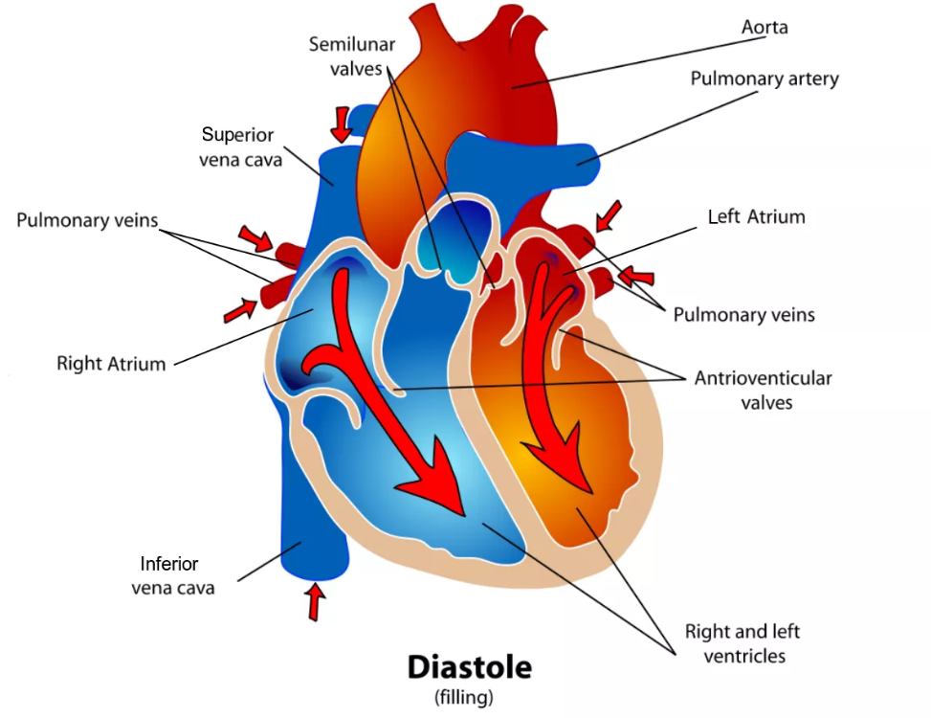
During the first diastole period, the atria and ventricles are relaxed and the atrioventricular valves are open. Oxygen-depleted blood returning to the heart from the body passes through the superior and inferior vena cavae and flows to the right atrium. The open atrioventricular valves (tricuspid and mitral valves) allow blood to pass through the atria to the ventricles. Impulses from the sinoatrial (SA) node travel to the atrioventricular (AV) node and the AV node send signals that trigger both atria to contract. As a result of the contraction, the right atrium empties its contents into the right ventricle. The tricuspid valve, located between the right atrium and right ventricle, prevents blood from flowing back into the right atrium.

Slide 15
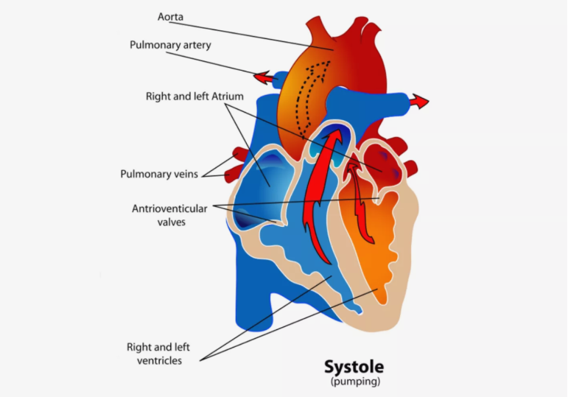
At the beginning of the first systole period, the right ventricle is filled with blood passed on from the right atrium. The ventricles receive impulses from fiber branches (Purkinje fibers), which carry electrical impulses to the ventricles causing them to contract. As this occurs, the atrioventricular valves close and the semilunar valves (pulmonary and aortic valves) open. Ventricular contraction causes oxygen-depleted blood from the right ventricle to be pumped to the pulmonary artery. The pulmonary valve prevents blood from flowing back into the right ventricle. The pulmonary artery carries oxygen-depleted blood along the pulmonary circuit to the lungs. There, blood picks up oxygen and is returned to the left atrium of the heart by the pulmonary veins.

Slide 16
In the second diastole period, the semilunar valves close and the atrioventricular valves open. Oxygenated blood from the pulmonary veins fills the left atrium (blood from the venae cavae is also filling the right atrium at this time). The SA node contracts again triggering both atria to contract. Atrial contraction causes the left atrium to empty its contents into the left ventricle (the right atrium is also emptying blood into the right ventricle at this time). The mitral valve, located between the left atrium and left ventricle, prevents oxygenated blood from flowing back into the left atrium.

Slide 17
During the second systole period, the atrioventricular valves close and the semilunar valves open. The ventricles receive impulses and contract. Oxygenated blood in the left ventricle is pumped to the aorta and the aortic valve prevents the oxygenated blood from flowing back into the left ventricle (oxygen-depleted blood is also being pumped from the right ventricle to the pulmonary artery at this time). The aorta branches out to provide oxygenated blood to all parts of the body through systemic circulation. After its tour through the body, oxygen-depleted blood is returned to the heart via the venae cavae.

Slide 18
الاذين الايسر يملئ بالدم
يفتح الصمام التاجي
البطين الايسر يملئ بالدم
يغلق الصمام التاجي
الرئة اوكسجين (مؤكسج)
وريد الرئوي
الاذين الايسر يملئ بالدم
البطين الايسر يملئ بالدم
انقباض عضلات البطين
وريد الرئوي
يفتح الصمام الابهري
للشرايين التي تغذي الجسم
اوردة
الاذين الايمن يملئ بالدم
يفتح ثلاثي شرفات يفتح
البطين الايمن يملئ بالدم
يفتح الصمام الرئوي
انقباض البطين الايمن
Co2 شعيرات دموية
وريد اجوف
تنقية الدم بالرئة ويحمل الاوكسجين ويعود للقلب ( الوريد الرئوي)
الرئة

Slide 19
The physics of some cardiovascular diseases
Heart diseases often have physical component Many of these diseases, for example, increase the work load of the heart or reduce its ability to work at a normal rate.
W = P ∆V equation of work done
The work done by the heart is roughly the tension of the heart muscle times how long it acts. Anything that increase the work load of the heart. For example:
1-Hypertension
Causes the muscle tension to increase in proportion to the pressure, due to Laplace law T = PR so the high blood pressure causes to increase the work done by equation W = P∆V.
2- Tachycardia
A fast heart rate increases the work load since the amount of time the heart muscle spend contracting increases.
3- Enlargement of the heart and reduction in the ability of the heart to provide adequate circulation. If the radius of the heart is doubled, the tension of the heart muscle must also be doubled if the same pressure is to maintained. Since the heart muscle is stretched, it may not be able to produce sufficient force to maintain normal circulation; the stretched heart muscle is also much less efficient than normal heart muscle.

Slide 20
Electrical signal from the heart- the electrocardiogram
Introduction
The body relies on the heart to circulate blood throughout the body. The heart is responsible for pumping oxygenated blood from the lungs out to the body through the arteries and also circulating deoxygenated blood back to the lungs. from the body through the veins. The heart is divided into four chambers and each chamber is responsible for a different part of the circulatory process mentioned above. Deoxygenated blood first enters the right atrium via the vena cava, where it is then pumped into the right ventricle. The right ventricle pumps this deoxygenated blood through the pulmonary artery to the lungs, where it flows through the alveoli, receives oxygen, and then is returned to the heart through the pulmonary vein and into the left atrium. The left atrium then pumps this oxygenated blood into the left ventricle, where then it is pumped out to the rest of the body through the aorta. This process of contracting the different chambers is highly coordinated and the coordination is controlled by specialized regions of the heart responsible for electrical stimulation of cardiac muscle.

Slide 21
Life several other bioelectrical signals, the electrical impulses generated by the heart can be measured on the surface of the skin with electrodes. Using surface electrodes, the cardiac potential of the heart can be measured and correlated with regions of cardiac excitation. This measurement is called an electrocardiogram (ECG). The ECG can be used to evaluate cardiac function, heart rate, and cardiac arrhythmias. The electrical activation that creates the normal heartbeat can in some instances cause abnormal cardiac function. Disorders such as bradycardia (slow heart rate), tachycardia (fast heart rate) and electrical conduction problems such as bundle branch blocks can be all diagnosed from the ECG.

