Slide 1
Dr. Ban H. Adil
Cold atmospheric plasma in medicine
د. بان حسن عادل

Slide 2
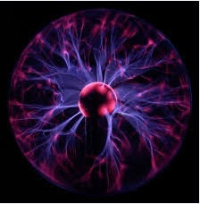
Dr. Ban H. Adil
plasma
Is a quasi neutral gas of charged and neutral particles which exhibits collective behavior

Slide 3
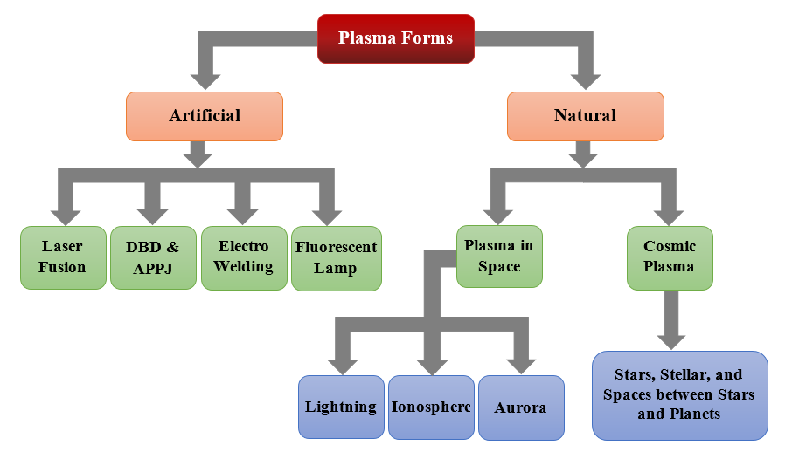
Dr. Ban H. Adil

Slide 4
Dr. Ban H. Adil
Plasma Components
Positive ions
photons
Free radicals
Negative ions
Electrons
Atoms
metastables

Slide 5
Dr. Ban H. Adil
Plasma
(According to Temperature)
High Temperature Plasma
Low Temperature Plasma
In equilibrium state, so:
T_{e} ≈ T_{i} ≈ T_{g}
T_{p} = 10⁶-10⁸ K
n_{e} ≥ 10²⁰m⁻³
Thermal
Non-Thermal
Laser Fusion Plasma
Quasi-Equilibrium
T_{e} ≈ T_{i} ≈ T_{g}
≤ 2×10⁴ K
n_{e} ≥ 10²⁰m⁻³
Non-Equilibrium
T_{e} >> T_{i} ≈ T_{g}
= 300 .. 10³ K
n_{e} ≈ 10¹⁰m⁻³
Plasma Torches
Corona, Jet, DBD

Slide 6
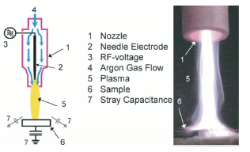
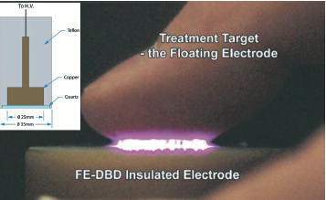
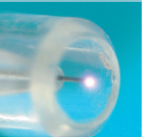
Dr. Ban H. Adil
Atmospheric non-thermal plasma schemes
Atmospheric – pressure plasma jet
plasma needle
Atmospheric – pressure plasma jet
FE-DBD
Flouting electrode

Slide 7
Dr. Ban H. Adil
Application of plasma
In the medical field
In the Industry field
sterilization
Blood clotting
treatment of burns
treatment of cancer
Nuclear fusion
electronic devices
Telecomm-unications
the Preservation of the environment

Slide 8
Plasma Applications
Depending on the features of plasma, it can be used in different life fields, such as electronics, textile, packaging, sciences, etc. Below are some of plasma application :
1. Surface cleaning: it is commercially adopted to remove the
disinfection of chemicals that applied on medical devices, which are
manufactured by sensitive plastic heating.
2. Biomedical sector: plasma is used for cold sterilization of prostheses and tools, in addition thermo unstable materials used in biological techniques, with negligible effect on substrate materials.
3. Toxicity avoidance: it is used for fruits, spices, and seeds surface disinfection instead of using chemical solutions that may have a damage or toxicity residues, even they are needed for time-consuming.
4. Microbial inactivation: the impact of non-thermal plasma is more than the impact of the use other methods like heating, UV treatment, or chemical materials, according to its ability of microbial inactivation
Dr. Ban H. Adil

Slide 9
Dr. Ban H. Adil
Plasma Clinical Applications
In recent years, the use of plasma has increased in medicine, which has been recorded in the area of research and development of clinical application worldwide. Electrical power and discharges have been used for decades in electro-surgery for blood coagulation and tissue removal. Recently the researchers have realized that the cold plasmas are quite useful for various other medical treatments including hand/skin sterilization, wound healing, cell apoptosis/regeneration, and so on These applications of cold plasma represent an emerging and rapidly growing frontier in low temperature plasma science and technology: The non-thermal plasma has a sterilization ability that may have a significant impact on healthcare which is related to the prevention of infection in skin wounds including ulcerations and burns due to their unique ability to kill bacteria that causes infections in such wounds without having an adverse effect on human tissues . Such infections are often difficult to be treated by conventional antibiotic treatment. Plasma treatment could potentially be used continuously in cases of severe burns as an adjunct to antibiotic therapy to attain sterilization of the affected areas thus preventing infections . Another application for cold plasma where the use of plasma is being investigated is in blood coagulation to stop bleeding in critical life threatening situations. The methods of inducing coagulation rapidly in such cases are critical for emergency medical responders to treat victims at the scene of an incident . Non-thermal plasma provides this opportunity to induce coagulation in a safe manner both at the accident site and in hospital emergency rooms, particularly for slow bleeding .

Slide 10
Dr. Ban H. Adil
Non-thermal plasma has been used in wound healing, there is an evidence that endothelial cells (cells which line all blood carrying vessels of our body) exposed to short duration (15-30 sec) of low power
(~ 0.2W/cm2), nonthermal plasma treatment exhibits enhanced proliferation which may be due
to observed release of Fibroblast Growth Factor (FGF) from plasma treated cells. Endothelial cells play a guiding role in angiogenesis, the growth of new blood vessels from existing vessels. In varied disease conditions, healing may result from promoting or inhibiting angiogenesis. This has further application to the effect of non thermal plasma on the vasculature, which is exposed during plasma treatment of many tissues . The most important plasma in medicine is cancer therapy, Non-thermal plasma has been tested for its ability to effectively treat various types of cancers by selectively killing cancer cells while leaving normal tissue unharmed. Experiments identified a dose of plasma that caused minimal immediate toxicity in additional to stimulate apoptosis in a cancer cell line

Slide 11
Dr. Ban H. Adil
Interaction of Plasma with Living Cells and Tissues
The applications of plasma in medicine is growing rapidly, that has
led to new field foundation entitled “Plasma Medicine”. The interaction of plasma with living cells and tissues is very complex, due to the complexity of both plasmas and tissues. Plasma interaction mechanism depends on how the plasma is produced, for example, RF discharge in helium gas would interact rather differently than nitrogen arc afterglow. Mainly, plasma-tissue interaction generates reactive species and charged species

Slide 12
Dr. Ban H. Adil
1-Role of Charged Species
When the plasma directly contracting a biological organisms, it achieves the required impact faster than indirectly contacting of the same plasma dose, due to the charged species in plasma, therefore, plasma
interaction role is played by ions:
a. Negative and positive ions approximately have a similar impact.
b. The impact of charged species is chemical not physical phenomena.
c. The ions catalyze peroxidation in both biological organisms inside and outside.
d. The role of oxygen and relative oxygen species is very important.
.2- Role of Photons
When the photons contact the tissue, it would cause a reflection for 4- 10% of photons due to the change in refractive index and incidence angle. In the tissues, the photons would be scattered or absorbed. Photons energy may affect the metabolism of the cell, and signaling pathways

Slide 13
Dr. Ban H. Adil
3-Role of Free Radicals
Free radicals are molecular fragment that include in their outermost atomic orbital one or more unpaired electrons, which can cause chain reactions. They play a significant role in tissue damage pathogenesis. The antioxidants (endogenous and exogenous) have a protective role to repair the damage that caused by free radicals

Slide 14
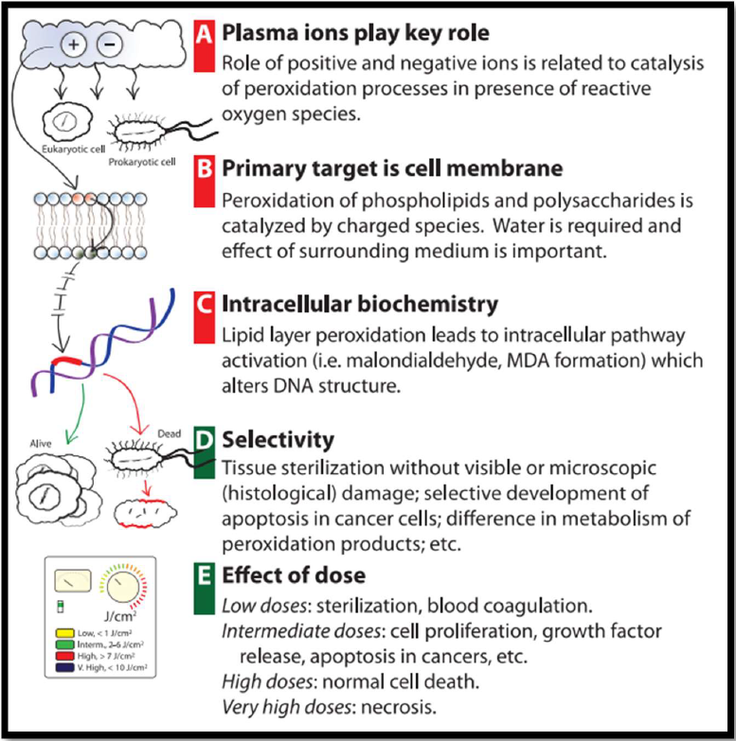
Dr. Ban H. Adil

Slide 15
Dr. Ban H. Adil
Lipid peroxidation is the oxidative degradation of lipids. It is the process in which free radicals "steal" electrons from the lipids in cell membranes, resulting in cell damage. This process proceeds by a free radical chain reaction mechanism. It most often affects polyunsaturated fatty acids, because they contain multiple double bonds in between which lie methylene bridges (-CH₂-) that possess especially reactive hydrogen atoms. As with any radical reaction, the reaction consists of three major steps: initiation, propagation, and termination. The chemical products of this oxidation are known as lipid peroxides or lipid oxidation products (LOPs).

Slide 16
Dr. Ban H. Adil
Reactive Oxygen Species (ROS)
Reactive Oxygen Species (ROS) represent free radicals or non-radical molecules that derived from molecular oxygen species, which can role as intercellular and intracellular messengers . The examples of free radical type of ROS include superoxide anion O₂● ─, and hydroxyl radical ●OH, while non-radical molecules type of ROS include hydrogen peroxide H₂O₂, and singlet oxygen ¹O₂. The molecular oxygen O₂ reduction by the exposure of high energy or electron transfer produces ROS.
Most Common ROS Radicals Generation
The oxygen bi-radical form has a parallel spinning, when a sufficient energy is absorbed, one of its unpaired electrons spin is reversed (opposite spinning), which leads to generate singlet oxygen ¹O₂ . Otherwise, species of oxygen that partially reduced is produced under the impact of mitochondrial enzymatic reactions, so that the intermediate molecules are generated basing on number of transferred electrons. Once, the bi-radical oxygen O₂ is auto-oxidized directly through electron transport reaction and P450 enzyme, to generate superoxide anion O₂● ─, which in turn catabolized to generate hydrogen peroxide H₂O₂ by the impact of Superoxide Dismutase (SOD) enzyme. The H₂O₂ may be reduced to H₂O by the catalase enzyme, or reacted with Fe⁺² (ferrous ions) to produce the hydroxyl radical ●OH, which is the most reactive free radical that causes cells damage by lipid peroxidation. Also, ●OH may be produced by H₂O radiolysis

Slide 17
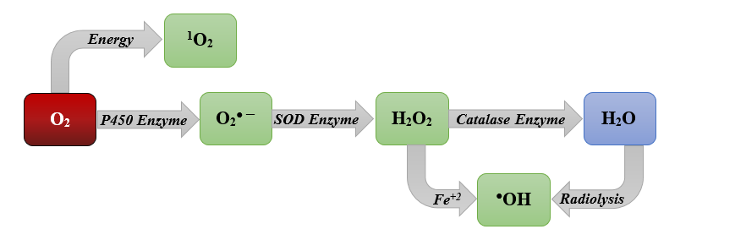
Dr. Ban H. Adil

Slide 18
Dr. Ban H. Adil
ROS in Plasma
Plasmas are rich resources of ROS, most of ROS produced by plasma regulates the biometrical pathways, thus, induction of chemical and physical cell changes by activating or deactivating certain biological processes. Plasma-generated ROS plays a key role in cell migration, proliferation, and angiogenesis as mentioned by many researchers who studied plasma impact on deactivation of bacteria and tumors. The main impact of plasma as cancer therapy is depends on the existence of plasma-generated ROS, due to the ROS ability in cell apoptosis induction, while it damages lipids, proteins, and DNA of cells

Slide 19
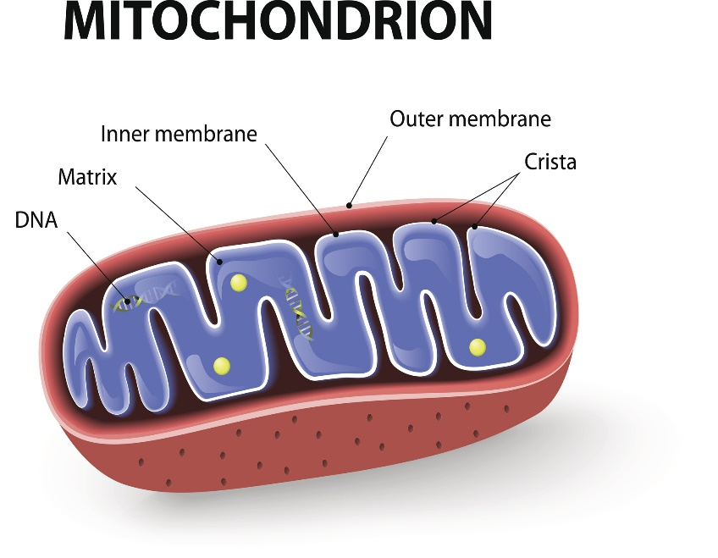
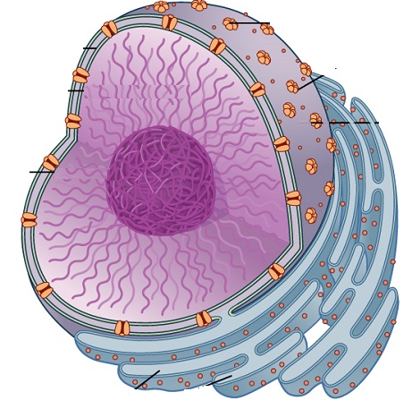
Dr. Ban H. Adil
ROS in Mammalian Cells
At low or moderate concentration levels, ROS causes some activities like angiogenesis, tissue repair, and cell proliferation, while at high concentration levels, ROS causes apoptosis, carcinogenesis, mutagenesis, and mitochondrial dysfunction. With in the mammalian cells, the mitochondria generates hydrogen peroxide, the generation of free radicals by the mitochondria may be occurred in inner membrane, outer membrane, or within matrix. ROS can cause mutations because of DNA damage resulted by the occurrence of mitochondria-nucleus interactions Under ordinary physiological circumstances, the cell controls the level of ROS through balancing ROS generation by scavenging system elimination ability, while ROS can damage cellular lipid, DNA, and proteins under oxidative stress circumstances
O₂ → O₂● ─→ H₂O₂ → ●OH
Signaling to Nucleus
ROS
Protein Import
Signaling
Cell Death
Mitochondrion
Nucleus

Slide 20
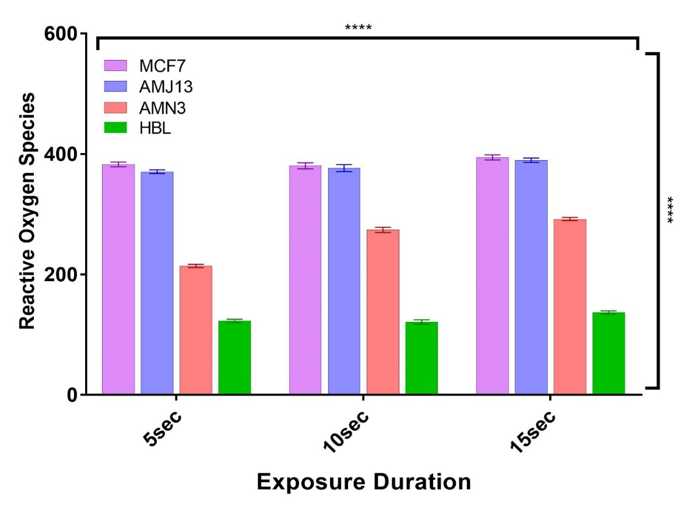
ROS in Cancer Cells
In cancer cells, high levels of ROS is resulted from oncogenic activity, increased metabolism, and mitochondrial dysfunction. At low level of ROS, it supports cancer cell surviving by the progression of cell cycle, while at high level of ROS it suppresses the growth of tumor by cell cycle inhibitor sustained activation, thus, cell death induction .The capability of recognizing signals (i.e. survival or apoptotic) in cancer cells depends on dose, type, site, and duration of ROS generation .The cytotoxicity of ROS can represent a driving force for apoptosis in cancer cells, and in a higher levels, it leads to both apoptosis and necrosis
Dr. Ban H. Adil

