Slide 1
Tendon surgery
By
Dr. Sinan Adnan

Slide 2
Tendons
Tendons consist of dense regular connective tissue.
The main cellular component of tendons are specialized fibroblasts called tenocytes.
Tenocytes synthesize the extracellular matrix of tendons, abundant in densely packed collagen fibers.
The collagen fibers are parallel to each other and organized into fascicles. Individual fascicles are bound by the endotenon, which is a delicate loose connective tissue containing thin collagen fibrils and elastic fibers.
Groups of fascicles are bounded by the epitenon, which is a sheath of dense irregular connective tissue.
The whole tendon is enclosed by a fascia. The space between the fascia and the tendon tissue is filled with the paratenon, a fatty areolar tissue.

Slide 3
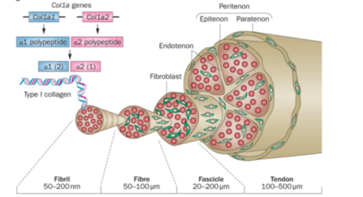
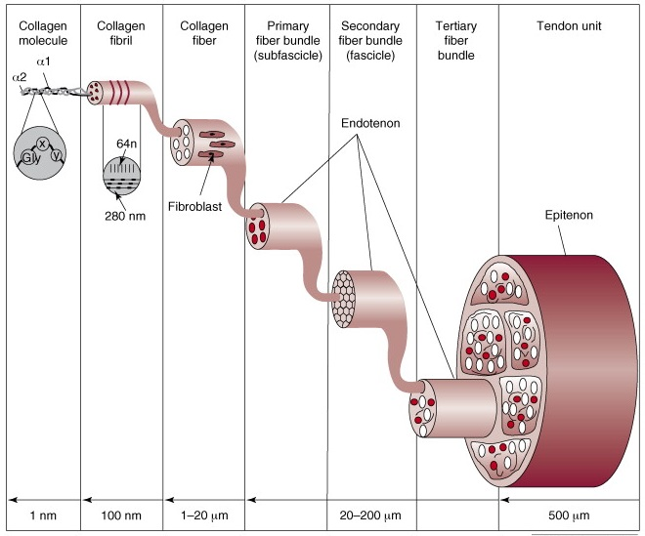

Slide 4
Blood supply
The blood supply enters the tendon in three locations: through a musculotendinous junction and osteotendinous insertion as intrinsic systems, and paratenon or synovial sheath as extrinsic system
In the absence of a synovial sheath, the paratenon provides the extrinsic component of the vasculature. Vessels entering the paratenon course transversely and branch repeatedly to form a complex vascular network and the arterial branches from the paratenon penetrate the epitenon to course in the peritenon septa
The other source of nutrition is diffusion from the synovial fluid, which provides a significant supply of nutrients for many tendons, and from the tissues enclosing and surrounding the tendon provides a cellular and vascular component for healing and providing nutrition to the tissue within the tendon .

Slide 5
Nerve Supply
Tendon innervation originates from cutaneous, muscular, and peri-tendinous nerve trunks and both sympathetic and parasympathetic fibers are present in tendon.
Nerve endings of myelinated fibers function as specialized mechano-receptors to detect changes in pressure or tension, while the unmyelinated nerve endings act as nociceptors, they sense and transmit pain. The mechanoreceptors are most numerous at the insertion of tendons into the muscle. These fibers terminate with a spray of fiber endings between bundles of collagen fibers of the tendon

Slide 6
Tendon Healing
The three main stages of tendon healing are inflammation, repair or proliferation, and remodeling, which can be further divided into consolidation and maturation. These stages can overlap with each other.
First or Inflammatory stage
In the first stage, starts immediately after injury and lasts for approximately 10 days inflammatory cells such as neutrophils are recruited to the injury site, along with erythrocytes. Monocytes and macrophages are recruited within the first 24 hours, and phagocytosis of necrotic materials at the injury site occurs. After the release of vasoactive and chemotactic factors, angiogenesis and the proliferation of tenocytes are initiated. Tenocytes then move into the site and start to synthesize collagen III.

Slide 7
2- Reparative (proliferative) Phase:
It begin within 4 days after injury and peaks at 3 wks. After a few days, the repair or proliferation stage begins. In this stage, the tenocytes are involved in the synthesis of large amounts of collagen and proteoglycans at the site of injury, and the levels of Glycosaminoglycan GAG and water are high.

Slide 8
3- Remodeling Phase:
After about six weeks, the remodeling stage begins. The first part of this stage is consolidation, which lasts from about six to ten weeks after the injury. During this time, the synthesis of collagen and GAGs is decreased, and the cellularity is also decreased as the tissue becomes more fibrous as a result of increased production of collagen I and the fibrils become aligned in the direction of mechanical stress.
The final maturation stage occurs after ten weeks, and during this time there is an increase in cross linking of the collagen fibrils, which causes the tissue to become stiffer. Gradually, over about one year, the tissue will turn from fibrous to scar-like.

Slide 9
General Principles of Tendon Surgery
1- minimizing the adhesions of tendon, this is accomplished by:
A- gentle handling of tissue
B- keeping the tissue moist (saline solution).
C- preventing hematoma formation.
D- preventing infection.
2- apposing the normal tissues as perfectly as possible.
3- use of a tourniquet.
4- if external fixation is required, a splint or cast applied.
5- a straight needle is used, or curved tapered needle may be used.
6- the suture material should be strong, permanent and non-reactive and the size of the material will depend on the size of the tendon.
7- the creation of a surgical wound should be away from the tendon.

Slide 10
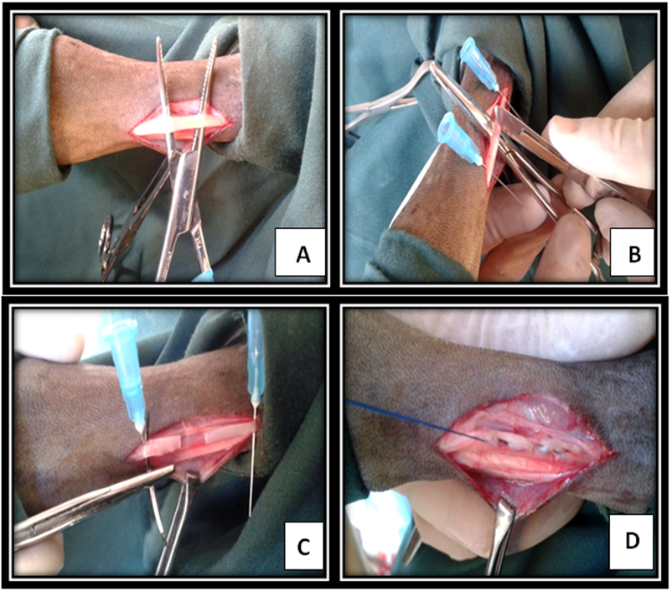
End- to- End Tenorrhaphy
Is the best method for restoration of a lacerated tendon (tenotomy).
The tension may be overcome by passing 2 straight needles transversely through the tendon proximal and distal to the proposed suture pattern.
Forceps are not recommended to use.
Use suitable suture pattern.

Slide 11
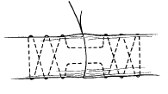
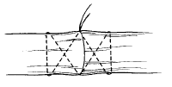
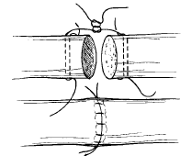

Core Suture Techniques
Bunnell stitch
Crisscross stitch
Robertson and Al-Qattan
Interlock stitch
Mason-Allen stitch

Slide 12
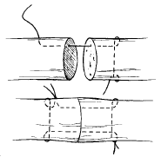
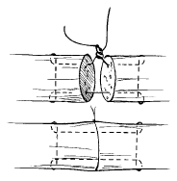
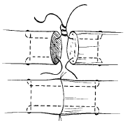
Kessler stitch
Modified Kessler
Tajima modification Of kessler stitch with double loop at repair site

Slide 13
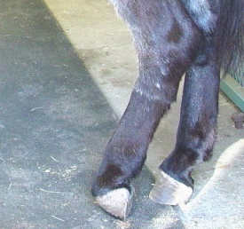
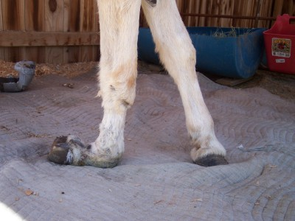
Contracted tendon
Contracted tendons it occur in foal ,calf ,lamb and pigs it can be congenital or acquired disease that most commonly involves the forelegs in one or both limbs.
Location:
Fore limb (either unilateral or bilateral)
Hind limb (either unilateral or bilateral)
It may affect the Superficial Digital Flexor Tendon or Deep Digital Flexor Tendon or both of them.

Slide 14
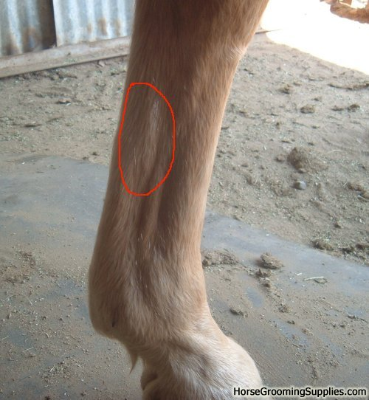
Treatment:
the treatment is according to the degree of contraction;
In case of mild contraction, splintage with continuous tension may lengthen the tendon and correct the contracture.
If the contracture is severe the simplest method of correcting contractures and
the simplest tendon operation is Tenotomy:
Site of operation:
Mid metacarpal region (fore limbs).
Mid metatarsal region (hind limbs).
In these sites no synovial sheath surrounding the
tendons.
Anesthesia:
local S/c infiltration (in ruminant).
General anesthesia (in equine).

Slide 15
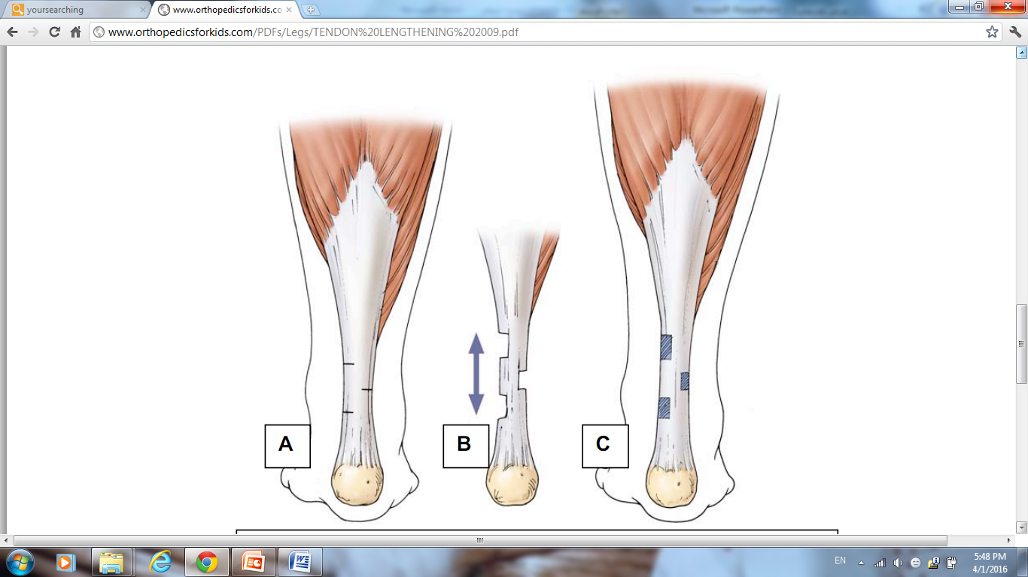
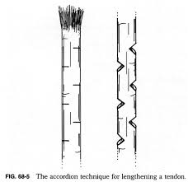
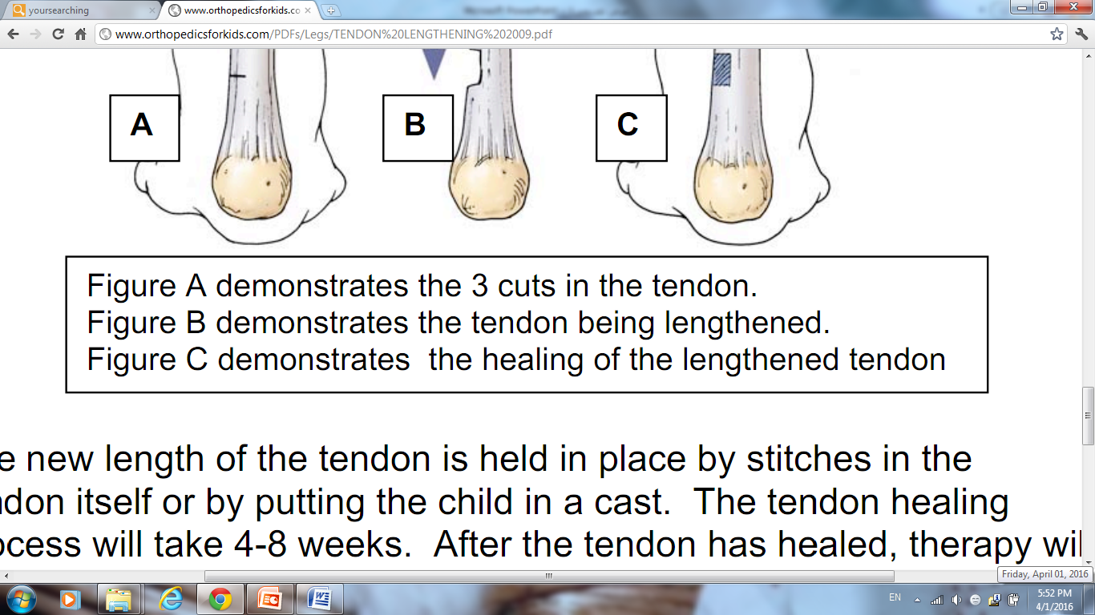
Tendon Lengthening (in contracted tendon)
1- Accordion method

Slide 16
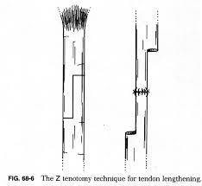
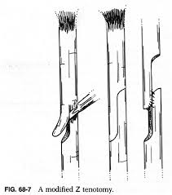
2- ῝Z῎ Tenotomy and modified ῝Z῎ Tenotomy :

Slide 17
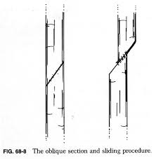
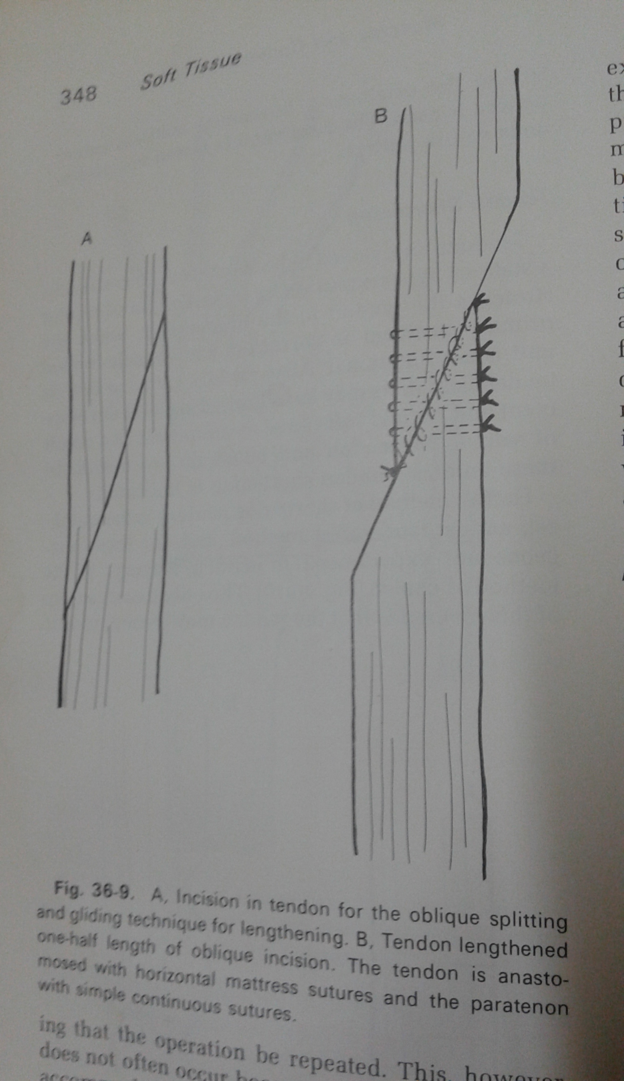
3- Oblique splitting and gliding technique

Slide 18
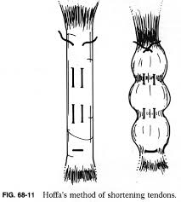
Tendon shortening
1- Hoffa's method

Slide 19
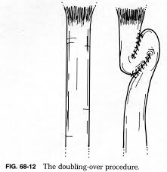
2- Doubling over method

Slide 20
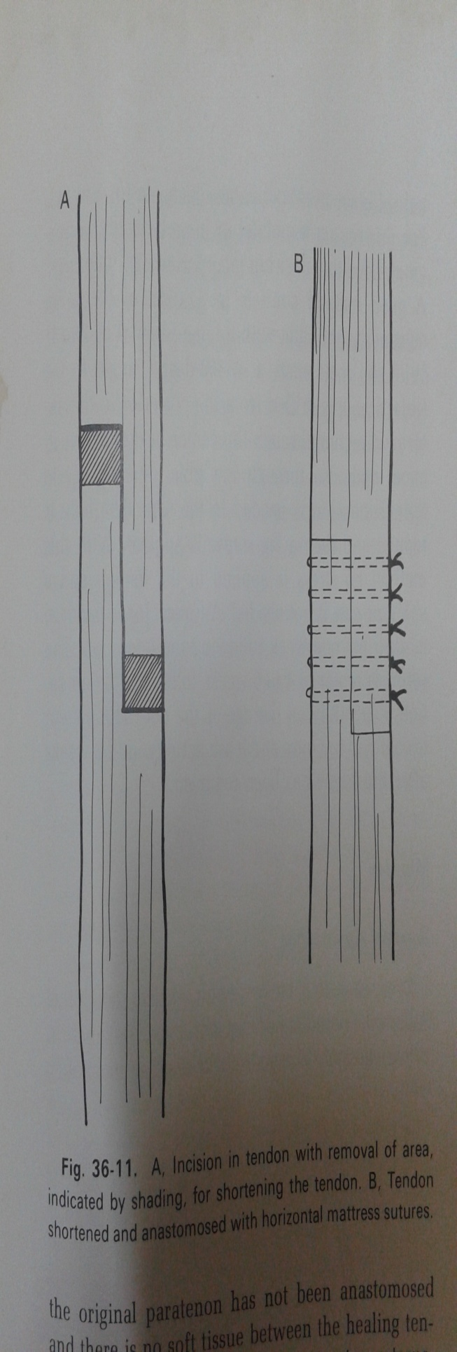
2- ῝Z῎ incision with excision of the tendons ends

Slide 21
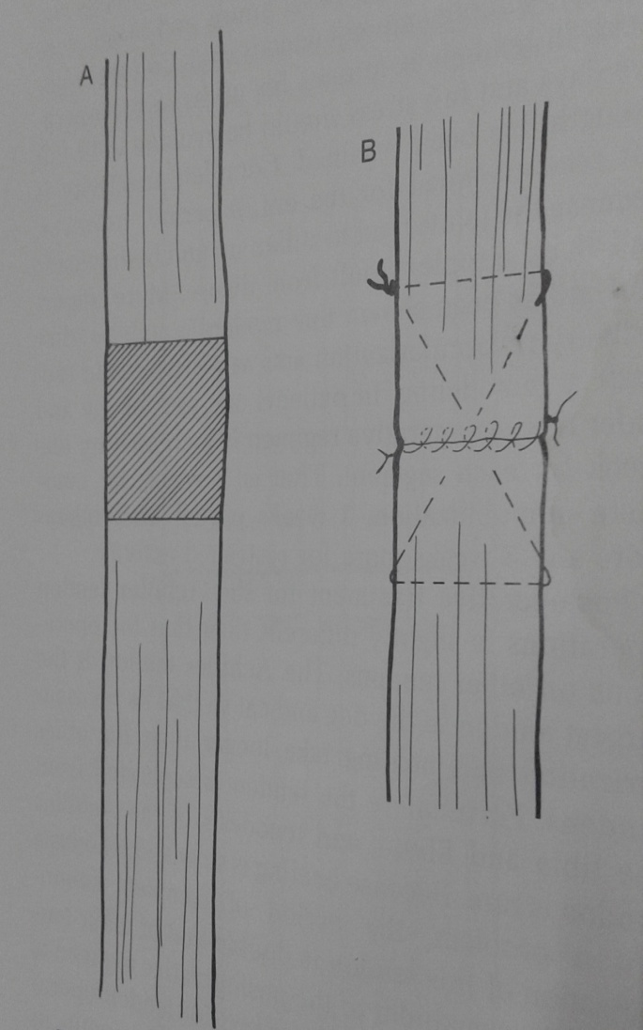
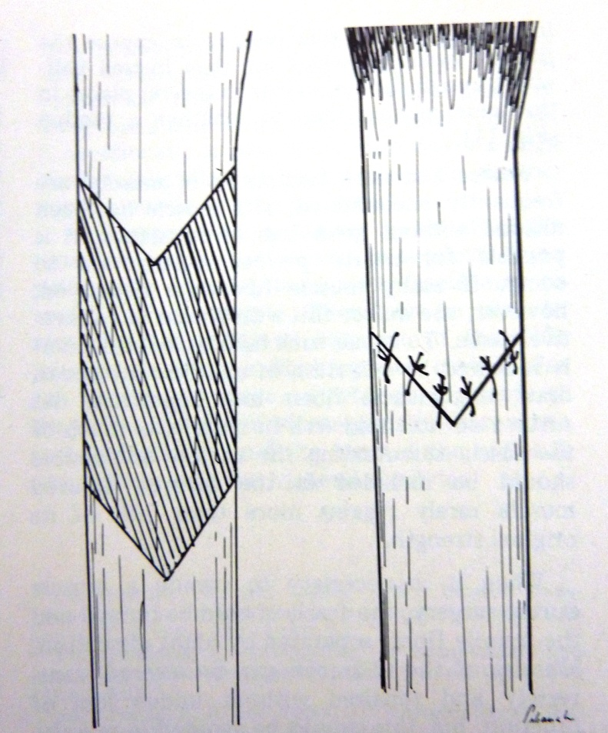
3- Shortening by remove portion and Anastomoses

