Slide 1
Endoscopic and laparoscopic Surgery
By
Dr. Sinan Adnan

Slide 2
Brief History of Endoscopy
In the early 1900s, the first attempts to view inside the body with lighted telescopes were made. These initial devices were often fully rigid. In the 1930s, semi-flexible endoscopes called gastroscopes were developed to view inside of the stomach.
Fiber-optic endoscopy was pioneered by South African-born physician Basil Hirschowitz at the University of Michigan in 1957.
Widespread use of fiber optic endoscopes began in the 1960s.
A fiber optic cable is simply a bundle of microscopic glass or plastic fibers that literally allows light and images to be transmitted through curved structures.
Laparoscopy is a minimally invasive diagnostic and surgical method for examining and performing surgical procedures in peritoneal cavity.
The Greek words laparo, which means “flank” and scope, which means “observing device” are the origin of word laparoscope.

Slide 3
What is Endoscopy?
Endoscopy is the examination and inspection of the interior of body organs, joints or cavities through an endoscope to allows physicians to peer through the body's passageways.
An Endoscope is a device using fiber optics and powerful lens systems to provide lighting and visualization of the interior of body organs, joints or cavities. The portion of the endoscope inserted into the body may be rigid or flexible, depending upon the medical procedure.

Slide 4
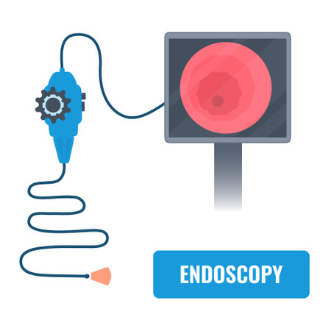
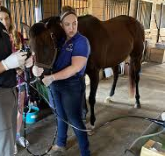
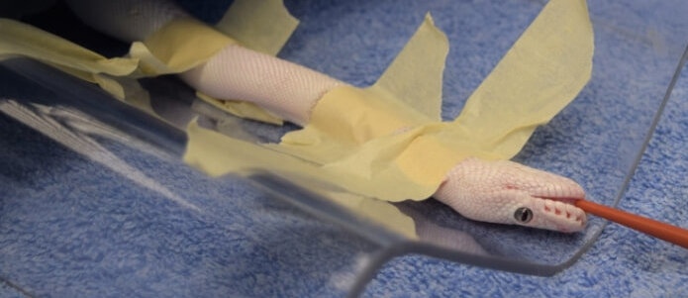
Endoscopic Surgery
Endoscopic Surgery: Visual inspection of any cavity of the body, uses scopes going through small incision or natural body opening in order to diagnose and treat disease. Endoscopy may be with rigid or flexible scopes depending on the nature of the problem.
Upper gastrointestinal endoscopy is used to examine esophagus, stomach and upper intestinal tract, the scope is inserted through mouth.

Slide 5
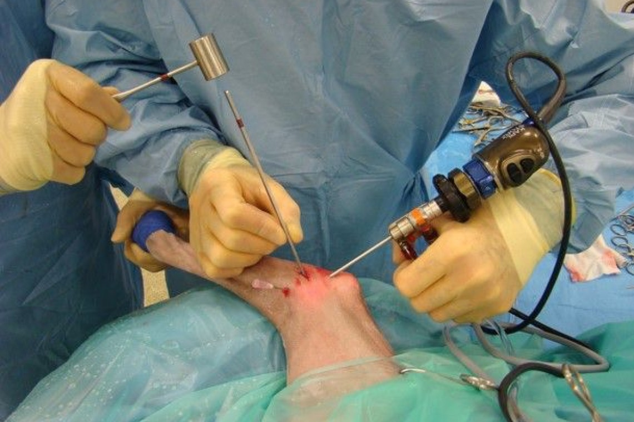
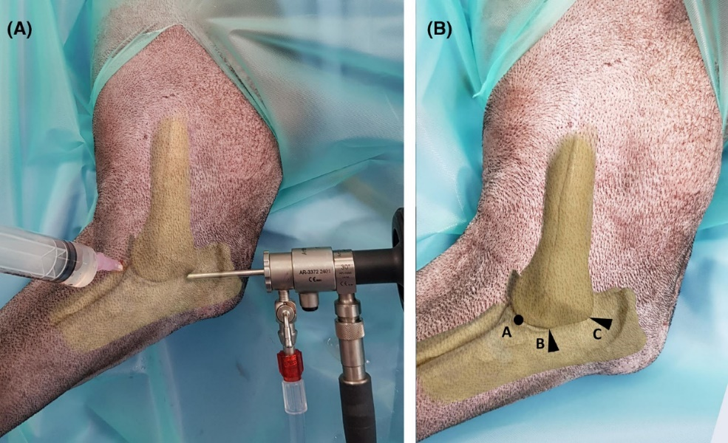
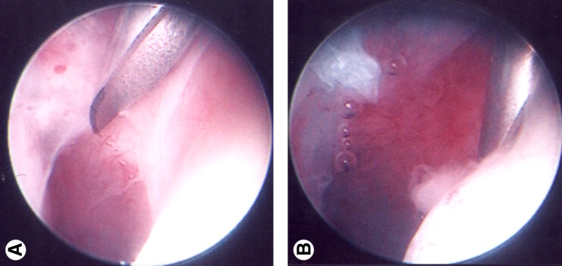
Arthroscopy (Arthroscopic Surgery): is used to examine joints, the scope is inserted through a small incision on the joint being examined.

Slide 6
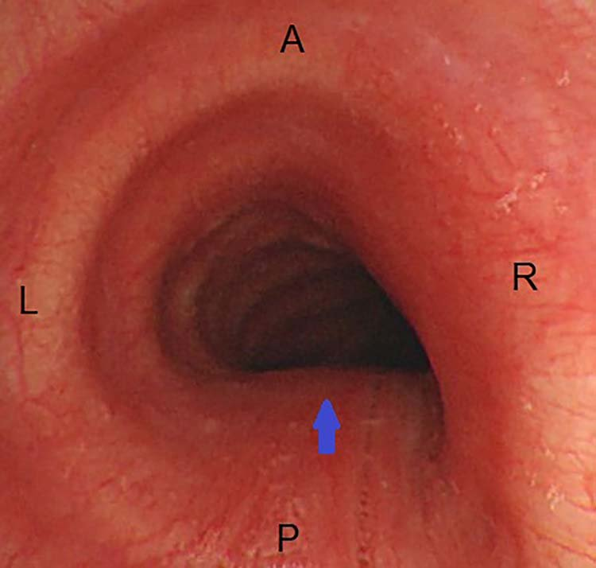
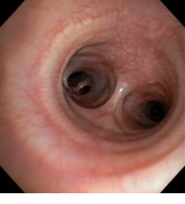
Bronchoscopy: is used to examine lungs, the scope is inserted through nose or mouth.

Slide 7
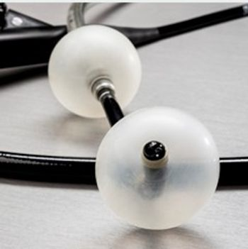
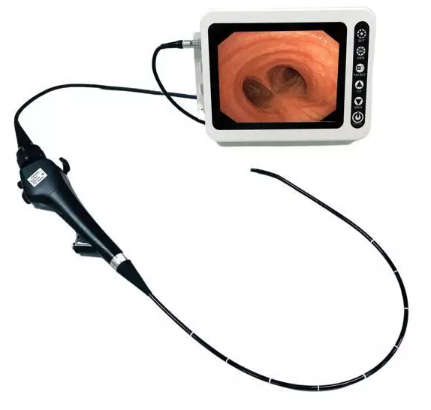
Colonoscopy: is used to examine colon, the scope is inserted through anus.

Slide 8
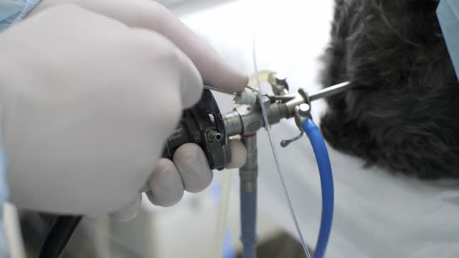
Cystoscopy: is used to examine bladder, the scope is inserted through urethra.

Slide 9
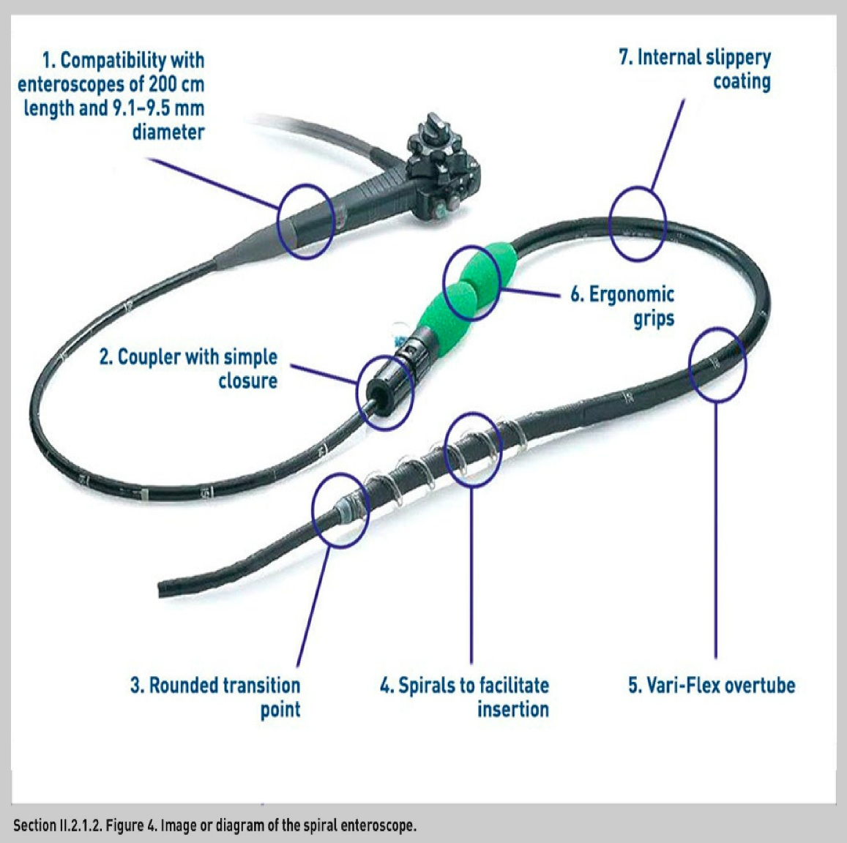
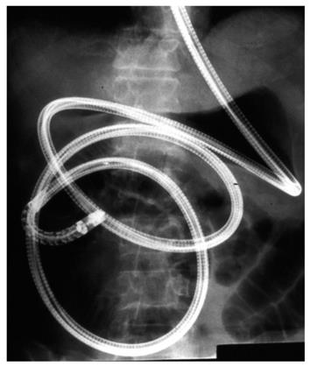
Enteroscopy: is used to examine small intestine, the scope is inserted through mouth or anus.

Slide 10
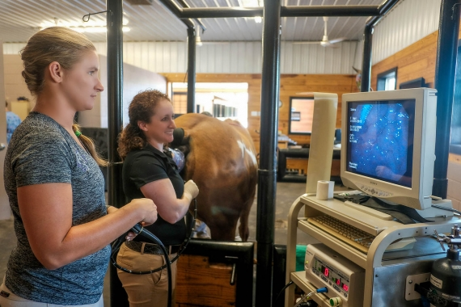
Hysteroscopy: is used for the examining the inside of uterus, the scope is inserted through vagina.

Slide 11
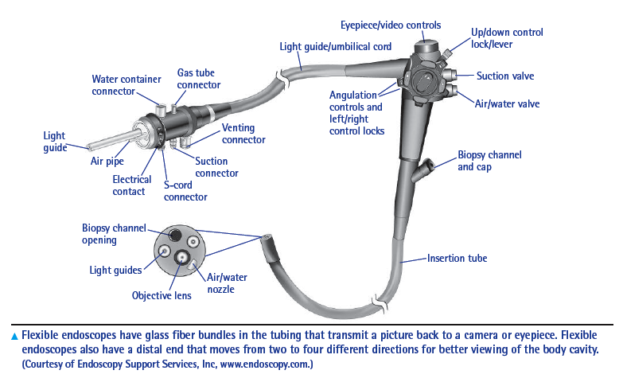
Laryngoscopy: is used to examine voice box, or larynx, the scope is inserted through mouth or nostril.

Slide 12
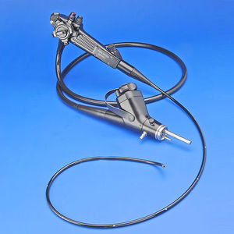
Urethroscopy: is used to examine urethra, the scope is inserted through urethra.

Slide 13
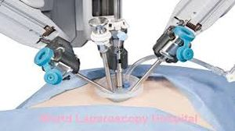
Laparoscopy: is used to examine abdominal or pelvic area, the scope is inserted through a small incision on abdominal wall.

Slide 14
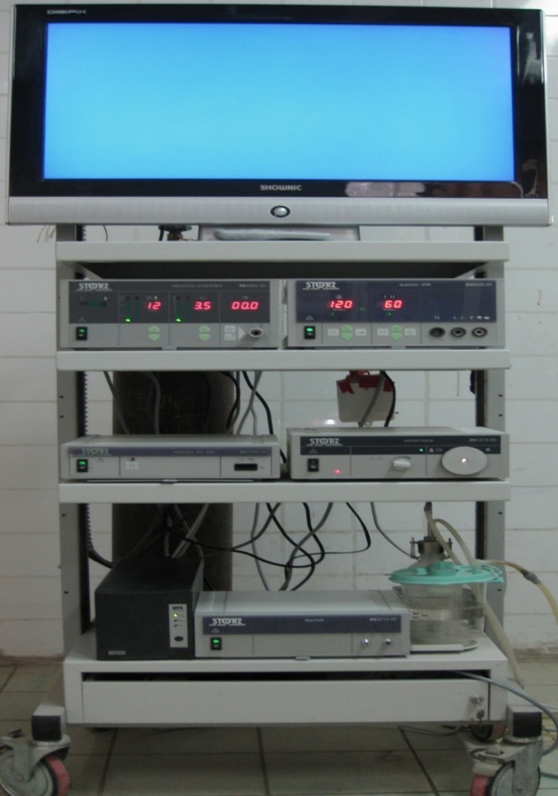
Laparoscopic system
Laparoscopic system consists of:
Monitor,
Insufflator unit,
Electro cautery unit,
DVD video recorder,
Video camera unit,
Light source unit,
Suction and Irrigation unit.

Slide 15
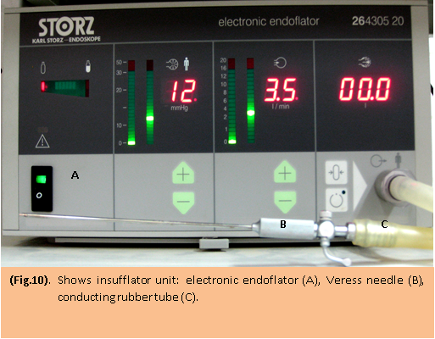
Insufflator:
Laproflator (Insufflator): It was used to create and maintain the desired degree of abdominal distention during laparoscopic procedure. This distention was necessary to provide an operating space between the distal lens of the laparoscope and the viscera being examined, as well as to permit comfortable manipulation of the telescope and instrument within the abdomen. Carbon dioxide gas was used for insufflation, the safe and effective abdominal pressure is 8- 12 mm. Hg.

Slide 16
Pneumoperitoneum
To observe abdominal organs and inserted the trocars and cannula safely, pneumoperitoneum should be established, this is accomplished by Veress needle with connection to a CO2 insufflation tube which is connected to an automatic gas insufflator.
One of the most gases used in an abdominal insufflation is CO2, which has a wider margin of safety with respect to gas emboli, high solubility in blood, expired in the lung and not explosive, for these reasons CO2 is chosen over room air, oxygen and nitrogen oxide.

Slide 17
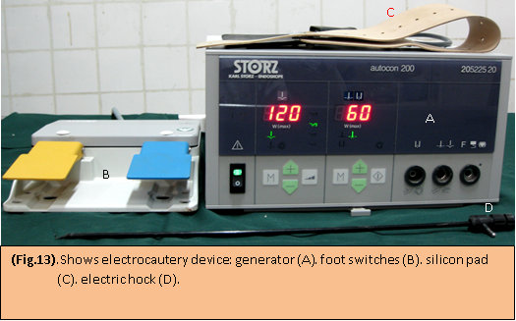
Electrocautery circuit: which is consisted of generator, foot switches (coagulation and cutting switches), active electrode (Silicon pad) and hock.

Slide 18
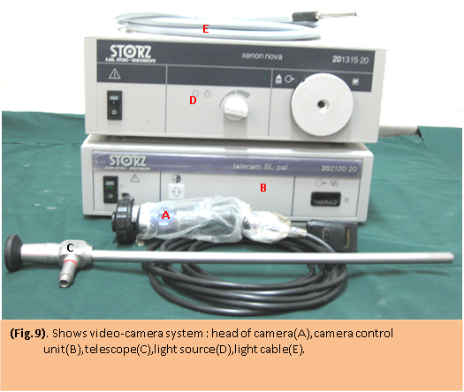
Camera unit and light source

Slide 19
Camera unit and light source
The camera transmits an image of the organs inside the abdomen onto a television monitor. The video camera becomes a surgeon’s eyes in laparoscopic surgery. The camera consisted of two parts; the head of the camera that was attached with the eye piece of telescope, and the camera control system. The camera was focused before inserting inside the abdominal cavity
Light source: A good Laparoscopic light source should emit light as much as possible near the natural sun light. Light source used was xenon nova (175 w), xenon has more natural color spectrum and a smaller spot size than halogen. It was regulated by a manual adjustment for better viewing.

Slide 20
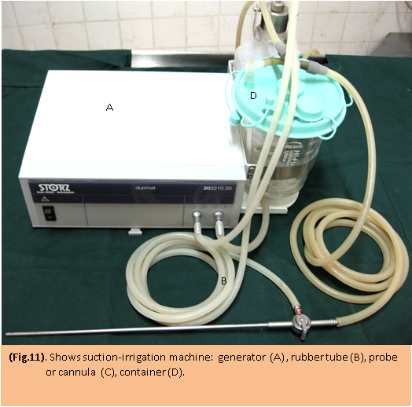
Suction irrigation machine:
It was used for flushing the abdominal cavity and cleaning during endoscopic operation. The suction irrigation machine was used frequently at the time of laparoscopy to make the field of vision clear. Most of the surgeons use normal saline or ringer lactate for irrigation.

Slide 21
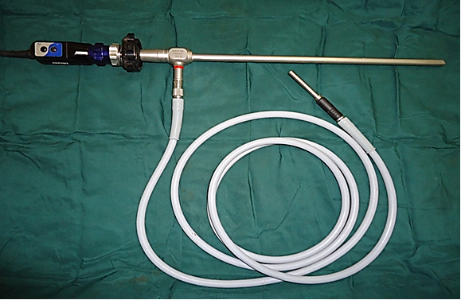
Telescope:
Rigid telescopes, its diameter was 10 mm, with length 33 cm and it was telescope 30 degree.

Slide 22
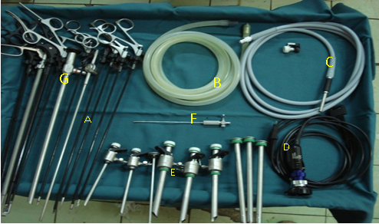
Laparoscopic instruments:
Graspers scissors (A),
CO₂ tube (B),
Light Cable (C),
Head of camera (D),
Trocars and cannulas (E),
Veress needle (F),
Telescope,(G).

Slide 23
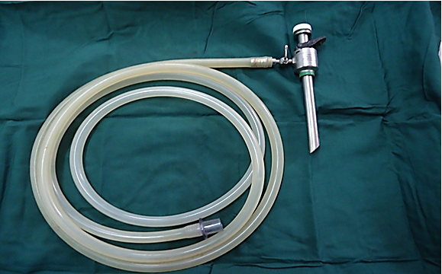
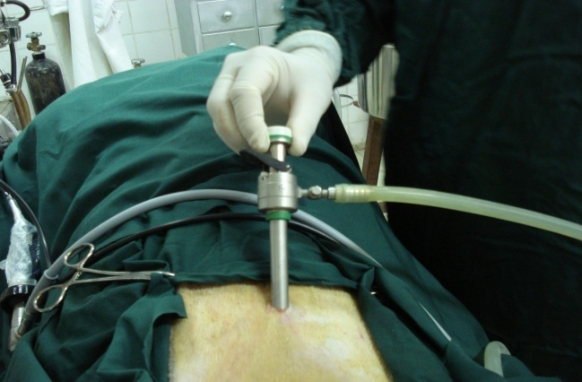
Port and Co2 tube
Port inserted in umbilical
area

Slide 24
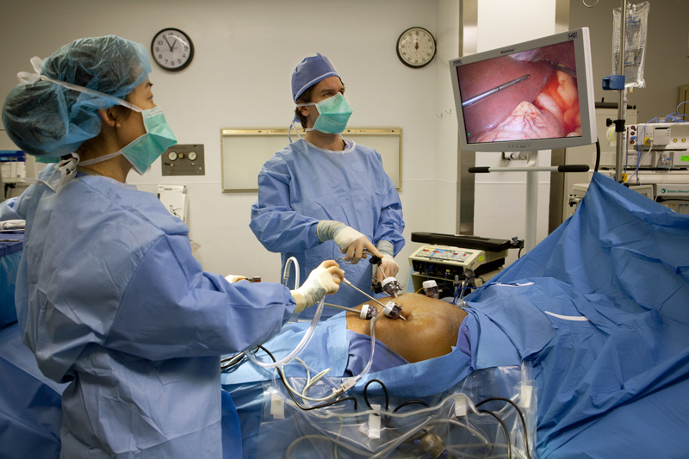
A laparoscope connected to a video camera is inserted into abdominal cavity and the surgical field is visualized on high resolution video monitors in the operating room. Long thin surgical instrument are inserted through the other small incisions and the surgeon performs the surgery by watching the video monitor.
Many examples of laparoscopic surgery include:
gallbladder excision, appendectomy, ovariohysterectomy, hernia repair,
intestinal surgery, general exploration, repair of esophagus achalasia,
liver resection and lung biopsies.

Slide 25
Advantages:
1. Reduced hemorrhage, which reduces the chance of needing a blood transfusion.
2. Smaller incision, which reduces pain and shortens recovery time, as well as resulting in less post-operative scarring.
3. Less pain, leading to less pain medication needed.
4. Hospital stay is less, and often with a same day discharge which leads to a faster return to everyday living.
5.Reduced exposure of internal organs to possible external contaminants thereby reduced risk of acquiring infections.

Slide 26
Disadvantages:
1. While laparoscopic surgery is clearly advantageous in terms of patient outcomes, the procedure is more difficult for the surgeon when compared to traditional, open surgery.
2. The surgeon has limited range of motion at the surgical site resulting in a loss of dexterity.
3. Poor depth perception.
4. Surgeons must use tools to interact with tissue rather than manipulate it directly with their hands. This results in an inability to accurately judge how much force is being applied to tissue as well as a risk of damaging tissue by applying more force than necessary.
5. The tool endpoints move in the opposite direction to the surgeon's hands.

Slide 27
Complications:
I. Hemorrhage:
Difficult to control laparoscopically and may lead to CO2 embolization therefore the hemorrhage may be responsible for the majority of conversion to open approach
2. Cardiac and Blood Flow Problems:
Generally, blood flow to the abdominal viscera, including the gut, liver and kidneys all are decreased during laparoscopy. Pneumoperitoneum relates to mechanical pressure up on the vena cava, which is lead to reduce filling pressure within the heart, also potentially reducing blood pressure; these effects can be modified by extremes position, which are important in laparoscopic surgery.
3. Subcutaneous Emphysema:
Subcutaneous emphysema increase the area for CO2 diffusion which can result in significant hypercarbia and respiratory acidosis, this emphysema resolved soon after abdominal deflation, if emphysema extends to the chest wall and the neck, the CO2 can track to the thorax and mediastinum thereby resulting in pneumothorax.

Slide 28
Complications:
4. CO2 Embolization:
CO2 embolism is rare but serious complication of laparoscopic approach and may be occurring accidentally during initial insufflations.
5. Wound Infection:
It is currently limited in laparoscopic surgery because laparoscopic approach utilizing small incisions that may be sutured or sealed with wound glue. Cosmetic results were excellent and patient satisfaction was high as no sutures had to be removed, glue application is easy and quick.
6. Port Hernia: If the primary cannula is withdrawn with its valve closed, it is possible to draw a piece of omentum in to umbilical wound by the negative pressure. Incisions greater than 7mm should be sutured in layers.
7. Adhesion Formation: Adhesions were extensive in the open surgery compared with laparoscopic surgery.

