Slide 1
Teat and Udder Surgery
By
Dr. Sinan Adnan

Slide 2
Anatomy
The udder of the cow and buffalo has four quarters each of which is a separate unit.
Each quarter is an independent compartment.
Affection of one quarter does not necessitate the involvement of the other quarters.
In buffaloes, the anterior teats are shorter than the posterior. In cow, the teats of the anterior quarters are longer than the posterior. This makes the anterior teats of the cow and the posterior teats of buffaloes more prone to injuries.
The udder in sheep and goat is composed of two halves, right and left.
Most of surgical procedures of the udder and appendages performed on the bovine are the same adopted on small ruminants and other large species.

Slide 3
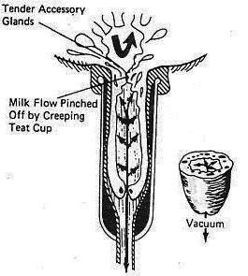
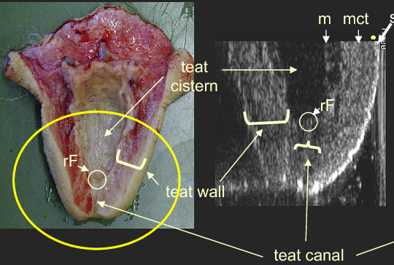
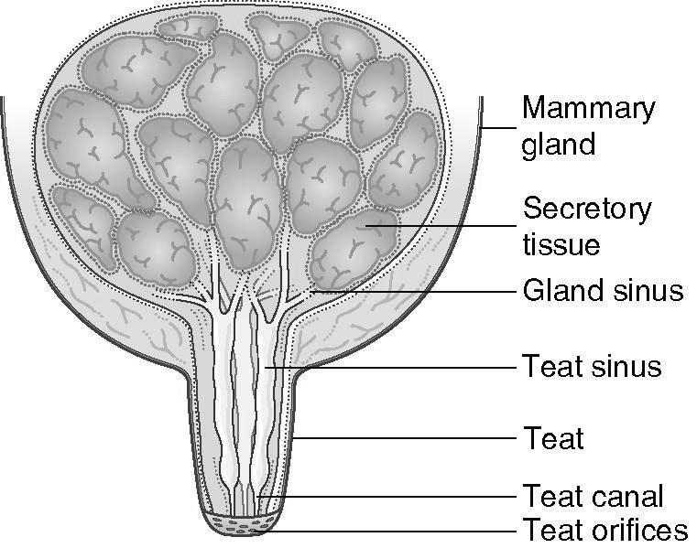

Slide 4
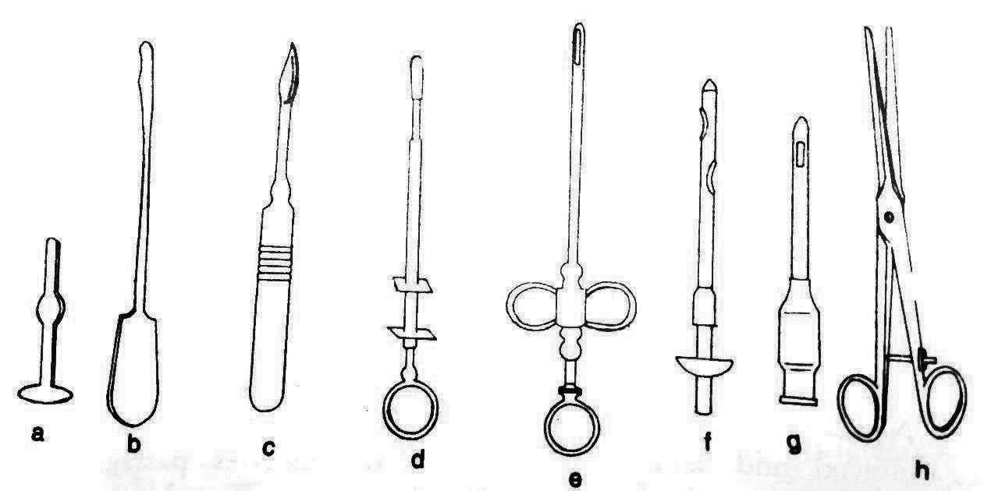
Teat Instruments
a- Teat plug b- Teat bistoury c- Lichty teat knife with sharp point
d- Teat tumor extractor e- Teat slitter f- Udder infusion tube
g- Milk tube h- Teat scissors

Slide 5
Blind teats
This condition may be congenital or acquired due to any trauma near the teat sphincter.
Such cases generally reported just after parturition on palpation milk thrill found in teat cistern on pressing.
Milk passed backward toward udder cistern. Imperforated teat (blind teat) treated by 15 gauge needle, after creating opening, it is further dilated using huge teat tumor extractor, milk cannula fixed for 24 hour after that frequent milking advised at 4 to 6 hours Intervals to prevent adhesion.
Administration of proper antibiotics is done for a minimum period of 3-5 days.

Slide 6
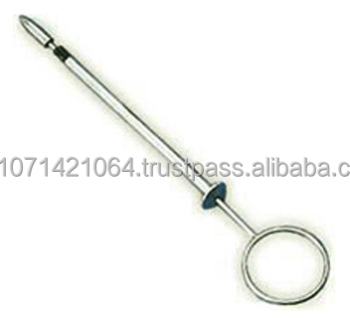
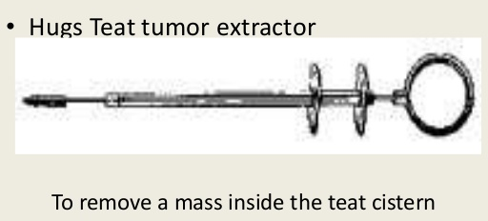
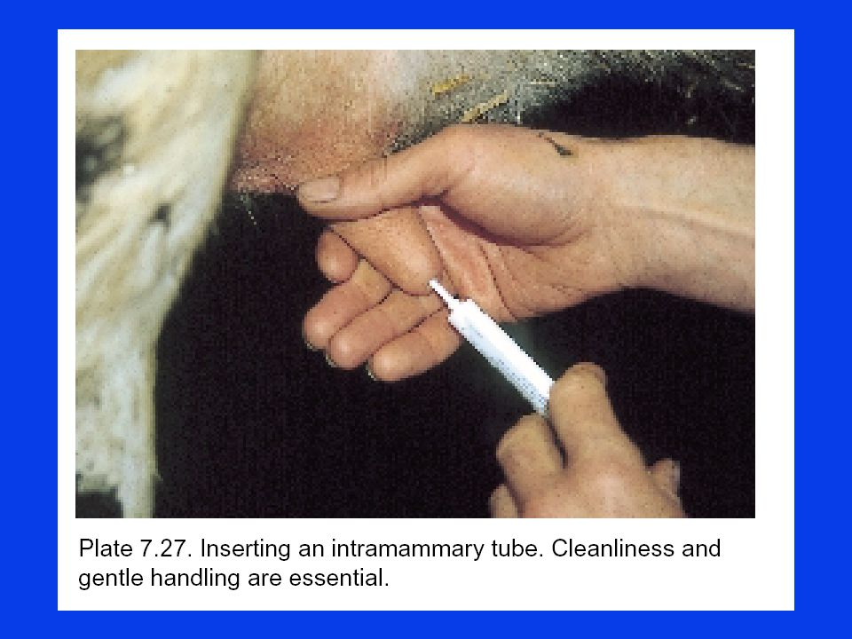
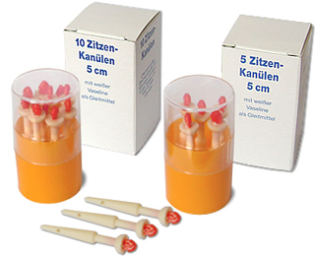

Slide 7
Lactolith calculi of the teat canal (milk stone) = Lactiferous Calculi (Milk Stones)
Milk stone are formed into the teat canal when the milk is rich in minerals and salty in taste.
Lactolith is usually not attached , moves freely in the teat canal, and hinder (delay) the milk flow. It obstructs only when it is lodged at the orifice.
It may be removed by milking out via the orifice.
In case of large calculus, it is crushed by passing a mosquito or alligator forceps and milked out.
In case it is too hard and large, teat sphincter is slit by inserting a Lichty teat knife or teat bistoury and calculus is milked out.
A Larson teat tube is inserted and left in place for 5 to 7 days, and milking can be removing the cap of the tube.

Slide 8
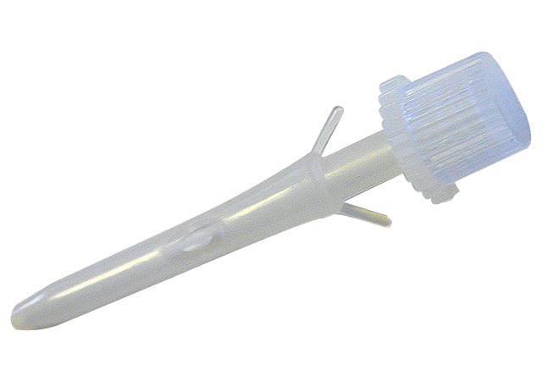
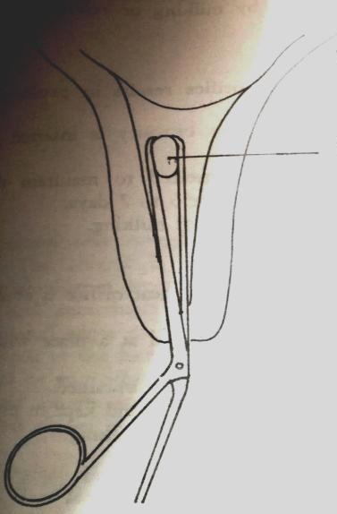
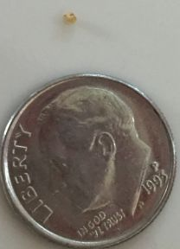
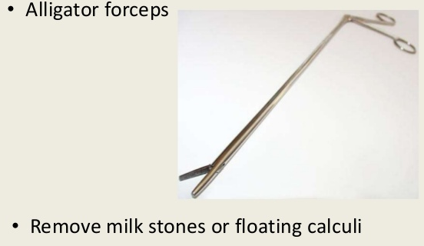

Slide 9
Teat Fistula
The term, teat fistula, refers to an opening in the wall of the teat, connecting the exterior to the pre-existing channel; the teat canal is characterized by persistent outflow of milk.
Such fistula may be congenital or acquired. It is mostly acquired as a result of penetrating wound that extend to the teat canal or cistern and fails to heal completely because of the continuous drainage of milk.
Fistula will vary in size from that one which is so tiny it is difficult to locate to large ones through which the mucous membrane may be seen.

Slide 10
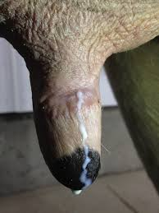
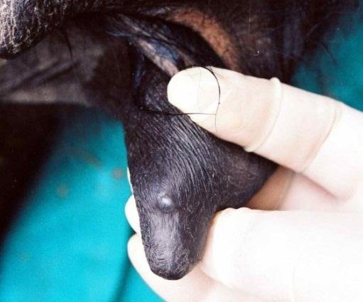
Symptoms:
It characterized by presence of tract and milk coming through it at milking time.

Slide 11
Treatment:
1. Anesthesia can be obtained by a ring block at the base of the teat or local infiltration anesthesia of the wound edges using 2 % solution of xylocaine.
2. The entire area is prepared for aseptic surgery by washing the field of the operation with soap and water, swap with alcohol. Tincture iodine should never be used because of its marked irritant effect.
3. Apply a suitable tourniquet as the rubber tube of the blood transfusion set at the base of the teat or teat band as much high as possible to secure hemorrhage during the operation.
4. The wound edges should be, if necessary, debrided before suturing. If the fistula is old and the tissue around it has healed, the tract should be excised before suturing.
5. Apply a teat siphon to guard against injuring tissues of the other side and to avoid excessive trimming.

Slide 12
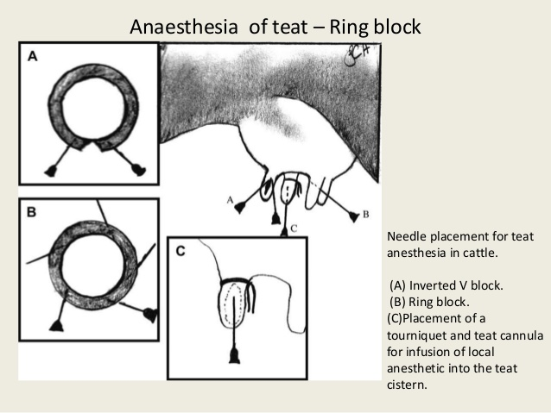
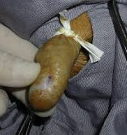

Slide 13
6. The teat fistula is then sutured after dusting the site with an antibiotic powder.
7. The suture is carried out in two rows including all layers with the exception of the mucosa using non-absorbable, non-capillary suturing material. A vertical mattress or similar stitch is used to effect the apposition of the edges deep in the tissue and superficially. The apposition must be complete and firmly held in place or milk seepage will cause the fistula to recur.
8. A teat bougie is applied to prevent adhesion of both sides of the teat cistern.

Slide 14
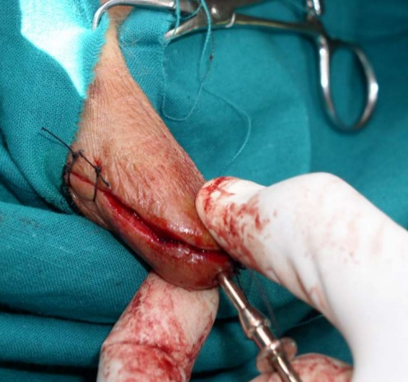
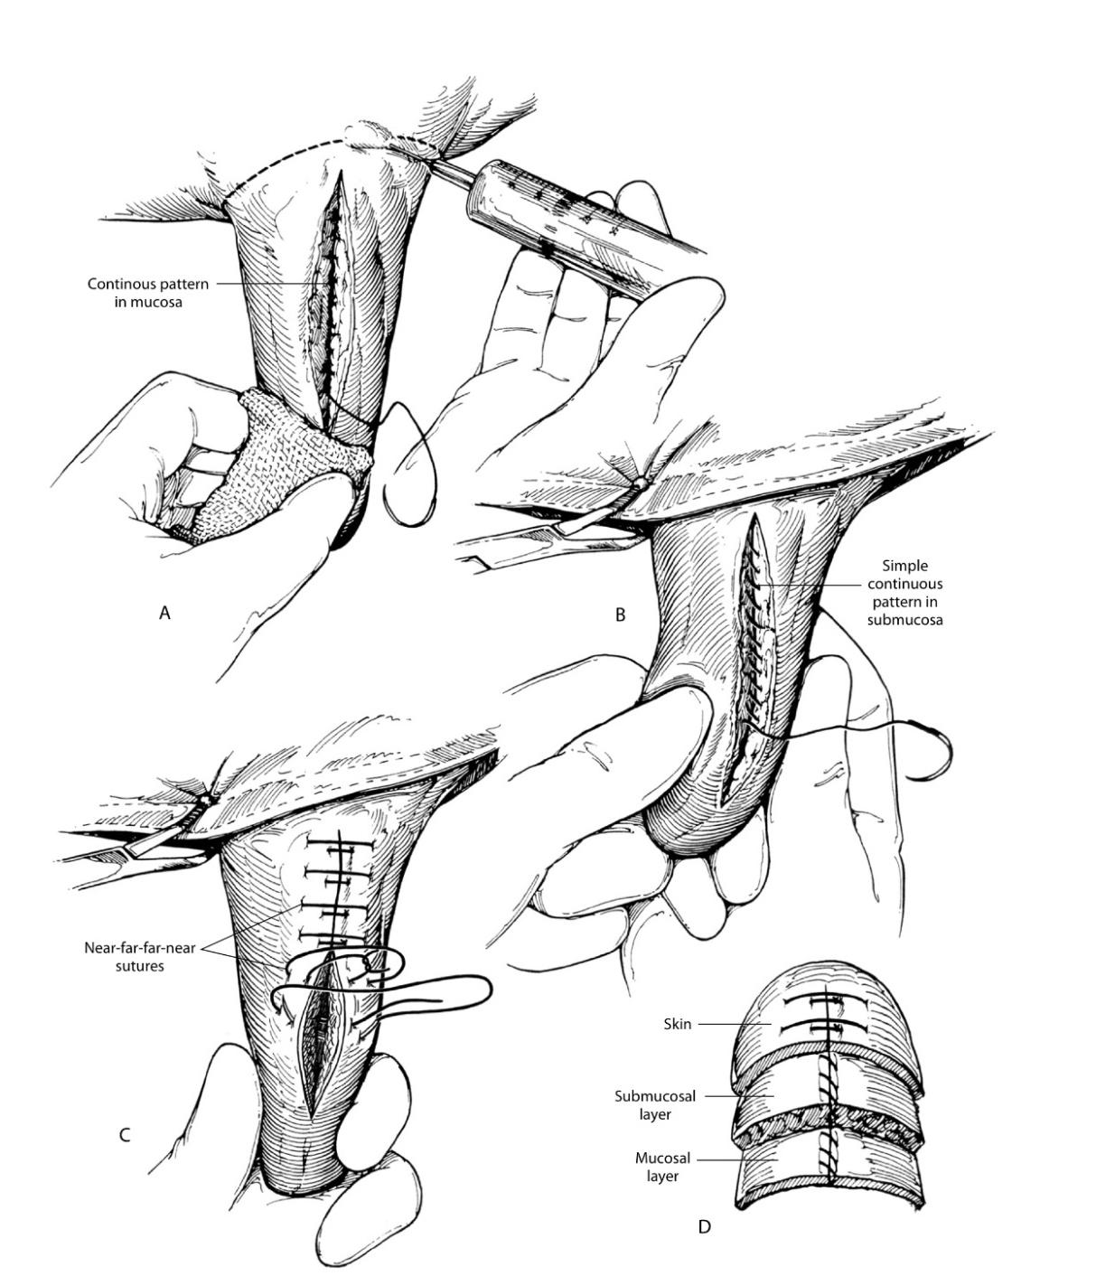
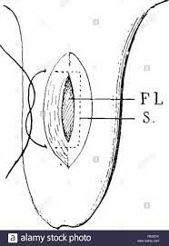

Slide 15
9. An elastic adhesive bandaged is wrapped around the teat to reduce milk pressure on the sutures, to protect the wound.
10.The tourniquet is then removed. The stitches may be removed in 10-14 days post operation. Remove the bandage after 5-7 days. Siphon the milk (2-3 days).
11.Intra-mammary infusion of broad-spectrum antibiotic ointment to guard against mastitis.
Care must be taken that it is contraindicated to carry out such surgery if mastitis is supervening or the lips of the wound are edematous. This should be first treated before the surgery.

Slide 16
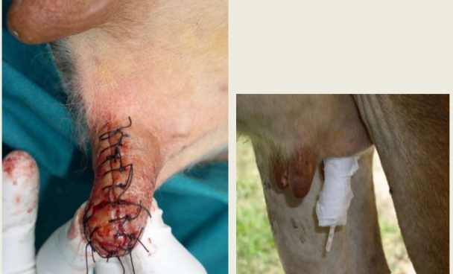

Slide 17
Mastectomy
means udder amputation or remove of the mammary gland.
Indication:
1. Chronic mastitis not responded to treatment.
Gangrenous mastitis it may affect one or more of the quarters of the udder.
It’s likely as a result of clostridia or E. coli bacterial affection causes complete necrosis of the udder and teat tissue.
2. Udder tumors.
3. Rapture of the suspensory ligament.
4. Keep the cow for breeding purpose.
5. Keeping the cow as a donor in embryo transfusion before slaughtering for meat healthy for human consumption.

Slide 18
Preparation of the patient:
Off food 24 hours prior to the operation and water few hours before the operation.
Sedation or muscle relaxant to restraint the animal.
Insert the stomach tube.
Insert the endotracheal tube.
Put the animal in the lateral position or in the semi dorsal position, with the hind limb distended.

Slide 19
Prepare the fluid therapy and the blood (to prevent shock due to great loss of the soft tissues and blood).
Prepare the site of operation by clipping, shaving, wash with soap and tap water, and disinfect the site of operation.
Cover all the body with sterile drapes except the field of operation (surgical incision).

Slide 20
Type of anesthesia:
Local anaesthesia:
Infusion with local anesthetic, inverted V- block, ring block.
Regional anaesthesia:
Perineal nerve block may be used for surgery on the caudal teats and the udder.
Epidural anaesthesia: may be used as an alternative to local anaesthesia for teat surgery in cows
Lumbar Paravertebral anaesthesia: (blocking L1, L2, and L3) may be used in the standing cow.
General anaesthesia: This is occasionally indicated for teat surgery

Slide 21
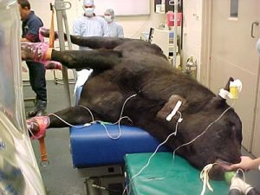
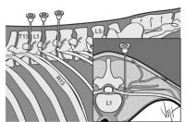

Slide 22
Surgical procedures:
Make surgical incision at the midline caudal to the base of mammary gland then cranially at the mammary base.
Then the skin separated bluntly from the lateral side of the body, (leave skin flap to cover the area after udder amputation).
Find the blood vessels then stop bleeding by two transfixing sutures using no. 1 non absorbable suture materials then fold the end for more secure from bleeding (pudendal artery and veins, perineal artery and veins, and large subcutaneous veins).
Cutting the suspensory ligaments (two laterals and one middle).
Repeat the same technique in the other side of the body.
Remove the mammary gland, Suture the skin flaps to the body with non capillary non absorbable suture materials no.1or 2 (don’t leave space or sinuses) to prevents the infection. The site heals by granulation tissues.

Slide 23
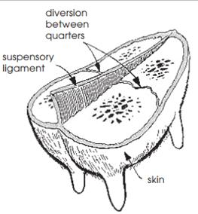
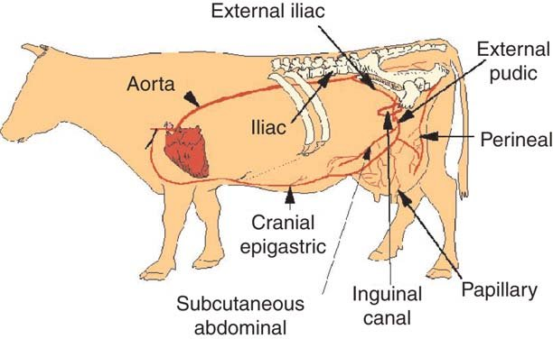

Slide 24
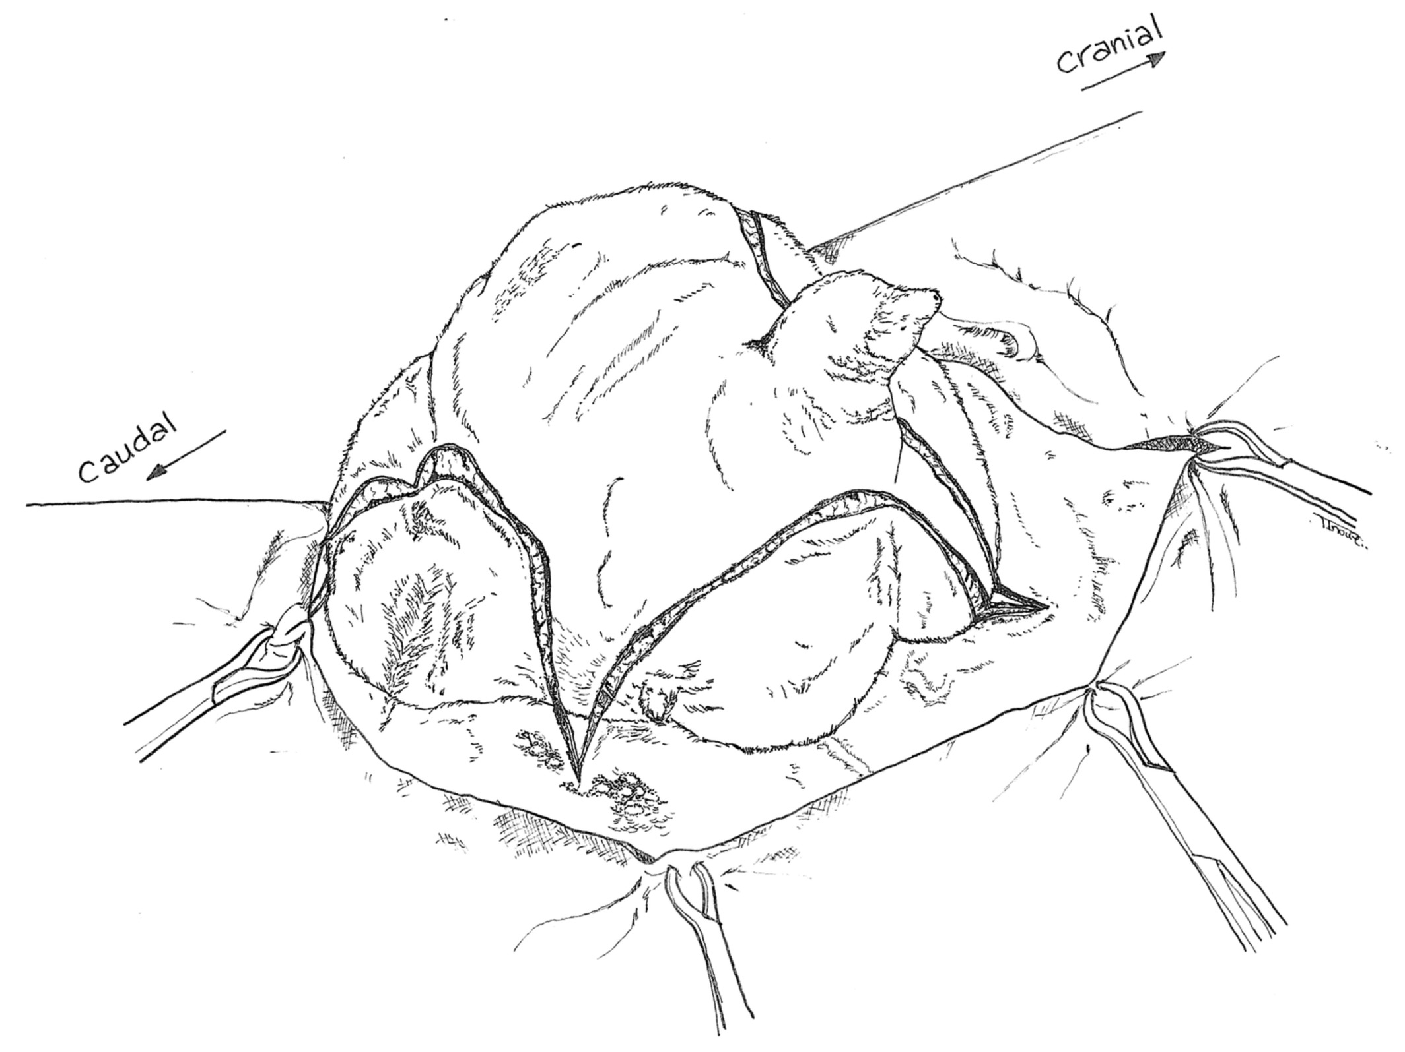
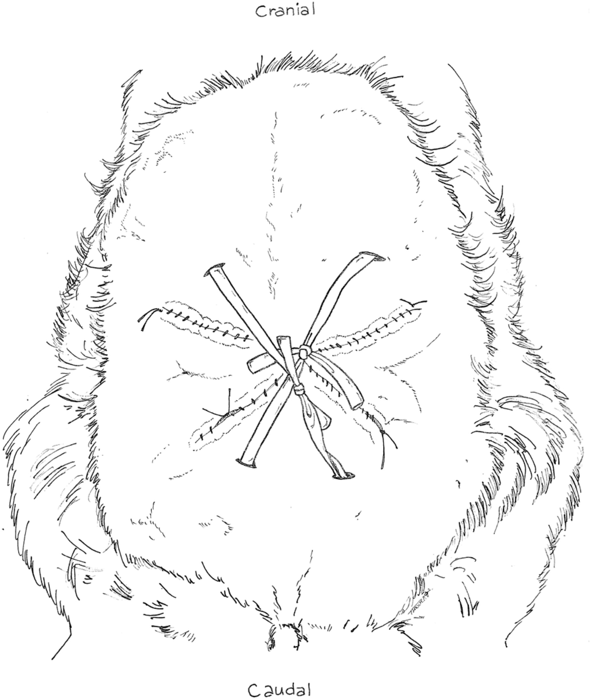

Slide 25
Post operative care :
Daily check the sight of operation (from inflammatory signs, rupture of the stitches, hernia, hematoma, stitches abscess).
Give local treatment to the site of incision and Pain killer daily.
Inject the animal with systemic antibiotics for 3-5 days.
Keep the animal away from others animals in clean stable.
Remove the sutures materials 7-10 days post operation.

Slide 26
Complication of the operation
1. Bleeding.
2. Abscess and Stitches abscess.
3. Subcutaneous emphysema.
4. Hernia.
5. Adhesion.
6. Infections and Dead occurs duo to shock.

