Slide 1
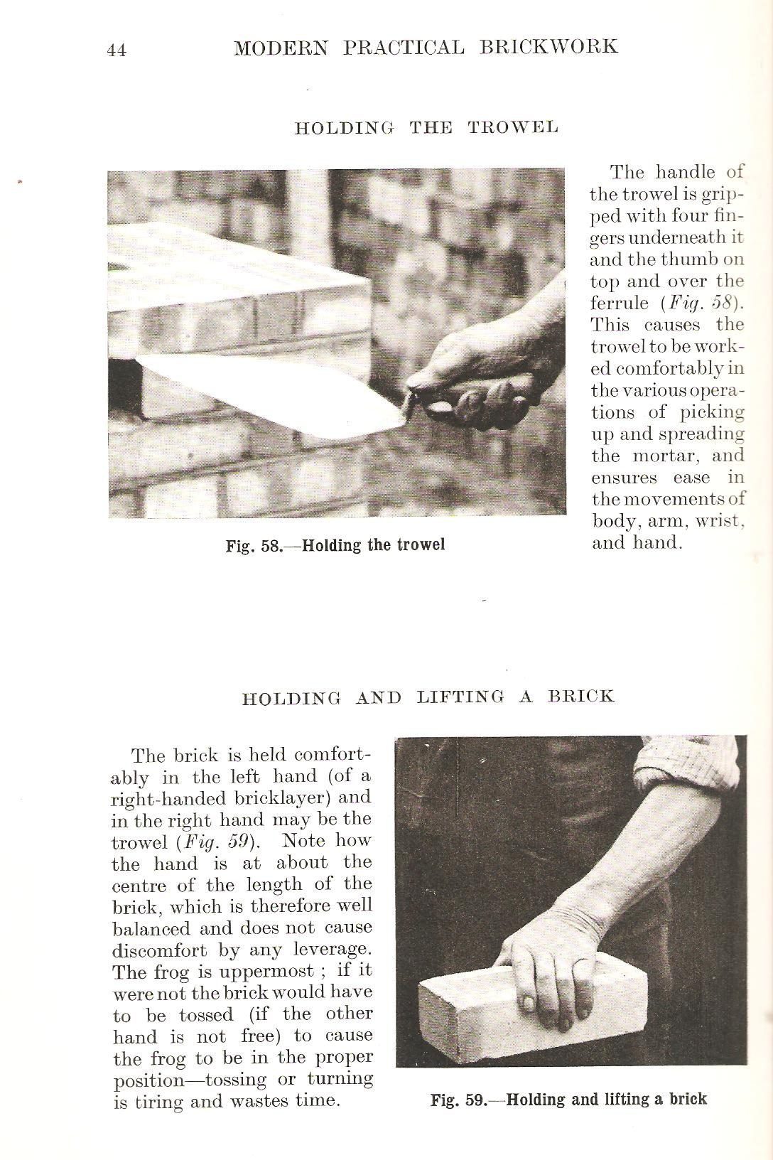
Building construction 1
Why do we study Building construction?
This is to know the available building materials and construction principles and to choose the best and most economically and environmentally appropriate method for the building fabric to perform its role in the best possible way.
2025-2026
Teacher: PhD Maysaa Izyara Mohammed
ا

Slide 2
Module Aims, Learning Outcomes and Indicative Contents
Introducing the student to some aspects of technical systems related to building information that the architect must know to develop his design and construction capacity. This course deals with the basic concept of Building Construction and Simple types of building construction are introduced to the students.. To understand how foundations, structural plans, and sections are working and drawing. This is the basic subject for all simple concrete floors and roofs, detailed sections in buildings To understand how load-bearing walls and Jack are working To understand buildings including doors and windows, stairs and partitions

Slide 3
Module Descriptor form

Slide 4
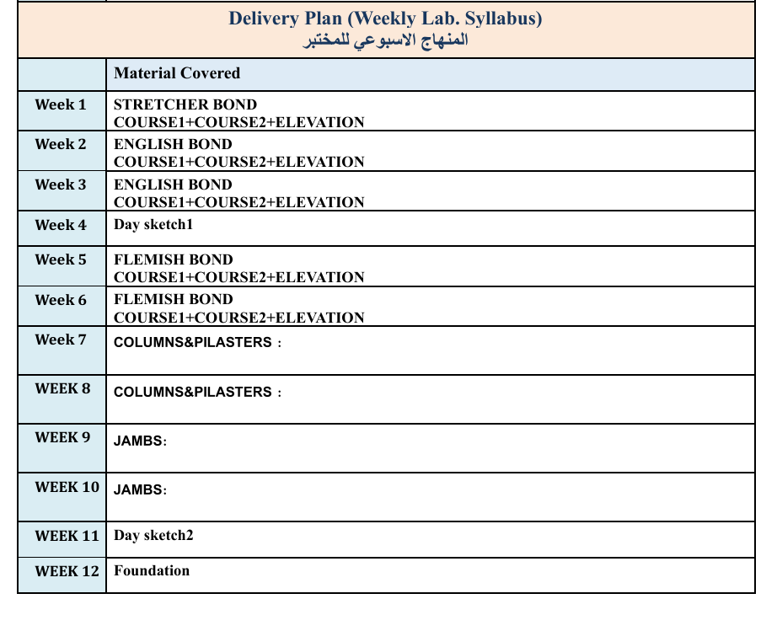
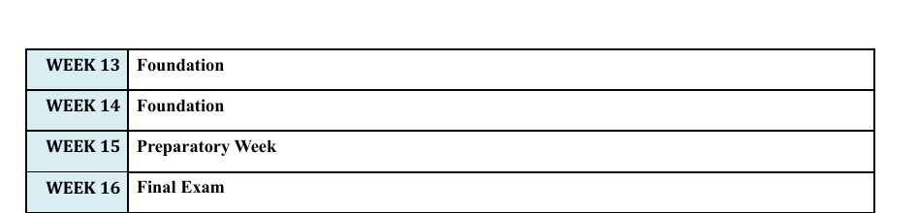
Delivery Plan

Slide 5
References
المصادر العربية:
انشاء المباني/عاطف السهيري-1991
انشاء المباني /ارتين ليفون-زهير ساكو1983
تركيب المباني -الجدران الحاملة وتفاصيلها المعمارية(الفصل الاول)/أنيس جواد سلمان 1989
المصادر الانكليزية:
Mitchell's Elementary Building Constriction / Raymond motley /1959.
Building Craft series: brickwork/w. b. ma Kay/1945.
Building Construction Details /Practice Drawings/Hans bans\1983
New Architecture and Technology /Gylula Sebastian/2003
Mitchells –introduction to the building -3rd edition2002
Building construction W.B.M cKay
● Building construction R Berry
● Building construction Chudley Building construction Francis D.K. Ching.

Slide 6
Structure VS Construction
Structure
Construction

Slide 7
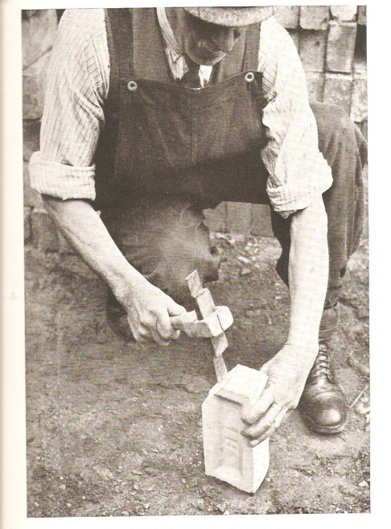
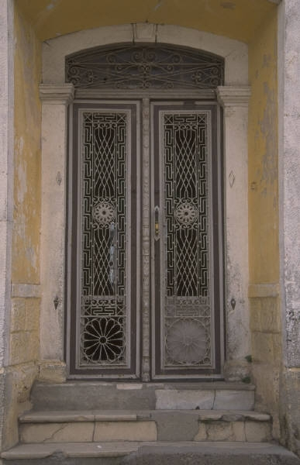
What are structural (functional) elements?
Wall
Floor
Upper floor
Roof
Staircase
Foundation
It is implemented in the form of:
1- Building units (bricks, concrete blocks)
2- Different sections (iron sections, aluminum sections)
3- Integrated composite units (door, window)

Slide 8
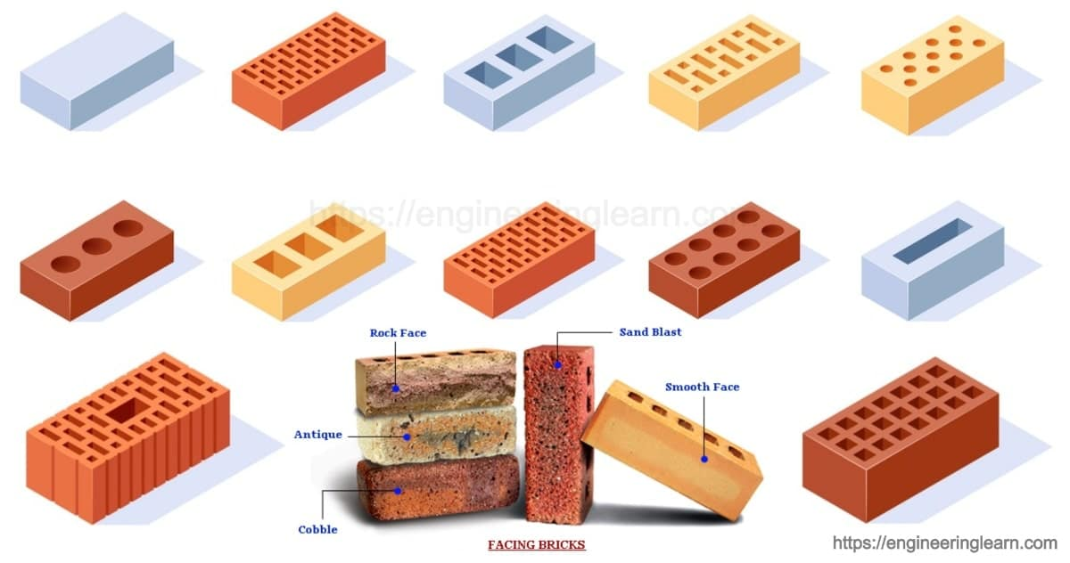
Types of bricks are classified based on the material they are made of:
Glass brick
Lime brick
Clay brick
Glazed brick
Yellow brick
Sand brick
White brick
Red brick
Faience brick

Slide 9
Depending on the density of the material
Types of brick depending on the density of the material
Solid brick
Hollow bricks
Perforated brick

Slide 10
Building:
The basic function of a building is to enclose or surround space to provide an internal environment suitable for human activities and conditions suitable for the comfort of its occupants.
Construction process:
It is giving the physical shape to the envelope surrounding the spaces inside the building.
It includes two main and overlapping activities:
Design activity
Production activity (implementation)

Slide 11
What are the most important construction methods?
(Classification of facilities according to construction methods)
1- Traditional Building:
Depends on craftsmanship.
Design and implementation activities are separate.
Useful for small projects.

Slide 12
What are the most important construction methods?
(Classification of facilities according to construction methods)
2- Post Traditional Building:
Some parts are prefabricated, especially the structural frame.
Design and implementation activities are less separate.
Useful for larger projects.

Slide 13
What are the most important construction methods?
(Classification of facilities according to construction methods)
3- Rationalized Building:
Integration of design and implementation.
Useful for implementing complex projects.

Slide 14
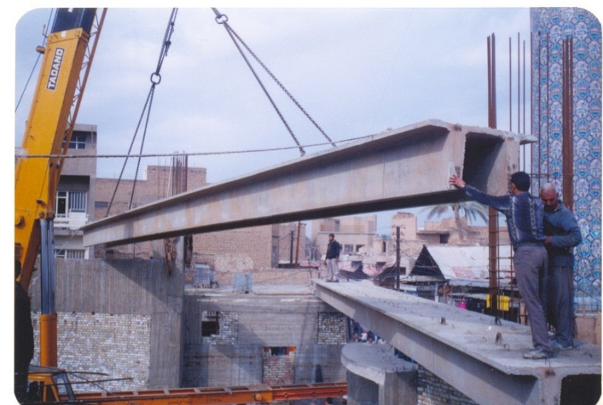
What are the most important construction methods?
(Classification of facilities according to construction methods)
4- System Building :
Integration of design and implementation.
It is useful for implementing more complex and interconnected projects such as schools and residential complexes.

Slide 15
Structure Concepts
(classification of structures in terms of structural systems or concepts - power transmission systems)
Solid Structure System.
Skeletal Structure System .
Surface Structure System.

Slide 16
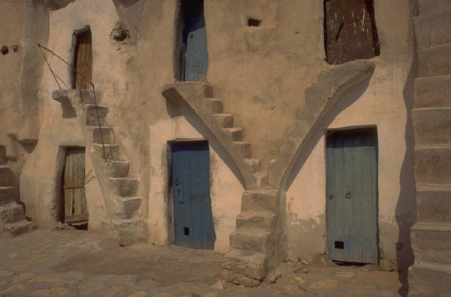
Structure Concepts
(classification of structures in terms of structural systems or concepts - power transmission systems)
Solid Structure System:
This system can with stand
compressive stresses
It relies on heavy walls with
homogeneous masses
Its elements have multiple functions
It is used for buildings with short, limited spans
The percentage of the area used for the walls is greater than the roofed area

Slide 17

Structure Concepts
(classification of structures in terms of structural systems or concepts - power transmission systems)
Skeletal Structure System:
It is used for buildings with short and medium spans.
It depends on clear horizontal and
vertical structural elements that bear
stresses.
The percentage of the area used
by the structural system for the spaces used
is small.
It needs other elements to resist external
conditions such as partitions and facade cladding.

Slide 18
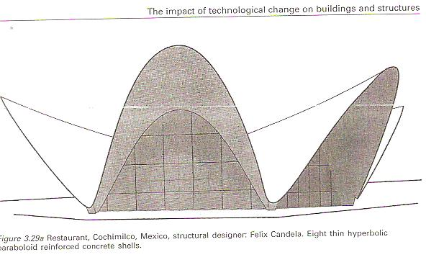
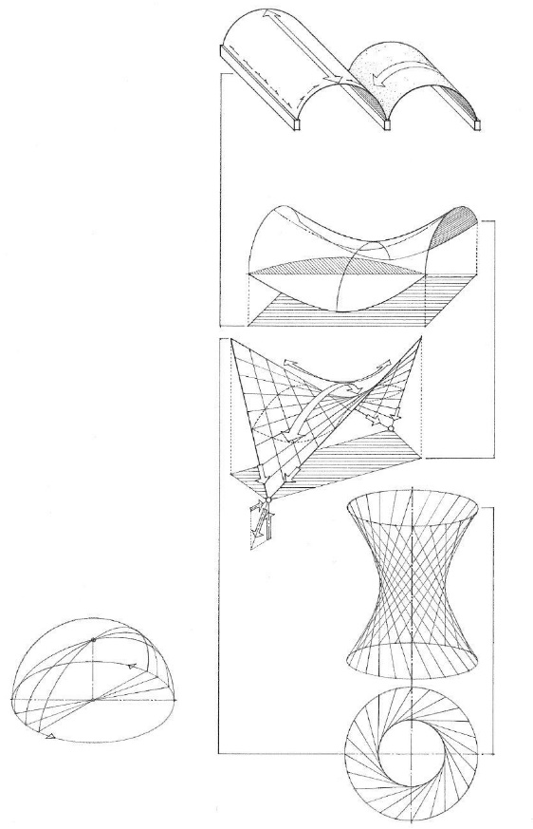

Structure Concepts
(classification of structures in terms of structural systems or concepts - power transmission systems)
Surface Structure System:
It is used for buildings with large
spans and roofing large open spaces.
The wall and roof perform the function
of enclosing the space.
The percentage of the area used by the
construction system for the spaces used
is very small.
The cost of construction and implementation with this system is high and with special specifications.

Slide 19
Structural systems
(classification of structures in terms of spans)
Structures with short spans less than 8 meters
Structures with medium spans from 8-18 meters
Structures with long spans more than 20 meters

Slide 20
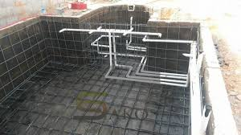
Structural elements the wall
(structural classification of walls according to the stresses exerted on them)
Load Bearing Walls.
Partition Walls.
Retaining Walls.

Slide 21
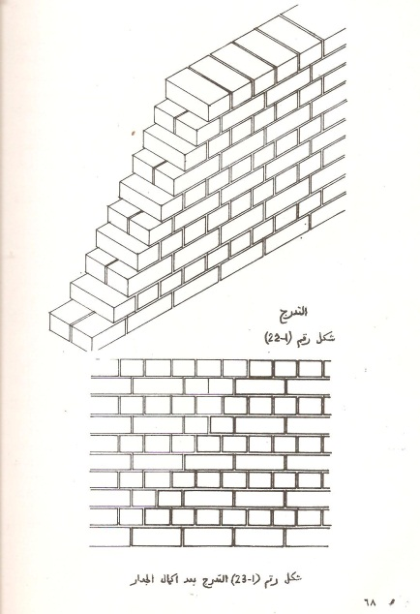
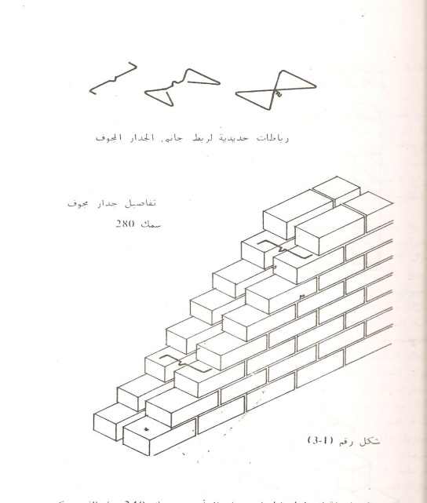
Structural elements
the wall
(Wall classification according to its method of operation or environmentally)
Solid Walls .
Cavity Walls.

Slide 22
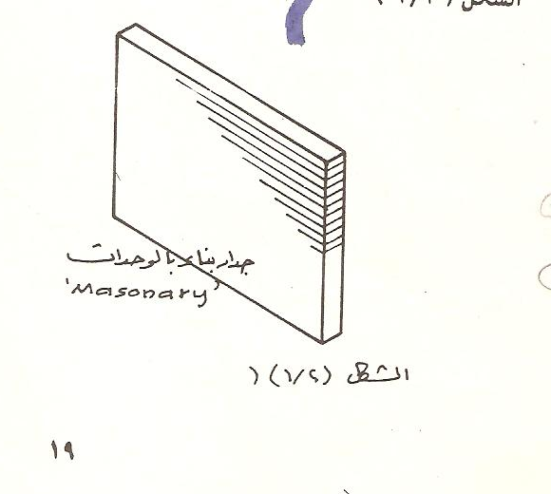
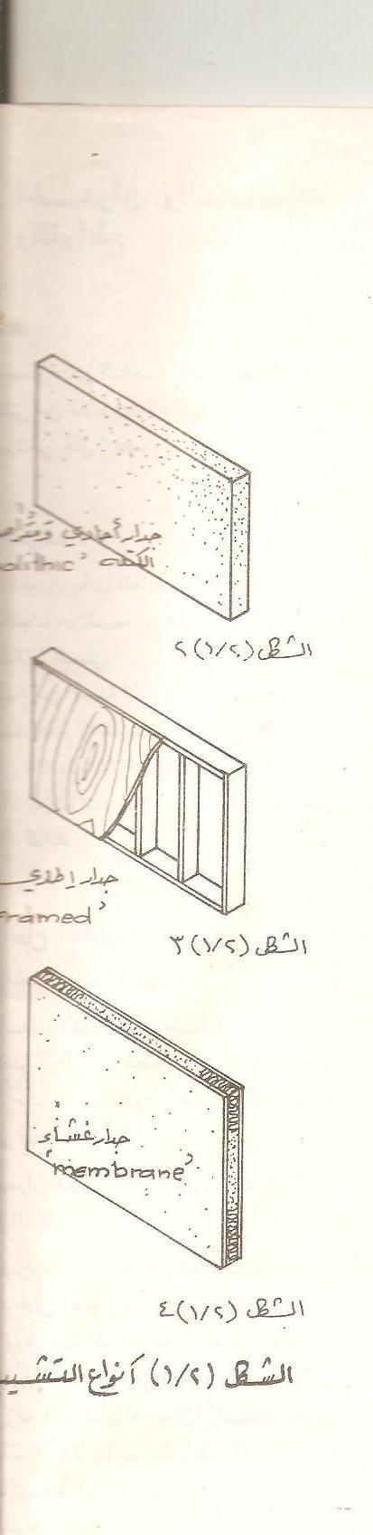
Structural elements
the wall
(Classification of walls according to the method of construction)
Masonry Wall (Brick, block).
Monolithic Wall(Reinforced concrete wall).

Slide 23
Structural elements
the wall
(Classification of walls according to the method of construction)
Framed Wall ( Wooden Partitions).
Membrane Wall (prefabricated walls).

Slide 24
Functional requirements for walls:
1- Durability and stability (stress resistance):
The durability of the wall is measured by its resistance to stresses generated in it as a result of its weight and the loads imposed on it.
The stability of the wall is also measured by its resistance to overturning under the influence of lateral forces and buckling or convexity resulting from excessive thinness.
To provide durability and stability to the wall, we must take into consideration the following:
Determine the correct ratios between the thickness of the wall and its height (slenderness factor).
Determine the correct ratios between the thickness of the wall and its length between the side supports.
Determine the width of the openings to provide sufficient space to transfer the loads to the foundation safely.

Slide 25
Functional requirements for walls
Thermal insulation
Fire resistance
Resistance to climatic factors
Durability and stability
Sound insulation
Safety and resistance to insects and rodents
Functional requirements for walls:

Slide 26
Functional requirements for walls:
2- Resistance to climatic factors:
The wall must be resistant to various climatic factors such as humidity, wind, and dust.
The resistance to humidity and water penetration of the wall is one of the most important points that must be available in the wall and it must meet several conditions, the most important of which are:
Ensuring limited water penetration in the thickness of the wall, allowing rainwater to be absorbed by the wall and then evaporate after the weather conditions improve.
Preventing any water penetration through the outer surface.
Preventing or breaking the continuity of capillary channels in the thickness of the wall.

Slide 27
Functional requirements for walls:
3- Fire resistance:
The wall must be fire resistant as it is expected to be an effective barrier against the spread of fire.
Walls are also used to divide spaces into sections that facilitate confining fire.
The fire resistance of the building is determined in light of the following considerations:
-Type of use.
-Area, height, capacity and volume of the building.

Slide 28
Functional requirements for walls:
4- Thermal insulation:
The wall must be characterized by heat insulation and its transfer through it.
The most important methods of heat transfer are:
Conduction.
Convection.
Radiation.
To prevent heat transfer through the structural elements into the building or vice versa, there are two protective lines:
The first protective line:
It is the shape of the external surfaces of the structural elements.
The second protective line:
It is choosing the appropriate materials to absorb heat and re-radiate it.

Slide 29
Functional requirements for walls:
5- Sound insulation:
The wall must be characterized by sound insulation and sound transmission through it.
The most important ways of sound transmission in construction are:
Airborne sound, and we need a mass to isolate the sound.
Sound transmitted by the vibration of the structure, and we need a structural separation to reduce it.
6- Safety and resistance to insects and rodents.

Slide 30
Clay Brick Making
Manually made bricks.
Semi-mechanically made bricks.
Modern mechanically made bricks.
Physical properties of bricks:
Among the properties of a good brick is that it is solid, does not shatter when broken, does not crumble under the influence of water, has sharp edges, right angles, parallel faces, and is free of foreign materials, in addition to:
1-Salt content less than 0.5%.
2-Porosity does not exceed 23%.
3-Thermal insulation.
4-Sound insulation.

Slide 31
Flaws of Brick
1- Irregular dimensions.
2- Cracking and breakage.
3- Blossoming and peeling.
4- Lack of complementary parts for bricks.

