Slide 1
The Tenses & Compound Words First Lecture
Baghdad University Class 4th Year
College Of Education Ibn al-Haytham Subject. English Language
Dept. Computer Science Year: 2022-2023
Lecturers : Shahlaa Talib & Sameer Sami

Slide 2
The Tense System
Verb tenses tell us how an action relates to the flow of time. There are three main verb tenses in English: present, past and future. The present, past and future tenses are divided into four aspects: the simple, progressive, perfect and perfect progressive.
Present Simple I do | Past Simple I did, I did do | Future Simple I will do
Present Continuous I am doing | Past Continuous I was doing | Future Continuous I will be doing
Present Perfect I have done | Past Perfect I had done | Future Perfect I will have done
Present Perfect Continuous I have been doing | Past Perfect Continuous I had been doing | Future Perfect Continuous I will have been doing

Slide 3
Here is a list of rules of these tenses with examples:
 | Simple Forms | Progressive Forms | Perfect Forms
PRESENT | Ist form + s / es | am/is/are + Ist form + ing | have/has + IIIrd form
PAST | IInd form | was/were + Ist form + ing | had + IIIrd form
FUTURE | will/shall + Ist form | will be + Ist form + ing | will have + IIIrd form
 | Simple Forms | Progressive Forms | Perfect Forms
PRESENT | I play | I am playing | I have played
PAST | I payed | I was playing | I had played
FUTURE | I shall play | I shall be playing | I shall have played
List of rules
Examples

Slide 4
The Present Simple Tense
To state facts or general truths
To express habits or customs
To relate future plans (often regarding programs and timetables)
To tell jokes and stories or to report sporting events in real time.
Examples of the Present Simple
The sun sets in the west.
We produce lasers for cosmetic surgery.
They move into their new home next week.
So, I go to Mr. D and say “I deserve a better mark in this class”.
Jones stops in mid-court and passes the ball to Schuster.

Slide 5
Homework
Read Jack's introduction. How many verbs in the present simple can you find?
My name's Jack. I'm nineteen years old. I come from Manchester but I live in London. I'm a student and I go to London University. I have two brothers and a sister. I love football! I play every weekend.

Slide 6
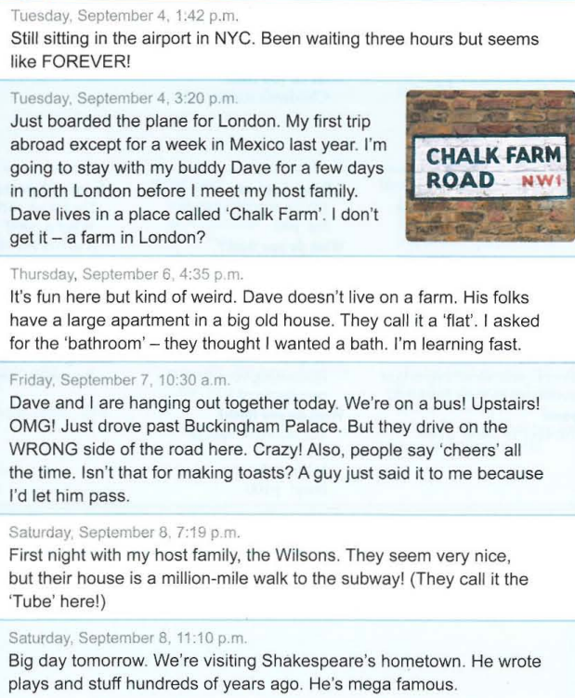
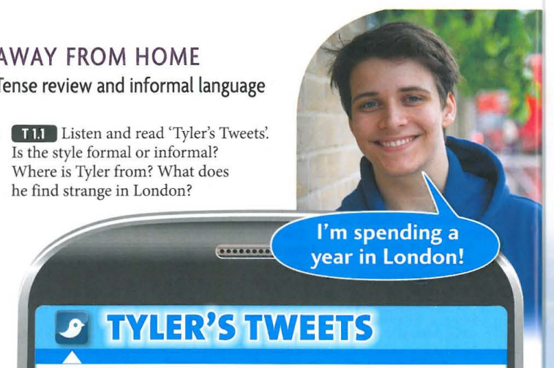

Slide 7
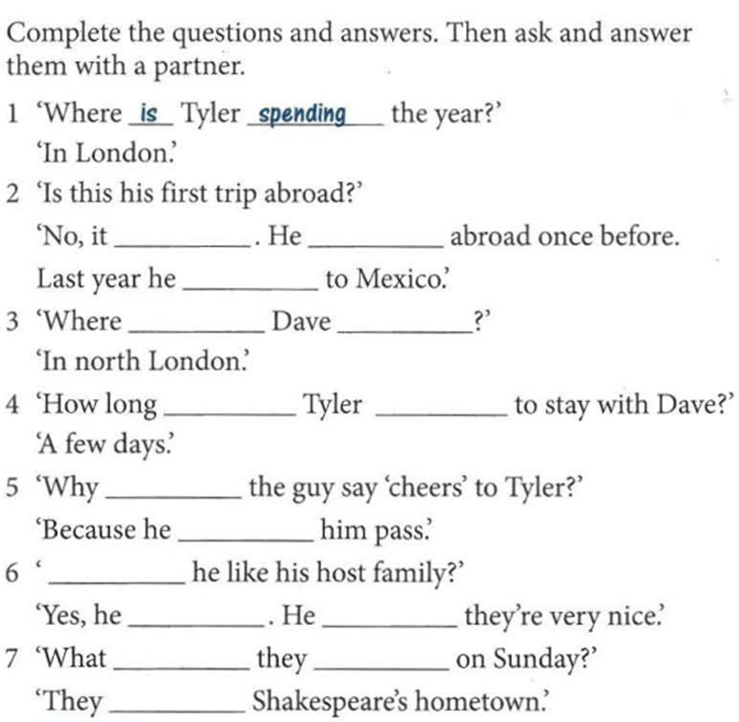


Slide 8
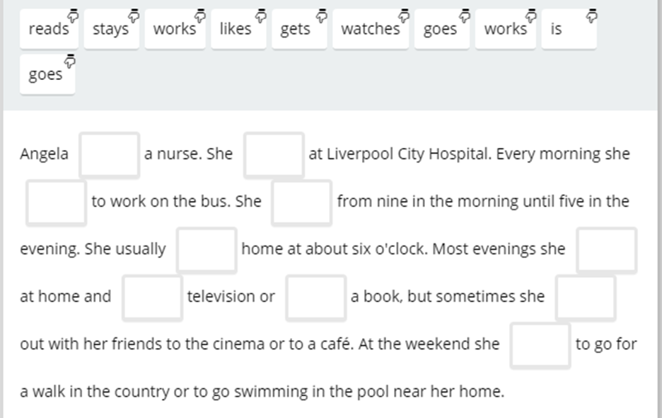
Use the correct verbs to complete the paragraph about Angela.

Slide 9
Compound Nouns and Adjectives
In English we can add two words together to make a new noun. For example:
A change in climate means a change in lifestyle. life + style = lifestyle
Compound nouns can be written three ways:
A single word | Two words | Hyphenated
haircut | rain forest | self-esteem
toothpaste | ice cream | brother-in-law

Slide 10
Compound nouns can be created may ways:
NOUN + NOUN:
We were waiting ages at the bus stop.
ADJECTIVE + NOUN:
I wrote an example on the whiteboard.
VERB+ING + NOUN:
Do you know if there’s a swimming pool near here?
NOUN + VERB:
Wow! I love your hairstyle!
With compound nouns, there are no rules whether the nouns are together, separated by a space, or separated by a hyphen.

Slide 11
Forming Compound Adjectives
Compound adjectives can be formed in many different ways:
NUMBER + NOUN (five-minute, twenty-page, ten-story)
ADJECTIVE + NOUN (short-term, high-quality, last minute)
ADJECTIVE + VERB+ING (good-looking, long-lasting, quick-thinking)
NOUN + VERB+ING (mouth-watering, record-breaking, English-speaking)
NOUN + ADJECTIVE (world-famous, smoke-free, ice-cold)
NOUN + PAST PARTICIPLE (solar-powered, middle-aged, sun-dried)
ADVERB + PAST PARTICIPLE (brightly-lit, well-known, highly-respected)
ADJECTIVE + PAST PARTICIPLE (old-fashioned, ready-made, short lived)
The vast majority of compound adjectives are separated by hyphens.

Slide 12
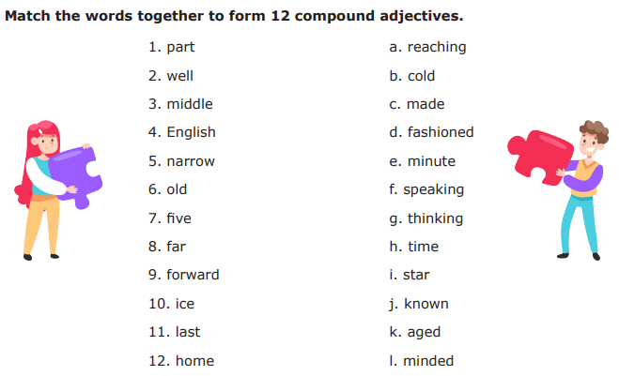
Exercise B

Slide 13
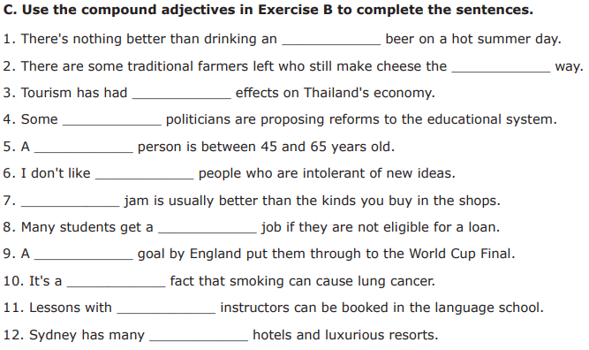
Homework:
Cola

