Slide 1
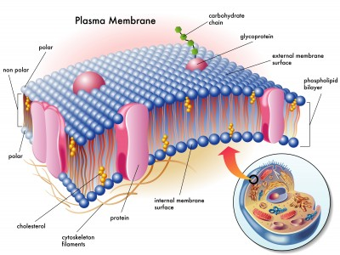
Molecular organization of plasma membrane
By
Assist. Prof. Dr. Humam Kasem Hussein

Slide 2

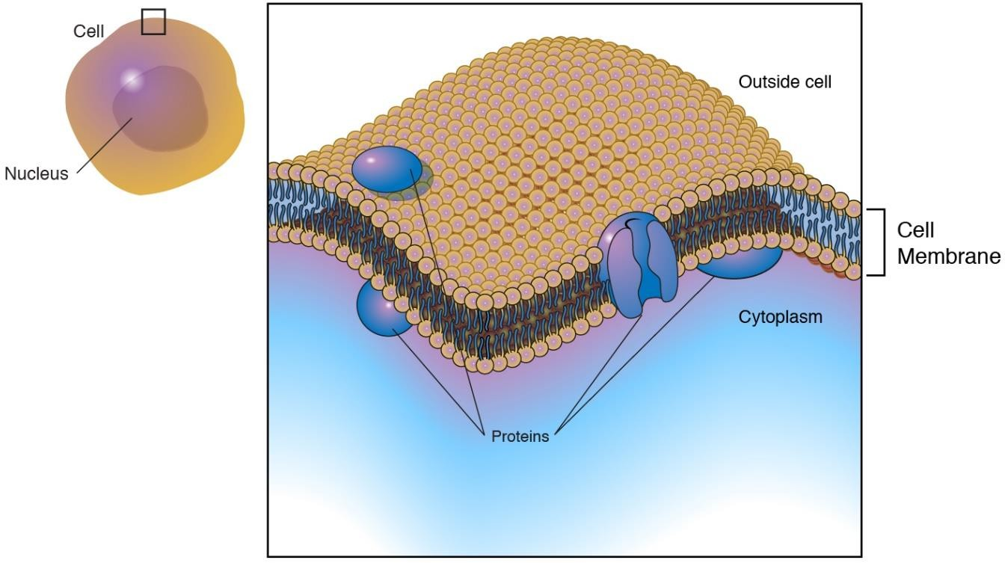
PLASMA MEMBRANE
A selectively permeable phospholipids bilayer.
found in all cells.
allow certain molecules or ions to pass through it by simple diffusion and facilitated diffusion.

Slide 3
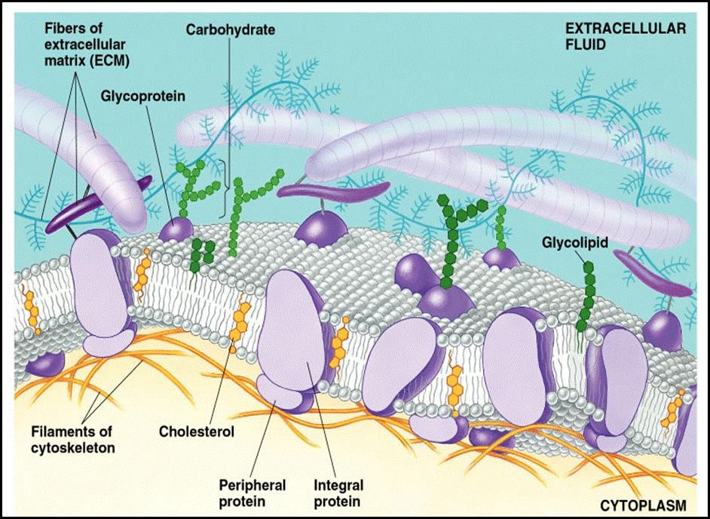
FLUID MOSAIC MODEL
Fluid Mosaic Model is used to describe the plasma membrane
The model proposed by Singer and Nicolson

Slide 4

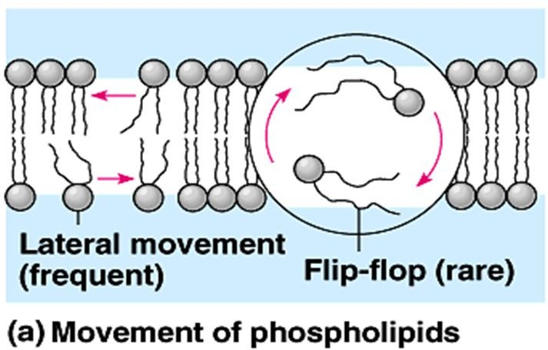
Fluid refers to:
Phospholipids and protein molecules can move laterally or change places and thus give the membrane fluidity.
Lateral movement of a phospholipid occurs rapidly. But flip-flopping across the membrane occurs at a very slow rate.

Slide 5
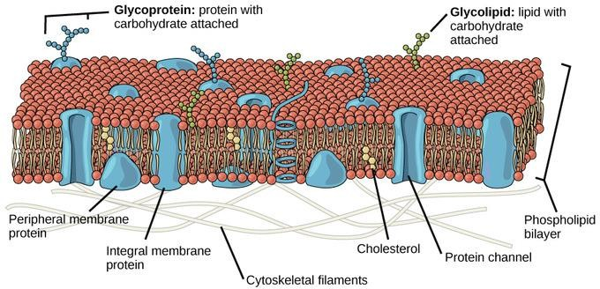
Various proteins are embedded in the phospholipid bilayer giving a mosaic appearance
Mosaic refers to:

Slide 6

PLASMA MEMBRANE COMPONENTS
Phospholipids
Proteins
Carbohydrates chain
Cholesterol

Slide 7
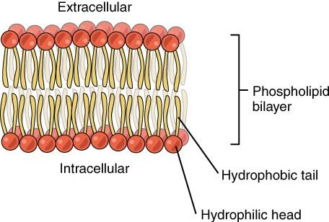
1. Phospholipids
Arranged in a bilayer
polar hydrophilic phosphate heads facing outwards
non-polar hydrophobic fatty acid tails facing each other

Slide 8
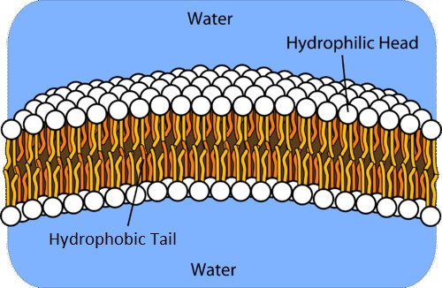
IMPORTANCE OF PHOSPHOLIPID?
Phospholipid bilayer prevent polar solutes from diffusing across the membrane, but allows the diffusion of hydrophobic molecules (such as lipid hormone)
This affords the cell the ability to regulate the movement of these substances via transmembrane protein complexes such as channel and carrier protein.

Slide 9
2 .Proteins
Peripheral proteins
not embedded in the lipid bilayer.
loosely bounded to the surface of the
protein.
penetrate the hydrophobic core of the
lipid bilayer
often completely spanning the membrane (a transmembrane protein).
Integral proteins

Slide 10
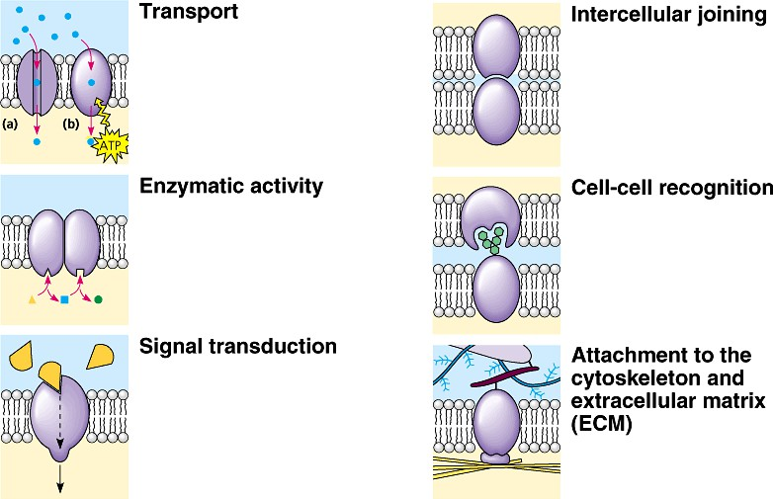
2.Proteins

Slide 11
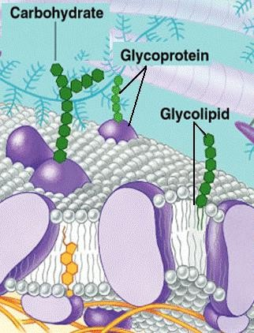
3. Carbohydrate
Usually branched
oligosaccharides.
Glycolipids: Oligosaccharides covalently bonded to lipids.
Glycoproteins: Oligosaccharides covalently bonded to proteins.

Slide 12
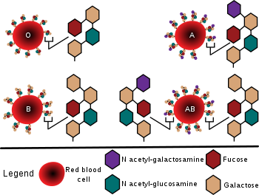
IMPORTANCE OF CARBOHYDRATE
Oligosaccharides are vary from species to species, individual to individual, and even from cell type to cell type within the same individual.

Slide 13
IMPORTANCE OF CARBOHYDRATE
In cell-cell recognition.
Cell-cell recognition is the ability of a cell to distinguish one type of neighboring cell from another.
This is important in cell sorting and organisation as tissues and organs in development.
It is also the basis for rejection of foreign cells by the immune system.
Cells recognise other cells by keying on surface
molecules, often
membrane.
carbohydrates, on the plasma

Slide 14
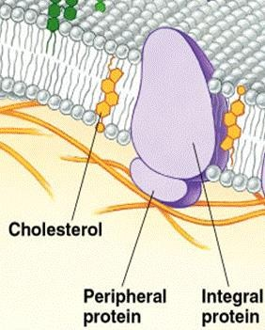
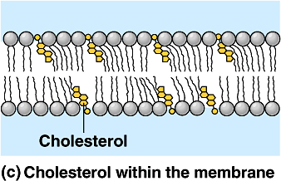
4.Cholesterol
wedged between phospholipid molecules in the plasma membrane.

Slide 15
4. Cholesterol
Functions.
  At warm temperatures, it restrains the movement of phospholipids and reduces fluidity.
  At cool temperatures, it maintains fluidity by preventing tight packing.

Slide 17


