Slide 1
Year 2
Practical: Endocrine System Module
Laboratory Diagnosis of Bacterial Infection
in Diabetic Foot Ulcer
By
Assist. Prof. Dr. Humam Kasem Hussein

Slide 2
Diagnostic tests are indicated when the cause of a skin lesion or disease is not obvious from history and physical examination alone. These include:
1. Biopsy.
2. Scrapings.
3. Tzanck Testing.
4. Nail clipping.
5. Wound swabs.

Slide 3
Skin Biopsy
There are several types of skin biopsy:
Punch biopsy
Shave biopsy
Wedge excision biopsy
In a punch biopsy, a tubular punch (diameter usually 4 mm) is inserted into deep dermal or subcutaneous tissue to obtain a specimen, which is snipped off at its base.

Slide 4
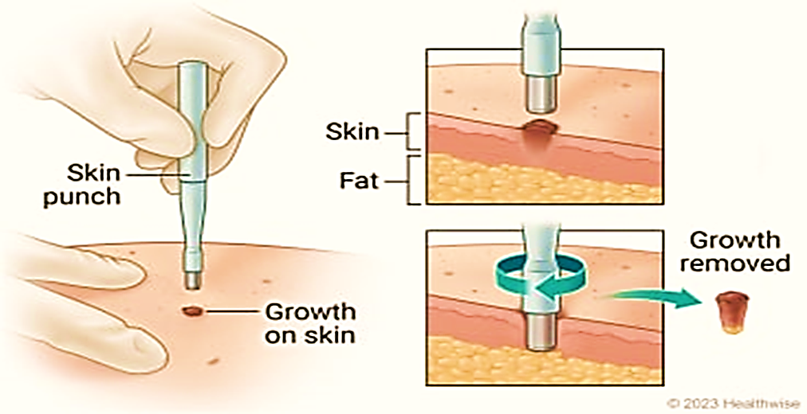

Slide 5
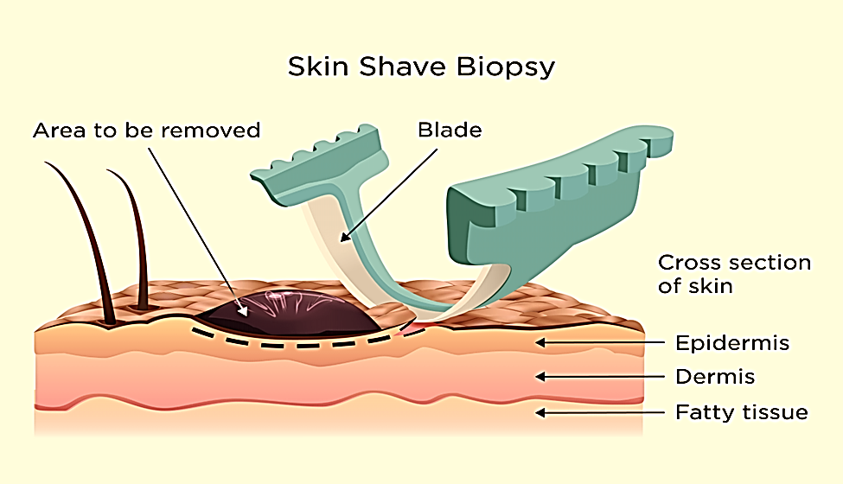
Shaving with a scalpel or razor blade may be done for more superficial lesions. Bleeding is controlled by electrodessications.

Slide 6
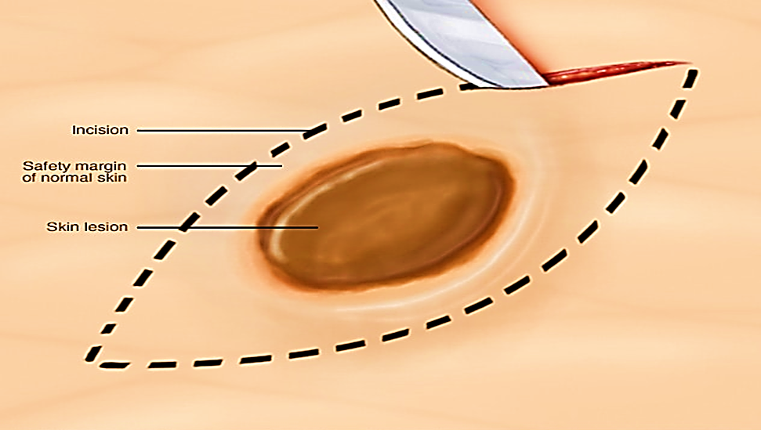
Wedge excision of skin using a scalpel can be done for larger or deeper biopsies, which are closed by sutures.

Slide 7
Skin Scrapings
Skin scrapings help diagnose fungal infections.
For fungal infection, scale is taken from the border of the lesion and placed onto a microscope slide.
Then a drop of 10 to 20% potassium hydroxide (KOH) is added,
between five and fifteen minutes, in order to dissolve skin cells. Hyphae, budding yeast, or both confirm the diagnosis of tinea or candidiasis.

Slide 8
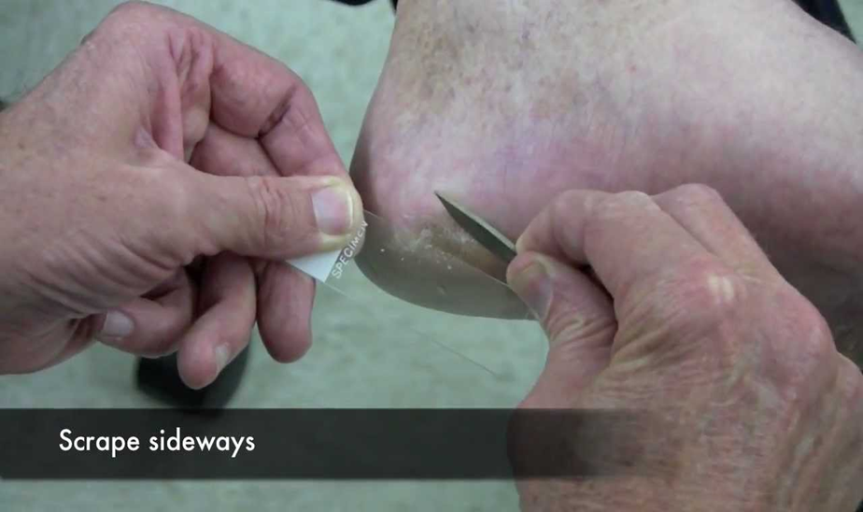

Slide 9
Tzanck Testing
Tzanck testing can be used to diagnose viral disease, such as herpes simplex and herpes zoster, and is done when active, intact vesicles are present.
An intact blister is the preferred lesion for examination. The blister roof is removed with a sharp blade, and the base of the vesicle is scraped with a scalpel blade. The scrapings are transferred to a slide and stained with Wright stain or Giemsa stain. Multinucleated giant cells are a sign of herpes infection.

Slide 10
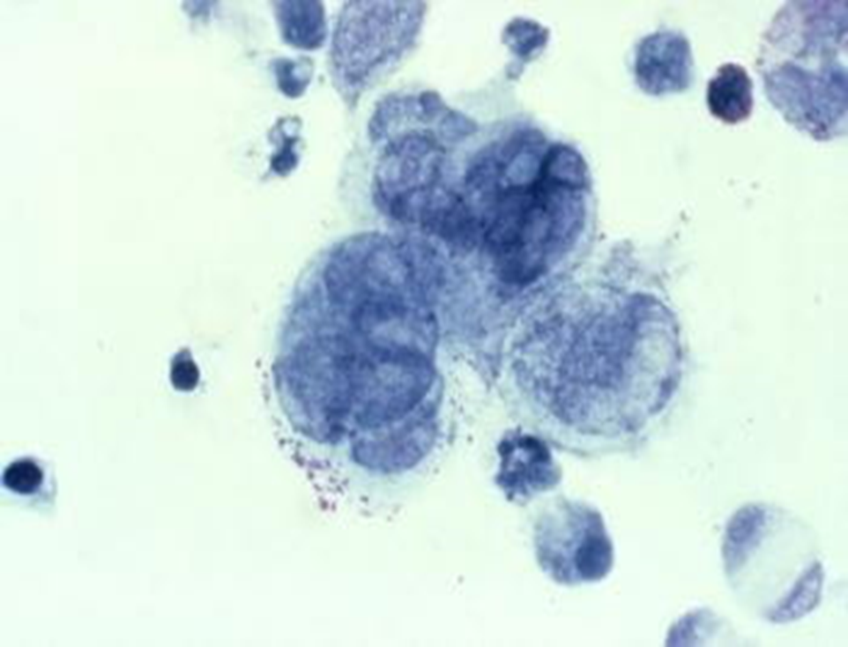

Slide 11
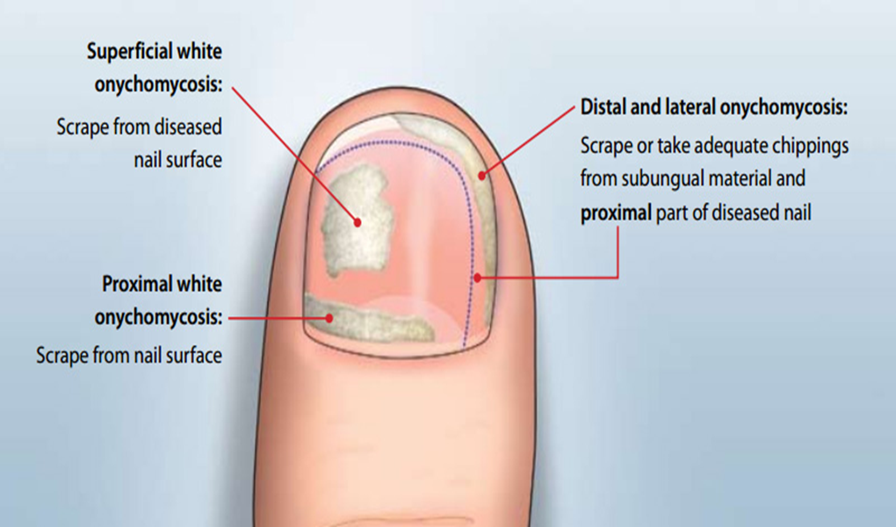
Nail clipping
Keratinized portion nail, is also a possible site for residing of fungus, should be sampled as nail clipping. Nail clipping is taken from any of the discolored or thickened part of the nail. Following steps should be considered during specimen collection:

Slide 12
Wound swabs.
1. Where possible specimens should be collected before starting any antimicrobial therapy.
2. Use aseptic technique.
3. If the area to be swabbed is dry, moisten the swab with sterile water or saline.
4. Sample the wound by moving the swab across the wound surface in a zigzag motion, at the same time as rotating it between the fingers. Immediately placed into the transport medium.
5. Label the sample.
6. If a large quantity of pus is present, aspirate into a syringe and send to the laboratory in a sterile container.

Slide 13
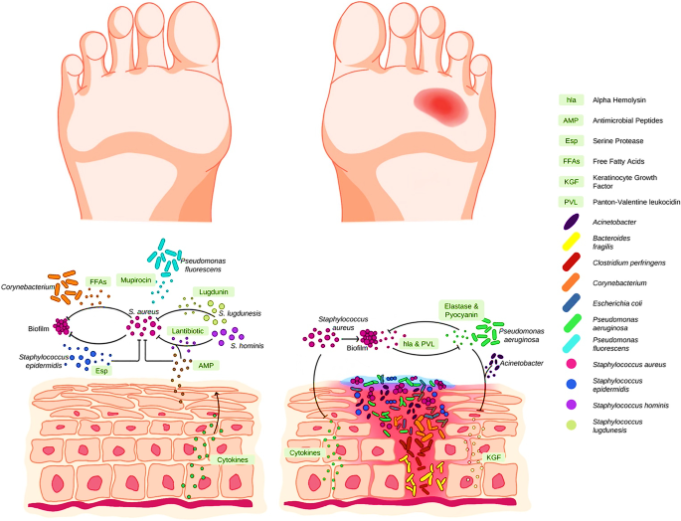

Slide 14
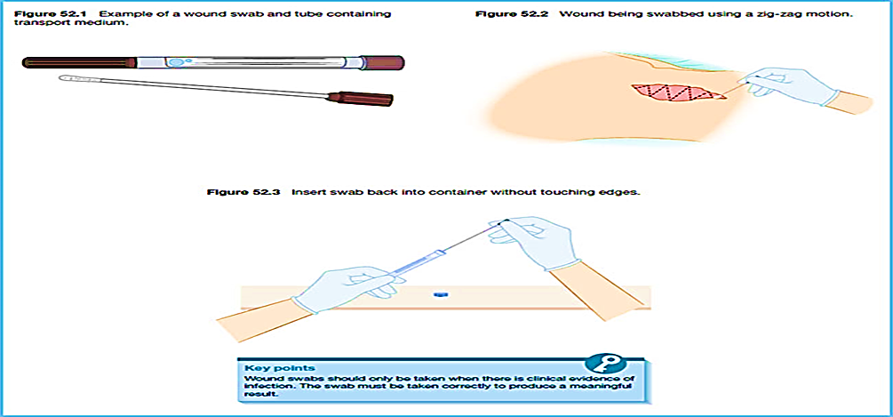

Slide 15
Skin or Nail Culture
A skin or nail culture is a laboratory test to look for and identify germs that cause problems with the skin or nails.
Mold and yeast are two types of fungus. Both can cause allergic reactions. Fungal spores can circulate in the air and may cause allergic rhinitis when inhaled.

Slide 16
How the Test is Performed
A sample of skin may need to be taken. Before the skin sample is removed, you will likely receive a shot (injection) of numbing medicine to prevent pain.
A small sample of a fingernail or toenail may be taken. The sample is sent to a lab. There, it is placed in a special dish (culture). It is then watched to see if bacteria, viruses, or fungi grow. It may take up to 3 weeks to get results of a nail culture.
Further tests can be done to identify the specific germ that is causing problem. This can help to provider determine the best treatment.

Slide 17
Why the Test is Performed
This test may be done to diagnose the cause of:
• A bacteria or fungus infection of the skin, finger, or toenail.
• A skin rash or sore that appears to be infected.
• A skin ulcer that is not healing.
*Normal Results
A normal result means no disease-causing germs are seen in the culture.
Some germs normally live on the skin. These are not a sign of infection and are considered a normal finding.

Slide 18
*Abnormal Results
An abnormal result means bacteria, fungus, or virus is present. This may be a sign of infection.
Common skin infections caused by bacteria include:
• Impetigo.
• Diabetes foot ulcers.
Common skin infections caused by fungus include:
• Athlete's foot.
• Nail infections.
• Ringworm.
Risks
Risks include slight bleeding or infection in the area where the skin sample was removed.

Slide 19
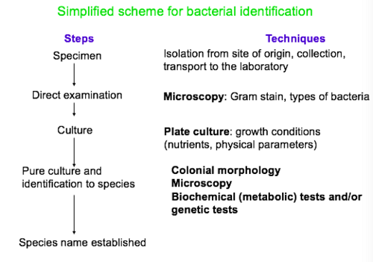

Slide 20
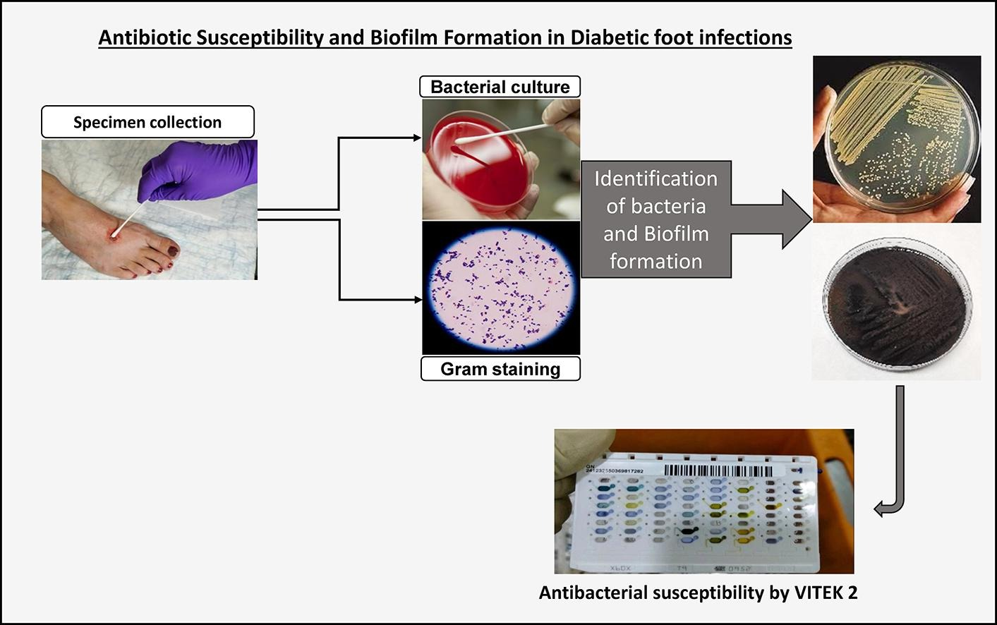

Slide 21
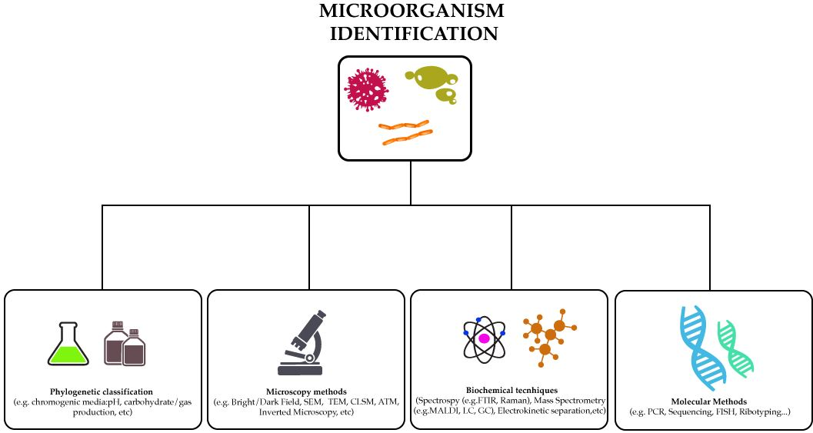

Slide 22

Biochemical Tests of Fungi

Slide 23
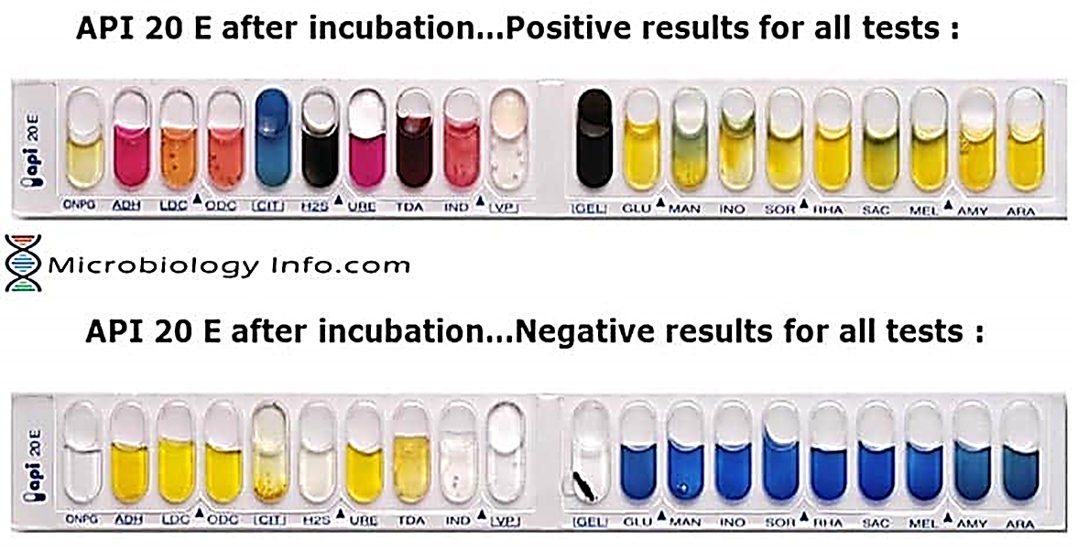
Biochemical Tests of Bacteria

Slide 24
The test kit enables the following tests:
1. ONPG: test for β-galactosidase enzyme by hydrolysis of the substrate o-nitrophenyl-b-D-galactopyranoside.
2. ADH: decarboxylation of the amino acid arginine by arginine dihydrolase.
3. LDC: decarboxylation of the amino acid lysine by lysine decarboxylase.
4. ODC: decarboxylation of the amino acid ornithine by ornithine decarboxylase.
5. CIT: utilization of citrate as only carbon source.
6. H2S: production of hydrogen sulfide.
7. URE: test for the enzyme urease.
8. TDA (Tryptophan deaminase): detection of the enzyme tryptophan deaminase: Reagent- Ferric Chloride.
9. IND: Indole Test-production of indole from tryptophan by the enzyme tryptophanase . Reagent- Indole is detected by addition of Kovac’s reagent.
10. VP: the Voges-Proskauer test for the detection of acetoin (acetyl methylcarbinol) produced by fermentation of glucose by bacteria utilizing the butylene glycol pathway.

Slide 25
11. GEL: test for the production of the enzyme gelatinase which liquefies gelatin.
12. GLU: fermentation of glucose (hexose sugar).
13. MAN: fermentation of mannose (hexose sugar).
14. INO: fermentation of inositol (cyclic polyalcohol).
15. SOR: fermentation of sorbitol (alcohol sugar).
16. RHA: fermentation of rhamnose (methyl pentose sugar).
17. SAC: fermentation of sucrose (disaccharide).
18. MEL: fermentation of melibiose (disaccharide).
19. AMY: fermentation of amygdalin (glycoside).
20. ARA: fermentation of arabinose (pentose sugar).

Slide 26
Thank You for Listening

