Slide 1

Mucormycosis in Diabetic Patients
By
Assist. Prof. Dr. Humam Kasem Hussein

Slide 2
What is Mucormycosis?
Mucormycosis is a serious fungal infection caused by a group of molds called mucormycetes. These fungi live throughout the environment. They live in soil and in decaying organic matter, such as leaves, compost piles, or rotten wood.
People get mucormycosis by coming in contact with the fungal spores in the environment. For example, infections involving the lung or sinus can occur after someone breathes in spores.

Slide 3
Types of mucormycosis
1. Rhino-cerebral (sinus and brain) mucormycosis: is an infection in the sinuses that can spread to the brain. This is most common in people with uncontrolled diabetes and in people who have had a organ transplant.
2. Pulmonary (lung) mucormycosis: is the most common type of mucormycosis in people with cancer and in people who have had an organ transplant.
3. Gastrointestinal mucormycosis: is more common among young children than adults. Premature and low-birth-weight infants less than 1 month of age are at risk if they have had antibiotics, surgery, or medications that lower the body’s ability to fight germs and sickness.

Slide 4
Types of mucormycosis
4. Cutaneous (skin) mucormycosis: occurs after the fungi enter the body through a break in the skin. This type of infection might occur after a burn, scrape, cut, surgery, or other types of skin trauma. This is the most common form of mucormycosis among people who do not have weakened immune systems.
5. Disseminated mucormycosis: occurs when the infection spreads through the bloodstream to affect another part of the body. The infection most commonly affects the brain, but also can affect other organs such as the spleen, heart, and skin.

Slide 5
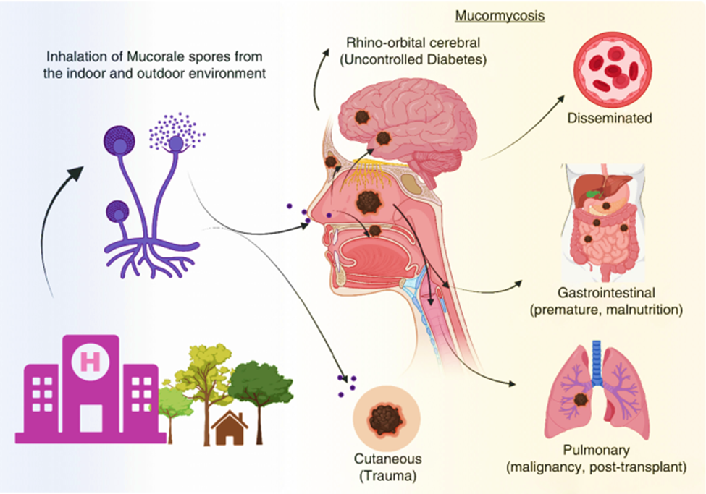

Slide 6
Etiology
Mucormycetes are common environmental organisms that are not harmful to humans who are immunocompetent. In patients with overt immunocompromised (i.e., transplant patients, HIV, leukemia or other cancer patients), they can present with rapidly progressive necrotizing infection. Similarly, uncontrolled diabetics are also at risk.

Slide 7
The species most frequently isolated from patients are:
Apophysomyces variabilis
Lichtheimia raosa
Mucor circinelloides
Rhizopus microsporus
Rhizomucor pusillus
Saksenaea vasiformis

Slide 8
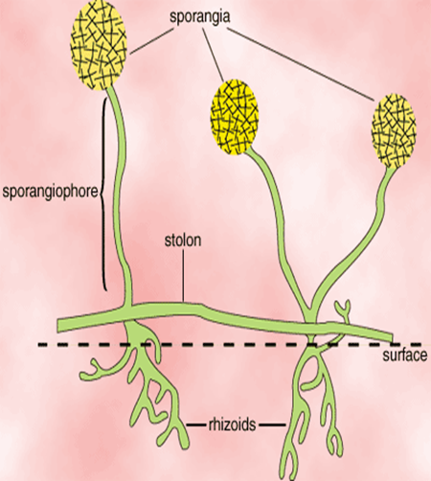
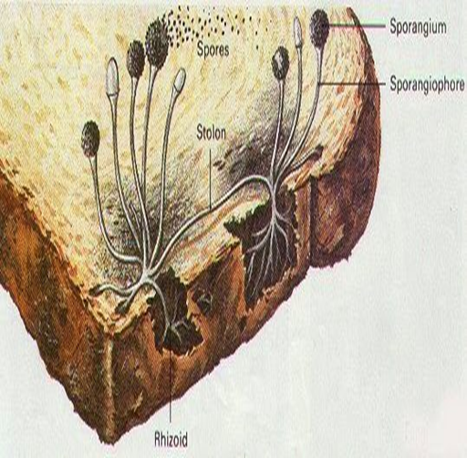

Slide 9
Epidemiology
Mucormycetes are thermotolerant fungi (<20Cº -- >50Cº ) found in soil and decaying matter and rarely cause disease because of low virulence.
Rhizopus is considered the most frequent fungal infection in immunocompromised populations.
Mucormycosis has increased its frequency because of the increased prevalence of immunosuppression states in the general population due to cancer and transplant patients, as well as various autoimmune diseases.

Slide 10
Risk factors
Risk factors include:
Diabetes mellitus.
Malnutrition.
Malignancies (lymphomas and leukemias).
Renal failure.
Organ transplant.
Burns.
Immunosuppressive therapy.
Cirrhosis.
AIDS.

Slide 11
Pathophysiology
Mucormycetes are present in soil and decaying matter. n immunocompetent people, the spores of Mucorales that reach the respiratory tract adhere to the nasal mucus and are eliminated either by swallowing or sneezing, if there is any wound in the mucous membranes, the polymorphonuclear neutrophils phagocytose and destroy the fungal structures.
Neutrophils are the host defense against these infections; therefore, individuals with neutropenia or neutrophil dysfunction are at the highest risk.

Slide 12
Diabetes patients usually present with clinically uncontrolled diabetes and the increased amounts of circulating glucose, providing excellent conditions for the rapid development of filamentous structures that first bind to blood vessels and then penetrate them, completely blocking them in a few days and causing extensive areas of necrosis.

Slide 13
Symptoms of Mucormycosis
The symptoms of mucormycosis will depend on where in your body the fungus is growing. They may include:
• Fever.
• Cough.
• Chest pain.
• Shortness of breath.
• Swelling on one side of the face.
• Headache.

Slide 14

• Sinus congestion.
• Black lesions on the bridge of nose or the inside of mouth.
• Belly pain.
• Nausea and vomiting.
• Gastrointestinal bleeding.
• Blood in stool.
• Diarrhea.

Slide 15
If the skin is infected, the area can look blistered, red, or swollen. It might turn black or feel painful.
The infection can also spread to other parts of the body through the blood. This is called disseminated mucormycosis.
When this happens, the fungus can affect organs like spleen and heart. In severe cases, changes in mental state or go into a coma. It can even be deadly.

Slide 16
Diagnosis
Medical history, symptoms, physical examinations, and laboratory tests are the techniques of diagnosing mucormycosis. Healthcare providers who suspect that mucormycosis in the lungs or sinuses might collect a sample of fluid from the respiratory system and send to a laboratory.
The healthcare provider may perform a tissue biopsy, in which a small sample of affected tissue is analyzed in a laboratory for evidence of mucormycosis under a microscope or in a fungal culture. Also may need imaging tests such as a CT scan of the lungs, sinuses, or other parts of the body, depending on the location of the suspected infection.

Slide 17
Treatment / Management
The standard management of mucormycosis requires early diagnosis, surgical debridement, and prompt administration of intravenous antifungals - usually amphotericin B.
Surgical debridement of infected tissue should be urgently performed to limit the further spread of infection. Surgical debridement of necrotic tissue should take place immediately.
Posaconazole or isavuconazole has some evidence as second-line therapy in mucormycosis.
Other adjuncts include hyperbaric oxygen. The increased oxygen pressure improves the ability of neutrophils to kill the organism and facilitates wound healing.

Slide 18
Complications
Complications of mucormycosis subdivide into those that result from the disease itself and those that are caused by the antifungal treatment.
Complications associated with the disease are sinus thrombosis, disseminated infection, periorbital destruction, palatine ulcers, osteomyelitis, and death.
B) Complications due to treatment are nephrotoxicity (specifically with the use of amphotericin B).

Slide 19
Prevention
There's no way to avoid breathing in spores. But you can do a few things to lower your chances of mucormycosis. It's especially important if you have a health condition that raises your risk.
Stay away from areas with a lot of dust or soil, like construction or excavation sites. If you have to be in these areas, wear a face mask like an N95.
Avoid infected water. This can include floodwater or water-damaged buildings, especially after natural disasters like hurricanes or floods.

Slide 20
If we have a weakened immune system, avoid activities that involve dust and soil, like gardening or yard work. If we can't, protect the skin with shoes, gloves, and long sleeves. Wash cuts or scrapes with soap and water as soon as we can.
If we get mucormycosis, we must take the medications as directed. If side effects cause problems or the infection doesn't get better, let the doctor know right away.

Slide 21


