Slide 1
Cellular Differentiation and Specialization
By
Assist. Prof. Dr. Humam Kasem Hussein

Slide 2
An adult human body can be made up from 1 trillion to 100 trillion cells depending on height, weight, etc…
Humans start from 1 cell and end up with many different types of cells (e.g. muscle cells, skin cells,) with different functions.
Cell differentiation is vital for the survival of an organism. Cell differentiation is the process by which a cell changes, becoming more and more suited, or specialized, for a particular function.
Differentiation involves many changes. The number of organelles may change, or the size of the cell may change. For example, during differentiation sperm cells gain lots of mitochondria.

Slide 3
The Definition of Cell differentiation
Differentiation is the natural process through which a less specialized cell, i.e., a stem cell, matures and becomes more distinct in function and shape.
Single-celled organisms perform all of their basic functions within a single cell. For maximum efficiency in each process, a unique cellular structure and machinery are needed. No one cell can provide optimal circumstances for all functions.
Each cell in a multicellular organism, from a mushroom to a human being, becomes specialized in several ways to fulfill a specific role. And the adaptations these acquire guarantee that they are as effective as possible in performing their functions.

Slide 4
Stem Cells
The specialized cells result from the differentiation of stem cells.
Stem cells are the raw materials of the body, the cells that have the potential to give rise to all other cell types with specific shapes and functions.
All cells in most multicellular organisms, including humans and most plants, are generated from the fertilization of two gametes from opposite biological sexes: an egg cell with a sperm cell.
A zygote is the first stem cell in an organism.

Slide 5
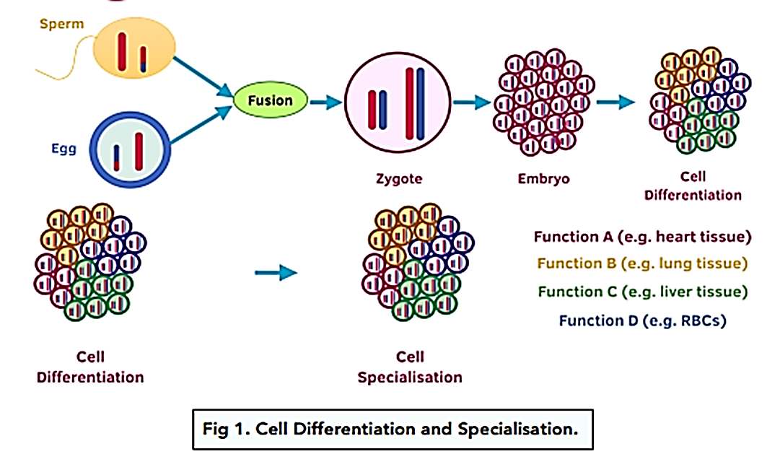

Slide 6
The Process of Cell Differentiation
Stem cells and specialized cells have identical genetic content. While stem cells retain the ability to express every one of their genes, specialized cells lose this ability. They can only express genes that are essential for viability and function.
For example:
The gene encoding haemoglobin is active in reticulocytes (precursors of red blood cells), but this gene is silenced and not expressed in neurons.
Regulation of gene expression drives cell differentiation. When cells express certain genes that define a specific type of cell, we say the cell has differentiated. Once a cell has differentiated, it only expresses the genes that code for the proteins that are unique to that kind of cell.

Slide 7
The Difference between Cell Differentiation and Cell Division
Cell differentiation is the process through which cells specialize to perform their roles. A cell will express particular genes to differentiate. Once a cell is determined and has become specialized, it loses the ability to divide via mitosis. New cells generated by mitosis of stem cells may transform into specialized cells.
Cell differentiation | Cell division (mitosis)
The process of turning undifferentiated stem cells into specialized cells. | The splitting of parent cells to produce new but identical daughter cells.
No new cell created. | New cells created.

Slide 8
Examples of Cell Differentiation
Red Blood Cells
Red blood cells (erythrocytes) are derived from adult stem cells in the red bone marrow. These stem cells, called haemopoietic stem cells, are the precursor to all blood cells, including lymphocytes, neutrophils, basophils, and platelets.
Erythrocytes are oxygen carriers in the body. They contain large quantities of haemoglobin, a protein that picks up oxygen in the lungs and delivers it to all tissues around the body. During their differentiation, erythrocytes lose almost all organelles, including the nucleus and mitochondria, making more room for haemoglobin to maximize their oxygen-carrying capacity.

Slide 9
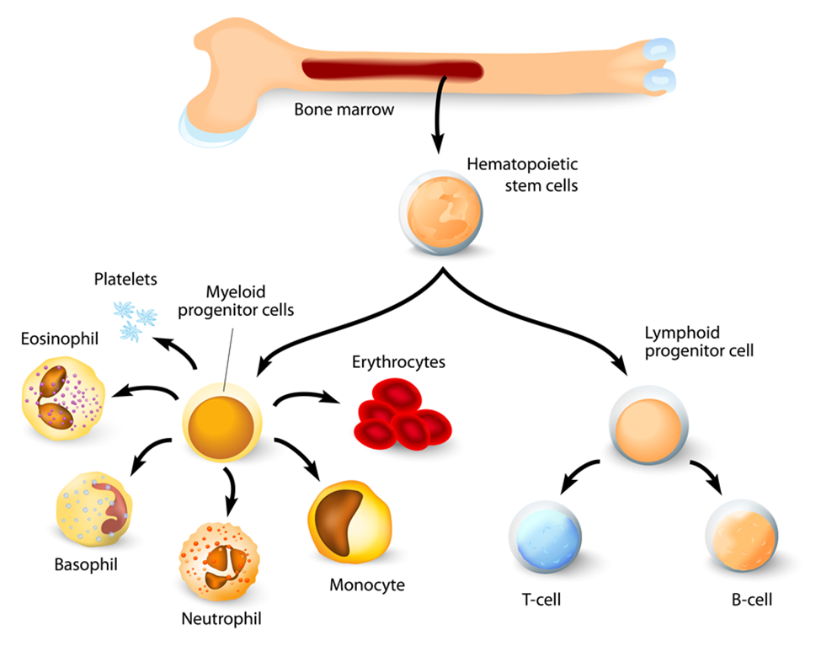

Slide 10
What is the importance of cell differentiation?
Cell differentiation is important because it allows cells to specialize and perform specific functions in an organism. This allows for the formation of tissues and organs, and is necessary for the proper functioning of the body.
What can go wrong during cell differentiation?
Errors during cell differentiation can lead to a variety of disorders and diseases, such as cancer, developmental abnormalities, and degenerative diseases. These can occur due to mutations in genes, environmental factors, or other causes.
How can knowledge of cell differentiation be applied in medicine?
Understanding cell differentiation can help in the development of new treatments and therapies for a variety of conditions, such as cancer, genetic disorders, and injuries. It can also be used in regenerative medicine, where stem cells are used to repair damaged tissues and organs.

Slide 11
What would happen without cell differentiation?
Without cell differentiation, multicellular organisms could not perform all the functions they need. In single-celled organisms, the relatively inefficient functions performed by a single cell may be adequate for it, but this falls short in multicellular organisms.
What factors influence cell differentiation?
When cells express certain genes that define a specific type of cell, we say the cell has differentiated. Once a cell has differentiated, it only expresses the genes that code for the proteins that are unique to that kind of cell. Factors involved in transcription and translation determine which genes remain active and which are silenced.

Slide 12
Differentiation is the natural process through which a less specialized cell, i.e., a stem cell, matures and becomes more distinct in function and shape.
All cells within an organism contain the same set of genetic instructions called the genome. What drives cell differentiation is the control of gene expression.
Specialized cells are formed from the differentiation of stem cells.
Stem cells have the potential to give rise to all other cell types with specific shapes and functions.
Some examples of specialized cells are red blood cells, muscle cells,…

Slide 13
Specialization of Cells
Specialized cells are cells in the body that do just a few specific things. They help break down food, they help fight infection, and they make hormones.
The majority of cells in an organism are specialized and have a designated function. Depending on its responsibility, a cell can look different to suit its specific purpose. For example, certain cells may have evolved different structures mainly due to their function more so than other parts of the body.
Specialisation enables the cells in these tissues to function more efficiently as they develop specific adaptations for their role. The development of these distinct specialised cells occurs by differentiation

Slide 14
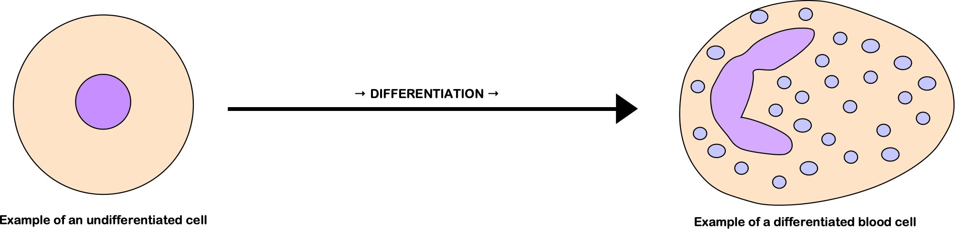
Differentiation is not a simple, linear process of cells getting more and more specialised but instead involves changes in subcellular structures and the development of different types of cells.

Slide 15
These specialized eukaryotic cells have specific adaptations to help them carry out their functions.
For example, the structure of a cell is adapted to help it carry out its function (this is why specialised eukaryotic cells can look extremely different from each other).
  Structural adaptations include:
  *The shape of the cell.
  *The organelles the cell contains (or doesn’t contain).
  For example: Cells that make large amounts of proteins will be adapted for this function by containing many ribosomes (the organelle responsible for protein production).

Slide 16
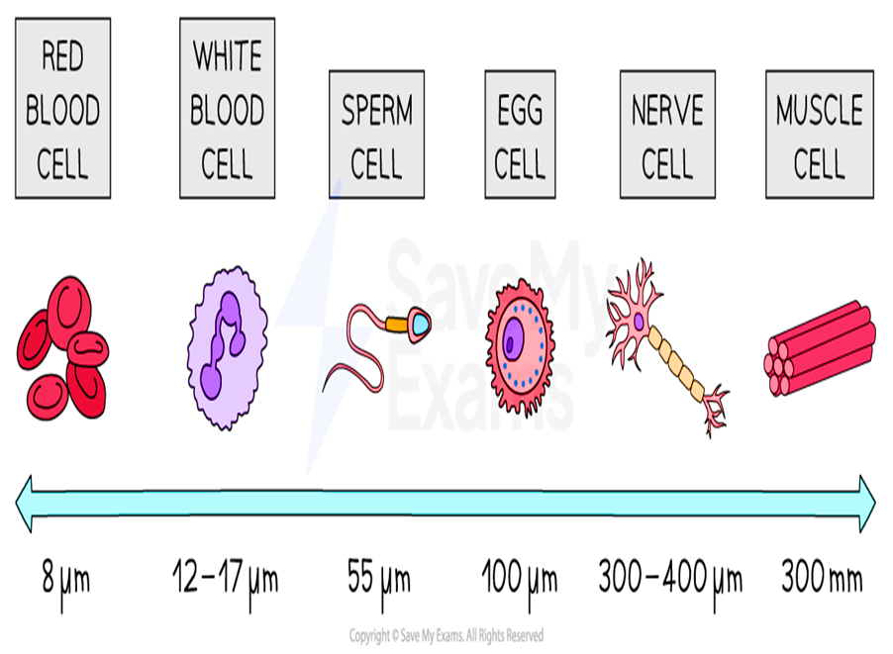
Cell Size and Specialisation
During the differentiation process, cell sizes can vary drastically.
Size is a feature of adaptation which means that cells require different dimensions to carry out their jobs efficiently.

Slide 17
How differentiation makes cells adapted to their function
Red blood cells are small to allow movement through narrow capillaries.
Sperm cells are long to allow for movement towards the egg cell, they also have narrow streamlined heads to reduce resistance to reaching the egg cell.
An egg cell body has the largest volume of all cells to allow for stored food reserves.
Muscle cells are larger than normal cells, length and diameter is designed to exert force during muscle contraction.

Slide 18
The cell specialization is the result of differentiation, the final form where a cell has a specific function and often a distinct structure aligned with that function, such as nerve cells for transmitting impulses or muscle cells for contraction. Specialization describes the unique role and structure that makes each cell type different from one another, despite them all containing the same DNA.
Throughout the development from a fertilized egg into a complex organism like a human, cellular differentiation leads to a vast array of specialized cells, each with unique morphological and physiological characteristics determined by the expression of specific genes controlled by transcription factors. Under normal conditions, once specialized, cells retain their specific roles, contributing to the organism's functionality as a whole.

Slide 19


