Slide 1
Laboratory Biosafety and How to
Use a Microscope
By
Assist. Prof. Dr. Humam Kasem Hussein

Slide 2

Safe Lab Practices
No Food or Drink.
Wear Your PPE and Proper Lab Outfit.
Good Hygiene.
Use Proper Storage Containers.
Label Your Work Space.
Don't Work Alone.
Stay Focused and Aware of Your Surroundings.
Participate in Safety Exercises.

Slide 3
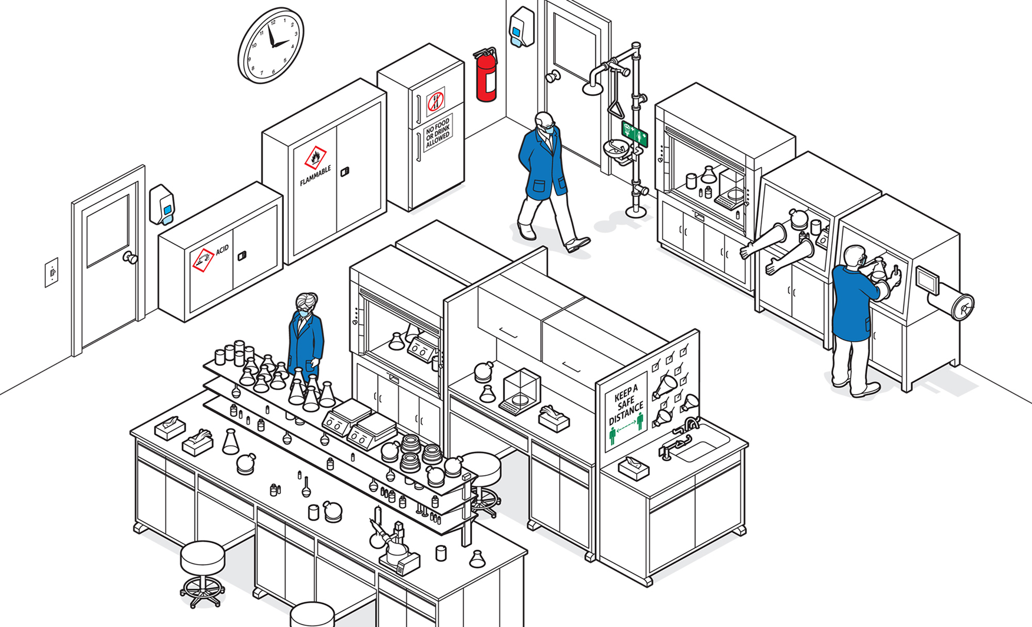

Slide 4
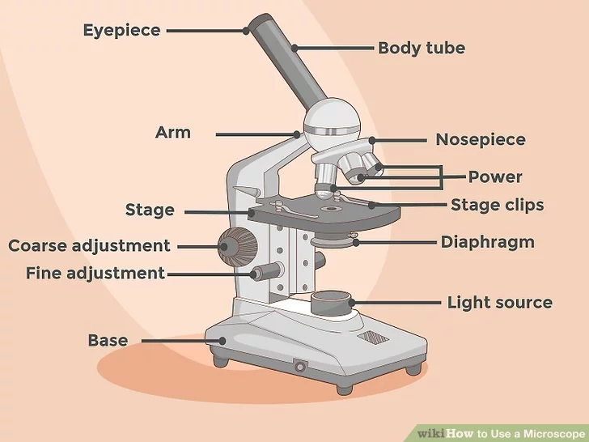
Setting Up the Microscope

Slide 5
The components of the microscope.
There are multiple essential pieces of the microscope that you need to be able to identify and use properly. The eyepiece is the portion that you will look into to view your specimen. Simple compound microscopes will only have one eyepiece while more complex microscopes will have a binocular eyepiece. Here are the components:
The stage is a platform where you will place your slides for viewing.
The arm is the portion that connects the base to the eyepiece.
The objective is the piece that magnifies the image. There are multiple objectives of varying magnifications.

Slide 6
There are two focus knobs: coarse and fine focus. The coarse focus knob is usually a large knob on the side of the microscope that moves the objective lens towards or away from the slide. It allows you to find your specimen and roughly focus on it. The fine focus is a smaller knob that is used to focus specifically on the specimen. It allows you to fine tune what you’re looking at under the microscope.
The light source is on the base of the microscope and points up toward the stage. It provides the light for image viewing.
The diaphragm is just underneath the stage and allows you to vary the amount of light shining on your image.

Slide 7
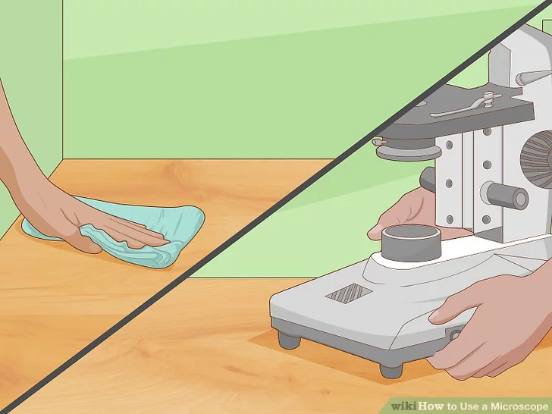
Place the microscope on a clean, flat surface.
Clear your surface of any debris that could potentially harm your microscope. Clean the area with a surface cleaner and lint-free rag. Make sure the table is located near an electrical outlet. Carry the microscope below the base and on the arm.
Place the microscope on the table and plug it in.

Slide 8
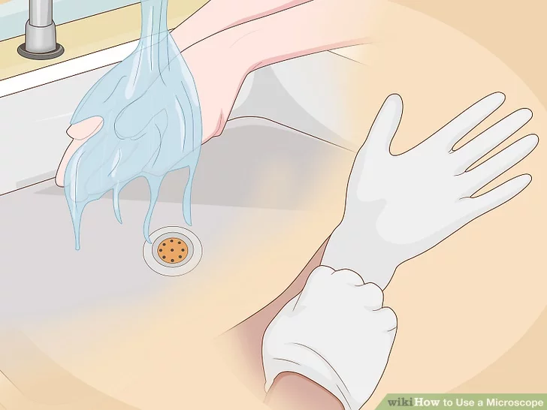
Preparing Microscope Slides
1. Wash your hands before you begin. Your hands have oils on them that can easily get onto your slides and specimens. These oils can damage both your specimens and the microscope. If you have access to gloves, it is a good idea to wear these as well. Keep your hands and the area you’re working as free of dirt and contaminating particles as possible.

Slide 9
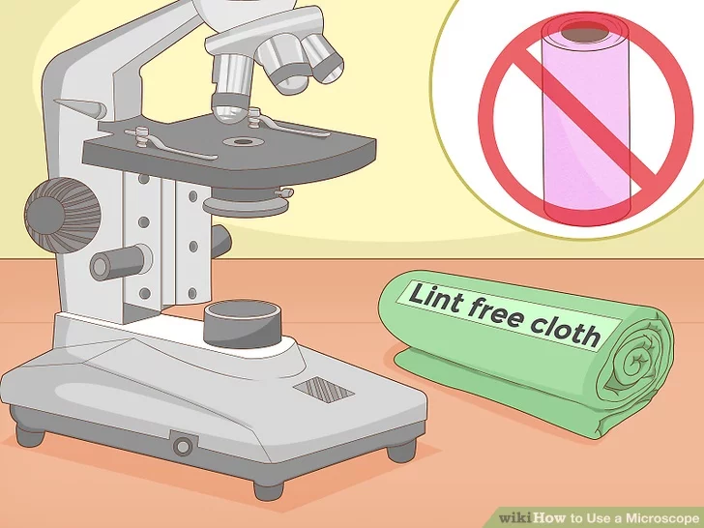
2. Keep a lint-free cloth nearby to use to clean and touch the slides.
A lint-free cloth is a special cleaning cloth that does not leave behind fluff after you wipe a surface with it. A lint-free cloth will limit contamination. Never use paper towels with the slides. These leave a lot of lint behind.
If you are wearing gloves you can touch the slide, but try to only pick up slides by their sides.

Slide 10
3. Use prepared slides to begin with.
Prepared slides already have a specimen mounted properly. You can buy these at scientific outlets or several may come with your microscope. Once you are comfortable using the microscope, you can try preparing your own slide.
To prepare your own slide, obtain a specimen you’d like to look at in more detail. Pond water or pollen are great samples to start with.
Drop a small drop of the water or place a few spores of the pollen directly onto the slide.
Place a cover slip at a 45-degree angle to the slide and gently let it fall on top of the slide.

Slide 11
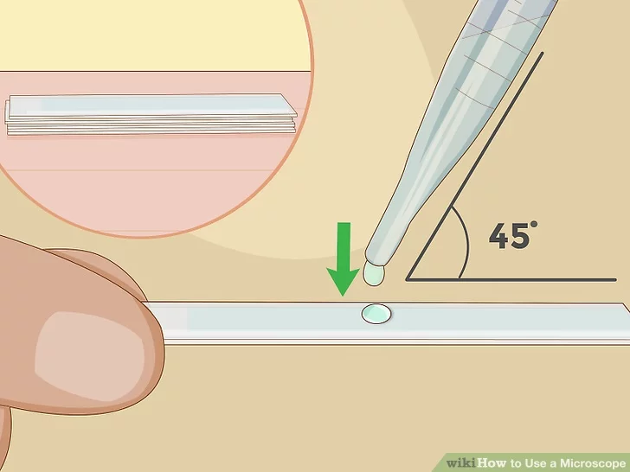

Slide 12
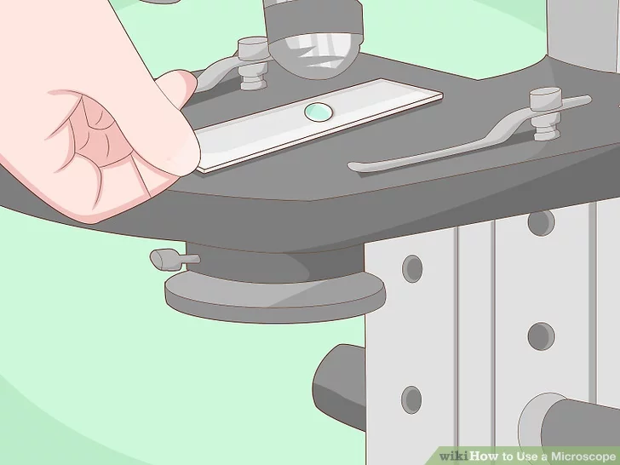
4. Place the slide on the stage of the microscope.
Pick up the slide using only the edges, so that you don't press fingerprints onto your clean slide. Fingerprints and oils from your hand can contaminate the slide. You can also use the lint-free cloth to pick up the slide. If the slide is dirty, wipe it gently with the lint-free cloth.

Slide 13
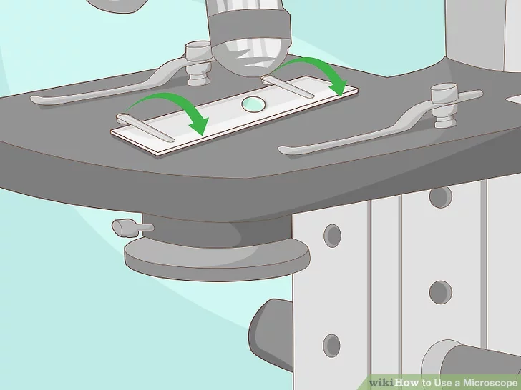
5. Secure the slide in place with the 2 stage clips.
There are two clips (metal or plastic) on the stage that function to secure a slide in place, so you can remove your hands and focus the microscope. You should be able to slip the slide underneath the clips easily.
Slides are quite fragile and can be broken if this step is not done properly.

Slide 14
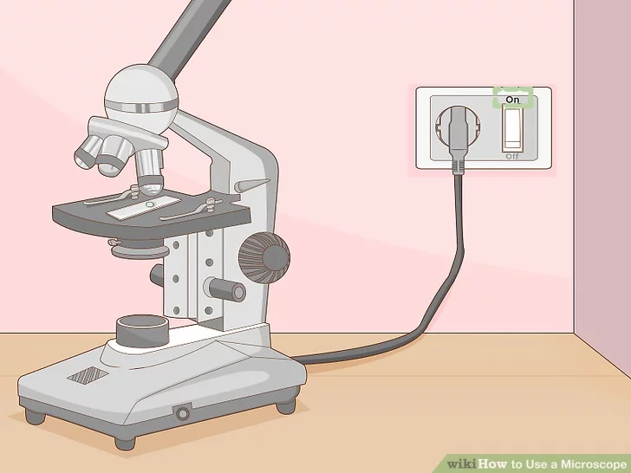
6. Turn on your microscope.
The switch is usually on the side of the microscope. The center of your slide should have a small circle of light appear on it. If you don’t see any light, try adjusting the diaphragm until it is open all the way.

Slide 15
Focusing the Microscope
1. Adjust your eyepiece.
If there is only one eyepiece, you can skip this step. With a binocular eyepiece, turn the eyepieces to find the correct space between the eyes. You should see a single circle of light when you look through both eyepieces.
If you see two images when you look through the eyepieces, you need to continue to adjust the distance.
Move the eyepieces closer together or further apart until you see a single circle of light.
Remove your glasses, if you wear them. You can use the microscope's settings to focus the object according to your sight

Slide 16
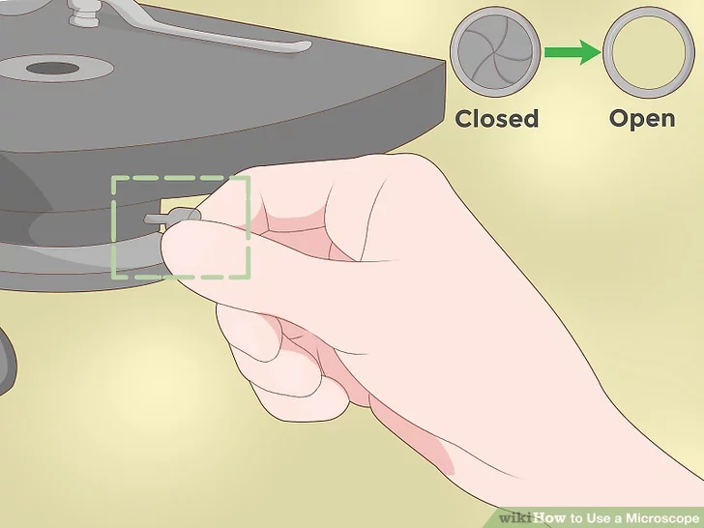
2. Adjust the diaphragm to its widest opening.
The diaphragm allows you to change the amount of light on the slide. To begin focusing on your specimen, you want to shine the maximum amount of light on the slide. There should be a lever or spinning disc that allows you to alter the diameter. Move the lever or spin the disc until the diaphragm is all the way open.

Slide 17
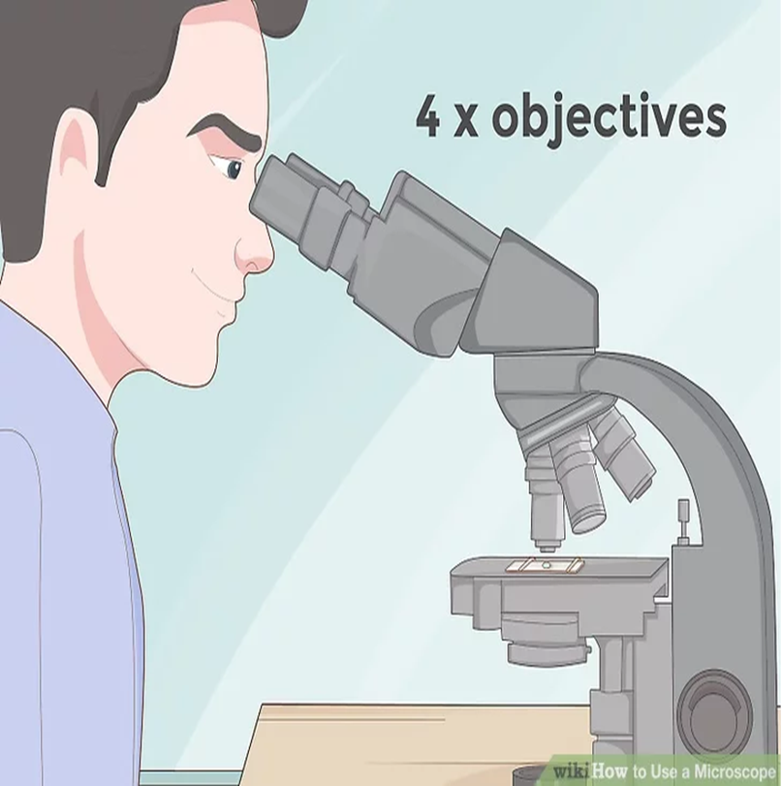
3. Start focusing on the lowest power objective.
You may have two or three different rotating objective lenses that you can switch into place to magnify the object. You should start with the lower objective and increase until it is focused.
The low power objective gives you
the widest view, and allows you to
slowly bring the object into focus
without missing it.
It is often called the scanning
objective for this reason. Starting
at the high power objective may
mean that you don't see the
object or you don't see
the full object.

Slide 18
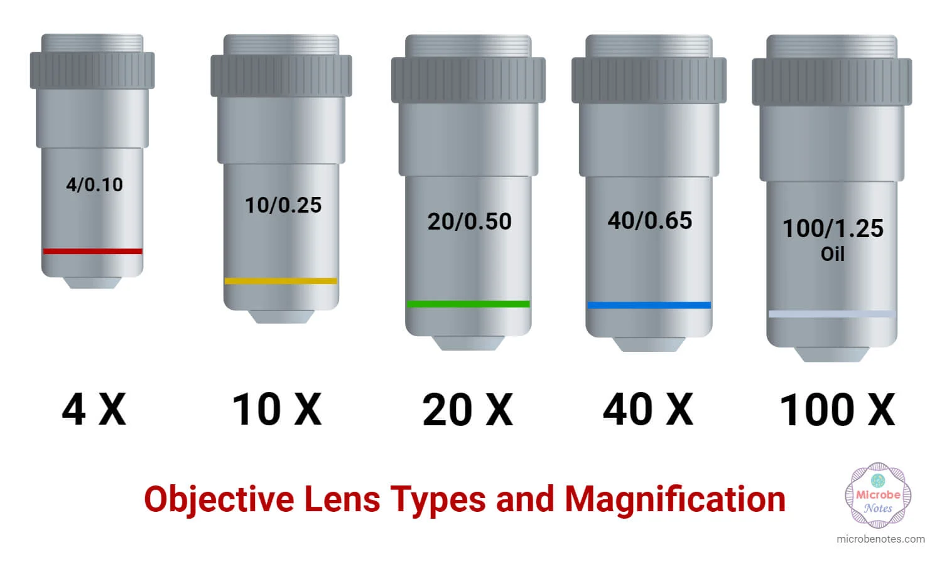

Slide 19
    Magnification: a measure of how much the image is enlarged.
Total magnification = (ocular lens)(objective lens being used)
4x objective lens = (10x)(4x) = 40 times total magnification
10x objective lens = (10x)(10x) = 100 times total magnification
40x objective lens = (10x)(40x) = 400 times total magnification
100x objective lens = (10x)(100x) = 1000 times total magnification

Slide 20
Magnification range and typical uses
Oil Immersion Objective Lens (100x) provides the most powerful magnification, but the refractive index of air and your glass slide are slightly different, so a special immersion oil must be used. Without adding a drop of immersion oil, the oil immersion objective lens will not function correctly, the specimen will appear blurry, and you will not achieve an ideal magnification or resolution.

Slide 21
4. Focus the slide using the adjustment knobs and diaphragm.
Start with the coarse adjustment knob (the larger of the two knobs), move to the fine adjustment, and then change the light levels. While looking into the eyepiece, slowly turn the coarse focus knob until you start to see the image come into focus. Use the fine adjustment knob to focus the slide further.
Be aware that as you focus, the stage rises closer to the objective. It is possible to raise the stage enough to touch some of the objective lenses, so take care during the focusing process to avoid this.
Adjust the diaphragm below the stage. Reducing the light may allow the object to look more rich and less washed out.

Slide 22
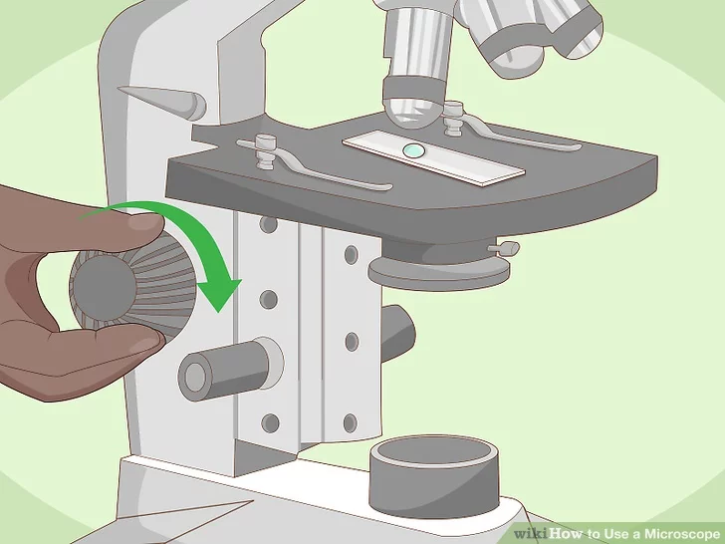

Slide 23
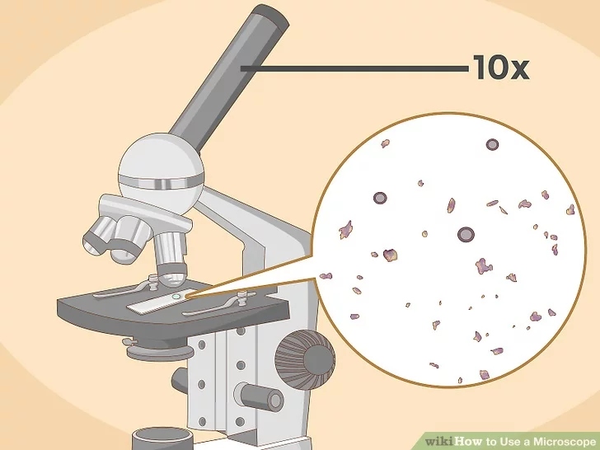
5. Magnify the image with a higher objective.
Switch to a higher objective only when you cannot focus it further with the low power objective scope. The higher magnification will allow you to see more detail in your specimen. Not all high objectives are used with all slides, since some can focus too closely. Use caution when switching between objectives to avoid breaking the slide.
Use the fine adjustment knob when working with the higher objectives. Because the coarse knob moves the objectives closer to the stage, the slide can crack if you’re not paying attention.

Slide 24
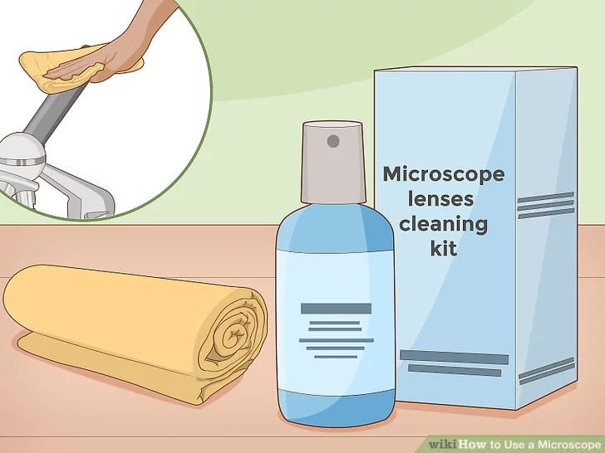
6. Store the microscope in a dust cover.
Lenses can easily be damaged by dust and other floating particles. Keeping the lenses and stage clear of dust will prevent damage from occurring. Only clean the lens with approved solution and a lint-free cloth.

Slide 25


