Slide 1
Year 2
Endocrine System Module
Bacterial Infections in Diabetic Foot Ulcer
By
Assist. Prof. Dr. Humam Kasem Hussein

Slide 2
Overview of the Endocrine System
Endocrine systems, also referred to as hormone systems, are found in all mammals, birds, fish, and many other species. The endocrine system consists of:
Glands located throughout the body.
Hormones made by the glands and released into the bloodstream.
Receptors in various organs and tissues that recognize and respond to the hormones.

Slide 3

Where are Endocrine Glands Located in the Human Body?

Slide 4
Diabetes mellitus (DM) is one of the most common endocrine diseases affecting millions of people worldwide. Its prevalence is increasing rapidly. Diabetes mellitus is the leading cause of kidney dysfunction, blindness, strokes, lower limb amputation, and heart attacks.
Complications associated with DM are diabetic retinopathy, neuropathy, and nephropathy. DM also impairs the ability of the human body to fight infections by weakening cellular immunity.

Slide 5
In general, people with diabetes have an increased risk of infection, and worse outcomes are known to be diabetes foot infection, urinary tract infection (especially E. coli infection), streptococcus pneumonia, Candida and mucor invasive fungal infection, and frequent skin infections.

Slide 6
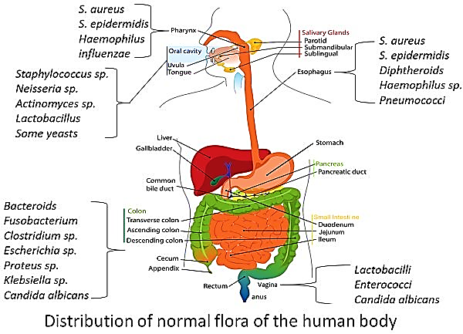

Slide 7
Bacterial Infection of Endocrine System
The incidence of bacterial infections of endocrine glands is low when compared to that in other organs of the body. The endocrine glands that may be affected by bacterial infections are: Pituitary, Thyroid, Adrenals and Gonads. Bacterial infection of parathyroid glands is extremely rare.

Slide 8
Among all the bacteria, Mycobacterium tuberculosis remains the most common agent involving the endocrine glands.
This organism can affect the adrenal glands and lead to primary adrenal insufficiency especially in developing countries.
Tuberculosis can also affect pituitary, thyroid, and gonads.

Slide 9
The other common bacteria that may affect the endocrine system are:
Staphylococcus aureus
Streptococcus pneumoniae
Neisseria meningitides (G -ve)
Escherichia coli
Pseudomonas aeruginosa (G -ve)
Klebsiella pneumoniae (G -ve)
Treponema pallidum (G -ve)
Yersinia enterocolitica (G -ve)

Slide 10
Bacterial Infections in Diabetic Patients

Slide 11
Due to weakened defenses and disease complications, people with diabetes are susceptible to new infections and recurrences. Uncommon life-threatening infections are more frequent in people with diabetes than in people without diabetes such as necrotizing soft tissue infection.
Diabetes is associated with the risk of blood flow infections obtained in communities and hospitals. Causing the change of congenital immune response and acquired immune response, increasing immune function disorder, chronic inflammation, and microbial persistence.

Slide 12
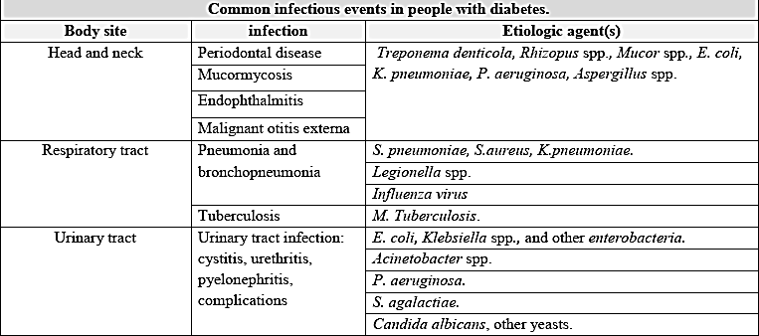
Common infectious events in people with diabetes

Slide 13
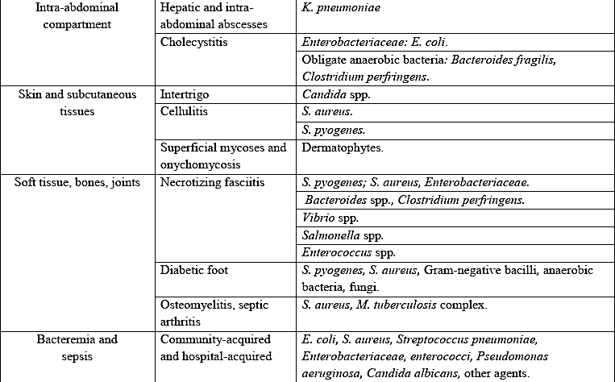

Slide 14
Diabetic Foot Infection
Pathophysiology
Patients with diabetes are particularly susceptible to foot infection primarily because of neuropathy, vascular insufficiency, and diminished neutrophil function.
Peripheral neuropathy has a central role in the development of a foot infection and it occurs in about 30 to 50 percent of patients with diabetes.

Slide 15
Patients with diabetes lose the protective sensations for temperature and pain, impairing awareness of trauma such as abrasions, and penetrating foreign body. Motor neuropathy can result in foot deformities, making skin ulceration even more likely. Once the skin is broken (typically on the plantar surface), the underlying tissues are exposed to colonization by pathogenic organisms.
The resulting wound infection may begin superficially, but with delay in treatment and impaired body defense mechanisms caused by neutrophil dysfunction and vascular insufficiency, it can spread to the subcutaneous tissues and to even deeper structures.

Slide 16
Pathogens
*Most Diabetic Foot Infections (DFIs) are polymicrobial.
Aerobic Gram positive:
Staphylococcus aureus
Streptococcal spp.
Enterococcus spp.
b) Aerobic Gram negatives
Enterobacteriaceae
Pseudomonas aeruginosa
c) Anaerobes, facultative anaerobes: usually when ulcers are deep, chronic and/or necrotic tissue is present.
Bacteroides fragilis (G -ve)
Clostridia spp. (G +ve)

Slide 17
*Superficial, early infections (cellulitis, cellulitis involving blisters and ulcers) are typically caused by S. aureus.
*Infections of ulcers that are chronic may be caused by aerobic Gram-negative bacilli, S. aureus and Streptococci.
*Deep soft tissue infections, osteomyelitis, and gangrene are more often polymicrobial, including aerobic Gram-negative spp and anaerobes (Bacteroides fragilis, Clostridium species), but Staphylococcus aureus is also common as a single pathogen.

Slide 18
The Diagnosis

Slide 19
The clinical diagnosis of foot infection is based on the presence of purulent discharge from an ulcer or the classic signs of inflammation (i.e., erythema, pain, tenderness, warmth, or induration). Other suggestive features of infection include foul odor, the presence of necrosis, and failure of wound healing despite optimal management.
Local inflammatory findings may be less prominent or absent in some diabetic foot infections. For example, pain and tenderness may be reduced or absent in patients who have neuropathy, whereas erythema may be absent in those with vascular disease.

Slide 20
The Treatment

Slide 21

Effective management of diabetic foot infection requires appropriate antibiotic therapy, surgical drainage, debridement and resection of dead tissue, appropriate wound care.

Slide 22
Antibiotic therapy
The selection of antibiotic therapy for diabetic foot infection involves decisions about choice of empiric and definitive antibiotic agent, route of administration, and duration of treatment.
Initial empiric antibiotic therapy should be based on the severity of the infection, history of recent antibiotic treatment, previous infection with resistant organisms, recent culture results, current Gram stain findings, and patient factors (e.g., drug allergy).

Slide 23
The empiric antibiotic regimen for diabetic foot infection should always include an agent active against S. aureus and streptococci. The patient should be reviewed 24 to 72 hours after initiating empiric antibiotic therapy to evaluate the response and to the antibiotic course of therapy.
Antibiotic therapy should not be used for foot ulcers without signs of infection because it does not enhance wound healing or prevent infection. Clinical failure of appropriate antibiotic therapy might be because of antibiotic resistance, superinfection, undiagnosed deep abscess and osteomyelitis.

Slide 24


