Slide 1
*Biosafety Barriers in Biological Labs.
*Microscope
By
Assist. Prof. Dr. Humam Kasem Hussein

Slide 2
Types of Laboratories
The laboratories can be divided to several types based on the form of work done.
1. Research and development (R&D) laboratories:
They provide research operations across various industries like technology and pharmaceuticals.
2. Medical or Clinical laboratories:
A medical laboratory is a place where doctors and other health professionals do tests on samples from patients in order to provide them with information about their health. Mostly found in hospitals and clinics or pharmaceutical companies.

Slide 3
3. Biosafety Laboratories:
Scientists use biosafety labs to study contagious materials safely and effectively. These state-of-the-art متطور facilities are designed not only for researchers protection from contamination but also to help prevent microorganisms from entering our environment as well.
4. Chemistry laboratory
Most laboratories are used for chemistry. Substances that do not occur in nature are produced, and substances that can be purified exist naturally or have been extracted from something else through laboratory processes like distillation with boiling point.

Slide 4
5. Physics laboratory
A physics laboratory refer to all sorts of equipment that can control light or slow it down, create materials without resistance, investigate how objects behave under pressure.
6. Biological laboratory
In these laboratories, research is carried out into, for example, fungi, bacteria or virology (microbiology laboratories). Another form of a biological laboratory is botanyعلم النبات , where tests are carried out on plants.

Slide 5
Biosafety: is the safe handling and containment of infectious microorganisms and hazardous biological materials. This includes how we handle animals, plants, cell culture, bacteria, viruses, fungi, parasites and public health crisis such as CoVID-19.
The goal of biosafety is to reduce or eliminate exposure of lab personnel, the community and the environment to potentially infectious or hazardous agents and this is achieved via the principles of containment and risk assessment.
Biosecurity: is defined as the strategic approach to analyzing and managing risks to human heath, animal and plant life and the associated risks to the environment.
laboratory biosecurity is a set of systems and practices employed in research facilities to protect microbial agents from loss, theft, diversion or intentional misuse.

Slide 6
Laboratory Biosafety Barriers
Primary barriers:
Physical barriers or personal protective equipment between lab worker and pathogen. Gloves, masks, special breathing apparatuses. Laboratorians use these types of safety equipment to protect themselves directly when working with organisms.
Secondary barriers:
Are structural aspects of the laboratory itself that make the working environment safer against the risk of infection; these include sinks for handwashing, special containment areas for working directly with organisms, and special air ventilation patterns designed to prevent contamination of other rooms and other workers in the building.

Slide 7
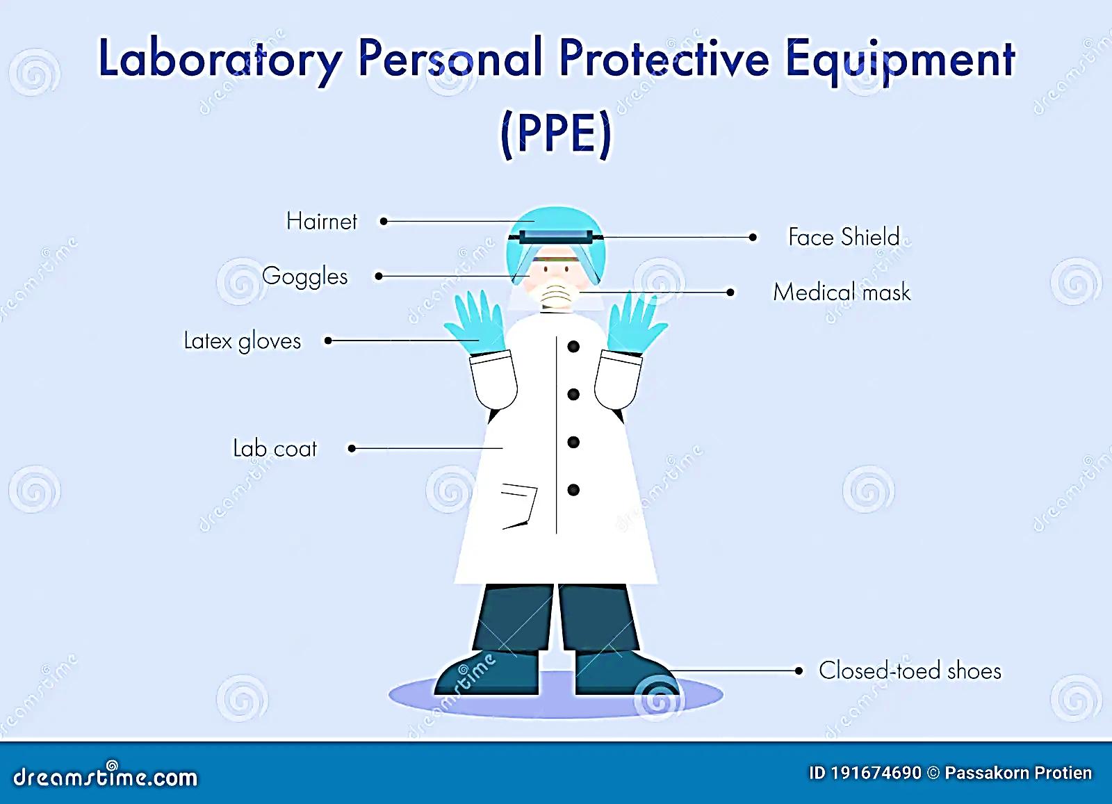

Slide 8
Biosafety Levels
There are four biosafety levels (BSLs) that define proper laboratory techniques, safety equipment, and design, depending on the types of agents being studied:
1. Biosafety Level 1 (BSL-1)
The lowest of the four biosafety levels, biosafety level 1 (BSL-1) applies to laboratory settings in which personnel work with low-risk microbes that pose little to no threat of infection in healthy adults — for example, a BSL-1 laboratory might work with a nonpathogenic strain of E.coli. BSL-1 labs typically conduct research on benches, do not use special contaminant equipment, and do not need to be isolated from surrounding facilities.

Slide 9
Safety protocols for biosafety level 1 labs — which require only standard microbial practices — include:
Mechanical pipetting (no mouth pipetting allowed).
Avoidance of splashes or aerosols.
Daily decontamination of all work surfaces when work is complete.
Regular handwashing.
Prevention of food, drink, and smoking materials.
The use of PPE, such as goggles, gloves, and a lab coat or gown.
Biohazard signs.

Slide 10
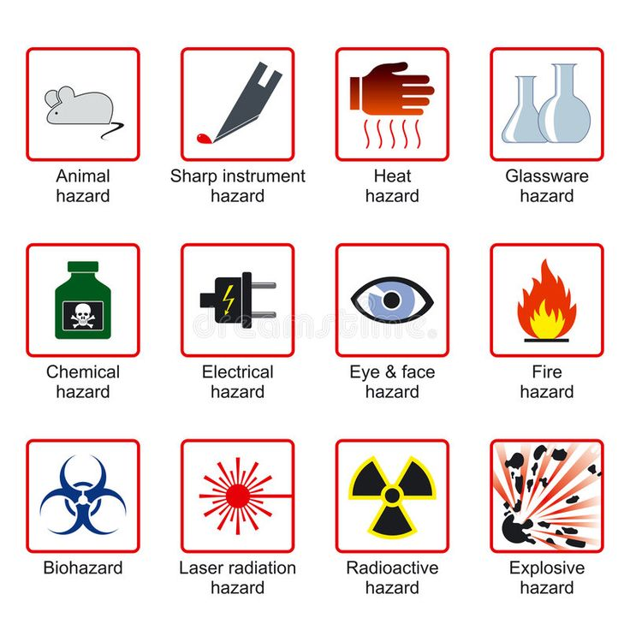

Slide 11
2.Biosafety Level 2 (BSL-2)
Biosafety level 2 (BSL-2) covers all laboratories that work with agents associated with human diseases — that is, pathogenic or infectious organisms — that pose a moderate health hazard. Common examples of agents found in a BSL-2 lab include staphylococcus aureus (staph infections).
BSL-2 labs are required to maintain the same standard microbial practices as BSL-1 labs, as well as enhanced measures due to the potential risk of that microbes. Personnel working in biosafety level 2 laboratories are expected to take even greater care to prevent injuries, such as cuts and other breakage to the skin, as well as ingestion and mucous membrane exposures.

Slide 12
In addition to the safety protocols established for BSL-1 labs, BSL-2 labs are subject to the following safety controls:
The use of PPE, including lab coats, gloves, eye protection, and in some cases face shields
All procedures that could cause infection from aerosols or splashes must be performed within a biological safety cabinet.
Decontamination of infectious materials prior to disposal, generally through the use of an autoclave.
Access to a sink and eyewash station.
Biohazard warning signs.

Slide 13
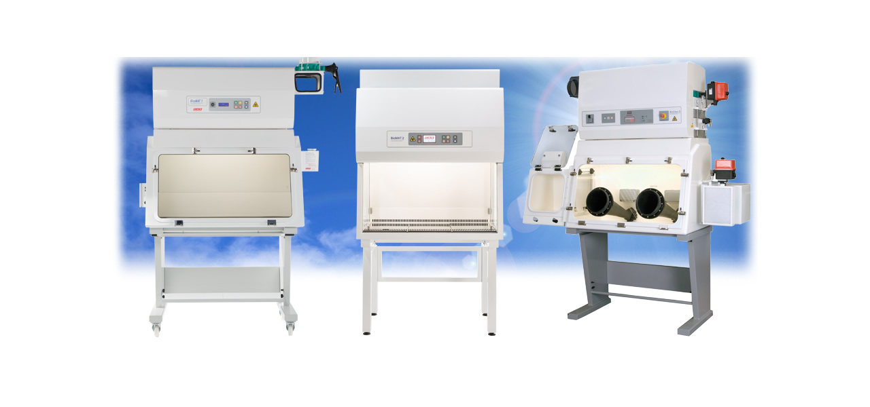


Slide 14
3. Biosafety Level 3 (BSL-3)
Once again building on the two prior biosafety levels, a biosafety level 3 (BSL-3) laboratory typically conducts research into or work on microbes that are either indigenous or exotic and can cause serious or potentially lethal disease through inhalation. Common examples of microbes found in BSL-3 labs include the bacteria that causes tuberculosis.
Microbes found within biosafety level 3 settings are so serious that work is often strictly controlled and registered through the appropriate government agencies.
Laboratory personnel are also under medical surveillance مراقبةand may require immunizations for the microbes they work with.

Slide 15
Common safety controls within a BSL-3 lab include:
The use of PPE, including goggles and gloves; respirators may also be required.
Access to a hands-free sink and eyewash station available near the exit.
Sustained directional airflow to draw air into the laboratory from clean areas toward potentially contaminated areas.
Self-closing set of locking doors with access away from general building corridors

Slide 16
4. Biosafety Level 4 (BSL-4)
Biosafety level 4 (BSL-4) labs are rare; however, a small number exist in the U.S. and around the world. As the highest level of biological safety, BSL-4 labs work with highly dangerous and exotic microbes, such as the Ebola viruses. Infections caused by these types of microbes are often fatal and come without treatment or vaccines.

Slide 17
In addition to biosafety level 3 considerations, biosafety level 4 laboratories must follow these safety protocols:
Personnel must change clothing before entering the facility and shower upon exiting.
All materials must be decontaminated before leaving the facility.
Personnel must wear the PPE as well as a full-body, air-supplied.
Access to a Class III biological safety cabinet.

Slide 18
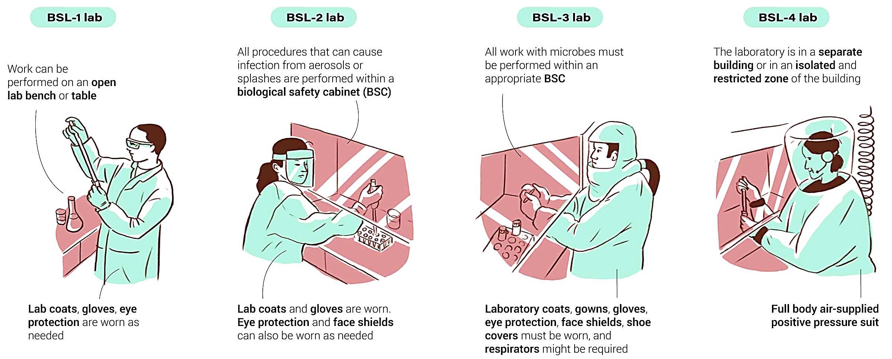

Slide 19
Microscope
Microscope – an instrument that produces an enlarged image of an object.
Biologists use microscopes to study cells, cell parts, and organisms that are too small to be seen with the naked eye.
Microscopes magnify and show details of the image.
Two types of microscopes:
  Light Microscope – light passes through one or more lenses to produce an enlarged image of a specimen.
  Electron Microscope – forms image of a specimen using a beam of electrons rather than light.

Slide 20
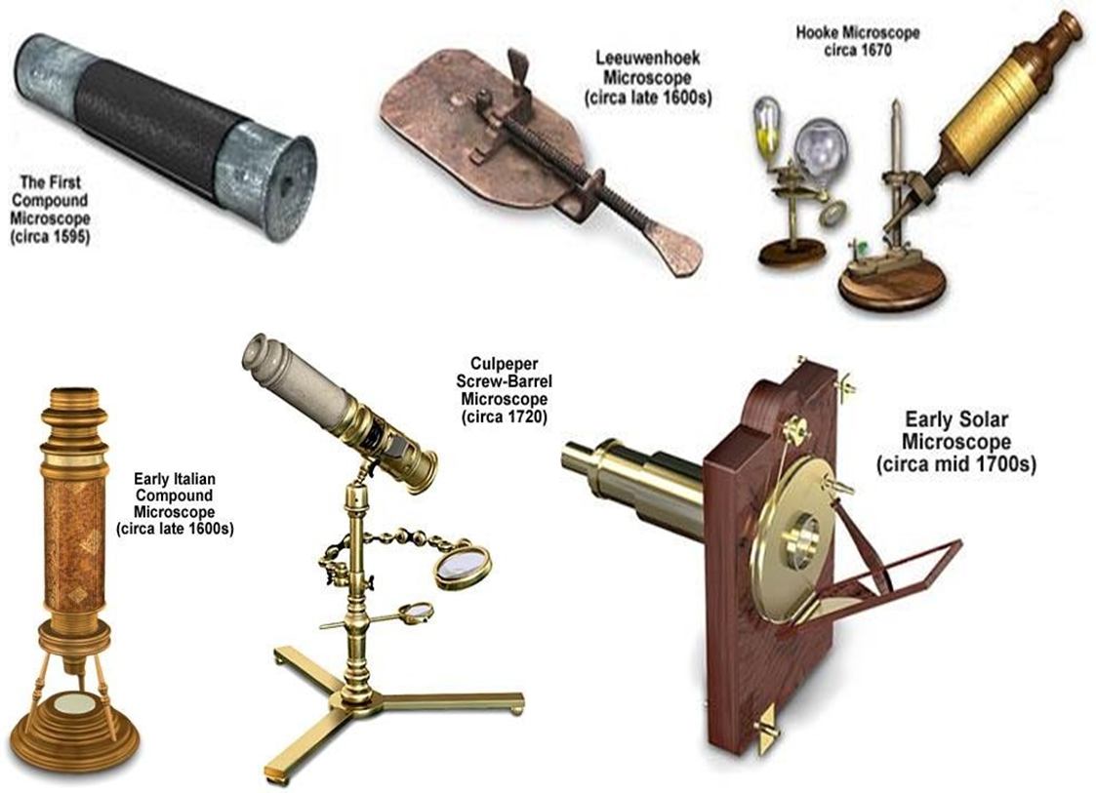


Slide 21
Zacharias Janssen : Dutch spectacle maker who tested several lenses in a tube and discovered that nearby objects appeared significantly enlarged.
* Robert Hooke: used a microscope to observe a thin slice of cork. The spaces he saw reminded him of the small rooms where monks lived, so he called them “cells,” which he used to describe the smallest units of life.
He used microscopes with two and three lenses, but they didn’t produce very detailed images.

Slide 22
Anton van Leeuwenhoek: produced clearer and more enlarged images than Hooke’s.
  He is considered “The Father of Microscopy” and built over 500 different microscopes.
  He was the first to discover microorganisms under a microscope by observing a drop of pond water filled with life. He called them “tiny animalcules.”
  He also saw and studied bacteria and the blood flow through capillaries in the tail of a fish.

Slide 23
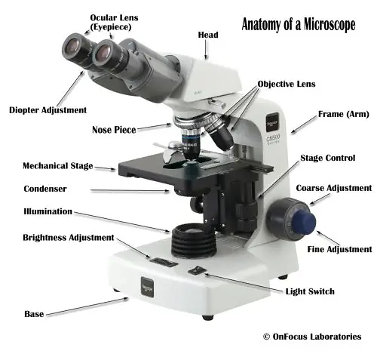

Slide 24
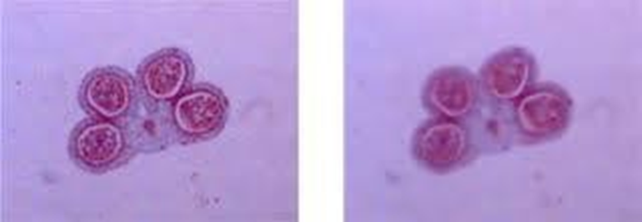
The Electron Microscope
Resolution is the limiting factor to a light microscope since the greater the magnification is, the less it is able to resolve the image. At magnifications beyond 2,000x, the image becomes blurry, but electron microscopes can be used at greater magnifications.

Slide 25
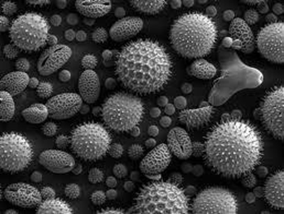
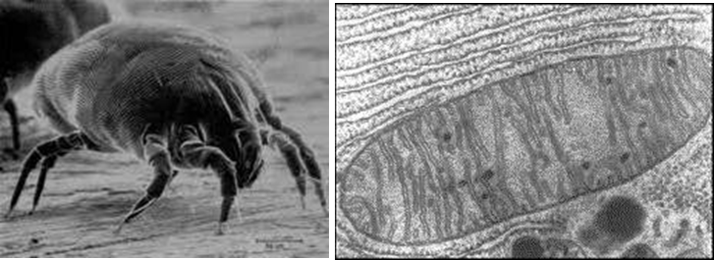

Characteristics of the Electron Microscope
  A beam of electrons is used to produce an enlarged image of the specimen (it does not use light).
  This electron beam and the specimen must be placed inside a vacuum chamber so that the electrons in the beam do not bounce off gas molecules in the air.
    Since living things cannot survive in a vacuum, the electron microscope cannot be used to view living cells.
Mitochondrion

Slide 26
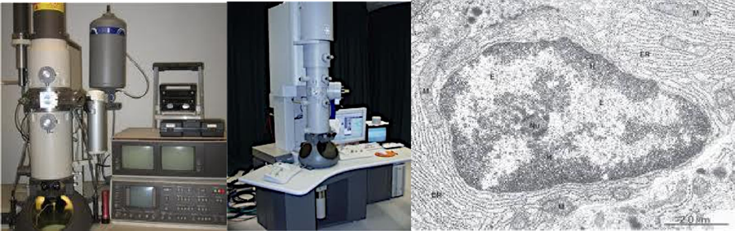
There are two types of electron microscopes:
  Transmission Electron Microscope (TEM)
Uses a beam of electrons transmitted through a very thinly sliced specimen. Magnets guide the beam of electrons toward the specimen, and the image is produced to view.
Magnification to 2500000 times.

Slide 27
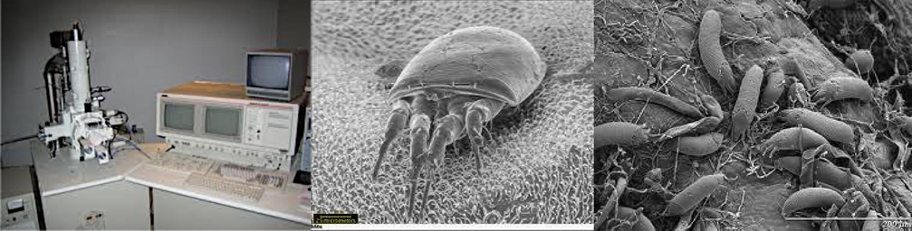
2. Scanning Electron Microscope (SEM)
Provides detailed 3-D images.
The specimen is sprayed with a fine metal coating.
As the beam of electrons is passed over the specimen’s surface, the metal coating emits a shower of electrons, and a 3-D image of the specimen’s surface is produced to view.
Magnification to 100000 times.

Slide 28


