Slide 1
Lab
Kingdom Protista
Sub kingdom Protozoa
Phylum Ciliophora
Subphylum : Ciliata
Class : Holotricha
Genus: Paramecium
Species : P. caudatum
Species 2 : P.bursaria

Slide 2
Paramecium is prevalent in freshwater , though some species can thrive in marine environment. Paramecium is a slipper - shaped and have two nuclei ( a large macronucleus and a single compact micronucleus ) . They cannot survive without the macronucleus and cannot reproduce without the micronucleus . Like all ciliates, the cilia plays a crucial role in the overall functioning of a paramecium body . While in water , groups of cilia orient in a particular direction , allowing the cell to propel forward or backward . The oral groove (cytostome or peristome ) is lined by compound cilia , which help in drawing foods inside the cell . Basically , paramecium feeds on bacteria , yeast and small algae . Thus , cilia serve as locomotory and feeding part of this unicellular organism .

Slide 3
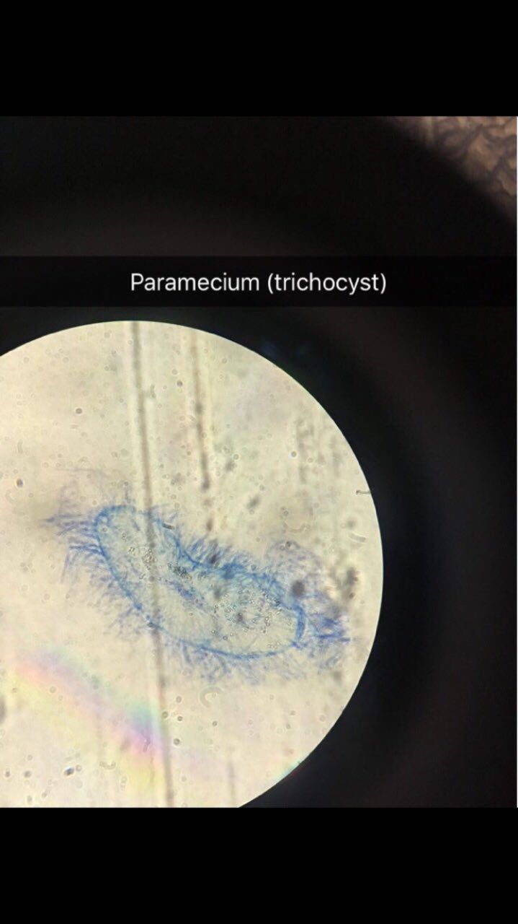
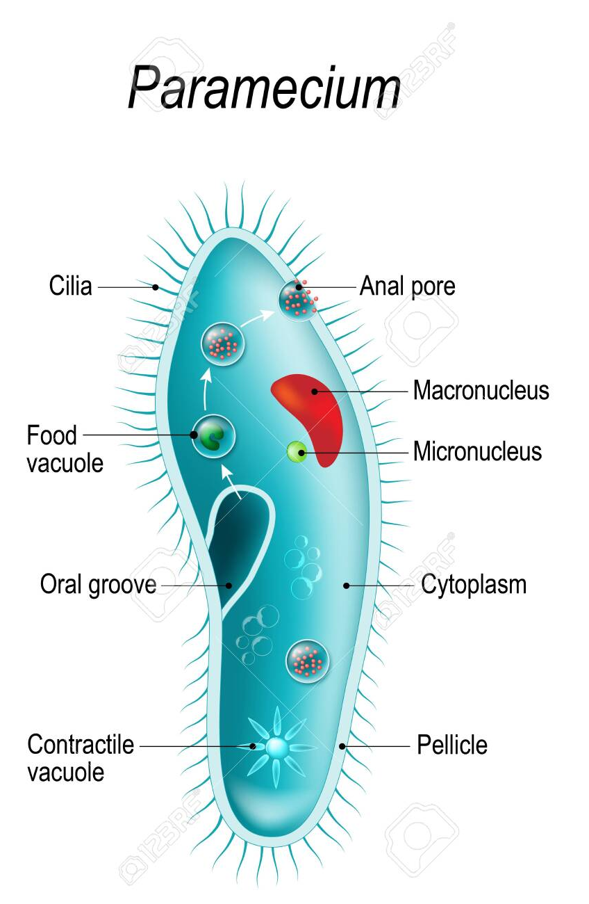

Slide 4
paramecium reproduce asexually , by binary fission . During reproduction , the macronucleus splits by a type of mitosis , and the micronuclei undergo mitosis . The cell then divides transversally , and each new cell obtains a copy of the micronucleus and the macronucleus , and it's reproduce sexually , by conjugation , During conjugation , the micronuclei of each conjugant divide by meiosis and the haploid gametes pass from one individual to the other . The gametes of ench organism then fuse to form diploid micronuclei . The old macronuclei are destroyed , and new ones are developed from the new micronuclei .

Slide 5
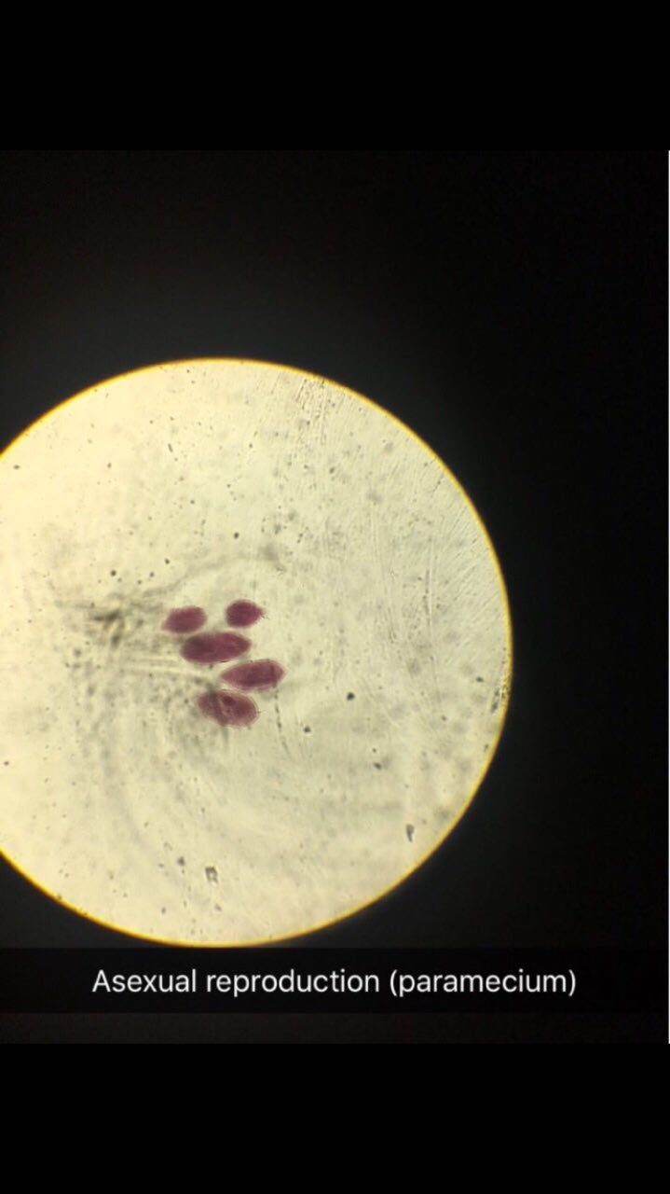
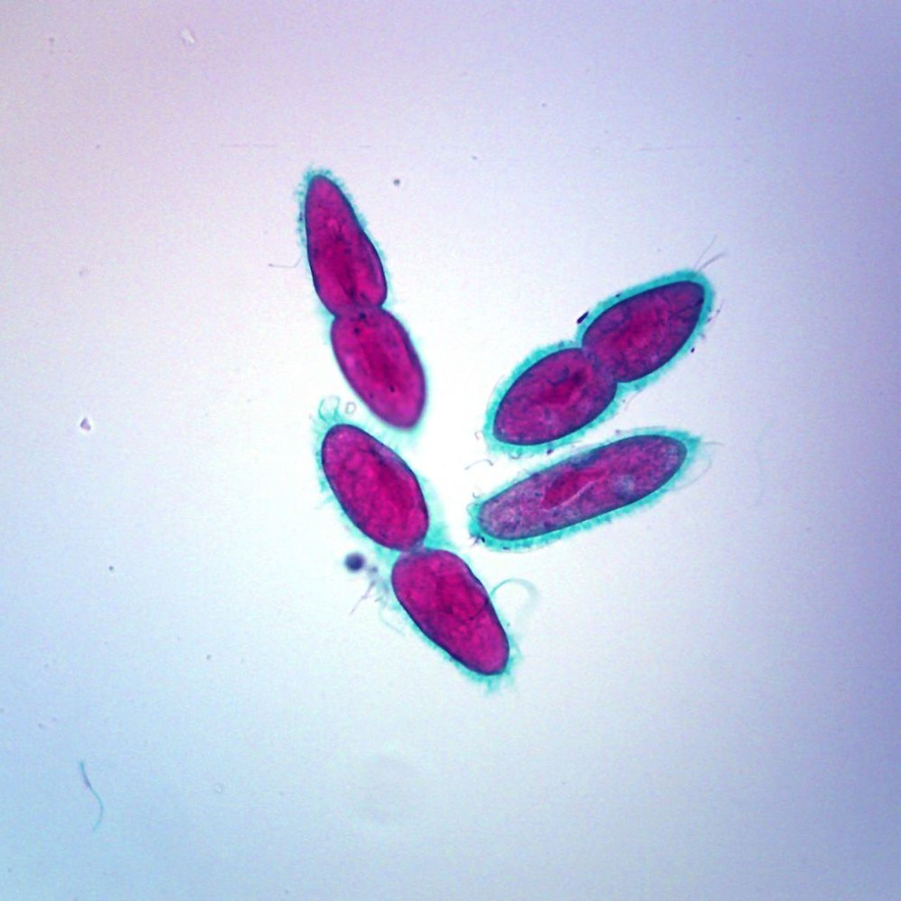

Slide 6
Paramecium bursaria is a species of ciliate protozoan that has a mutualistic symbiotic relationship with green algae called Zoochlorella . The algae live inside the Paramecium in its cytoplasm provide it with food , while the Paramecium provides the algae with movement and protection . P. bursaria is 80-150 um long , with a wide oral groove , two contractile vacuoles , and a single micronucleus as well as a single macronucleus . P bursaria is the only species of Paramecium that forms symbiotic relationships with algae , and it is often used in biology classrooms both as an example of a protozoan and also as an example of symbiosis .

Slide 7
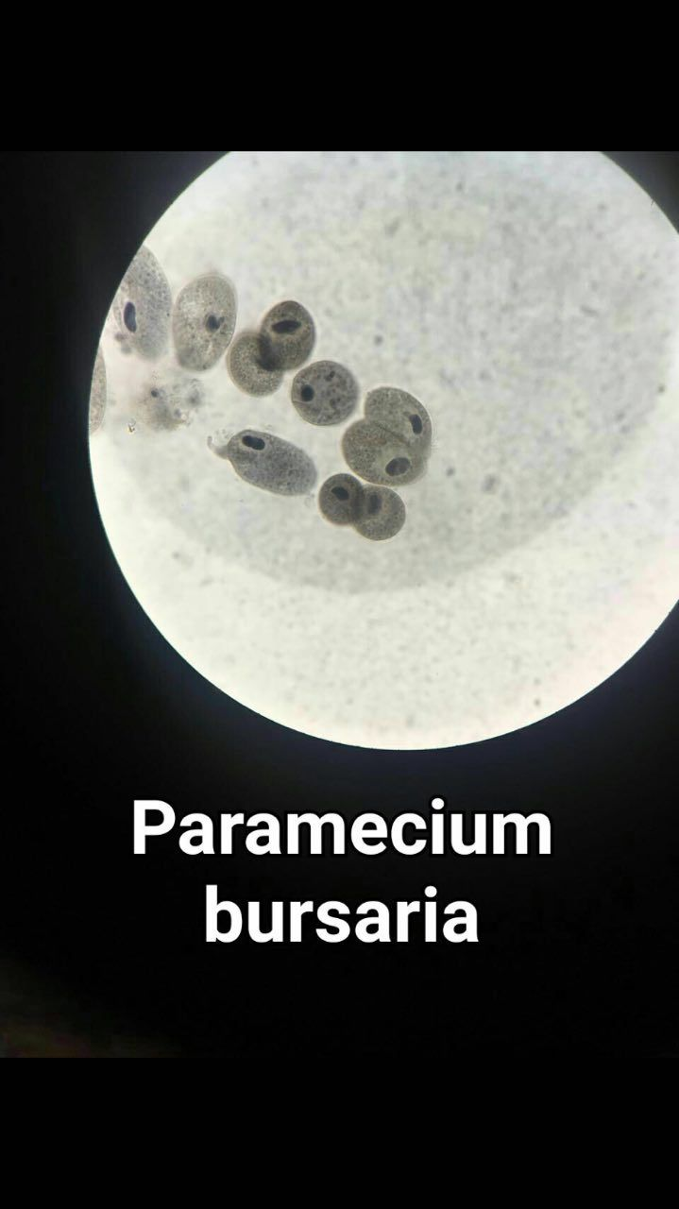
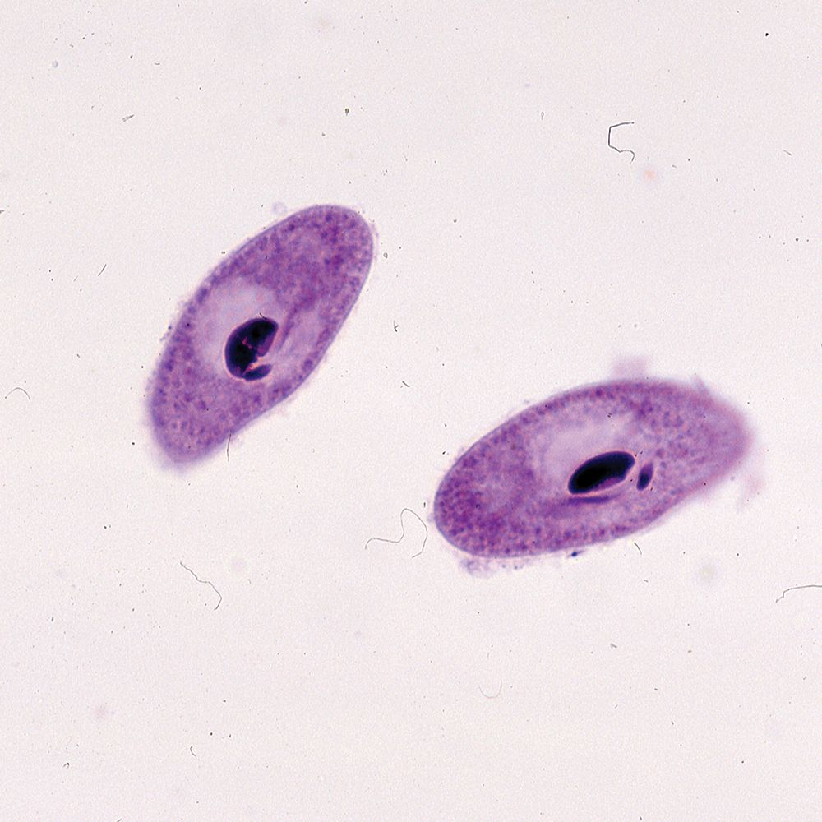

Slide 8
Paramecium caudatum is 120-330 um long . The cell body is roughly cigar shaped , rounded at the front , tapering at the posterior to a blunt point . The pellicle is uniformly covered with cilia , and has a long oral groove , leading to deeply embedded oral cavity , lined with cilin . P. caudatum has two star - shape contractile vacuoles , and a cell envelope ( cortex ) densely studded with spindle - shaped extrusomes called trichocysts . The species is very common , and widespread in marine , brackish and freshwater environments.

Slide 9
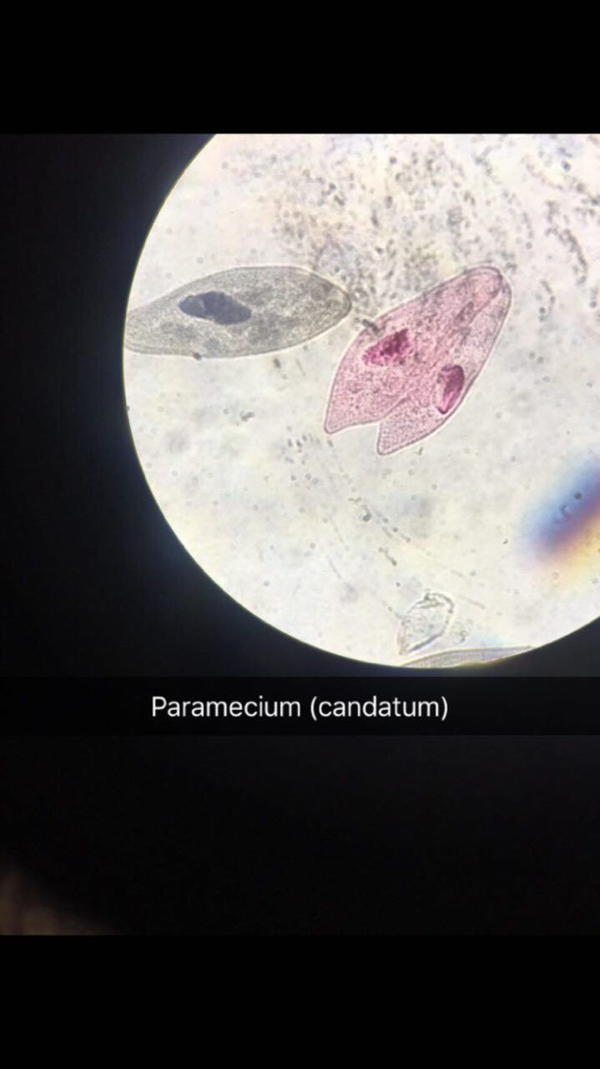
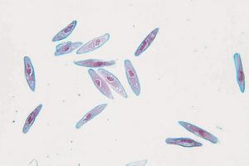

Slide 10
Species : Balantidium coli:
is the largest protozoa parasite inhabit in the large intestine of man caused Balantidiasis . It has two stage in their life cycle :
1- Trophozoite stage : Oval in shape , the anterior end is pointed and has groove leading to a mouth ( cytostome ) . The posterior end is broadly rounded and has an excretory opening known as cytopyge . The cytoplasm has : a - two nuclei , a macronucleus which is large and present in the middle of the body, It may kidney shaped and curved . The micronucleus is a small round and lies in close to the macronucleus . b - two contractile vacuoles which may lie side by side or one above the other e - food vacuoles which have food particles such as bacteria , starch granules . RBC , .... ect . The body covered with delicate pellicle embedded with it short cilia .

Slide 11
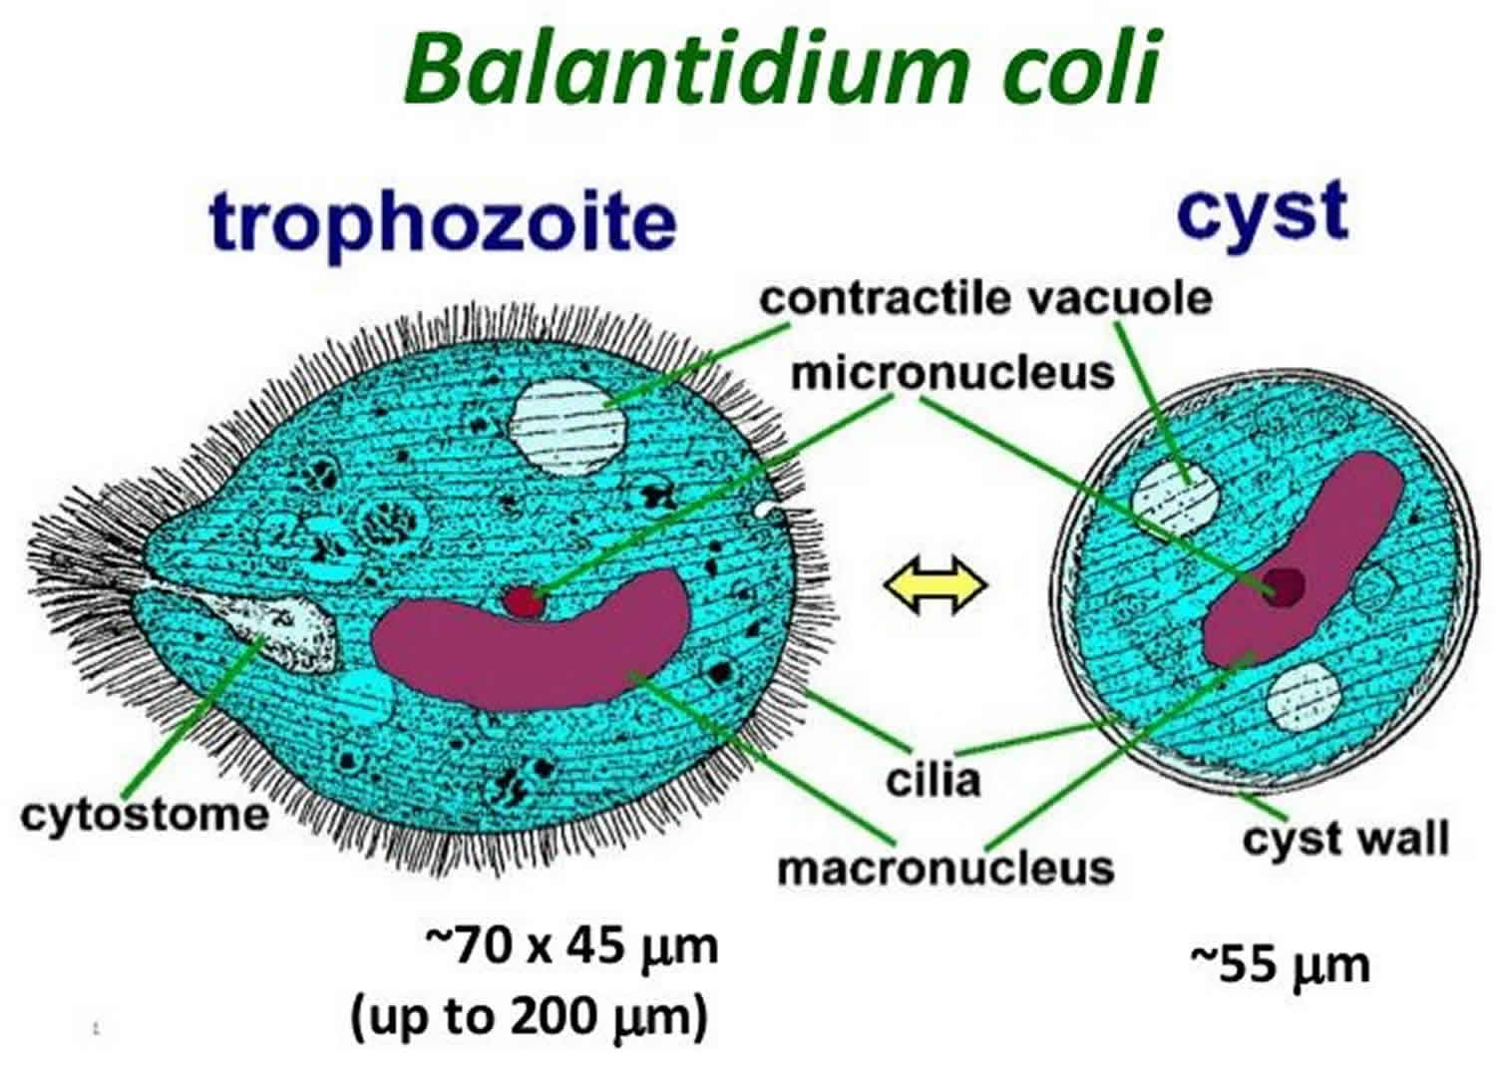

Slide 12
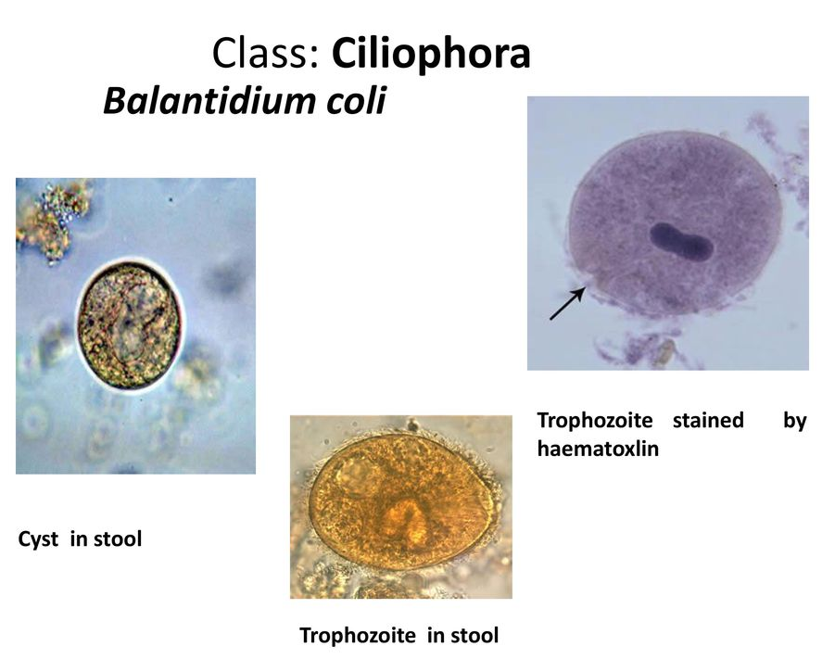

Slide 13
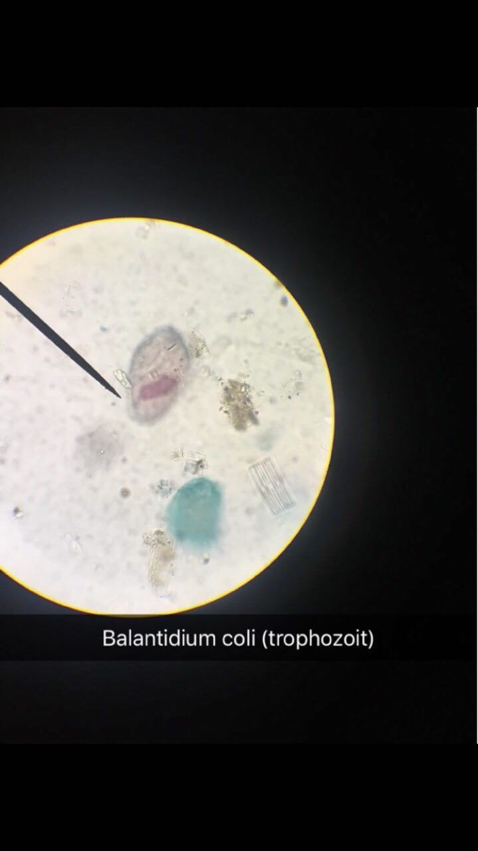

Slide 14
Cyst stage : Spherical or oval surrounded by a thick double - layered wall . In the mature cyst the cilia are absorbed , macronucleus micronucleus , and vacuoles are present in the cyst .
Pathogenicity : Most infection with B.coli are harmless Rarely the trophpzoites invade the mucosa and submucosa of the large intestine and produce ulcers or abscesses extend to the muscular layer . The ulcer round and covered with pus and necrotic material
Diagnosis : G.S.E.

Slide 15
