Slide 1
Protozoa lab
DR. Aveen Ramadhan
Lab3
Kingdom: Protista
Sub kingdom: Protozoa
• Phylum: Sarcomastigophora (Sarcomastigina)
• Sub phylum: Mastigophora (Flagellata)
•Class: zoomastigina (zooflgellata)
Order: Protomonadina

Slide 2
1-Genus ;Leishmania
Leishmania a parasite genus responsible for the disease Leishmaniasis1-Genus ;Leishmania
Leishmania a parasite genus responsible for the disease Leishmaniasis .
It spread through sand flies of the genius Phlebotomus (intermediate host) and their final hosts are vertebrate such as rodents ;humans:
This parasite have two stages in its life cycle :
1_Amastigote stage - Round - non motile , which have Oval nucleus present near the middle of the body, kinetoplast present in front of nucleus extend from it short flagellum and not have undulating membrane.
2_Promastigote stage : Spindle shape nucleus present in the middle of the body . The kinetoplast is located in front of the nucleus, near the anterior end of the body. The flagellum is found in the anterior of the nucleus and not attached to the cell body, this stage not have undulating membrane

Slide 3
A-Leishmania donovani Causes visceral leishmaniasis (Kala azar )
affecting the spleen; liver: bone marrow; lymph nodes : lymphoid tissues Involved and resulting in severe hepatosplenomegaly

Slide 4
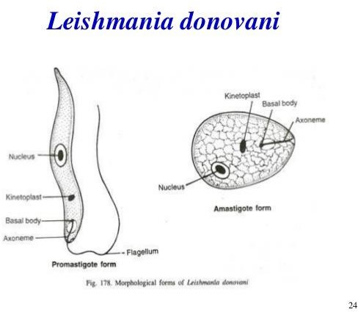
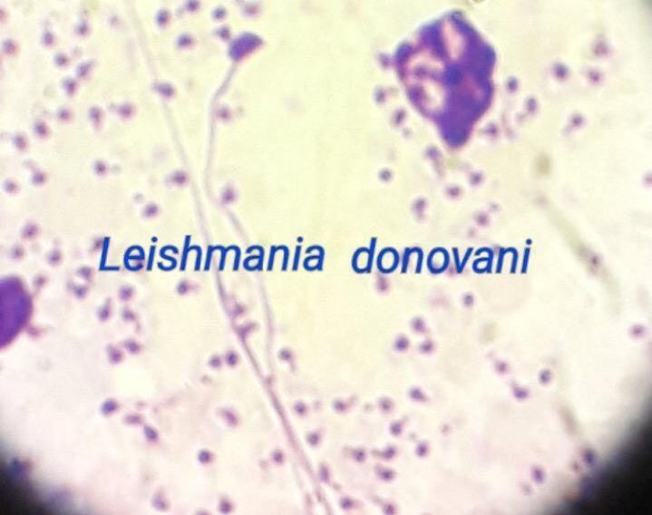

Slide 5
B-Leishmania tropica : causes cutaneous leishmaniasis which is develops at the site of a sand fly bite (the primary host) .
The sand fly carries the promastigote stage of L . tropica in its blood ,

Slide 6
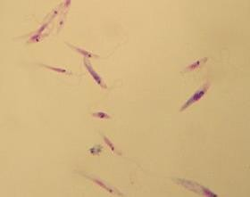

Slide 7
C-Leishmania braziliensis: It can causes mucocutaneous lesihmaniasis ( American lesihmaniasis).

Slide 8
2-Genus: Trypanosoma
Trypanosoma spp. is parasitic and heteroxenous (Requiring more than one obligatory host to complete life cycle) transmitted via vector.
The majority of its species are transmitted by blood feeding invertebrates, but there are different mechanisms among the varying species.
In the invertebrate host they are generally found in the intestine but normally occupy the bloodstream or in intracellular environment in the Mammalian host.

Slide 9
A-Trypanosoma brucei: cases the African Trypanosomiasis (or sleeping sickness) in human
It is transmitted by Glossina( tsetse fly).

Slide 10
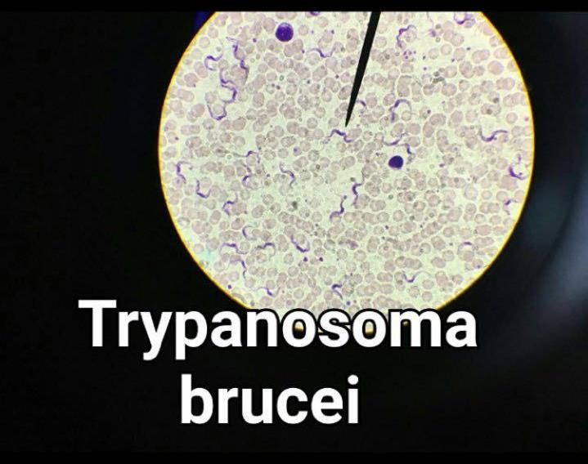

Slide 11
B-Trypanosoma cruzi: Causes American trypanosomiasis ( Chagas disease )in human and animal.
Transmissison occur when the reduviid (Triatomine bug) deposits feces on skin and subsequently bites.

Slide 12
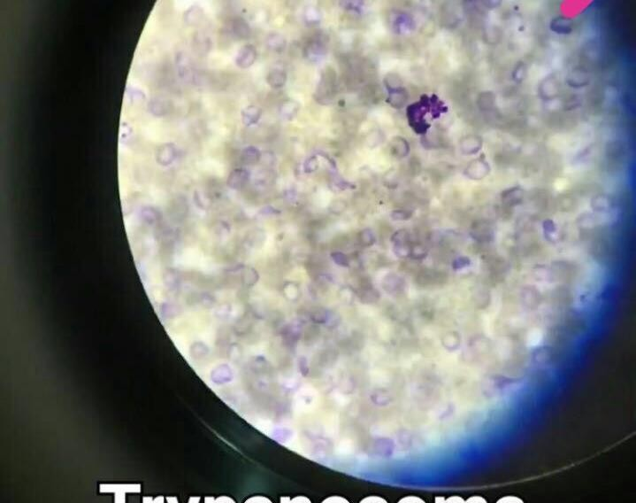

Slide 13
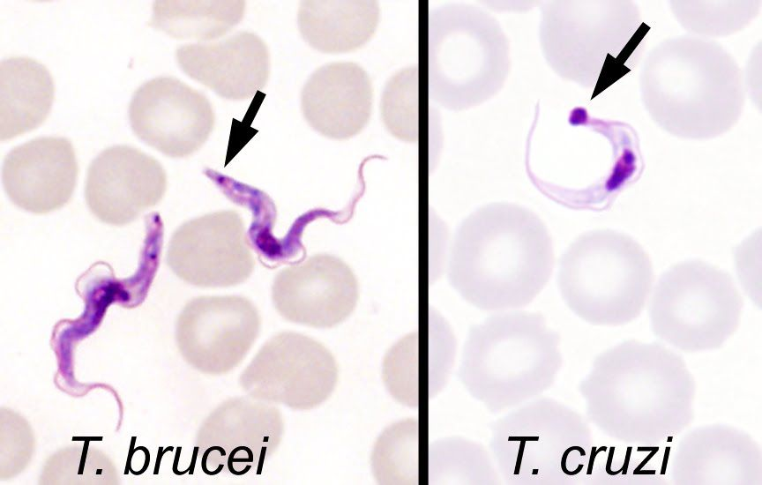
The most reliable method for differentiating the trypomastigotes (motile blood stage forms) of T. brucei and T. cruzi is by:
the size of the kinetoplast (see arrows).T. brucei has a relatively small kinetoplast, while T. cruzi has a larger kinetoplast.
T. cruzi trypomastigotes also commonly form a "C" shape, although this is a less reliable feature.
Finally, T. cruzi may also be found as a non-motile amastigote form in various tissues, while T. brucei is only found in the trypomastigote form in humans.

