Slide 1
Protozoa lab Lab 4
•Kingdom: Protista
•Sub kingdom : Protozoa
•Phylum : Sarcomastigophora (Sarcomastigina)
Sub phylum : Sarcodina (Rhizopodia)
•Class : Amoebina ( naked Amoeba )
•Genus 1: Amoeba
•Species : Amoeba proteus

Slide 2
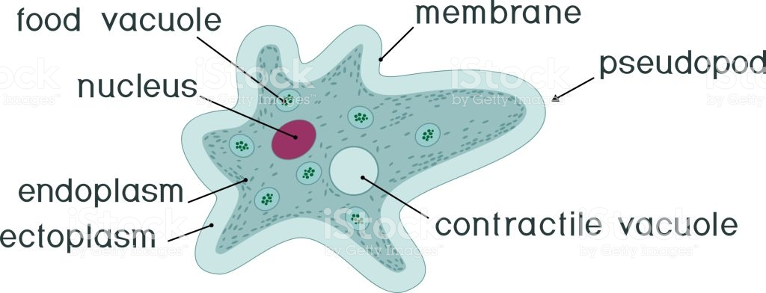
Amoeba proteus
- is free living organism in fresh and marine water, and many of them live in soil
- their body is tiny whitish flexible mass of protoplasm and change continuously with movement,
- consist of clear ectoplasm and granular endoplasm
- with many food vacuole (contain digestive enzyme), contractile vacuole
- has discoid shape nucleus in the center of the organisms
- amoeboid movement and food capture by pseudopodia (lobopodia)
- asexually reproduction by binary fission
- Amoeba can encyste with difficult condition.

Slide 3
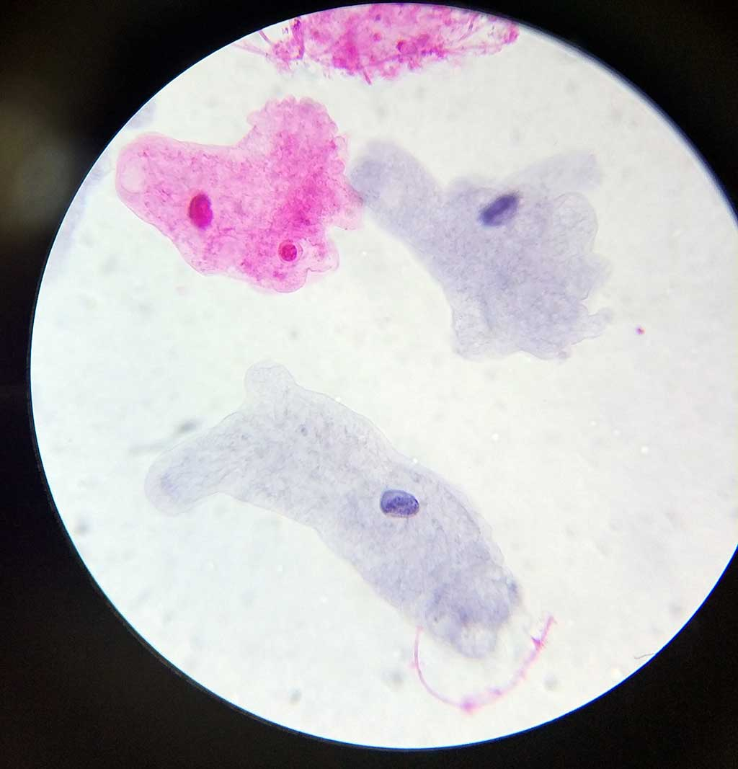

Slide 4
Genus2:Entamoeba
There are three common species for this genus :
Species l : Entamoeba histolytica
is pathogenic parasite , causing amoebiasis
which includes amoebic dysentery and amoebic liver abscesses ) , by feeding on the tissues and red blood cells ,
particularly in the lumen of large intestine ( colon)

Slide 5
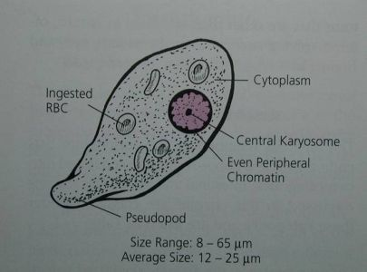
The common stage of this species recognized in the stool are
1 –Trophozoite stage :
is small in size, simple structure with very thin clear outer ectoplasm
an inner finely granular endoplasm
in which food vacuoles present that full with red blood cells ,
lack contractile vacuoles ,
it nucleus spherical in shape relatively large shows a central karyosome
the nuclear membrane is delicate and is lined by a single layer of fine chromatin granules.
Trophozoites are motile and movement often very slowly by throwing out short blunt pseuelopodia ( lobopodia) only one or two ,
asexual reproduction by binary fission.

Slide 6
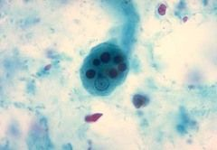
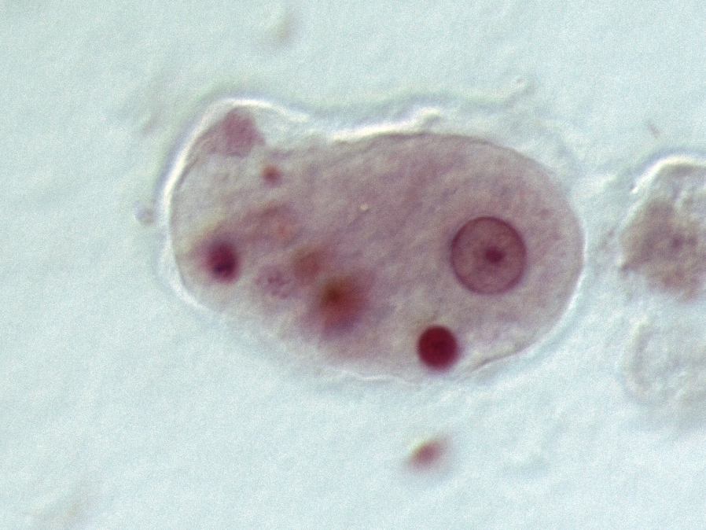

Slide 7
Species l : Entamoeba histolytica
2- Cyst stage : it is has two forms are
A- lmmature cyst( pre cyst ) uninucleate or binucleate Cyst
B- Mature cysts quadrinucleate cysts
The cyst is spherical in shape and surrounded by thick wall which make it highly resistance to the gastric acid.
The cytoplasm contains Vacuoles(in young Cysts ) with dark stained glycogen sausage shaped bars called (chromatoid bodies). The mature infective cyst contain four nuclei.

Slide 8
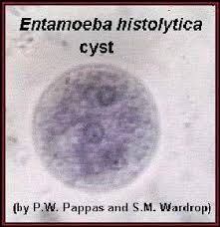
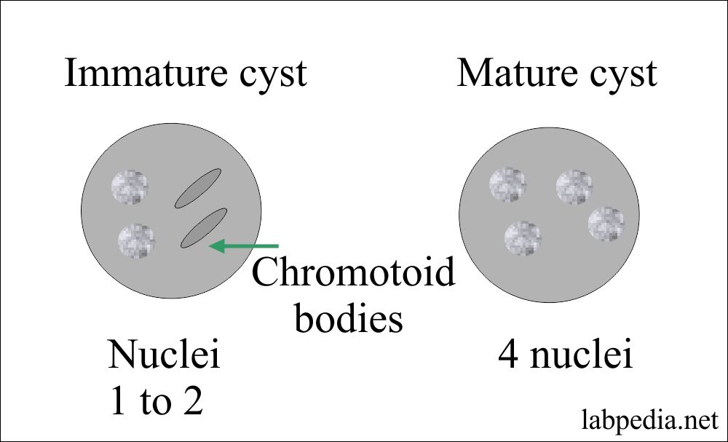
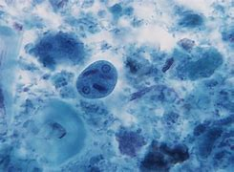

Slide 9
Species 2 : Entamoeba coli
it lives normally in the lumen of large intestine of man and is non pathogenic .
The trophozoite is colorless , the ectoplasm is usually difficult to distinguish from the granular and vacuolated endoplasm .
within the endoplasm there are few food vacuoles usually contain bacteria.
The round nucleus has a thick membrane lined with irregular of coarse chromatin granules and large eccentric karyosomne .
The pseudopodia are short and granular

Slide 10
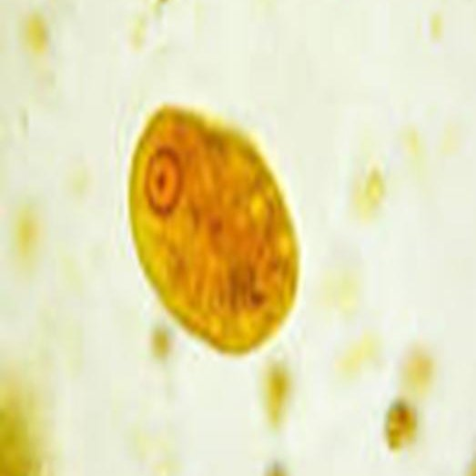
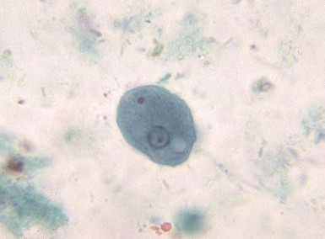

Slide 11
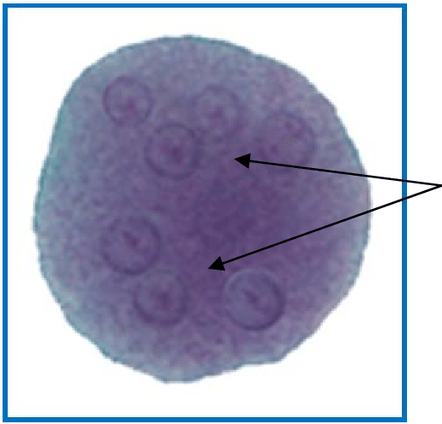
Immature cysts contain glycogen vacuole and sharp ended chromatoidal bodies . But in mature cyst , the glycogen and the chromatoidals appear less or disappear and containing 8 nuclei with eccentric karyosomes .

Slide 12
Species 3: Entamoeba gingivalis
lives harmlessly in the mouth of the man , feeding on the bacteria around the bases of the teeth -

