Slide 1
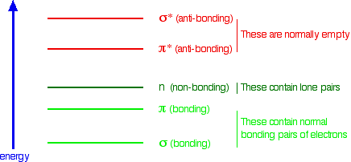
UV-VISIBLE ABSORPTION SPECTRA
This page explains what happens when organic compounds absorb UV or visible light, and why the wavelength of light absorbed varies from compound to compound.
What happens when light is absorbed by molecules?
Promotion of electrons
When we were talking about the various sorts of orbitals present in organic compounds on the introductory page you will have come across this diagram showing their relative energies:

Slide 2
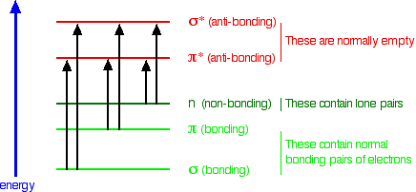
When light passes through the compound, energy from the light is used to promote an electron from a bonding or non-bonding orbital into one of the empty anti-bonding orbitals.
The possible electron jumps that light might cause are:
In each possible case, an electron is excited from a full orbital into an empty anti-bonding orbital. Each jump takes energy from the light, and a big jump obviously needs more energy than a small one.

Slide 3
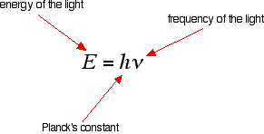
Each wavelength of light has a particular energy associated with it. If that particular amount of energy is just right for making one of these energy jumps, then that wavelength will be absorbed - its energy will have been used in promoting an electron.
We need to work out what the relationship is between the energy gap and the wavelength absorbed. Does, for example, a bigger energy gap mean that light of a lower wavelength will be absorbed - or what?
It is easier to start with the relationship between the frequency of light absorbed and its energy:

Slide 4
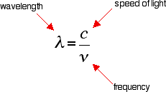
You can see that if you want a high energy jump, you will have to absorb light of a higher frequency. The greater the frequency, the greater the energy.
That's easy - but unfortunately UV-visible absorption spectra are always given using wavelengths of light rather than frequency. That means that you need to know the relationship between wavelength and frequency
You can see from this that the higher the frequency is, the lower the wavelength
So . . . If you have a bigger energy jump, you will absorb light with a higher frequency - which is the same as saying that you will absorb light with a lower wavelength.

Slide 5
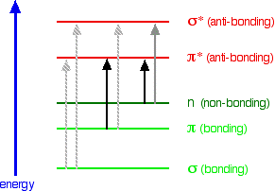
Some jumps are more important than
others for absorption spectrometry
An absorption spectrometer works in a range from about 200 nm (in the near ultra-violet) to about 800 nm (in the very near infra-red).
Only a limited number of the possible electron jumps absorb light in that region.
Look again at the possible jumps. This time, the important jumps are shown in black, and a less important one in grey. The grey dotted arrows show jumps which absorb light outside the region of the spectrum we are working in.
Remember that bigger jumps need more energy and so absorb light with a shorter wavelength.
The jumps shown with grey dotted arrows absorb UV light of wavelength less that 200 nm.

Slide 6
The important jumps are:
from pi bonding orbitals to pi anti-bonding orbitals π :π*
from non-bonding orbitals to pi anti-bonding orbitals n:π*
from non-bonding orbitals to sigma anti-bonding orbitals. n : σ*
That means that in order to absorb light in the region from 200 - 800 nm (which is where the spectra are measured), the molecule must contain either pi bonds or atoms with non-bonding orbitals. Remember that a non-bonding orbital is a lone pair on, say, oxygen, nitrogen or a halogen.
Groups in a molecule which absorb light are known as chromophores.

Slide 7
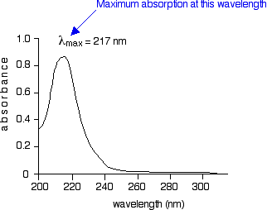
What does an absorption spectrum look like?
The diagram below shows a simple UV-visible absorption spectrum for buta-1,3-diene - a molecule we will talk more about later. Absorbance (on the vertical axis) is just a measure of the amount of light absorbed. The higher the value, the more of a particular wavelength is being absorbed.
You will see that absorption peaks at a value of 217 nm. This is in the ultra-violet and so there would be no visible sign of any light being absorbed - buta-1,3-diene is colourless.
You read the symbol on the graph as "lambda-max“
.
In buta-1,3-diene, CH₂=CH-CH=CH₂, there are no non-bonding electrons. That means that the only electron jumps taking place (within the range that the spectrometer can measure) are from pi bonding to pi anti-bonding orbitals.

Slide 8
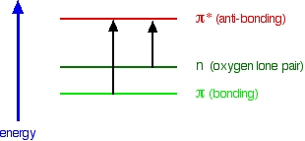
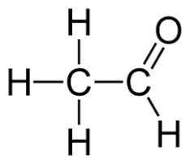
A chromophore producing two peaks
A chromophore such as the carbon-oxygen double bond in ethanal, for example, obviously has pi electrons as a part of the double bond, but also has lone pairs on the oxygen atom.
That means that both of the important absorptions from the last energy diagram are possible.
You can get an electron excited from a pi bonding to a pi anti-bonding orbital, or you can get one excited from an oxygen lone pair (a non-bonding orbital) into a pi anti-bonding orbital.
π :π* and n:π*

Slide 9
The non-bonding orbital has a lower energy than a pi bonding orbital. That means that the jump from an oxygen lone pair into a pi anti-bonding orbital needs less energy. That means it absorbs light of a lower frequency and therefore a higher wavelength.
Ethanal can therefore absorb light of two different wavelengths:
the pi bonding to pi anti-bonding absorption peaks at 180 nm; π :π
the non-bonding to pi anti-bonding absorption peaks at 290 nm. * n:π*
Both of these absorptions are in the ultra-violet, but most spectrometers won't pick up the one at 180 nm because they work in the range from 200 - 800 nm.

Slide 10

The importance of conjugation and delocalisation in what wavelength is absorbed Consider these three molecules:
Ethene contains a simple isolated carbon-carbon double bond, but the other two have conjugated double bonds. In these cases, there is delocalisation of the pi bonding orbitals over the whole molecule.
Now look at the wavelengths of the light which each of these molecules absorbs

Slide 11
All of the molecules give similar UV-visible absorption spectra - the only difference being that the absorptions move to longer and longer wavelengths as the amount of delocalisation in the molecule increases.
molecule | wavelength of maximum absorption (nm)
ethene | 171
buta-1,3-diene | 217
hexa-1,3,5-triene | 258

Slide 12
You can actually work out what must be happening
The maximum absorption is moving to longer wavelengths as the amount of delocalisation increases.
Therefore maximum absorption is moving to shorter frequencies as the amount of delocalisation increases.
Therefore absorption needs less energy as the amount of delocalisation increases.
Therefore there must be less energy gap between the bonding and anti-bonding orbitals as the amount of delocalisation increases.

Slide 13
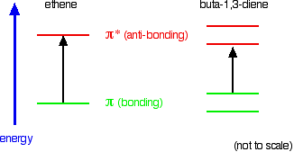
Compare ethene with buta-1,3-diene.
In ethene, there is one pi bonding orbital and one pi anti-bonding orbital. In buta-1,3-diene, there are two pi bonding orbitals and two pi anti-bonding orbitals.

Slide 14
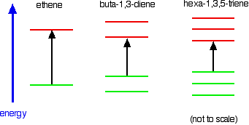
The highest occupied molecular orbital is often referred to as the HOMO - in these cases, it is a pi bonding orbital. The lowest unoccupied molecular orbital (the LUMO) is a pi anti-bonding orbital.
Notice that the gap between these has fallen. It takes less energy to excite an electron in the buta-1,3-diene case than with ethene. In the hexa-1,3,5-triene case, it is less still.

Slide 15
If you extend this to compounds with really massive delocalisation, the wavelength absorbed will eventually be high enough to be in the visible region of the spectrum, and the compound will then be seen as coloured.
A good example of this is the orange plant pigment, beta-carotene - present in carrots, for example.
Why is beta-carotene orange?

Slide 16

Why is beta-carotene orange?
Beta-carotene has the sort of delocalisation that we've just been looking at, but on a much greater scale with 11 carbon-carbon double bonds conjugated together. The diagram shows the structure of beta-carotene with the alternating double and single bonds shown in red.

Slide 17
The more delocalisation there is, the smaller the gap between the highest energy pi bonding orbital and the lowest energy pi anti-bonding orbital.
To promote an electron therefore takes less energy in beta-carotene than in the cases we've looked at so far - because the gap between the levels is less.
Remember that less energy means a lower frequency of light gets absorbed and that's equivalent to a longer wavelength.
Beta-carotene absorbs throughout the ultra-violet region into the violet - but particularly strongly in the visible region between about 400 and 500 nm with a peak about 470 nm.

Slide 18
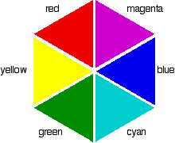
If you have read the page in this section about electromagnetic radiation, you might remember that the wavelengths associated with the various colours are approximately
colour region | wavelength (nm)
violet | 380 - 435
blue | 435 - 500
cyan | 500 - 520
green | 520 - 565
yellow | 565 - 590
orange | 590 - 625
red | 625 - 740
So if the absorption is strongest in the violet to cyan region, what colour will you actually see?

Slide 19
Sometimes what you actually see is quite unexpected. Mixing different wavelengths of light doesn't give you the same result as mixing paints or other pigments.
You can, however, sometimes get some estimate of the colour you would see using the idea of complementary colours.
Complementary colours
If you arrange some colours in a circle, you get a "colour wheel". The diagram shows one possible version of this. An internet search will throw up many different versions!
Complementary colours Mean the Colours directly opposite each other on the colour wheel.

Slide 20
Colours directly opposite each other on the colour wheel are said to be complementary colours.
Blue and yellow are complementary colours; red and cyan are complementary; and so are green and magenta.
Mixing together two complementary colours of light will give you white light.
What this all means is that if a particular colour is absorbed from white light, what your eye detects by mixing up all the other wavelengths of light is its complementary colour.

Slide 21
In the beta-carotene case, the situation is more confused because you are absorbing such a range of wavelengths. However, if you think of the peak absorption running from the blue into the cyan, it would be reasonable to think of the colour you would see as being opposite that where yellow runs into red - in other words, orange

Slide 22
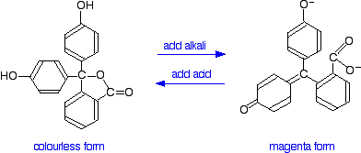
Applying this to the colour changes of two indicators
Phenolphthalein
You have probably used phenolphthalein as an acid-base indicator, and will know that it is colourless in acidic conditions and magenta (bright pink) in an alkaline solution. How is this colour change related to changes in the molecule?
The structures of the two differently coloured forms are:

Slide 23
Both of these absorb light in the ultra-violet, but the one on the right also absorbs in the visible with a peak at 553 nm.
The molecule in acid solution is colourless because our eyes can't detect the fact that some light is being absorbed in the ultra-violet. However, our eyes do detect the absorption at 553 nm produced by the form in alkaline solution.
553 nm is in the green region of the spectrum. If you look back at the colour wheel, you will find that the complementary colour of green is magenta - and that's the colour you see.
So why does the colour change as the structure changes?
What we have is a shift to absorption at a higher wavelength in alkaline solution. As we've already seen, a shift to higher wavelength is associated with a greater degree of delocalisation.
Here is a modified diagram of the structure of the form in acidic solution - the colourless form. The extent of the delocalisation is shown in red.

Slide 24
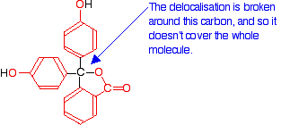
But the delocalisation doesn't extend over the whole molecule.
The carbon atom in the centre with its four single bonds prevents the three delocalised regions interacting with each other.

Slide 25
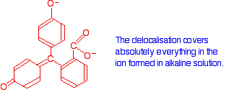
Now compare that with the magenta form:
Notice that there is delocalisation over each of the three rings - extending out over the carbon-oxygen double bond, and to the various oxygen atoms because of their lone pairs.

Slide 26
The rearrangement now lets the delocalisation extend over the entire ion. This greater delocalisation lowers the energy gap between the highest occupied molecular orbital and the lowest unoccupied pi anti-bonding orbital.
It needs less energy to make the jump and so a longer wavelength of light is absorbed.
Remember: Increasing the amount of delocalisation shifts the absorption peak to a higher wavelength.

Slide 27


Methyl orange
You will know that methyl orange is yellow in alkaline solutions and red in acidic ones.
The structure in alkaline solution is:
In acid solution, a hydrogen ion is (perhaps unexpectedly) picked up on one of the nitrogens in the nitrogen-nitrogen double bond.

Slide 28

This now gets a lot more complicated! The positive charge on the nitrogen is delocalised (spread around over the structure) - especially out towards the right-hand end of the molecule as we've written it.
The normally drawn structure for the red form of methyl orange is . . .

Slide 29
So which is the more delocalised structure - red or yellow?
Let's work backwards from the absorption spectra to see if that helps.
The yellow form has an absorption peak at about 440 nm. That's in the blue region of the spectrum, and the complementary colour of blue is yellow. That's exactly what you would expect.
The red form has an absorption peak at about 520 nm. That's at the edge of the cyan region of the spectrum, and the complementary colour of cyan is red.
Notice that the change from the yellow form to the red form has produced an increase in the wavelength absorbed. An increase in wavelength suggests an increase in delocalisation.
That means that there must be more delocalisation in the red form than in the yellow one.

