Slide 1
Flame ionization (FID)
The effluent from the column is mixed with hydrogen and air, and ignited. Organic compounds burning in the flame produce ions and electrons which can conduct electricity through the flame.
A large electrical potential is applied at the burner tip, and a collector electrode is located above the flame.
The current resulting from the pyrolysis of any organic compounds is measured. FIDs are mass sensitive rather than concentration sensitive; this gives the advantage that changes in mobile phase flow rate do not affect the detector's response.
The FID is a useful general detector for the analysis of organic compounds; it has high sensitivity, a large linear response range, and low noise. It is also robust and easy to use, but unfortunately, it destroys the sample.

Slide 2
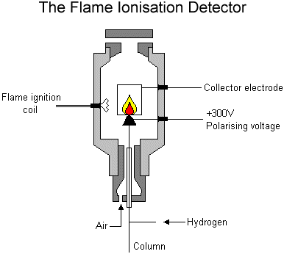

Slide 3
Data system
It is a set of dedicated software that provides control over many important operational parameters like injection sequence, wash cycles, over-temperature control, the flow rate of gases, detector wavelength, etc. Simultaneously, the data station calculates and displays the parameters.
How does gas chromatography work?
First, the sample is introduced into a stream of inert gas, or a carrier, which is usually helium or argon. For a liquid sample, it needs to be evaporated before being injected into the carrier. Sample components move through the packed column at a rate affected by the degree of interaction of each component with the stationary non-volatile phase.
Substances that interact more with the stationary phase are delayed and thus separated from substances that interact less. When the components are eluted from the column, they can be quantified and/or collected through the detector for further analysis.

Slide 4
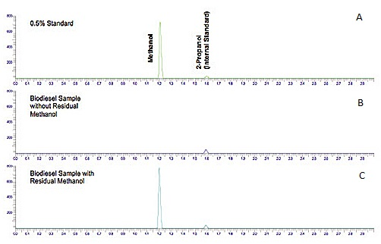
A Typical Chromatogram
Figure5 : shows a chromatogram of the analysis of residual methanol in biodiesel, which is one of the required properties that must be measured to ensure the quality of the product at the time and place of delivery.
Chromatogram (Figure5) shows a standard solution of methanol with 2-propanol as the internal standard.
From the figure it can be seen that methanol has a higher affinity for the mobile phase than 2-propanol (iso-propanol), and therefore elutes first. Chromatograms (Figure 5 b and c) show two samples of biodiesel, one with methanol (Figure 5 c ) and another with no methanol detection (Figure 5 b ).
Figure 5 Chromatogram of the analysis of methanol in B100 biodiesel,

Slide 5
Chromatograph Columns
The heart of the gas chromatograph is the chromatograph columns. The columns separate the gas mixture into its individual components using some physical characteristic. In the case of most hydrocarbon applications, “boiling point” columns are used and separate the components by their individual boiling points; however, other applications may use molecular size (molecular sieve columns) or polarity differences to achieve the separation.
Chromatograph columns are constructed by packing a tube with column packing material. The material is held in place by sintered metal filters at either end of the tube. The packing material consists of very small support material that has a very thin coating of liquid solvent. This is called the stationary phase.
Notes:
يتم تثبيت المادة في مكانها بواسطة مرشحات معدنية ملبدة على طرفي الأنبوب.

Slide 6
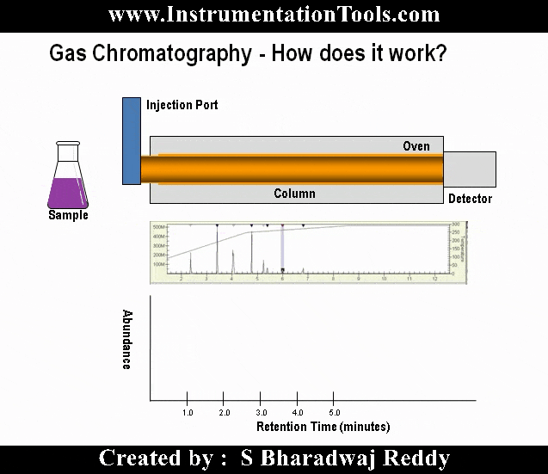

Slide 7
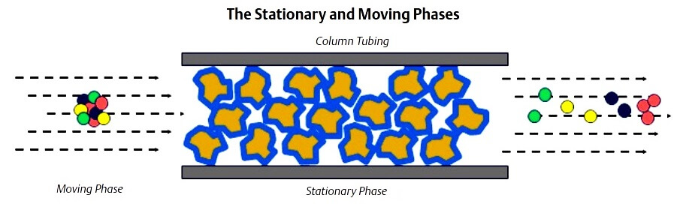
The sample gas is carried through the columns by the carrier gas. The combination of the carrier gas and the sample gas is called the moving phase. The carrier gas is a gas which is not a component of interest (it is not being measured) and acts as a background gas that permits the easy detection of the components being measured. Typically, helium is used
for hydrocarbon applications; however, hydrogen, argon, and nitrogen are also used, depending on the application.
As the gas sample moves through the column, components with lower boiling points move more faster than the components with higher boiling points. The speed at which this separation occurs is dependent on the temperature of the column.
The lower the boiling point is, the higher the vapor pressure of the compound and the shorter retention time usually is because the compound will spent more time in the gas phase. That is one of the main reasons why low boiling solvents

Slide 8
Gas chromatography applications
Since the discovery of the gas chromatographic system, the areas of Gas chromatography applications is ever-increasing which includes:
Pharmaceutical industry
Research
Medical and Forensic
Environmental monitoring (both inside laboratories, and natural water bodies)
Petroleum refining and petrochemicals
Edible oils
Flavors, beverages, and the food industry
Fragrance industry (Cosmetics)
Polymers and plastics
Pesticides

Slide 9
Gas Chromatography: Limitations and Common Issues
Limitations
Gas chromatography is broadly utilized across many industries for routine analysis, research or analysing hundreds and thousands of compounds in different samples and components from solids to gases. This technique is quite robust and can be easily mixed or coupled with other distinctive techniques, such as mass spectrometry.
However, gas chromatography can analyse volatile compounds from helium/hydrogen only when their molecular weights are around 1250 u. In the case of compounds that are thermally labile, exposure to high temperatures in GC can degrade them.
Cold injection techniques and low temperatures can be used to minimize that. To prevent polar analytes from getting lost or stuck in GC, the system must be well-maintained and the analytes must be derivatized.

Slide 10
Glossary of GC terms
The glossary will help you familiarize with the terminology in case you are not already familiar with the gas chromatography working technique.
Stationary Phase | A solid phase which absorbs the sample components and later releases them in a sequential manner
Mobile Phase | A stream of carrier gas used for transporting sample from injection port to the column to the detector
Column Oven | A compartment inside which the column is mounted. It maintains a constant temperature or a varying temperature in response to a set temperature programme.
Detector | A device which gives the signal response in terms of area counts under a peak
Column Efficiency | Expressed in terms of HETP expresses the resolving power of the GC column
Packed Column | A steel or glass tube wound as a coil which holds the stationary phase
Capillary Column | A fused silica capillary column that holds the liquid absorbent on the tube on its walls
Autosampler | A device capable of holding several samples, standard vials and automatically injects a predetermined sample volume into the gas chromatograph
Injector | Manual or automated device for precise sample volume introduction
FID | Flame Ionisation detector which responds to most organic compounds
TCD | Thermal Conductivity detector. Universal and nondestructive detector

Slide 11
Advantages of GC
Due to its high efficiency, GC allows the separation of the components of complex mixtures in a reasonable time.
Accurate quantitation (usually sharp reproducible peaks are obtained)
Mature technique with many applications notes available for users.
Multiple detectors with high sensitivity (ppb) are available, which can also be used in series with a mass spectrometer since MS is a non-destructive technique.
Disadvantages of GC
Limited to thermally stable and volatile compounds.
Most GC detectors are destructive, except for MS.

Slide 12
Gas Chromatography Versus High Performance Liquid Chromatography (HPLC)
Unlike gas chromatography, which is unsuitable for nonvolatile and thermally fragile molecules, liquid chromatography can safely separate a very wide range of organic compounds, from small-molecule drug metabolites to peptides and proteins
Table 3 . Relative advantages and disadvantages of GC versus HPLC.
GC | HPLC
Sample must be volatile or derivatized previous to GC analysis | Volatility is not important, however solubility in the mobile phase becomes critical for the analysis.
Most analytes have a molecular weight (MW) below 500 Da (due to volatility issues) | There is no upper molecular weight limit as far as the sample can be dissolved in the appropriate mobile phase
Can be coupled to MS. Several mass spectral libraries are available if using electron ionization (e.g., http://chemdata.nist.gov/) | Methods must be adapted before using an MS detector (non-volatile buffers cannot be used)
Can be coupled to several detectors depending on the application | For some detectors the solvent must be an issue. When changing detectors some methods will require prior modification

Slide 13
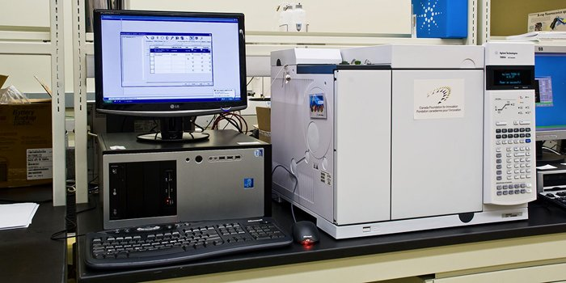
GC instrument

