Slide 1
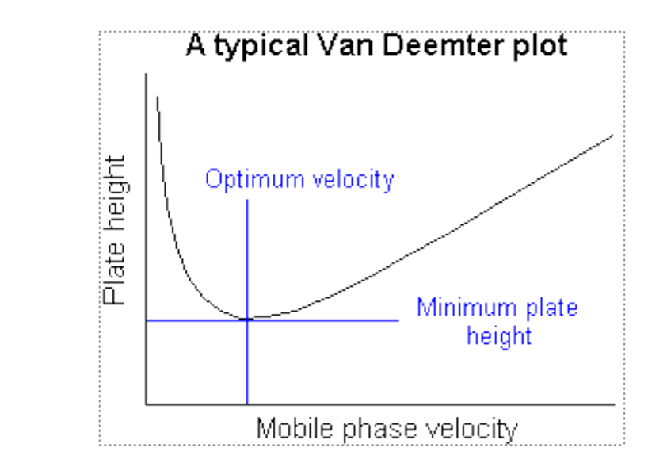
Theory of Chromatography
Based on a random walk mechanism for the migration of molecules through a column • Takes into account: – mechanism of band broadening – effect of rate of elution on band shape – availability of different paths for different solute molecules to follow – diffusion of solute along length
H = H_{L} + H_{S} + H_{M} + H_{SM}
H = height equivalent to theoretical plate (as in Plate Theory)
H_{L} = contribution due to longitudinal diffusion
H_{S} = stationary phase mass transfer contribution
H_{M} = diffusion associated with mobile phase effects
H_{SM} = diffusion into or mass transfer across a stagnant layer of mobile phase (neglect)
H = B/μ + Cμ +A
van Deemter Equation A, B & C are coefficients, μ = velocity)
)

Slide 2
Theoretical Plate
The plate model supposes that the chromatographic column is contains a large number of separate layers, called theoretical plates. Separate equilibrations of the sample between the stationary and mobile phase occur in these "plates". The analyte moves down the column by transfer of equilibrated mobile phase from one plate to the next.

Slide 3
It is important to remember that the plates do not really exist; they are a figment of the imagination that helps us understand the processes at work in the column. They also serve as a way of measuring column efficiency, either by stating the number of theoretical plates in a column, N (the more plates the better), or by stating the plate height; the Height Equivalent to a Theoretical Plate (the smaller the better). If the length of the column is L, then the HETP is
HETP = L / N
The number of theoretical plates that a real column possesses can be found by examining a chromatographic peak after elution;
N = 3.55 t_{r} ² / W_{1/2} ²
where w1/2 is the peak width at half-height.
As can be seen from this equation, columns behave as if they have different numbers of plates for different solutes in a mixture.

Slide 4
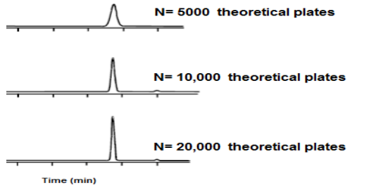
Column efficiency improves by increasing the number of theoretical plates or decreasing the equivalent height of a theoretical plate One, as in Figure below.
The smaller the equivalent height of one theoretical plate, H, the smoother and sharper the peaks will be. The efficiency of the column in separating a mixture improves by decreasing H, and it can be said that a good column has a number of Larger theoretical plates .

Slide 5
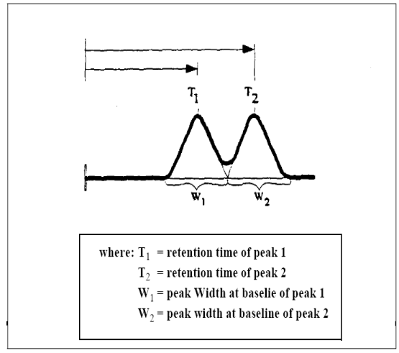
Resolution (RS)
we can define an equation for the resolution (RS) of two compounds. This will be a measure of how much two compounds in a chromatogram are separated from each other.
Rs= 2(t 2 - t1) /(W1 + W2)
The terms t2 and t1 refer to the retention time of the two compounds, and W1 and W2 to the width of each peak at baseline.
equation indicates that the resolution is the difference between peak retention times divided by the average peak width.

Slide 6
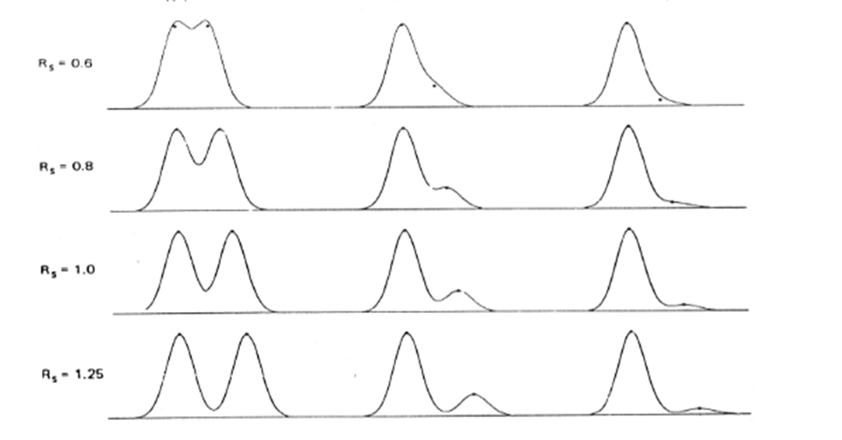
If the value of RS is less than 1, then the two peaks are overlapping
But when its value is equal to one the two peaks are adjacent and separated, with a slight overlap that can be neglected.(Partial resolution)
In the case of RS greater than 1, the two peaks are completely separated and spaced apart ,
Two peaks adjacent are considered to be completely resolved when a distinct baseline can be observed between the peaks, indicated by an RS value near 1.5 , inducted a perfect separation (Complete resolution)

Slide 7
Distribution Coefficient (KD)
The flow rate of the eluent and the distribution of the solute between the mobile and stationary phases determine a solute’s retention time. In a system without flow, a solute will achieve equilibrium between the two phases. This equilibrium can be described as the distribution coefficient KD and is defined by the equation
KD = CS/CM
where : CS = the concentration of solute in the stationary phase CM = the concentration in the mobile phase The distribution is influenced by the ionic attraction to the active sites on the column packing. A solute with a high KD is more likely to be found associated with the stationary phase at any given moment. A a low KD indicates a solute that favors the mobile phase.
Any two analytes will generally have distinct distribution coefficients. This difference in KD’s is the basis for the differential migration of various components.
An analyte with a relatively low KD favors distribution in the mobile phase of the system where it is subject to the influence of eluent flow. This analyte will be pushed through the column more quickly than one with a higher KD
An analyte with a higher KD favors distribution towards the stationary phase. This analyte elutes at a slower rate.
The KD describes the ratio of sample in either phase at equilibrium under a given set of conditions. Thus, although a solute favors the stationary phase, it is still present to an extent in the mobile phase and can flow through the column.
Under ideal conditions the KD will be constant of a molecule within a system composed of a stationary and mobile phase at a constant temperature .

Slide 8
Example :Two solutes have retention time 16.4 ,17.63 min continuity over column of ion chromatography 20 cm , V_{M}: 1.55 ml; V_{S}:0.178 ml ; flow rate: 0.313 cm³/min, the band width of two peak were 1.21,1.11 min and flow rate was 1ml/min calculate 1-the resolution of column 2- is the resolution is complete , 3- the number of plates for the peak generated by Peak A 800 ,Calculate The Height Equivalent Theoretical Plate (HETP), 4-Destrbution coefficients ?
Rs= 2(t 2 - t1) /(W1 + W2)
= 2(17.63 -16.4) / (1.21+1.11)
=2(1.23) /2.32
= 1.06
H =L/N = 20 /800=0.025 cm
KD = V_{S}/V_{M} = 0.155 /1.17 8 = 0.131
1- R=1.06
2-Partial resolution
3- H = 0.025
4- KD = 0.131

Slide 9
Injector
This is the place where the sample is volatilized and quantitatively introduced into the carrier gas stream.
Usually a syringe is used for injecting the sample into the injection port. Samples can be injected manually or automatically with mechanical devices that are often placed on top of the gas chromatograph: the auto-samplers.
Column
This is filled with the stationary phase or its walls are covered with a liquid adsorbent. This is done for selective absorbance and retention of the sample components.

Slide 10
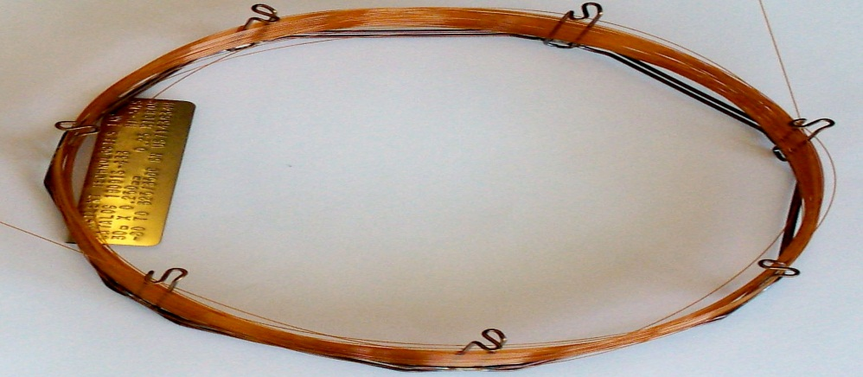
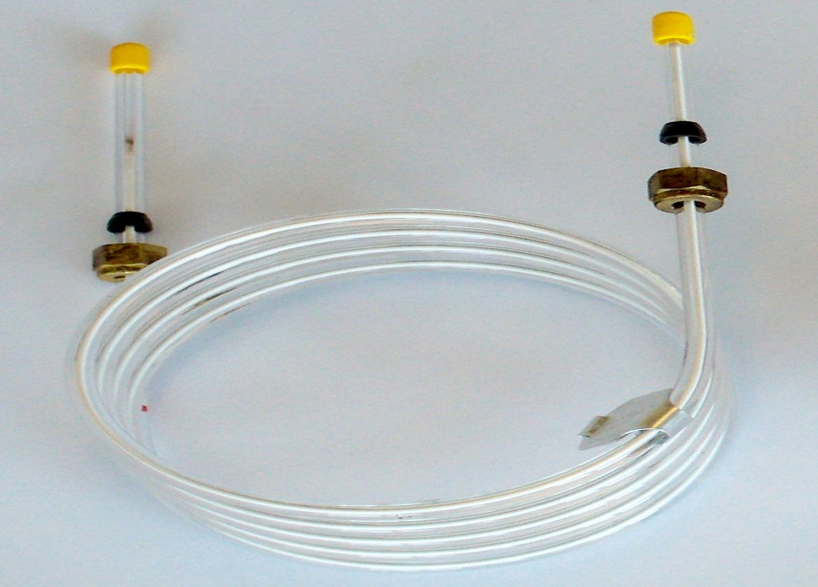
Commonly used: Packed columns and Capillary columns (More popular)
The gas chromatographic column may be considered the heart of the GC system, where the separation of sample components takes place.
Columns are classified as either packed or capillary columns. A general comparison of packed and capillary columns is shown in Table 1 . Images of packed columns are shown in Figure 2 and Figure 3.
A typical capillary GC column
A Glass Packed GC Column

Slide 11
Table 1 A summary of the differences between a packed and a capillary column.

Slide 12
Since most common applications employed nowadays use capillary columns, we will focus on this type of columns. To define a capillary column, four parameters must be specified:
The stationary phase is the parameter that will determine the final resolution obtained, and will influence other selection parameters. Changing the stationary phase is the most powerful way to alter selectivity in GC analysis.
The length is related to the overall efficiency of the column and to overall analysis time. A longer column will increase the peak efficiency and the quality of the separation, but it will also increase analysis time. One of the classical trade-offs in gas chromatography (GC) separations lies between speed of analysis and peak resolution.
The column internal diameter (ID) can influence column efficiency (and therefore resolution) and also column capacity. By decreasing the column internal diameter, better separations can be achieved, but column overload and peak broadening may become an issue.
The sample capacity of the column will also depend on film thickness. Moreover, the retention of sample components will be affected by the thickness of the film, and therefore its retention time. A shorter run time and higher resolution can be achieved using thin films, however these films offer lower capacity.

Slide 13
Component of a Column – Oven
The column is enclosed by a column oven which is responsible for maintaining a constant temperature during isothermal operation.
This temperature when temperature programming is needed can be increased in a controlled way for acquiring effective separation of mixture components possessing different volatilities.

Slide 14
Detector
This is employed for the identification and quantification of components.
The detector senses a physicochemical property of the analyte and provides a response which is amplified and converted into an electronic signal to produce a chromatogram. Detectors that exhibit an enhanced response to certain analyte types are known as "selective detectors".
After the components have been separated by the chromatograph columns, they then pass over the detector. Several types of detectors are available for gas chromatographs, including flame ionization detectors (for ppm-level hydrocarbons) and flame photometric detectors (for ppb- to ppm-level sulphur detection), but the most common detector used for most hydrocarbon gas measurements is the thermal conductivity detector (TCD) (Figure 4).

Slide 15
The TCD can measure components from the low ppm levels up to 100 % concentration. The TCD uses two thermistors that will reduce in resistance as their temperature rises.
There are many detectors which can be used in gas chromatography. Different detectors will give different types of selectivity see table below.
A non-selective detector responds to all compounds except the carrier gas,
A selective detector responds to a range of compounds with a common physical or chemical property and a specific detector responds to a single chemical compound.

Slide 16
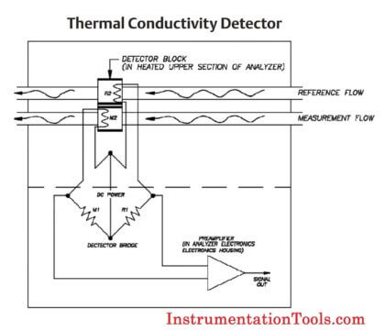
Figure 4: Thermal conductivity detector (TCD)

Slide 17
Detector | Support gases | Selectivity | Detectability | Dynamic range
Flame ionization (FID) | Hydrogen and air | Most organic cpds. | 100 pg | 10⁷
Thermal conductivity (TCD) | hydrogen or helium | Universal | 1 ng | 10⁷
Electron capture (ECD) | Nitrogen or helium | Halides, nitrates, nitriles, peroxides, anhydrides, organometallics | 50 pg | 10⁵
Nitrogen-phosphorus | Hydrogen and air | Nitrogen, phosphorus | 10 pg | 10⁶
Flame photometric (FPD) | Hydrogen and air possibly oxygen | Sulphur, phosphorus, tin, boron, arsenic, germanium, selenium, chromium | 100 pg | 10³
Photo-ionization (PID) | Nitrogen and helium | Aliphatics, aromatics, ketones, esters, aldehydes, amines, heterocyclics, organosulphurs, some organometallics | 2 pg | 10⁷
Hall electrolytic conductivity | Hydrogen, oxygen | Halide, nitrogen, nitrosamine, sulphur

