Slide 1
Error Analysis and propagation
This section shows how to calculate and propagate experimental errors and discusses the effects of uncertainty on empirical findings.
Uncertainty Analysis
Uncertainty analysis is a mathematical tool for analyzing the imprecision
and inaccuracies introduced into an experiment during measurement. Such an analysis is necessary for several reasons:
You need to know how well you can trust your results.
You should know if your experimental results agree with any previously measured or theoretical values. Knowing the inaccuracies associated with your results allows you to make more meaning full comparisons. Is the difference between your result and the theoretical value significant or is it just a result of experimental (i.e., measurement) uncertainty?
If you have measured something in two different ways, you need to know if the difference between the two values is larger or smaller than the measurement uncertainty. Is one method more accurate than another?
You should know where the greatest uncertainties exist in an experiment so that the procedure may be improved.

Slide 2
Precision and Accuracy
Two terms are widely used in discussions of the reliability of data:
precision and accuracy.
Precision describes the reproducibility of results, that is, the agreement between numerical values for two or more measurements that have been made under identical conditions. In general the precision of a given analytical method is obtained by simply repeating the measurement. To describe the precision of a set of replicate data three statistics are widely used: standard deviation, variance and coefficient of variation.
Accuracy is related to the CORRECTNESS of an experimental result.
Accuracy is a relative term, which finally depends on the magnitude of the amount measured. Accuracy is expressed in terms of either absolute error or relative error.
N.I: Accuracy refers to how close a measurement or result is to being correct.
Precision refers to the repeatability of a measurement. A precise measurement or result is not necessarily accurate.

Slide 3
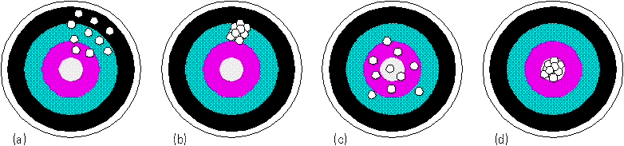
Precision –
Precision +
Precision –
Precision +
Accuracy –
Accuracy –
Accuracy +
Accuracy +

Slide 4
Random (indeterminate) and Systematic (determinate) Errors
We will be concerned with two types of errors: random (indeterminate) and systematic (determinate) errors.
Random Errors
There is some random error associated with any measurement you make. Random errors come primarily from the inherent limits of the accuracy of an instrument, a piece of glassware, or other experimental apparatus. When you measure the length of an object with a millimeter ruler; you can clearly distinguish between 3 mm and 4 mm, but the gradations are too closely spaced for you to very clearly distinguish between 3.5 and 3.6 mm.

Slide 5

The limitation on the accuracy of your measurement comes from the ruler itself. These errors are random or indeterminate errors because they do not occur in any particular direction; they are present in every measurement. In the case of the ruler, if the actual length of the object were 3.7 mm, you might, in 6 different measurements, read:
The errors are just as likely to be on the low side of the accepted value as they are to be on the high side. Random error is an inherent part of any measurement, so there is no way to avoid it. We can reduce the effect of random error on our results by repeating the experiment several times. What you must learn from this section is how random errors affect your experimental results.

Slide 6
Systematic Errors
Systematic errors are distinguished from random errors largely by being unidirectional and of a consistent degree. A systematic error causes consistently high or consistently low results. Systematic errors in your results can be attributed to the following three sources: instrumental errors, personal errors and errors introduced by the method of experimentation. Specifics about possible sources of error and how to correct these errors follows.
1. Instrumental Errors
a. Typical sources of instrumental errors include:
Laboratory thermometers sometimes read a degree high or a degree low on every measurement. This is a very common systematic error.
Reagents which have decomposed, and whose concentrations have therefore changed, can cause consistently low results in titrations.
Balances may be defective, consistently indicating a mass too high or too low.
Dirty glassware causes errors by delivering less than the calibrated volume of solution, or by adding impurities to the reagent.

Slide 7
b. Ways to correct or compensate for these errors:
Thermometers can be calibrated by measuring the melting points of a number of compounds whose melting points are sharp and precisely known. If the true melting points can be plotted on a graph against the readings obtained with your thermometer, a calibration curve can be constructed. Every time you take a thermometer reading, you can determine an accurate temperature using the calibration curve. Due to lack of time we will not do this in our laboratory.
Reagents known to decompose can be prepared and stored under special conditions to minimize their deterioration. They can also be standardized against reagents of known concentration. Standardization will be done for several reagents in this course. 
Balances, like thermometers, can be calibrated as well. There is no way to compensate for a defective balance except by being observant. If a balance appears to behave strangely or gives you a 'suspicious' reading, use another balance and report the defective balance to your instructor.
Glassware must be thoroughly cleaned before each use, and rinsed with the solution with which you will be working.

Slide 8
2.Personal Errors
An almost universal source of error is prejudice. Most of us have the natural tendency to estimate scale readings in a direction that improves the precision in a set of results or causes the results to fall closer to a preconceived notion of the accepted value for the measurement.
Personal errors may also be the result of so-called operator defects or blunders. Blunders include adding the wrong reagent or the wrong amount, dropping your sample, or failing to record a pertinent piece of data.
Blunders can also account for random errors in your experiment. If you pay careful attention to the procedures and keep a complete record of your observations, you need never compromise your experiments with a major blunder

Slide 9
3. Method Errors
Examples of systematic errors caused by incorrect method
Running a reaction at too high a temperature may decompose the products, causing a low yield.
If the end of a reaction is signaled by an indicator color change, indicators that change color before or after the end of the reaction (endpoint) will cause erroneous results.

Slide 10
Differentiating between Systematic and Random Error
You need to be able to differentiate between systematic and random errors and the effects they have on results. Do not confuse a set of random errors that all occur in one direction with systematic error. For example, say you are recording the temperatures of five different solutions whose actual temperatures are shown in the chart below:

Slide 11
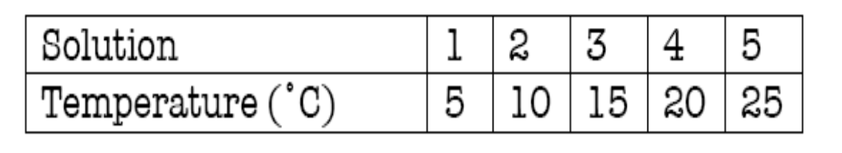
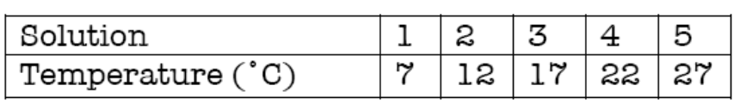
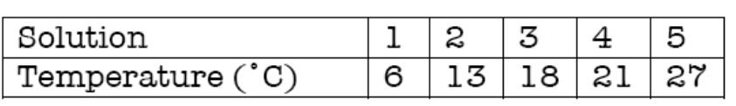
Let us consider what occurs if a systematic error is present. For instance, say the thermometer used consistently reads two degrees too high. The results would then look like this:
Now consider a case of random error: because you cannot see the level of the alcohol very well, you misread the thermometer every time. You then obtain the following results:
In both cases, the erroneous results are higher than the actual values, but in the systematic error case, the results are consistent
- they are always two degrees higher than the actual value. In the random error case, the results vary, sometimes one degree higher than actual, sometimes three degrees higher than actual. Just because a set of errors is unidirectional does not mean that it is systematic.
Random error is unpredictable and affects precision, while systematic error is more regular and affects accuracy.

Slide 12
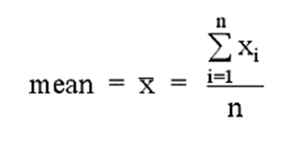
Statistical analysis
How to choose an analytical method? How good is measurement?
How reproducible? - Precision
How close to true value? - Accuracy/Bias
How small a difference can be measured? - Sensitivity
What range of amounts? - Dynamic Range
How much interference? – Selectivity
mean. It is calculated by adding together the numerical values of all measurements and dividing this sum by the number of measurements.

Slide 13
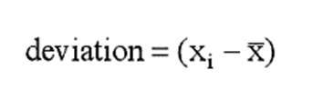
Deviation: How much each measurement differs from the mean is an important number
Precision - Indeterminate or random errors
Absolute standard deviation:
Standard deviation, : A useful measure of the precision of the average of a series of n measurements (xi) of the same quantity;

Slide 14

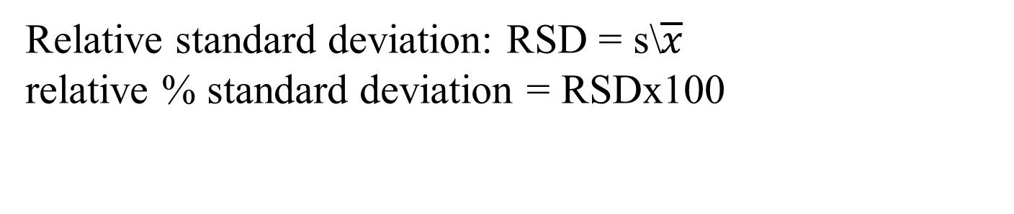
Relative standard deviation: RSD = s\$\overline{x}$
relative % standard deviation = RSDx100
Accuracy - Determinate errors (operator, method, instrumental)
‘Absolute error’ is the difference between the experimental value and the true value.
d = experimental value - true value
Present Absolute error % E =

Slide 15

Example : An analyst determines a value of 70.55% cineole in a fresh sample of Eucalyptus Oil that actually contains 70.25%, the absolute error is given by :
70.55 – 70.25 = 0.30%
The error thus obtained is invariably stated with regard to the actual size of the measured quantity i.e., either in percent (%) or in parts per thousand (ppt). Therefore, the relative error is given

Slide 16
Example 1.1
The following numerical results were obtained in a given laboratory experiment: 0.09376, 0.09358, 0.09385, and 0.09369. Calculate the relative parts per thousand standard deviation.
Solution 1.1
We must calculate both the mean and the standard deviation in order to use Equations (1.3) and (1.5).
First, the mean, m:

Slide 17
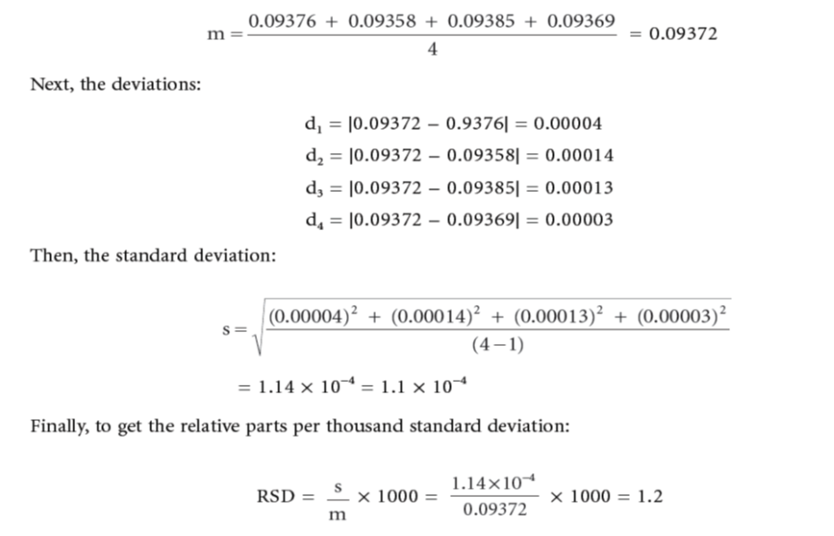

Slide 18
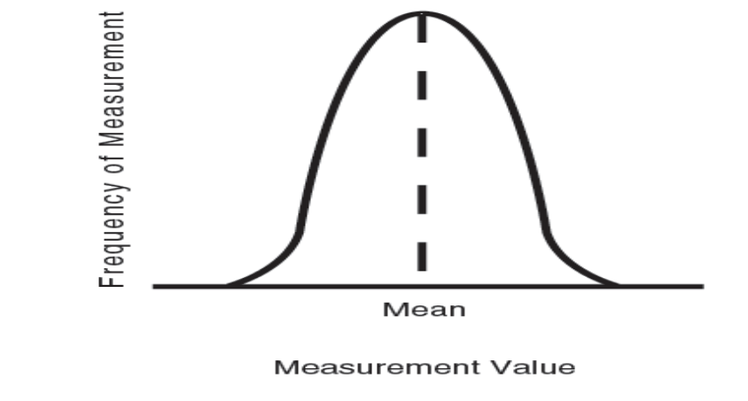
7.3 Normal Distribution
For an infinite data set. A plot of frequency of occurrence vs the measurement value yields a smooth bell-shaped curve. It is referred to as bell-shaped because there is equal drop-off on both sides of a peak value, resulting in a shape that resembles a bell. The peak value corresponds to m , the population mean. This curve is called the normal distribution curve because it represents a normal distribution of values for any infinitely repeated measurement

