Slide 1
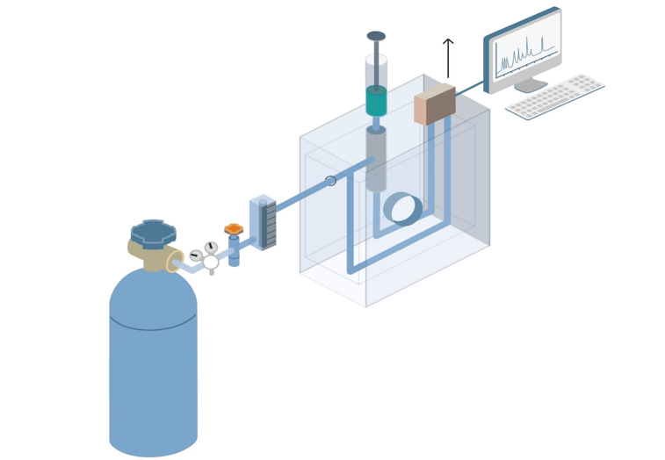
Introduction to Gas chromatography—principles, characteristics, and process

Slide 2
What is gas chromatography ？
Chromatography is a technique that separates components in a mixture by the difference in partitioning behavior between mobile and stationary phases.
Gas chromatography (GC) is one of the popular chromatography techniques to separate volatile compounds or substances. The mobile phase is a gas such as helium, and the stationary phase is a high-boiling liquid that is adsorbed on a solid.
Because of its simplicity, high sensitivity, and the ability to effectively separate mixtures, gas chromatography has become one of the most important tools in chemistry.

Slide 3
Purpose of gas chromatography
The main purpose of the gas chromatography technique is to separate the compounds that possess:
High volatility
Low molecular weights
Thermal stability

Slide 4
The principle of gas chromatography
Components in the mixture are distributed between two phases, one of which is a stationary phase, and the other is a mobile phase gas, or carrier gas, that carries the mixture through the stationary phase.
Compounds in the mobile phase interact with the stationary phase as they pass through. Due to the differences in properties and structures of each component, the size and affinity of each interaction with the stationary phase are different.
Therefore, under the same driving force, the retention time of different components differs in the column, thus moving out of the column in different orders

Slide 5
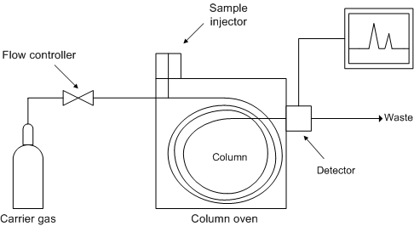
Components of a Gas Chromatograph System
Figure 1 below shows a schematic diagram of the components of a typical gas chromatograph,
Figure: Systematic Diagram of GC

Slide 6
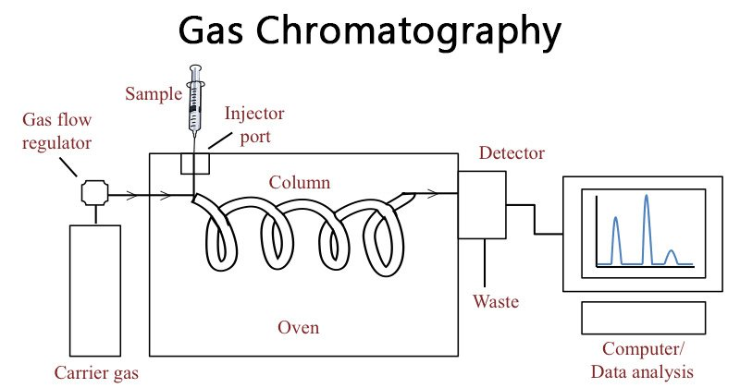
Figure: Systematic Diagram of GC

Slide 7
Carrier Gas
The role of the carrier gas -GC mobile phase- is to carry the sample molecules along the column while they are not dissolved in or adsorbed on the stationary phase.
The carrier gas is inert and does not interact with the sample, and thus GC separation's selectivity can be attributed to the stationary phase alone.

Slide 8
Mobile phase
In gas chromatography, usually, three types of gases are employed namely –
Carrier gas – This is needed for the transfer of the injected sample to the separation column. They are also responsible for the subsequent transfer of separated components to the detector. Common examples: Nitrogen, helium, or hydrogen
Fuel gas – They support the flame in Flame ionization detector (FID) detector such as Hydrogen.
Zero air – These are the purified air that plays the role of oxidant to support the combustion of flame in the detector. Before being led to the gas chromatographic system, the above three are intermixed in the desired proportion.

Slide 9
However, the choice of carrier gas is important to maintain high efficiency. The effect of different carrier gases on column efficiency is represented by the van Deemter (packed columns) and the Golay equation (capillary columns).
The van Deemter equation, 1, describes the three main effects that contribute to band broadening in packed columns and, as a consequence, to a reduced efficiency in the separation process.
HEPT = A+B/ u+Cu (1)

Slide 10
HEPT = A+B/ u+Cu (1)
These three factors are:
the eddy diffusion (the A-term), which results from the fact that in packed columns spaces between particles along the column are not uniform. Therefore, some molecules take longer pathways than others, and there are also variations in the velocity of the mobile phase.
the longitudinal molecular diffusion (the B-term) which is a consequence of having regions with different analyte concentrations.
the mass transfer in the stationary liquid phase (the C-term)

Slide 11
The broadening is described in terms of the height equivalent to a theoretical plate, HEPT, as a function of the average linear gas velocity, u.
A small HEPT value indicates a narrow peak and a higher efficiency.
Since capillary columns do not have any packing, the Golay equation, 2 , does not have an A-term. The Golay equation has 2 C-terms, one for mass transfer in then stationary phase (C_{s}) and one for mass transfer in the mobile phase (C_{M}).
HEPT = B / u + (Cs + CM)u (2)
High purity hydrogen, helium and nitrogen are commonly used for gas chromatography. Also, depending on the type of detector used, different gases are preferred.

Slide 12
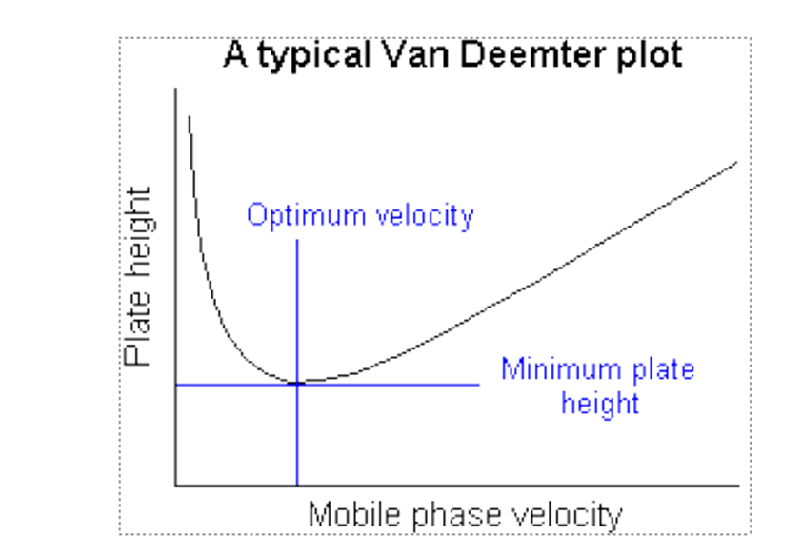
Theory of Chromatography
Based on a random walk mechanism for the migration of molecules through a column • Takes into account: – mechanism of band broadening – effect of rate of elution on band shape – availability of different paths for different solute molecules to follow – diffusion of solute along length
H = H_{L} + H_{S} + H_{M} + H_{SM}
H = height equivalent to theoretical plate (as in Plate Theory)
H_{L} = contribution due to longitudinal diffusion
H_{S} = stationary phase mass transfer contribution
H_{M} = diffusion associated with mobile phase effects
H_{SM} = diffusion into or mass transfer across a stagnant layer of mobile phase (neglect)
H = B/μ + Cμ +A
van Deemter Equation A, B & C are coefficients, μ = velocity)
)

