Slide 1
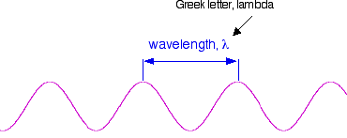
ELECTROMAGNETIC RADIATION
Wavelength, frequency and the speed of light
If you draw a beam of light in the form of a wave (without worrying too much about what exactly is causing the wave!), the distance between two crests is called the wavelength of the light. (It could equally well be the distance between two troughs or any other two identical positions on the wave.)
You have to picture these wave crests as moving from left to right. If you counted the number of crests passing a particular point per second, you have the frequency of the light. It is measured in what used to be called "cycles per second", but is now called Hertz, Hz. Cycles per second and Hertz mean exactly the same thing.
Orange light, for example, has a frequency of about 5 x 10¹⁴ Hz (often quoted as 5 x 10⁸ MHz - megahertz). That means that 5 x 10¹⁴ wave peaks pass a given point every second.
Light has a constant speed through a given substance. For example, it always travels at a speed of approximately 3 x 10⁸ metres per second in a vacuum. This is actually the speed that all electromagnetic radiation travels - not just visible light.

Slide 2
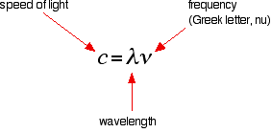

There is a simple relationship between the wavelength and frequency of a particular colour of light and the speed of light:
and you can rearrange this to work out the wavelength from a given frequency and vice versa:

Slide 3
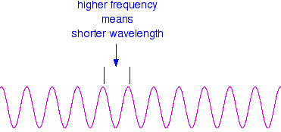
These relationships mean that if you increase the frequency, you must decrease the wavelength.
Compare this diagram with the similar one above.
and, of course, the opposite is true. If the wavelength is longer, the frequency is lower.
It is really important that you feel comfortable with the relationship between frequency and wavelength. If you are given two figures for the wavelengths of two different colours of light, you need to have an immediate feel for which one has the higher frequency.
For example, if you were told that a particular colour of red light had a wavelength of 650 nm, and a green had a wavelength of 540 nm, it is important for you to know which has the higher frequency. (It's the green - a shorter wavelength means a higher frequency. Don't go on until that feels right!)

Slide 4
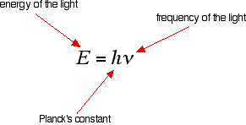
Note: nm = nanometer = 10⁻⁹ meter
The frequency of light and its energy
Each particular frequency of light has a particular energy associated with it, given by another simple equation:
Light which has wavelengths of around 380 - 435 nm is seen as a sequence of violet colours. Various red colours have wavelengths around 625 - 740 nm. Which has the highest energy?

Slide 5
The light with the highest energy will be the one with the highest frequency - that will be the one with the smallest wavelength. In other words, violet light at the 380 nm end of its range.
Wave number: The number of waves in one centimeter .and it is reversible of wavelength. It is measured by cm⁻¹.
V = 1/λ

Slide 6

The Electromagnetic Spectrum
Visible light
The diagram shows an approximation to the spectrum of visible light

Slide 7
The main colour regions of the spectrum are approximately:
Colour region | Wavelength (nm)
Violet | 380 - 435
Blue | 435 - 500
Cyan | 500 - 520
Green | 520 - 565
Yellow | 565 - 590
Orange | 590 - 625
Red | 625 - 740
Don't assume that there is some clear cut-off point between all these colours. In reality, the colours just merge seamlessly into one another - much more seamlessly than in my diagram!

Slide 8
Placing the visible spectrum in the whole electromagnetic spectrum
The electromagnetic spectrum doesn't stop with the colours you can see. It is perfectly possible to have wavelengths longer than violet light or shorter than red light.
On the spectrum further up the page, I have shown the ultra-violet and the infra-red, but this can be extended even further into x-rays and radio waves, amongst others.

Slide 9
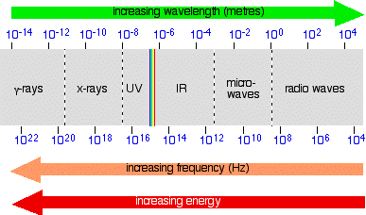
The diagram shows the approximate positions of some of these on the spectrum.

Slide 10
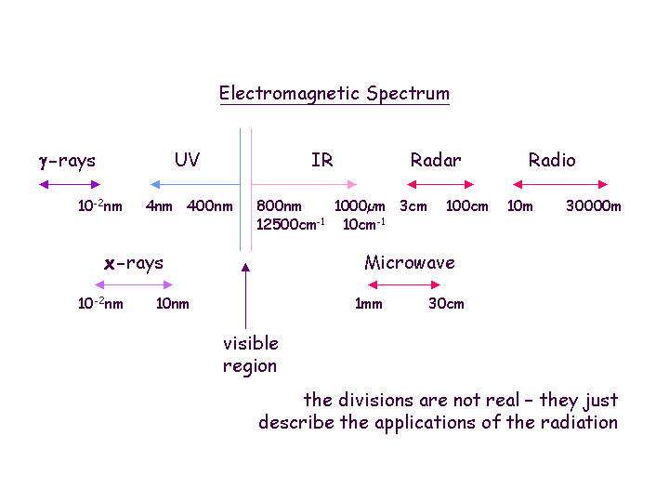

Slide 12
Also be aware that the energy associated with the various kinds of radiation increases as the frequency increases
The spectrum of electromagnetic radiation as a whole spans the range of wavelengths λ from 10¹⁰ m (infrasound) down to 10^{–14} m (cosmic radiation). Ultraviolet (UV) and visible (VIS) radiation comprise only a small portion of wavelengths from about 10^{–6} to 10^{–7} m (see Fig. 1). For all types of electromagnetic radiation, the associated energy (E) is calculated using Planck’s constant:
E = h .ν 1
E Energy
h Planck’s constant (6.626.10^{–34} J s^{–1})
ν Frequency in s^{–1}
The frequency of the radiation is calculated according to the following equation
c Velocity of light (3.10⁸ m s–1)
λ Wavelength in nm

Slide 13
In UV/VIS spectroscopy, wavelengths are usually expressed in nanometers (nm = 10^{–9} m).The presumably best-known example is the yellow colour of the sodium flame, which is due to the 589.5 and 589.0 nm double line of wavelengths. Equations (1) and (2) also readily show that radiation energy increases with shorter wavelengths. Hence, UV radiation contains more energy than does visible light.
Electromagnetic radiation can be generated with a wide range of wavelengths. Different wavelengths have differing energies, and interact with molecules in different ways.
The energy in a mole of 400 nm photons is calculated by:

Slide 14
The table below gives the range of wavelengths and energies of photons in the electromagnetic spectrum. High-energy photons contain enough energy to break covalent bonds, although they only break bonds under certain conditions. Low energy photons contain too little energy to disrupt covalent interactions, and are limited to contributing energy to molecules, usually without altering the molecular structure

Slide 15
Q 1. Calculated the energy in joule for wavelength 30 cm
Planck’s constant (6.626.10^{–34} J s^{–1})
Velocity of light (3.10⁸ m s^{–1})

Slide 16
Q 1. Calculated the energy in joule for wavelength 600 nm
Planck’s constant (6.626.10^{–34} J s^{–1})
Velocity of light (3.10⁸ m s^{–1})

