Slide 1

Introduction
Luminescence is the emission of light by a substance. It occurs when an electron returns to the electronic ground state from an excited state and loses it's excess energy as a photon.
Luminescence spectroscopy is a collective name given to three related spectroscopic techniques. They are;
Molecular fluorescence spectroscopy
Molecular phosphorescence spectroscopy
Chemiluminescence spectroscopy

Slide 2
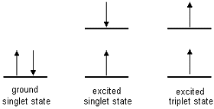
Fluorescence and phosphorescence (photoluminescence)
The electronic states of most organic molecules can be divided into singlet states and triplet states;
Singlet state: All electrons in the molecule are spin-paired Triplet state: One set of electron spins is unpaired

Slide 3
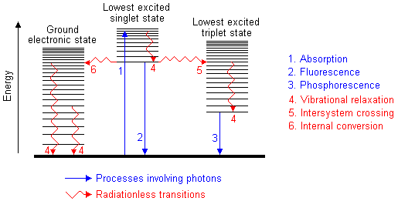
Fluorescence
Absorption of UV radiation by a molecule excites it from a vibrational level in the electronic ground state to one of the many vibrational levels in the electronic excited state. This excited state is usually the first excited singlet state.
A molecule in a high vibrational level of the excited state will quickly fall to the lowest vibrational level of this state by losing energy to other molecules through collision. The molecule will also partition the excess energy to other possible modes of vibration and rotation.
Fluorescence occurs when the molecule returns to the electronic ground state, from the excited singlet state, by emission of a photon.
If a molecule which absorbs UV radiation does not fluoresce it means that it must have lost its energy some other way. These processes are called radiationless transfer of energy. Have a look at this diagram:

Slide 4
The molecule returns to the electronic ground state.The excess energy is converted to vibrational energy (internal conversion), and so the molecule is placed in an extremely high vibrational level of the electronic ground state. This excess vibrational energy is lost by collision with other molecules (vibrational relaxation).
The spin of an excited electron can be reversed, leaving the molecule in an excited triplet state; this is called intersystem crossing. The triplet state is of a lower electronic energy than the excited singlet state.
The probability of this happening is increased if the vibrational levels of these two states overlap. For example, the lowest singlet vibrational level can overlap one of the higher vibrational levels of the triplet state.
A molecule in a high vibrational level of the excited triplet state can lose energy in collision with solvent molecules, leaving it at the lowest vibrational level of the triplet state

Slide 5
Phosphorescence : A molecule in the excited triplet state may not always use intersystem crossing to return to the ground state. It could lose energy by emission of a photon. A triplet/singlet transition is much less probable than a singlet/singlet transition. The lifetime of the excited triplet state can be up to 10 seconds, in comparison with 10⁻⁵ s to 10⁻⁸ s average lifetime of an excited singlet state. Emission from triplet/singlet transitions can continue after initial irradiation. Internal conversion and other radiationless transfers of energy compete so successfully with phosphorescence that it is usually seen only at low temperatures or in highly viscous media.

Slide 6
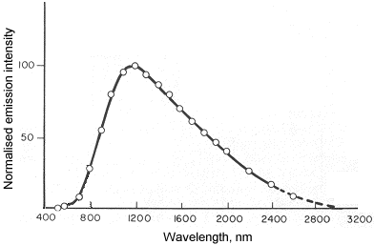
Chemiluminescence
occurs when a chemical reaction produces an electronically excited species which emits a photon in order to reach the ground state. These sort of reactions can be encountered in biological systems; the effect is then known as bioluminescence. The number of chemical reactions which produce chemiluminescence is small. However, some of the compounds which do react to produce this phenomenon are environmentally significant.
A good example of chemiluminescence is the determination of nitric oxide:
NO + O₃ → NO₂* + O₂
NO₂* → NO₂ + hv (l = 600 - 2800 nm)
The following graph shows the spectral distribution of radiation emitted by the above reaction:

