Slide 1
Factors affecting drug absorption

Slide 2
Physiological Factors Affecting Drug Absorption from GIT:
1-Surface area of absorption site and nature of cell membrane.
2- PH of GIT.
3- Gastric emptying rate.
4- Intestinal motility.
5- Hepatic metabolism.
6- Effect of food.
7- Drug absorption interactions.

Slide 3
Physicochemical Factors Affecting Drug Absorption from GIT:
1- PH partition theory.
2- pKa .
3- Lipid solubility.
4- Deviation from pH partition theory
5- Effect of dissolution rate.
6- Noyes-Whitney equation.

Slide 4
7- Effect of particle size.
8- Solid dispersion and solid solution
9- Crystal form.
10- Solubility in diffusion layer.
11- Complexation and adsorption.
12- Chemical stability of drugs in GI fluids.

Slide 5
Dosage form factors influencing drug absorption from the GIT:
1- Effects of excipients.
2-Effects of dosage form type.

Slide 6
Physiological Factors Affecting Drug Absorption
Membrane Physiology:

Slide 7
Rate of Gastric Emptying
Rate of Gastric Emptyingis a major determinant of initial delay in drug absorption.
Stomach emptying influenced by food content and osmolality.
Fatty acids and mono- and diglycerides delay gastric emptying.
High density foods emptied from stomach more slowly.

Slide 8
Gastric Emptying Time:
Some drugs, such as penicillin, are unstable in acid and decompose if stomach emptying is delayed.
drugs, such as aspirin, irritate G mucosa during prolonged contact.
A number of factors affect gastric emptying time.
Some factors delay G emptying:
consumption of meals high in fat.
cold beverages.
anticholinergic drugs.

Slide 9
Liquids and small particles less than 1 mm generally not retained in the stomach. Different constituents of meal empty from stomach at different rates.
Liquids emptied faster than digested solids from stomach.

Slide 10
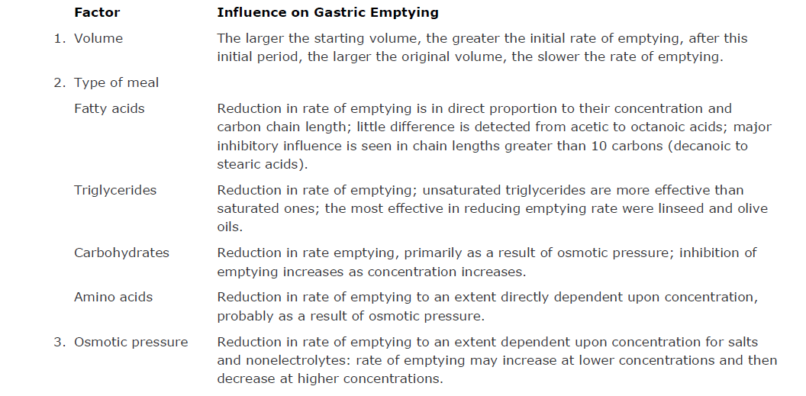

Slide 11
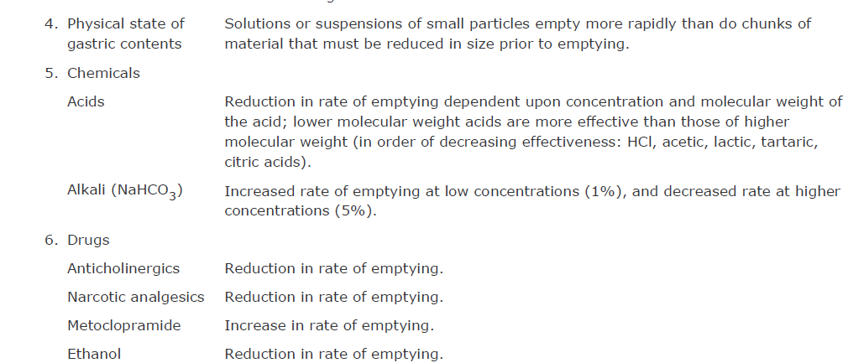

Slide 12
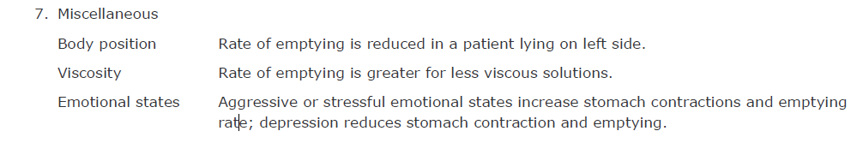

Slide 13
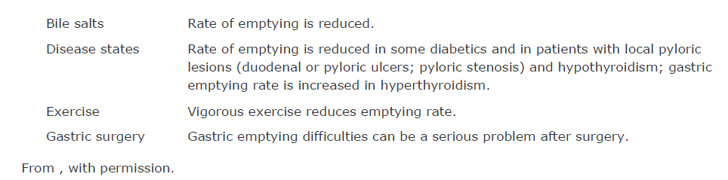

Slide 14
Large particles, including tablets and capsules, are delayed from emptying for 3 to 6 hours by the presence of food in stomach.
Indigestible solids empty very slowly, probably during the interdigestive phase.

Slide 15
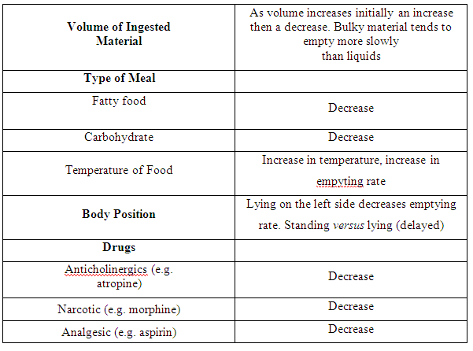
Factors Affecting Gastric Emptying

Slide 16
Intestinal Motility:
is a determinant of the extent of drug absorption.

Slide 17
The drug residence time is used to design the drug dosage form taken orally like enteric coated, sustained release, and targeting dosage form. The residence time of drug also used for drugs which are absorbed by carrier mediator.
Example erythromycin affected by gastric juice so enterically coated to dissolve at certain pH of intestine.

Slide 18
Normal peristaltic movements mix contents bring the drug into contact with intestinal mucosal .
Drug must have a sufficient time at absorption site for optimum absorption.
In high motility as in diarrhea, the drug has a very short residence time and less opportunity for adequate absorption.

Slide 19
Drug take 4-8 hr to pass through stomach and small intestine infasting state.
In fed state, take 8-12 hr.
For modified-release or controlled-dosage forms: slow release over extended period of time.
so drug contents are released and absorbed before loss in stool.

Slide 20
Drugs better absorbed in small intestine (large surface area) than in stomach therefore quicker stomach emptying increase drug absorption.
Example: good correlation found between stomach emptying time and peak plasma concentration for acetaminophen.

Slide 21
4-Perfusion of GIT
Blood flow to GIT carry absorbed drug to circulation.
A large network of capillaries and lymphatic vessels perfuse the duodenal region and peritoneum.
The splanchnic circulation receives 28% of cardiac output and increased after meals.
Once drug is absorbed from small intestine, it enters via mesenteric vessels to hepatic-portal vein and liver prior to reach circulation.
Any decrease in mesenteric blood flow, as in congestive heart failure, will decrease rate of drug removal from intestine, thereby reducing rate of drug absorption.

Slide 22
Food Effect:
Presence of food can increase, decrease, or have no effect on absorption, (characteristics of drug and food.

Slide 23
Effects of food on bioavailability of drug include:
Delay in gastric emptying.
Stimulate of bile flow.
A change pH of the GI tract.
An increase in blood flow.
A change metabolism of the drug substance.

Slide 24
A delay in drug reaching intestine can delay its absorption.
Oral administration of medicine under fasting conditions recommended when rapid effect is needed.
Generally the extent of absorption is not greatly reduced.

Slide 25
Drugs with Absorption Reduced, Delayed, Increased, or Not Affected by the Presence of Food
Reduced Delayed Increased Not Affected
Amoxicillin Acetaminophen Canrenone Cephradine
Ampicillin Amoxicillin Dicoumarol Chlorpropamide
Aspirin Aspirin Griseofulvin Digoxin elixir)
Ethanol Cephalexin Hydrochlorothiazide Glipizide
Isoniazid Cephradine Metoprolol Metronidazole
Furosemide Nitrofurantoin Phenytoin Theophylline

Slide 26
Food effects on bioavailability when drug administered shortly after meal.
The nutrient and caloric contents, meal volume, and meal temperature cause physiologic changes in GI tract in a way that
affects drug transit time,
dissolution,
Permeability.
systemic availability.

Slide 27
In general, meals that are high in total calories and fat content are more likely to affect GI physiology and thereby result in a larger effect on the bioavailability of a drug substance or drug product.

Slide 28
The absorption of some antibiotics, such as penicillin and tetracycline, is decreased with food.

Slide 29
Occasionally absorption may be improved:
Griseofulvin absorption improved by fatty food:poorly soluble griseofulvin dissolved in fat and then more readily absorbed.
The presence of food in GI lumen stimulates the flow of bile. Bile contains bile acids, which are surfactants involved in the digestion and solubilization of fats, also increases the solubility of fat-soluble drugs through micelle formation.

Slide 30
For some basic drugs (eg, cinnarizine) with limited aqueous solubility, the presence of food in the stomach stimulates hydrochloric acid secretion, which lowers the pH, causing more rapid dissolution of the drug and better absorption.
Absorption of this basic drug is reduced when gastric acid secretion is reduced.

Slide 31
Propranolol plasma concentrations are larger after food than in fasted subjects. Because of interaction with components of food.

Slide 33
Most drugs should be taken with a full glass (approximately 8 fluid ounces) of water to ensure that drugs will wash down the esophagus.

Slide 34
Generally, bioavailability better in fasted state and with large volume of water.
The solubility of many drugs is limited, and sufficient fluid is necessary for dissolution of drug.
Some patients may be on several drugs that are dosed frequently for months. These patients are often nauseous and are reluctant to take a lot of fluid.

Slide 36
Erythromycin, iron salts, aspirin, and NSAIDs are irritating to GIT and given with food to reduce irritation.
These drugs, rate of absorption reduced in presence of food, but extent of absorption may be the same.
Enteric-coated tablets stay in stomach for longer period of time because food delays stomach emptying. Thus, enteric tablet does not reach duodenum rapidly, delaying drug release and systemic absorption.

Slide 37
Stomach emptying of particles less affected by food. presence of food may delay stomach emptying of enteric coated tablets or non disintegrating dosage forms for several hours.
Fine granules not significantly delayed emptying from stomach in presence of food.
Food can affect integrity of dosage form, causing alteration in the release of drug.
For example, theophylline bioavailability from Theo-24 controlled-release tablets is more rapid when given to fed subject because of dosage form failures, known as dose-dumping.

Slide 38
Food enhance absorption of drug beyond 2 hours after meals. For example, the timing of fatty meal on absorption of cefpodoxime studied in 20 healthy adults.
Auc and peak drug concentration were significantly higher after administration of cefpodoxime tablets with meal and 2 hours after a meal relative to dosing under fasted conditions or 1 hour before a meal.
The time to peak concentration was not affected by food, suggests that food increased extent but not rate of drug absorption.
These results indicate that absorption of cefpodoxime is enhanced with food or if the drug is taken closely after a heavy meal.

Slide 39
Timing of drug administration in relation to meals is important.
advise patients to take drug 1 hour before or 2 hours after meals to avoid any delay in drug absorption.
Since fatty foods may delay stomach emptying time beyond 2 hours, patients who have just eaten a heavy, fatty meal should take these drugs 3 hours or more after the meal.
Products used to curb stomach acid secretion usually taken before meals, in anticipation of acid secretion stimulated by food.

Slide 40
Famotidine , and cimetidine are taken before meals to curb excessive acid production.
Fluid tends to distend the stomach and speed up stomach emptying; however, large volume of nutrients with high caloric content supersedes that faster rate and delays stomach emptying time.
Reduction in drug absorption caused by several factors. For example, tetracycline hydrochloride absorption is reduced by milk and food that contains calcium, due to tetracycline chelation. However, significant reduction in absorption may simply be the result of reduced dissolution due to increased pH.
Co-administration of sodium bicarbonate raises the stomach pH and reduces tetracycline dissolution and absorption.

Slide 41
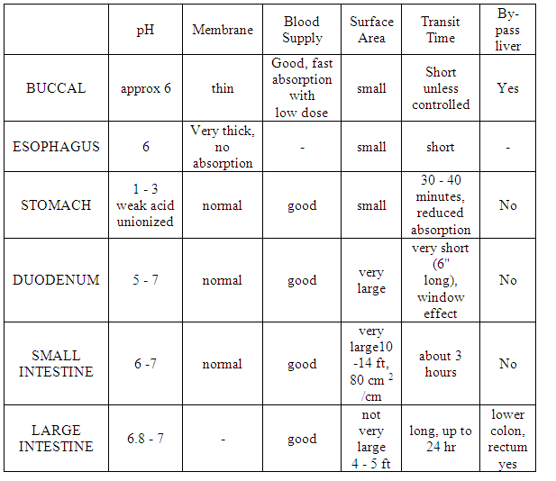

Slide 42
PH of the GIT and pka of the drug
Most drugs are esters either from alcohol of acid or alcohol of amino acids (this drug is nutral).
Only free nonionized form of the drug absorbed (Hendrson-Hasselbalch equation).

Slide 43
In the stomach the pka of drug is constant and the pH is variable because:
Disease state, like stomach ulcer or chlor hydria, or cancer of stomach increase acidity.
Individual variation.
Use of antacids (increase pH).
Use of acidic drugs like non steroidal anti inflammatory drugs such as diclofenac that cause GI irritation.
Presence of food.

Slide 44
GI fluid is composed of various components which may affect the drug absorption, some of these are as the following:
A) The Bile Salts B) The Enzymes C) The Mucin

Slide 45
A) THE BILE SALTS
Being surface active agents, the bile salts enhance the absorption of poorly wettable drugs (hydrophobic drugs) by enhancing their wettability, the dissolution rates of such drugs can be facilitated; for example, When Griseofulvin is taken after meals, its absorption is enhanced, due to the increase of bile salts excretion which promotes the dissolution rate of the drug.
On the other hand bile salts were observed to reduce the absorption of certain drugs, through the formation of non-absorable complexes; for example; Aminoglycosides (streptomycin & Kanamycin), neomycin & nystatin form a non-absorable complex with bile salts.

Slide 46
B) ENZYMES
Since GIT fluid contains large concentration of enzymes needed for food digestion, it should be expected that some of these enzymes will act on drugs, for example the enzyme Esterase (secreted by pancreas) will hydrolyse a number of ester derivative drugs such as aspirin & propoxyphene in the intestine & also digestive enzymes may break some proteinic like drugs such as protein-insulin.

Slide 47
MUCIN
Mucin is a viscous muco-polysaccharaide (glycoprotein) that lines the GIT mucosa for protection & lubrication purposes, it may form non-absorable complex with certain drugs for example aminoglycosides, while it may
form an ion-pair with certain cationic drugs such as Quaternary Ammonium Compounds leading to their absorption, because mucin it self is holding a negative anionic charges.

