Slide 1
Chapter 4 part 2
Preformulation studies

Slide 2
Physical Description
Solid drugs :pure chemical compounds of either crystalline or amorphous constitution.
The purity of chemical substance is essential for its identification and for evaluation of its chemical, physical, and biologic properties.
Chemical properties include structure, form, and reactivity.
Physical properties include: physical description, particle size, crystalline structure, melting point, and solubility.
Biologic properties relate to its ability to get to a site of action to give biologic response.

Slide 3
Liquid drugs
Many liquids are volatile and must be physically sealed from atmosphere to prevent evaporation loss.
Amyl nitrite, for example, is a clear yellowish liquid that is volatile even at low temperatures and highly flammable. It is kept in small sealed glass cylinders wrapped with gauze.
When amyl nitrite is administered, the glass is broken between the fingertips, and the liquid wets the gauze covering, producing vapors that are inhaled by patient requiring vasodilation.

Slide 4
Other example
Propyl hexedrine is volatile liquid that must be contained in a closed system. This drug is used as a nasal inhalant for vasoconstrictor action.
A cylindrical roll of fibrous material is impregnated with
Propyl hexedrine, and the saturated cylinder is placed in a suitable, plastic, sealed nasal inhaler.
The inhaler maintains its effectiveness for only a limited time because of the volatility of the drug.

Slide 5
Another problem associated with liquid drugs is that those intended for oral administration cannot generally be formulated into tablet without chemical modification.
An exception to this is liquid drug nitroglycerin, which is formulated into sublingual tablets that disintegrate within seconds after placement under the tongue.
However, because the drug is volatile, it has a tendency to escape from the tablets during storage,
the tablets sould be stored in a tightly sealed glass container.

Slide 6
when a liquid drug is to be administered orally and a solid dosage form is desired, one of two approaches is used.
First, liquid sealed in soft gelatin capsule. Vitamins A, D, and E are liquids available in capsule form.
Second, liquid drug developed into solid ester or salt so will be suitable for tablets or capsules.
Example: scopolamine hydrobromide is a solid salt of liquid drug scopolamine and is easily pressed into tablets.
Another approach to formulate liquids into solids is by mixing drug with a solid or melted semisolid material, such as a high molecular weight PEG. The melted mixture is poured into hard gelatin capsules to harden, and the capsules are sealed.

Slide 7
liquid drugs, that taken orally in large doses or applied topically, their liquid nature may have some advantage in therapy.
For example, 15-mL doses of mineral oil may be administered conveniently as such.
However, for pharmacists prefer solid materials in formulation work because they can easily form them into tablets and capsules.

Slide 8
Formulation and stability difficulties arise less frequently with solid dosage forms than with liquid for this reason, many new drugs first reach the market as tablets or capsules.
Later, liquid form of same drug marketed. This procedure is doubly advantageous, because physicians and patients prefer small, tasteless, accurately dosed tablets or capsules.
It is estimated that tablets and capsules constitute 70% of dosage forms.
pharmacists, dispense tablets twice as capsules.

Slide 9
Microscopic Examination
Microscopic examination of raw is important step in preformulation. It gives an indication of particle size and crystal structure.
Photomicrographs of initial and subsequent batch can provide important information in case of problems in formulation processing attributable to changes in particle or crystal characteristics of drug.
During some processing procedures, the solid drug powders must flow freely. Spherical and oval powders flow more easily than needle-shaped powders and make processing easier.

Slide 10
Heat of Vaporization
use of vapor pressure is important in implantable pumps delivering medications and in aerosol dosage forms.
Some volatile drugs can migrate within a tablet dosage form so the distribution may not be uniform any longer. So drug in one portion may be higher or lower than in the other portion.
heat of vaporization of liquid: is the amount of heat absorbed when 1 g of liquid vaporizes and measured in calories.
The heat of vaporization of water at 100°C is 540 cal/g

Slide 11
Melting Point Depression
A characteristic of a pure substance is a defined melting point or melting range.
If not pure, the substance will exhibit a change in melting point.
This phenomenon is commonly used to determine the purity of a drug and compatibility of various substances before inclusion in the same dosage form.

Slide 12
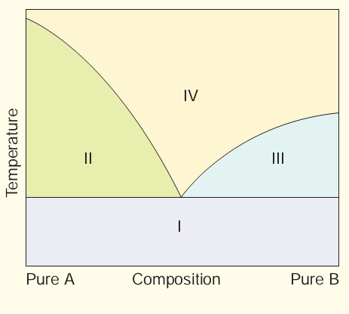
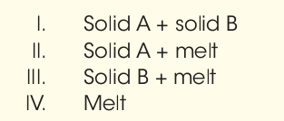
The Phase Rule
Phase diagrams are used to provide visual picture of the existence and extent of the presence of solid and liquid phases in binary, ternary, and other mixtures.

Slide 13
The Phase Rule
A phase diagram, or temperature composition diagram, represents the melting point as a function of composition of two or three component systems.
The figure is an example of such a representation for a two-component mixture. This phase diagram depicts a two component mixture in which the components are completely
miscible in the molten state and no solid solution or addition compound is formed in the solid state. As is evident, starting from the extremes of either pure component A or pure component B, as the second component is added, the melting
point of the pure component decreases.

Slide 14
Particle Size
physical and chemical properties of drug are affected by particle size which are :dissolution rate, bioavailability, content uniformity, taste, texture, color, stability.
In addition, flow characteristics and sedimentation rates, are important factors related to particle size.
particle size affect absorption profiles of certain drugs, including griseofulvin, nitrofurantoin, spironolactone, and procaine penicillin.
Also, satisfactory content uniformity in solid dosage forms depends on particle size and the equal distribution of the active ingredient through-out the formulation.

Slide 15
Polymorphism
An important factor on formulation is crystal or amorphous form of drug.
Polymorphic forms usually exhibit different physicochemical properties, including melting point and solubility.
Polymorphic forms in drugs are relatively common. It has been estimated that at least one third of all
organic compounds exhibit polymorphism

Slide 16
In addition to polymorphic forms, compounds may occur in non crystalline or amorphous forms. The energy required for a molecule of drug to escape from a crystal is much greater than is required to escape from an amorphous powder. Therefore, amorphous form is always more soluble than crystal form.
The changes in crystal characteristics can influence bioavailability and chemical and physical stability. For example, it can be a significant factor relating to tablet formation because of flow and compaction behaviors.
Various techniques are used to determine crystal properties:
hot stage microscopy,
thermal analysis,
infrared spectroscopy, and
x-ray diffraction

Slide 17
Solubility
important especially aqueous solubility. A drug must possess some aqueous solubility for therapeutic efficacy.
For a drug to enter the systemic circulation and exert a therapeutic effect, it must first be in solution.
Relatively insoluble compounds exhibit incomplete absorption.
If the solubility of the drug substance is less than desirable, should improve solubility. The methods used depend on chemical nature of drug and type of drug product under consideration.
Chemical modification of the drug into salt or ester forms is frequently used to increase solubility.

Slide 18
Equilibrium solubility method
A drug’s solubility is usually determined by the equilibrium solubility method, by which an excess of the drug is placed in a solvent and shaken at a constant temperature over a long period until equilibrium is obtained. Then chemical analysis of the drug content in solution is performed to determine degree of solubility.

Slide 19
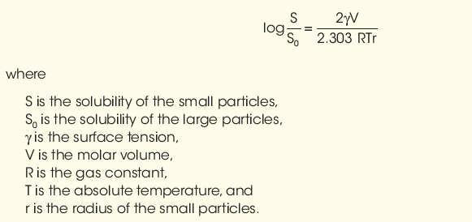
Solubility and Particle size
The particle size and surface area of a drug exposed to a medium can affect actual solubility within reason, for example, in the following relationship:

Slide 20
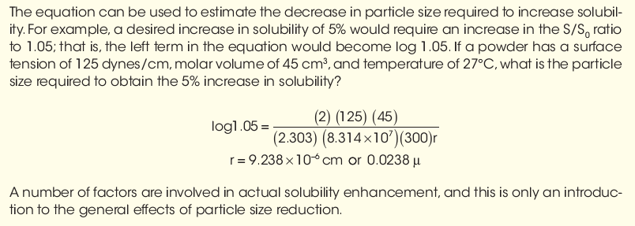

Slide 21
Solubility and pH
To formulate liquid product, should adjust the pH of solvent to enhance solubility.
for many drug substances, pH adjustment is not an effective means of improving solubility.
Weak acidic or basic drugs may require extremes in pH that are outside accepted physiologic limits or that may cause stability problems with formulation ingredients.
Adjustment of pH usually has little effect on the solubility of substances other than electrolytes. In many cases, it is desirable to improve aqueous solubility by:
1-use cosolvents
2-complexation,
3-micronization,
4-solid dispersion.

Slide 22
Dissolution
dissolution rate, or the time it takes for the drug to dissolve in the fluids at the absorption site, is the rate-limiting step in absorption.
This is true for drugs administered orally in solid forms, such as tablets, capsules, or suspensions,
and for those administered intramuscularly.
When the dissolution rate is the rate-limiting step, anything that affects it will also affect absorption. Consequently, dissolution rate can affect the onset, intensity, and duration of response and control the overall bioavailability of the drug from the dosage form

Slide 23
The dissolution rate of drugs increased by:
decreasing drug’s particle size.
Increase solubility in diffusion layer.
Use highly water-soluble salt of parent substance.
Dissolution rates of chemical compounds determined by two methods:
The constant surface method, which provides intrinsic dissolution rate of the agent.
Particulate dissolution, in which a suspension of the agent is added to a fixed amount of solvent without exact control of surface area.

Slide 24
fick’s laws of diffusion and Noyes-Whitney equation
All drugs must diffuse through various barriers when administered to the body.
Ficks low govern absorption through membrane
Noyes-Whitney equation govern dissolution rate.

Slide 25
Membrane Permeability
passage of drug molecules across biologic membranes to produce a biologic response.
The biologic membrane acts as a lipid barrier to most drugs and permits the absorption of lipid-soluble substances by passive diffusion.
while lipid-insoluble substances cannot diffuse across the barrier.

Slide 26
technique using everted intestinal sac used to evaluate absorption of drug:
In this method, a piece of e intestine is removed from intact animal, is everted, and is filled with a solution of drug, and the degree and rate of passage of the drug through the membrane sac are determined.
In the latter stages of preformulation testing or early formulation studies, animals and humans must be studied to assess absorption efficiency and pharmaco kinetic parameters and to establish possible in vitro and in vivo correlation for dissolution and bioavailability.

Slide 27

Partition coefficient
P depends on drug concentration only if drug molecules have a tendency to associate in solution.
The oil–water partition coefficient is a measure of a molecule’s lipophilic character; that is, its preference for the hydrophilic or lipophilic phase.
If a solute is added to a mixture of two immiscible liquids, it will distribute between the two phases and reach an equilibrium at a constant temperature.

Slide 28
pKa /Dissociation constant
The extent of dissociation or ionization is highly dependent on pH of medium containing drug.
In formulation, the vehicle is adjusted to a certain pH to obtain a certain level of ionization of drug for solubility and stability.
In pharmacokinetic area, the extent of ionization of a drug has a strong effect on its extent of absorption, distribution, and elimination.
dissociation constant, or pKa , is usually determined by potentiometric titration.

Slide 29
Hydrates and Solvates
Many active pharmaceutical agents exist as hydrates or solvates; some are hygroscopic, deliquescent, and/or efflorescent.
Hygroscopic powders are those that will tend to absorb moisture from the air.
Deliquescent powders are those that will absorb moisture
from the air and even liquefy.
Efflorescent powders are those that may give up their
water of crystallization and may even become damp and pasty.
When working with these powders, extra care must be taken.

Slide 30
if a hygroscopic or deliquescent powder is being weighed on a balance, the powder may absorb moisture from air and weigh heavier than it should. Therefore, weighings should be made quickly after opening the bulk chemical containers and then resealing them.
Solvates and hydrates must be packaged in “tight” containers to prevent the loss or gain of moisture.
In fact, it is best to have all chemicals stored in “tight” containers and to keep them closed at all times except for the short time when a weighing step is involved. Storage at the indicated temperatures is also important and to minimize any exposure to very high humidity levels.

Slide 31
organic Salt considerations
Because many drugs are either weak acids or weak bases and have limited water solubility, they are often used as their “salts” to increase their aqueous solubility.
For example: sodium salicylate is salt of weak acid, salicylic acid, and sodium hydroxide).
Also, ephedrine hydrochloride can be prepared between a weak base, ephedrine, and hydrochloric acid.
Generally, the “unionized” portion of drug in solution that will be absorbed for systemic effect.
This is described by the “dissociation constant” or “pKa ” of the drug.

Slide 32
Active pharmaceutical ingredient (API) in a salt form is
not 100% active drug, it is important to know whether or not the dose of drug is based upon drug salt or drug base form.
The purpose of “salt” form is usually to enhance solubility of drug; but it may also enhance stability and change other attributes of the drug that make it easier to handle and manipulate for producing dosage forms.
the “unionized” portion of drug will exert effect in body

Slide 33
Potency-Designated active Pharmaceutical ingredients
API, is not 100% active drug in all cases. It is important to know the assayed potency designation of the ingredient so that appropriate allowances can be made to obtain the correct amount. This may be on the label or on the Certificate of
Analysis.
Some APIs, including some antibiotics, endocrine products, biotechnology-derived products, biologics, etc., have potencies that are based on “activity” and are expressed in terms of “units of activity,” “micrograms per milligram,” or other standard terms of measurements. These are described for each API in USP.

Slide 34
drug and drug Product stability
Stability studies conducted in preformulation phase include:
1- solid-state stability of drug alone
2- solution-phase stability
3-stability in presence of excipients.
Initial investigation begins with knowledge of the drug’s chemical structure, which allows the preformulation scientist to anticipate possible degradation reactions.

Slide 35
Drug Stability: Mechanisms of Degradation
Chemical : Chemically, drug substances are alcohols, phenols, aldehydes, ketones, esters, ethers, acids, salts, alkaloids, glycosides, and others, each with reactive chemical groups having different susceptibilities to chemical instability.
Chemically, the most frequently encountered destructive processes are hydrolysis and oxidation.

Slide 36
Hydrolysis is a solvolysis process in which (drug) interact with water to yield breakdown products.
For example, aspirin, or acetylsalicylic acid, combines with a water molecule and hydrolyzes into one molecule of salicylic acid and one molecule of acetic acid.
Hydrolysis is probably the most important single cause of drug decomposition, mainly because a great number of medicinal agents are esters or contain such other groupings as substituted amides, lactones, and lactams, which are susceptible to the hydrolytic process.

Slide 37
Another destructive process is oxidation,
which destroys many drug, including: aldehydes, alcohols, phenols, sugars, alkaloids, and unsaturated fats and oils.
Chemically, oxidation is loss of electrons from atom or molecule. Each electron lost is accepted by some other atom or molecule, reducing the recipient.
In inorganic chemistry, oxidation is accompanied by
increase in positive valence of an element: for example, ferrous (+ 2) oxidizing to ferric (+ 3).
In organic chemistry, oxidation is frequently considered synonymous with loss of hydrogen dehydrogenation) from molecule.

Slide 38
Drug and Drug Product Stability: Kinetics and Shelf Life
Stability is the extent to which a product retains within specified limits and through out its period of storage and use (i.e., its shelf life) the same properties and characteristics that it possessed at the time of its
manufacture.

Slide 39
Five types of stability concern pharmacists:
1. Chemical: Each active ingredient retains its chemical integrity and labeled potency within the specified limits.
2. Physical: The original physical properties, including appearance, palatability, uniformity, dissolution, and suspendability, are retained.
3. Microbiologic: Sterility or resistance to microbial growth is retained according to the specified requirements. Antimicrobial agents retain effectiveness within specified limits.
4. Therapeutic: The therapeutic effect remains unchanged.
5. Toxicologic: No significant increase in toxicity occurs.

Slide 40
Chemical stability is important for selecting storage conditions (temperature, light, humidity), selecting the proper container for dispensing (glass versus plastic, clear versus amber or opaque, cap liners), and anticipating interactions when mixing drugs and
dosage forms.
Stability and expiration dating are based on reaction kinetics, that is, the study of the rate of chemical change and the way this rate is influenced by concentration of reactants, products, and other chemical species and by factors such as solvent, pressure, and temperature.

Slide 41
In considering chemical stability of a pharmaceutical, one must know the reaction order and reaction rate. The reaction order may be the overall order (the sum of the exponents of the concentration terms of the rate expression) or the order with respect to each reactant (the exponent of the individual concentration term in the rate expression).
Reaction rate: The reaction rate is a description of drug concentration with respect to time. Most commonly, zero-order and first-order reactions are encountered in pharmacy.

Slide 42
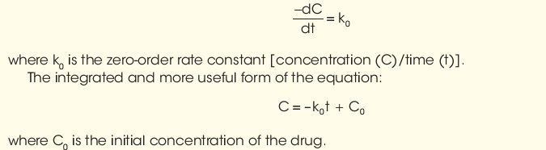
Zero-order rate reactions
If the loss of drug is independent on concentration of reactants and constant with respect to time (i.e., 1 mg/mL/h), the rate is called zero order. The mathematical expression is

Slide 43
units for zero rate constant K0 are concentration per unit time such as:
Mole/liter/ second or mg/ml/min
It is meaningless to attempt to describe the time required for all material in a reaction to decompose that is infinity therefore reaction rate are commonly described by K or by their half life t1/2
The half life equation for a zero order reaction
t1/2 = ½ (C0/K0)
If the C0 changes the t1/2 changes . There is inverse relationship between t1/2 and K

Slide 44
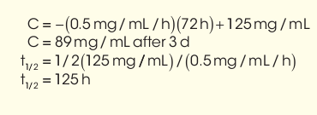
Example1
A drug suspension (125 mg/mL) decays by zero-order kinetics with a reaction rate constant of 0.5 mg/mL/h. What is the concentration of intact drug remaining after 3 days (72 hours), and what is its t1/2 ?

Slide 45
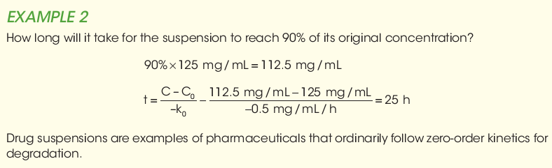

Slide 46
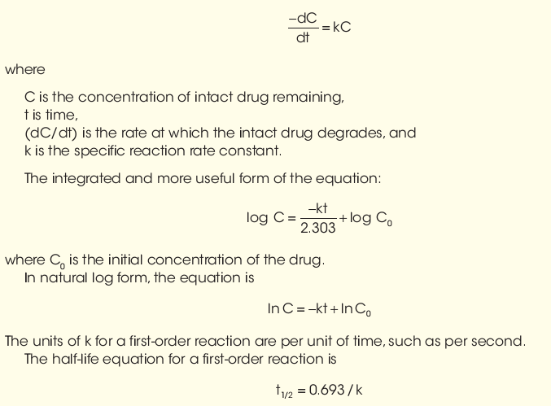
First order reactions
If loss of drug is directly proportional to concentration remaining with respect to time, it is called a first-order reaction and has the units of reciprocal time, that is, time− 1 The mathematical expression is:

Slide 47
and can be easily derived from first-order equation by substituting values of C = 50% and C0 = 100%, representing a decrease in concentration by 50%.
Example 3
An ophthalmic solution of a mydriatic drug at 5 mg/mL exhibits first-order degradation with a rate of 0.0005/day. How much drug will remain after 120 days, and what is its half-life?

Slide 48
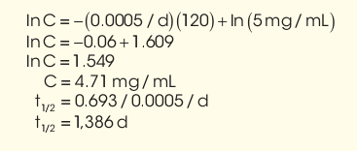
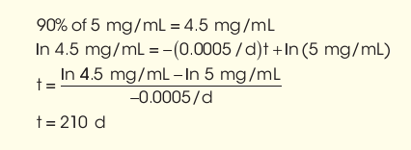
Example 4
In Example 3, how long will it take for drug to degrade to 90% of its original concentration?

Slide 49
Enhancing Stability of Drug Products
Many pharmaceutical ingredients used to prepare the desired dosage form of a drug substance. Some of these agents used to achieve the desired physical and chemical characteristics of the product or enhance its appearance, odor, and taste. Other substances used to increase the stability of drug substance, against hydrolysis and oxidation.

Slide 50
There are several approaches to stabilize pharmaceutical preparations containing drugs subject to hydrolysis:
1-reduction or elimination of water from pharmaceutical system.
2- solid dosage forms containing water-labile drugs must be protected from humidity in the atmosphere. This may be accomplished by applying a waterproof protective coating over tablets or by keeping the drug in a tightly closed container. It is fairly common to detect hydrolyzed aspirin by noticing odor of acetic acid upon opening a bottle of aspirin tablets.
3-In liquid preparations, water can frequently be or reduced in the formulation through the use of substitute liquids such as glycerin, propylene glycol, and alcohol.

Slide 51
In certain injectable products, anhydrous vegetable oils may be used as the drug's solvent to reduce the chance of hydrolytic decomposition.
4- hydrolysis prevented in liquid drugs by suspending them in nonaqueous vehicle rather than dissolving them in aqueous solvent. Particularly for unstable antibiotic drugs, when aqueous preparation is desired, the drug supplied in a dry form for reconstitution by adding a specified volume of purified water just before dispensing. The dry powder is mixture of antibiotic, suspending agents, flavorants, and colorants; when reconstituted by the pharmacist, it remains stable for the period of use.

Slide 52
5-Refrigeration is advisable for most preparations considered subject to hydrolysis. Together with temperature, pH is a major determinant of the stability of drug prone to hydrolytic decomposition. Hydrolysis of most drugs depends on relative concentrations of the hydroxyl and hydronium ions, and a pH at which each drug is optimally stable can be easily determined. For most hydrolysable drugs, optimum stability is on the acid side, somewhere between pH 5 and 6. Therefore, through use of buffering agents, the stability can be increased.
Buffers are used to maintain a certain pH

Slide 53

Buffer Capacity
pH, buffers, and buffer capacity are especially important in drug product formulation, since they affect the drug’s solubility, activity, absorption, and stability and the patient’s comfort.
A buffer is a system, usually an aqueous solution, that can resist changes in pH upon addition of acid or a base. Buffers are composed of a weak acid and its conjugate base or a weak base and its conjugate acid. Buffers are prepared by one of these processes:
1. Mixing a weak acid and its conjugate base or a weak base and its conjugate acid
2. Mixing a weak acid and a strong base to form the conjugate base or a weak base and a strong acid to form the conjugate acid
Using the Henderson-Hasselbalch equation:
Remember that acid is the proton donor and the base is the proton acceptor.

Slide 54
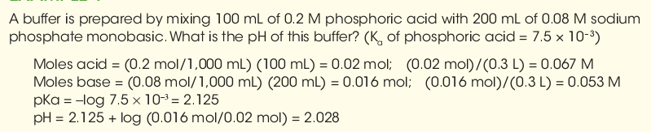
Example1

Slide 55
Pharmaceutically, oxidation of a susceptible drug substance is most likely to occur when it is not kept dry in the presence of oxygen or when it is exposed to light or combined with other chemical agents without proper regard to their influence on oxidation.
Oxidation of a chemical in a pharmaceutical preparation is usually accompanied by an alteration in the color of that preparation. It may also result in precipitation or a change in odor.
The oxidative process is inhibited by agents called antioxidants, which react with
one or more compounds in drug to prevent progress of reaction.

Slide 56
Because oxygen may adversely affect their stability, certain pharmaceuticals require an oxygen-free atmosphere during preparation and storage.
Oxygen may be present in pharmaceutical liquids in the airspace within the container or may be dissolved in the liquid vehicle.
To avoid these exposures, oxygen-sensitive drugs may be prepared in the dry state and packaged in sealed containers with the air replaced by an inert gas such as nitrogen, as may liquid preparations. This is a
common practice in commercial production
of vials and ampules of easily oxidizable preparations intended for parenteral use.

Slide 57
Light can also act as a catalyst to oxidation reactions,
As a precaution against acceleration of oxidation, sensitive preparations are packaged in light-resistant or opaque containers. Because most drug degradations proceed more rapidly as temperature increases, it is advisable to maintain oxidizable drugs in a cool place. Another factor that can affect stability of oxidizable drug in solution is the pH of the preparation. Each drug must be maintained in solution at pH most favorable to its stability.

Slide 58
For easily oxidizable drugs, pharmacist stabilize the preparation by selective exclusion from oxygen, oxidizing agents, trace metals, light, heat, and other chemical catalysts to oxidation process. Antioxidants, chelating agents, and buffering agents may be added to create and maintain a favorable pH.
Product containers, closures, and other packaging features must be considered in stability testing. For instance, tablets or capsules packaged in glass or plastic bottles require different stability test protocols from those for blister packs or strip packaging.
This varies from preparation to preparation and must be determined on an individual basis for each drug.

Slide 59
Drug instability in pharmaceutical formulations detected by change in physical appearance, color, odor, taste of formula, whereas in other instances chemical changes may not be self-evident and may be ascertained only through chemical analysis.

Slide 60
In summary, for easily oxidizable drugs, the formulation pharmacist may stabilize the preparation by the selective exclusion from the system: of oxygen, oxidizing agents, trace metals, light, heat, and other chemical catalysts to oxidation process.
Antioxidants, chelating agents, and buffering agents may be added to create and maintain a favorable pH.
In addition to oxidation and hydrolysis, destructive processes include:
polymerization,
chemical decarboxylation, and
deamination. However, these processes occur less frequently and are peculiar to only small groups of chemical substances.

Slide 61
FDA-required demonstration of drug stability is necessarily different for each stage of drug development, such as for a 2-week preclinical study, an early phase I study, a limited phase II trial, a pivotal phase III clinical study, or for a new drug application.
As a drug development program progresses, so do the requisite data to demonstrate and document the product’s stability profile.

Slide 62
Before approval for marketing a product’s stability must be assessed with regard to its formulation;
influence of its pharmaceutical ingredients;
influence of container and closure;
manufacturing and processing conditions (e.g., heat);
packaging components;
conditions of storage;
conditions of shipping,
temperature,
light, and
humidity; and
duration and conditions of pharmacy shelf life and patient use.
Holding intermediate product components (such as drug granulations for tablets) for long periods before processing into finished pharmaceutical products can affect the stability of
Both intermediate component and finished product.

Slide 63
Therefore, in-process stability testing, including retesting of intermediate components, is important.
Product containers, closures, and other packaging features must be considered in stability testing.
For instance, tablets or capsules packaged in glass or plastic bottles require different stability test protocols from those for blister packs or strip packaging.
Drugs particularly subject to hydrolysis or oxidative decomposition must be evaluated accordingly.
And sterile products must meet sterility test standards to ensure protection against microbial contamination. All preservatives must be tested for effectiveness in the finished product.

Slide 64
Study stability of drug products by:
long-term storage at room temperature and relative humidity.
accelerated stability studies as indication of shelf life stability.
Drug instability in pharmaceutical formulations may be detected by change in physical appearance, color, odor, taste, or texture of formulation, whereas in other instances, chemical changes may not be self-evident and may be ascertained only through chemical analysis.
Scientific data pertaining to stability of formulation can lead to prediction of expected shelf life of proposed product, and when necessary to redesign of drug (e.g., into more stable salt or ester form) and to reformulation of the dosage form. Obviously, the rate at which a drug product degrades is important.

Slide 65
study of rate of chemical change and the way it is influenced by such factors as:
concentration of drug or reactant,
the solvent,
temperature and
pressure, and
other chemical agents in the formulation .
In general, a kinetic study begins by measuring:
the concentration of drug at given intervals under a specific set of conditions, including temperature, pH, ionic strength, light intensity, and drug concentration.

Slide 66
The measurement of the drug’s concentration at the various times reveals the stability or instability of the drug under the specified conditions with the passage of time.
From this starting point, each of the original conditions may be varied to determine the influence of such changes on drug’s stability.
For example, the pH of the solution may be changed while the temperature, light intensity, and original drug concentration are held constant.

Slide 67
accelerated Stability Studies
stability testing is to provide evidence on how the quality of a drug product varies with time under the influence of environmental factors, such as temperature, humidity, oxidation, light and microbial exposure. Stability testing is also used to establish the shelf life for a drug product and recommended storage conditions

Slide 68
Accelerated testing:
Studies designed to increase the rate of chemical degradation or physical change of a drug substance or drug product by using exaggerated storage conditions as part of long-term, intermediate, and accelerated studies.
Drug product: The dosage form in the final immediate packaging intended for marketing.
Drug substance: The unformulated drug substance that may subsequently be formulated with excipients to produce dosage form.
Excipient: Anything other than the drug substance in dosage form.

Slide 69
Expiration date: The date placed on container label of drug product designating the time prior to which a batch of the product is expected to remain within approved shelf life specification, if stored under defined conditions, and after which it must not be used.
Shelf life (also referred to as expiration dating period):The time period during which a drug product is expected to remain within the approved shelf life specification, provided that it is stored under the conditions defined on container label.

Slide 70
Stress testing (drug substance):
Studies undertaken to elucidate the intrinsic stability of a drug substance. Such testing is part of the drug development process and is normally carried out under more severe conditions than those used for accelerated testing.
Stress testing (drug product):Studies undertaken to assess the effect of severe conditions on drug product. Such studies include photostability testing as well as the specific testing of certain product types (e.g., metered dose inhalers, creams, emulsions).
For the drug substance, the testing should evaluate its susceptibility to hydrolysis across a wide range of pH values when in solution or suspension.
Photo stability testing should be an integral part of stress testing.

Slide 71
Data should be obtained from at least three pilot-scale batches of the drug substance, manufactured by the method and procedures that mirror the process to be used for final full-scale production batches.
Stability studies also should be conducted on drug substance packaged in the container closure system that is the same or simulates the packaging proposed for final product.

Slide 72
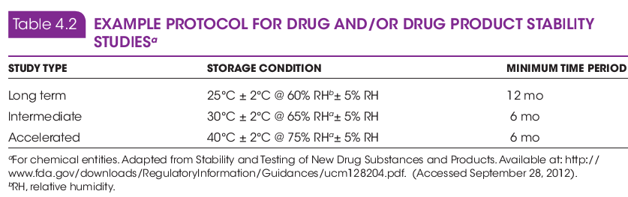

Slide 73
on at least three batches of manufactured dosage form, packaged in the container and closure system, including all secondary packaging (e.g., outer carton) proposed for marketing.
The studies should include testing product that susceptible to change during storage, thereby affecting quality and efficacy.
The testing should cover, as appropriate, the physical, chemical, biological, and microbiological attributes;
preservative content (e.g., antioxidant, anti-microbial preservative); and functionality tests (e.g., metered-dose delivery system).

Slide 74
Table 4.2 presents an example protocol for long-term, intermediate, and accelerated stability studies for a chemical drug entity and dosage form product.
Protocols vary for products intended to be maintained under conditions of refrigeration, for those to be
frozen, for products known to be destined for geographic areas of temperature extremes, and for biotechnological /biological products, which have separate protocols for stability studies.

Slide 75
Following FDA product approval and initial marketing, pharmaceutical manufacturers retain production samples of drug/drug product for 5 years or longer and continue studies for signs of degradation under various conditions of storage.
Pharmacy practitioners should also observe signs of product instability (e.g., color change, distorted capsules, softened tablets, etc.) and report such
findings.
Prescriptions requiring compounding by pharmacist do not require extended shelf life that commercially manufactured and distributed products do because they are intended to be used immediately by patient and used only during immediate course of prescribed treatment

Slide 76
These compounded prescriptions must remain stable and efficacious during the course of use, and compounding pharmacist must employ formulative components and techniques that will result in a stable product.
Today, there are a number of literature sources for the pharmacist to utilize in compounding of high quality and stable prescriptions.

Slide 77
USP guidelines on stability
state that in the absence of stability information applicable to a specific drug and preparation, the following guidelines can be used:
non aqueous liquids and solid formulations when manufactured drug is the source of the active ingredient, not later than 25% of the time remaining until the product’s expiration date or 6 months; non aqueous liquids and solid formulations in which a USP or National Formulary (NF) substance is the source of active ingredient, a beyond-use date of 6 months;
for water-containing formulations prepared from ingredients in solid form, a beyond-use date not later than 14 days in storage at cold temperatures;
for all other formulations, a beyond-use date of intended duration of therapy or 30 days. Thus, if oral aqueous liquid preparation is made from a tablet or capsule formulation, the pharmacist should make up only at most 14 days’ supply, and it must be stored in a refrigerator.
Furthermore, the pharmacist must dispense the medication in a container conducive to stability and use and must advise the patient of proper method of use and conditions of storage of the medication

