Slide 1
Operations Research 1 (OR)
First Semester
For the 3rd class students
Mathematics Department
College of Science for Women

Slide 2
Transportation Problem
Definition of the Transportation Problem

Slide 3
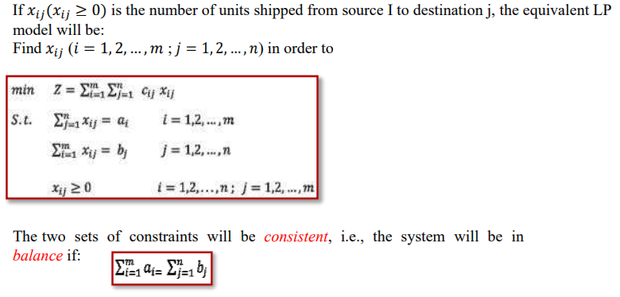

Slide 4
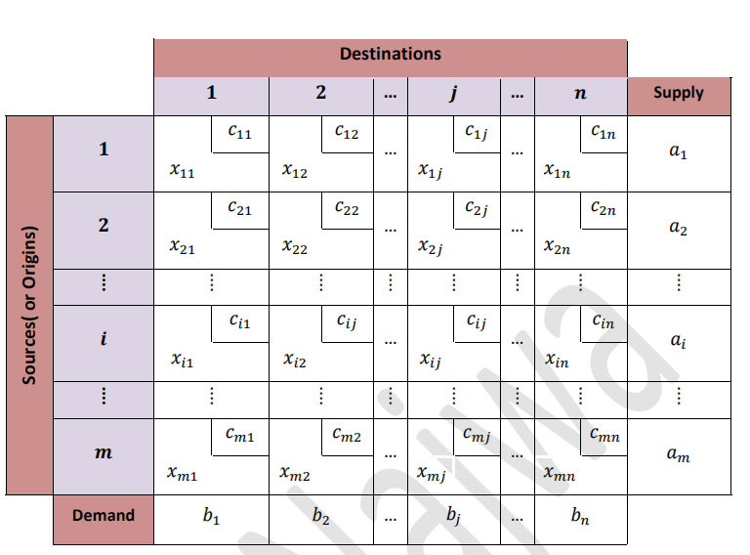

Slide 5
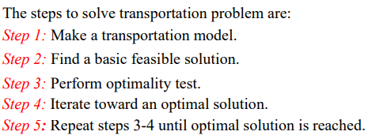
Definition
Solution of the Transportation Model

Slide 6
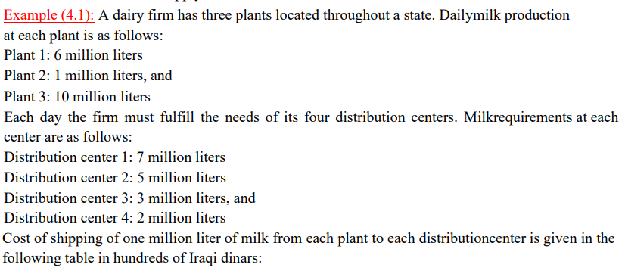
1

Slide 7
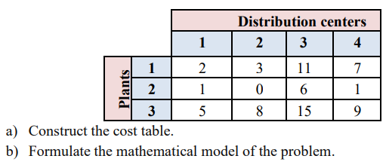
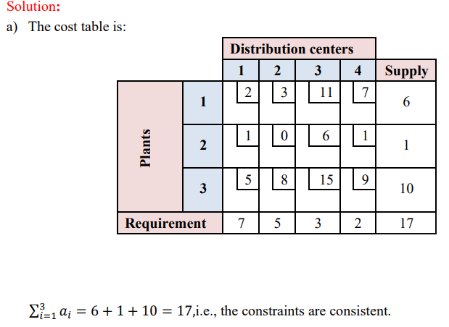

Slide 8
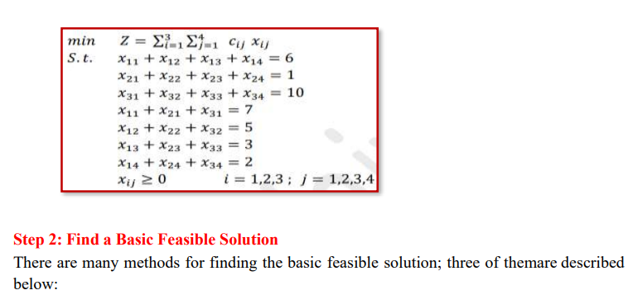

Slide 9
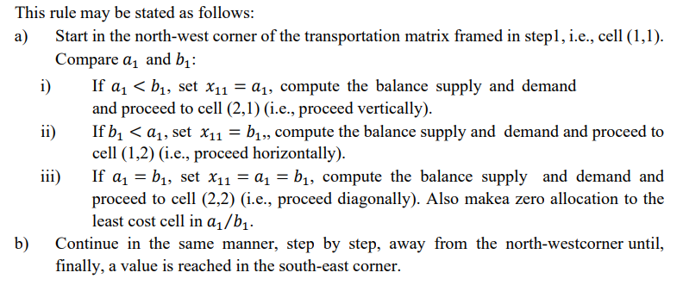
North-West Corner Method (NWCM)

Slide 10
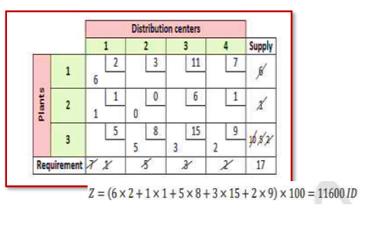
Example
For the transportation problem in example 1

Slide 11
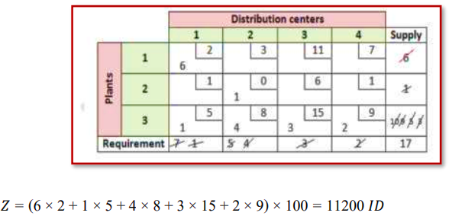
Least-Cost Method
Example
For the transportation problem in example 1

Slide 12
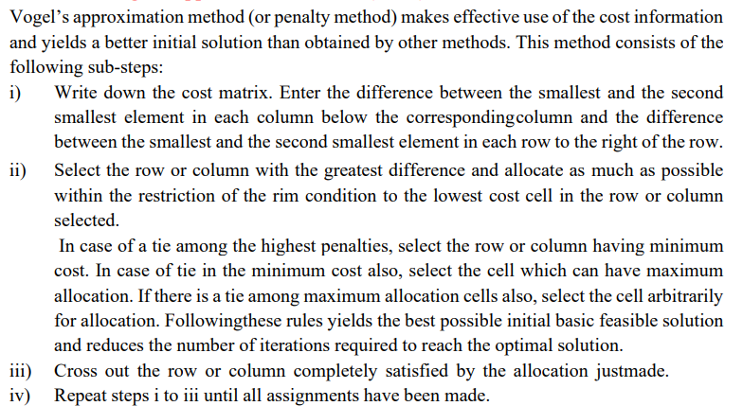
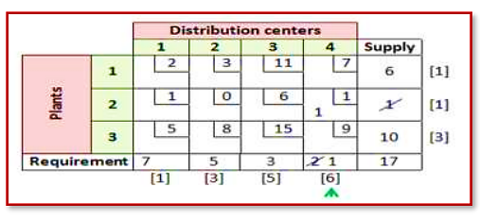
Vogel’s Approximation Method (VAM)
Vogel’s Approximation Method (VAM)
Example
For the transportation problem in example (4.1), the cost matrix with penalties is shown below:

Slide 13
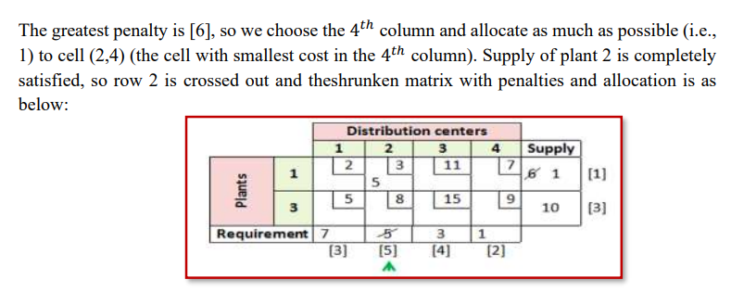
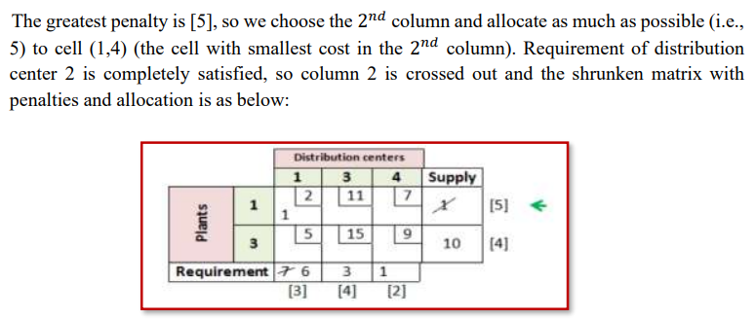

Slide 14
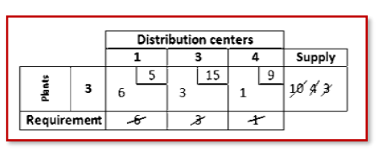
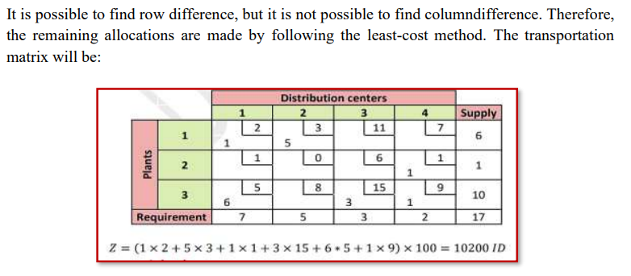

Slide 15
Remark
It is possible to all the previous steps in one table as follows:
Remark
Vogel method yields the best initial solution, and the north-west corner method yields the worst.

Slide 16
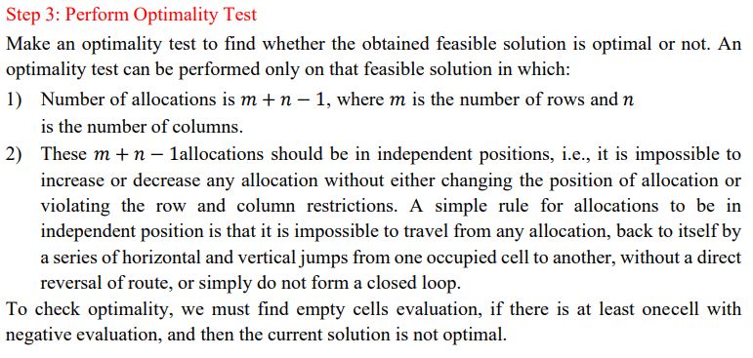

Slide 17
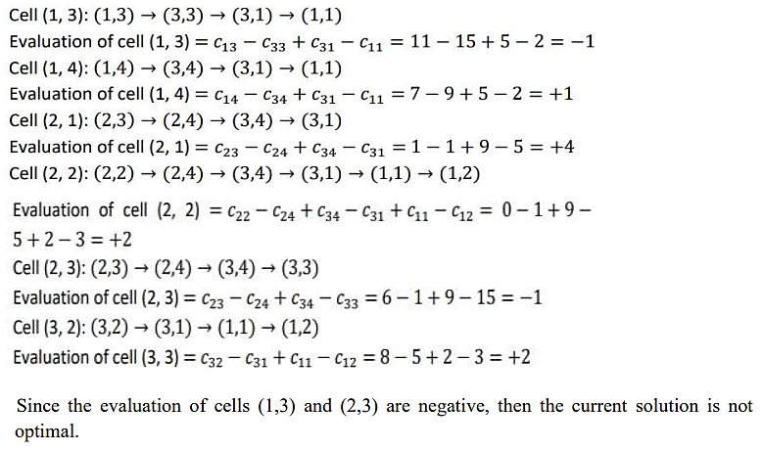

Slide 20
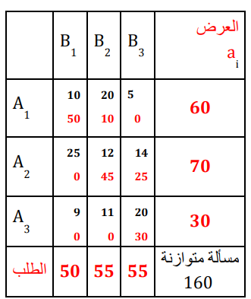

Slide 21
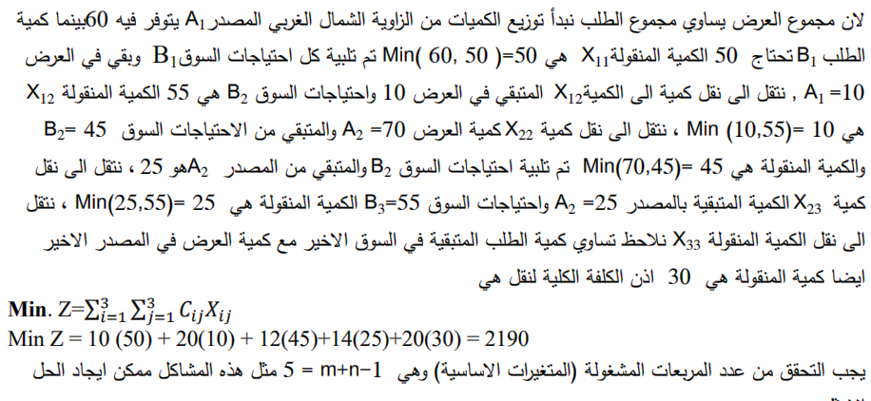
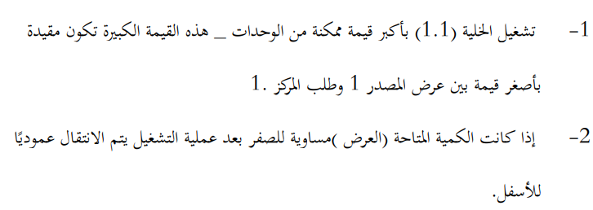
خطوات الحل بهذه الطريقة تتمثل فيما يلي :

Slide 22
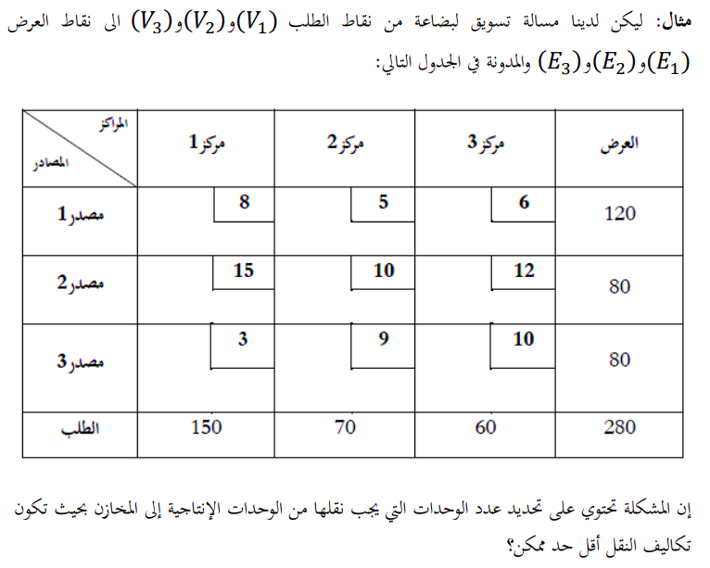

Slide 23
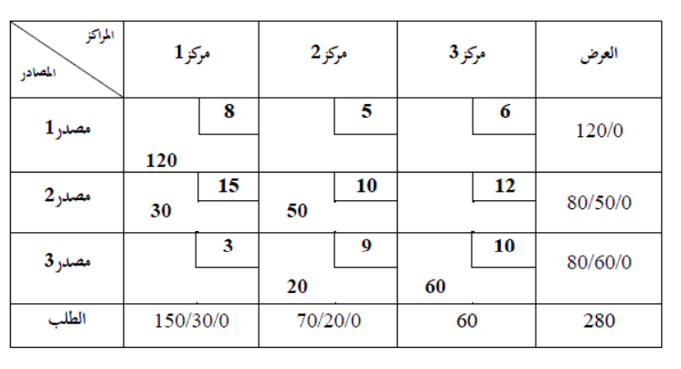
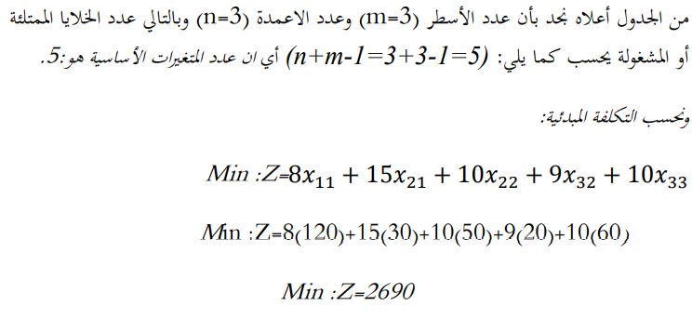
الحل:
الحل:

Slide 24
ملاحظة :
ملاحظة :
ملاحظة: اذا تساوت الكلف في الصف تعطى الاولوية للمربع الذي يقابل اكبر كمية من الطلب لانه يخفض الكلفة الكلية

Slide 25
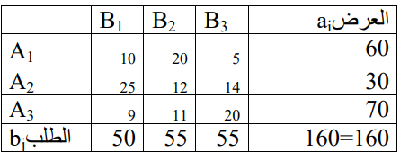
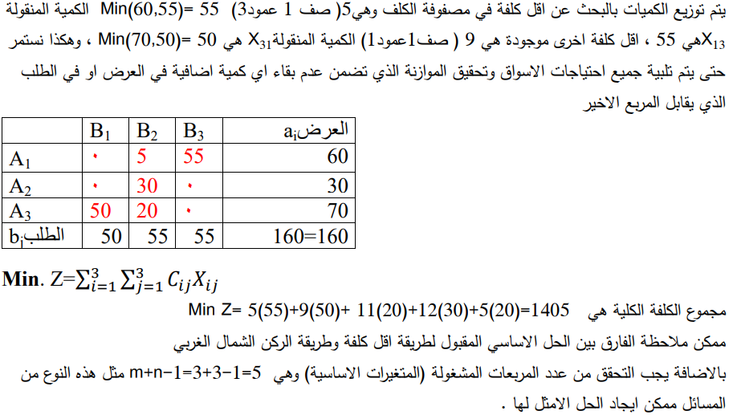
مثال

Slide 27
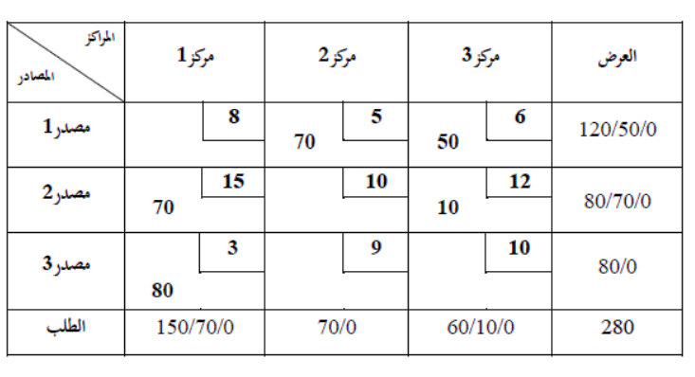
مثال

Slide 28
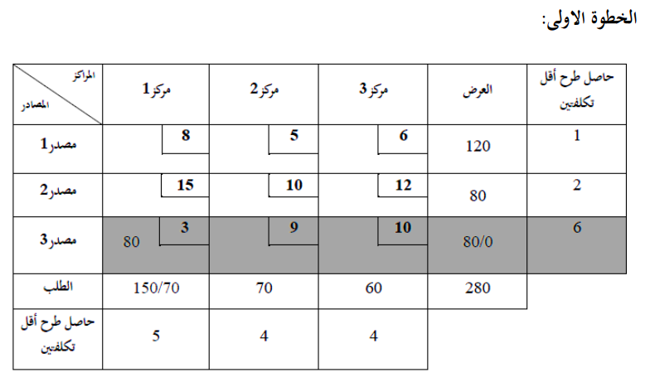
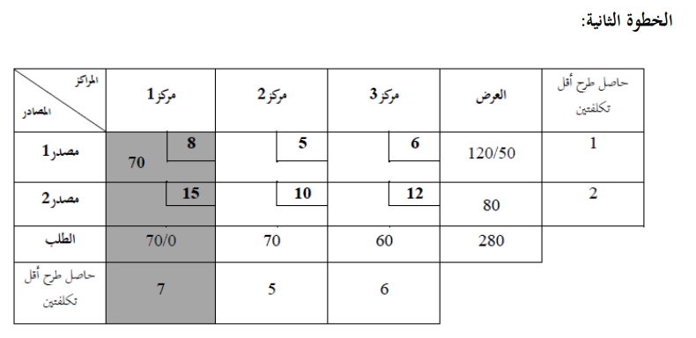

Slide 29
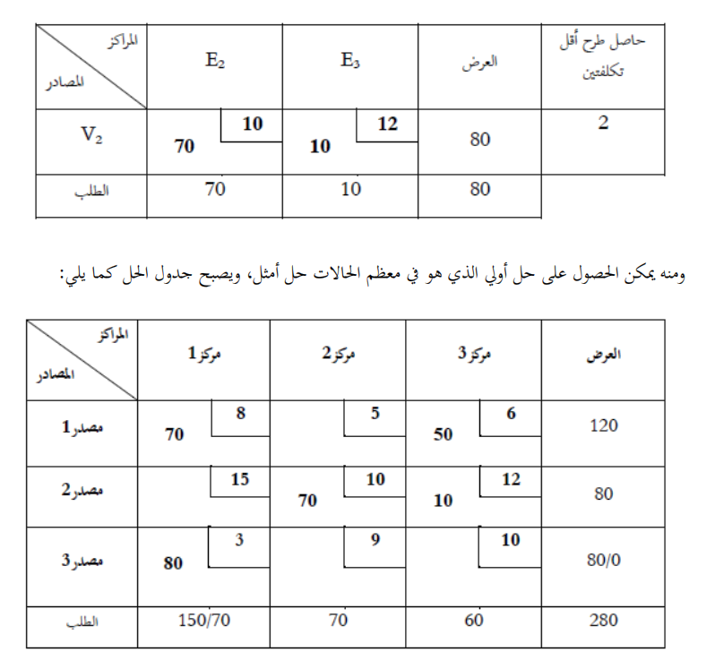

Slide 30
