Slide 1
Differential White Blood Cell Count test

Slide 2
Definition and Aim
A white blood cell (WBC) differential test, measures the number or percentage of each of the five types of white blood cells present in blood:
Neutrophils
Lymphocytes
Monocytes
Eosinophils
Basophils

Slide 3
AIM
To differentiate the type of WBCs.

Slide 4
Each of these types is affected in a different way depending on the type of condition or disease that is affecting WBC counts
Differential blood count is not a part of complete blood count (CBC) but is interpreted together with CBC to help support or exclude a suspected diagnosis. For example, the presence of anemia along with thrombocytopenia with a low or high white blood cell count may suggest bone marrow involvement by leukemia.. It’s also necessary if the results from your CBC are not within the normal range.

Slide 5
A differential count test can detect if there is abnormal or immature cells or increase or decrease in one type to other type and can help to diagnose an infection, inflammation, leukemia, a bone marrow disorder or an immune system disorder.

Slide 6
When is it ordered?
It is performed when an individual undergoes a routine health examination or pre-surgical workup
The test may be done when someone has general signs and symptoms of an infection and/or inflammation such as:
Fever, chills
Body aches, pain
Headache

Slide 7
when there are signs and symptoms that may be related to a blood disorder( as anemia or leukemia), autoimmune disorder, or an immune deficiency.
It may also have been ordered periodically for people who take chemotherapy or radiation for cancer treatment.( to monitor the effectiveness of treatment).
Your CBC are not within the normal range

Slide 8
Normal Results
Reference ranges for differential white blood cell count in normal adults is as follows::
Neutrophils: 60 to 70%
Lymphocytes: 20 to 40% or 20-25%
Monocytes: 2 to 8%
Eosinophils: 1 to 4%
Basophils: 0.5 to 1%

Slide 9
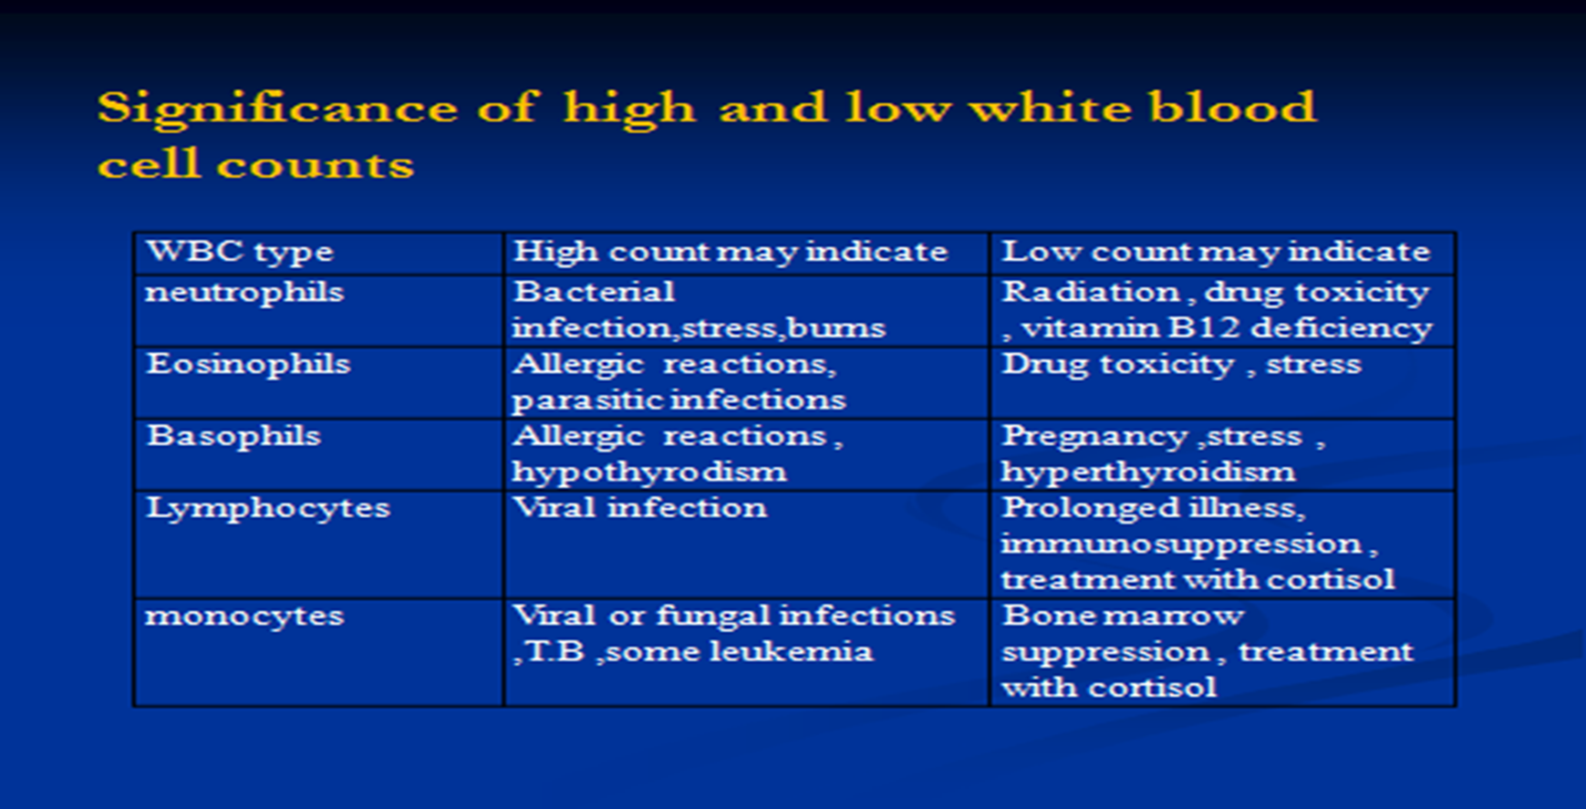

Slide 10
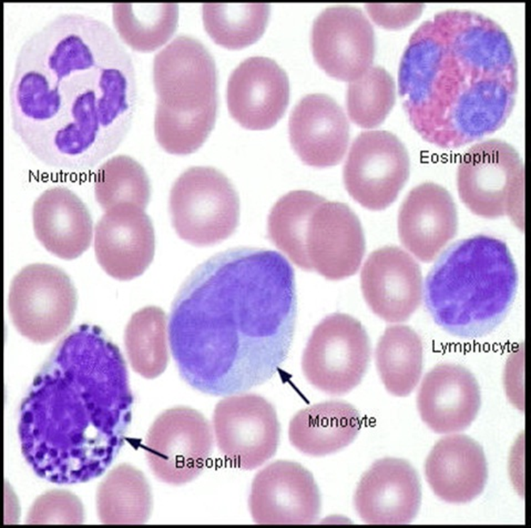
Normal peripheral blood smear

Slide 11
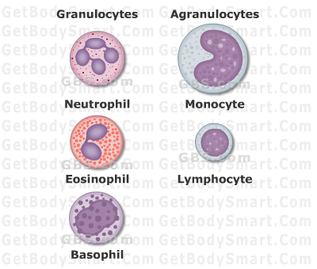

Slide 12
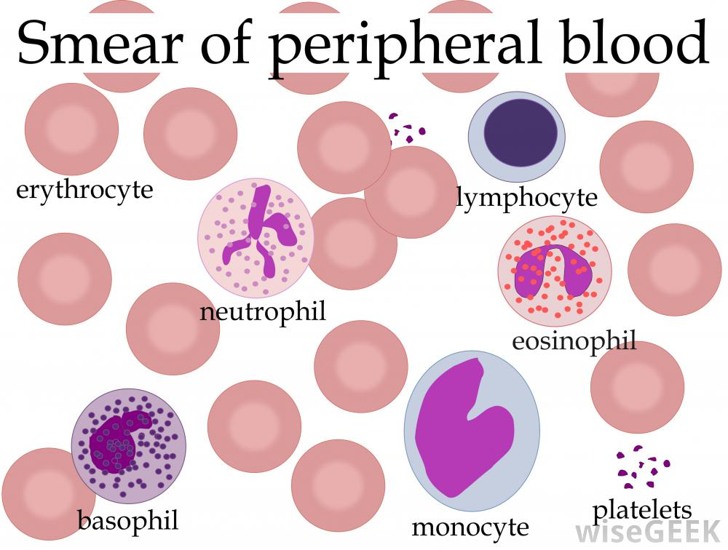

Slide 13
White blood cell
Are named according to their appearance in stained preparation.
Depended on presence or absence of granules in cytoplasm.
Affinity of granules for staining with Leishman's stain. It consists of a mixture of eosin (an acidic stain), and methylene blue (a basic stain) in alcohol and is usually diluted and buffered before use. It stains the different components of blood in a range of shades between red and blue.

Slide 14
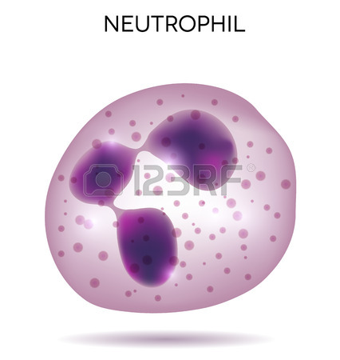
Neutrophils
60-70% of all WBCs.
10-12 μm in diameter.
* Nucleus with 2 to 5 lobes connected by strands of chromatin, cytoplasm has very fine pale lilac granules.
* Function :phagocytosis. Destruction of bacteria with lysozyme, and strong oxidant(free radical) such as superoxide anion(O^{.−−}) ,hydrogen peroxide(H₂O₂), hydroxyl radical(OH^{.-}) and hypochlorite anion(ClO⁻ ).

Slide 15
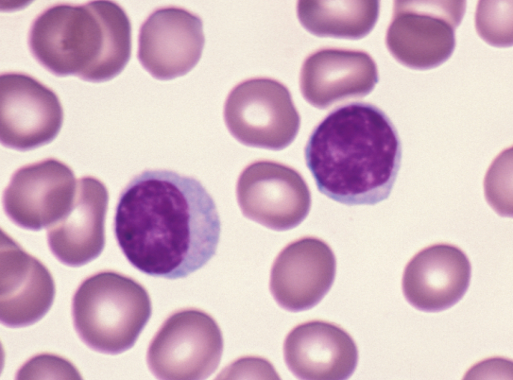
Lymphoctes
20 to 40% of all WBCs.
Small lymphocytes are 6-9 μm in diameter, large lymphocytes are 10-14 μm in diameter.
Nucleus is round ,cytoplasm forms rim around nucleus that looks sky blue , the larger the cell the more cytoplasm is visible.
Function :produces antibodies and other chemicals responsible for destroying M.O, regulation of immune system.

Slide 16
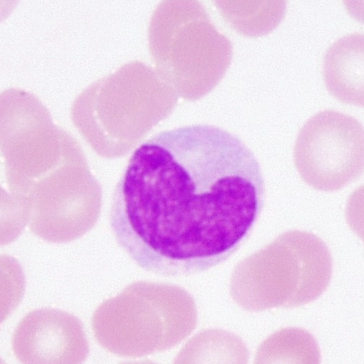
Monocytes
2-8% of all WBCs.
12-20 μm in diameter.
* Nucleus round, kidney -shaped ,or horseshoe-shaped; contains more cytoplasm than does lymphocyte ; cytoplasm is blue –grey and appears foamy.
Function : phagocytic cell in the blood ; leaves the blood and becomes a macrophage, which phagocytizes bacteria, dead cell and other debris within tissues.

Slide 17
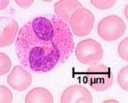
Eosinophils
2-4% of all WBCs.
10-12 μm in diameter.
* Nucleus usually has 2 lobes connected by thick strand of chromatin, large , red-orangr granules fill cytoplasm.
Function : combat effects of histamine in allergic reactions and destroy certain parasitic worms.

Slide 18
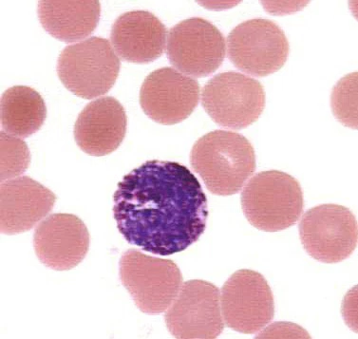
Basophils
0.5-1% of all WBCs.
8-10 μm in diameter.
* Nucleus has 2 lobes , large cytoplasmic granules appear deep blue-purple .
Function: liberate heparin , histamine and serotonin in allergic reactions that intensify overall inflammatory response

Slide 19
Principle:
Correct preparation of the blood film.
Proper staining by Leishman's stain.
Accurate examination.

Slide 20
Procedure
Placing a drop of blood from blood sample on a clean glass slide.
Spreader slide using another clean glass slide at 30-40 degree angle.
Control thickness of the smear by changing the angle of spreader slide
Allow the blood film to air-dry completely before staining.

Slide 21
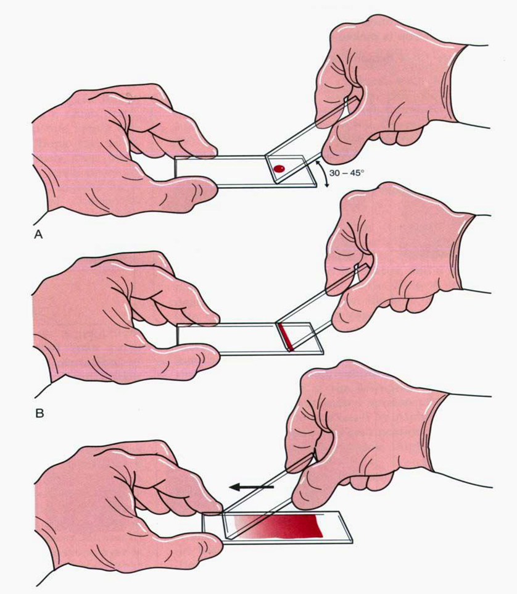

Slide 22
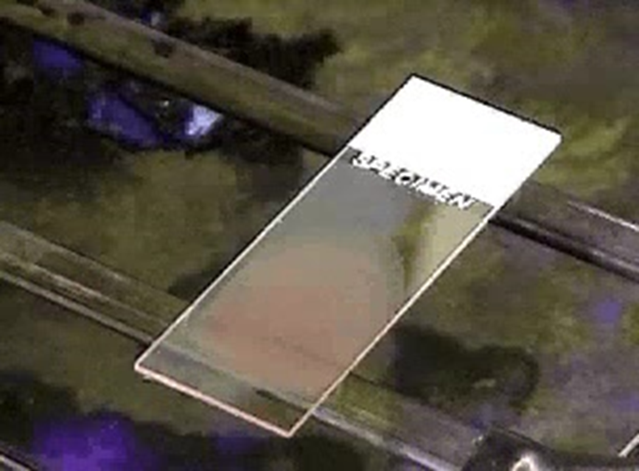

Slide 23
Thickness of the film may be regulated by :
Increasing or decreasing the angle between the slides.
The rate of spreading.
Adjusting the force of spreading.
Adjusting the amount of blood.
Thick film results when the drop of blood is large, the angle greater than 45 degrees and spreading is fast.

Slide 24
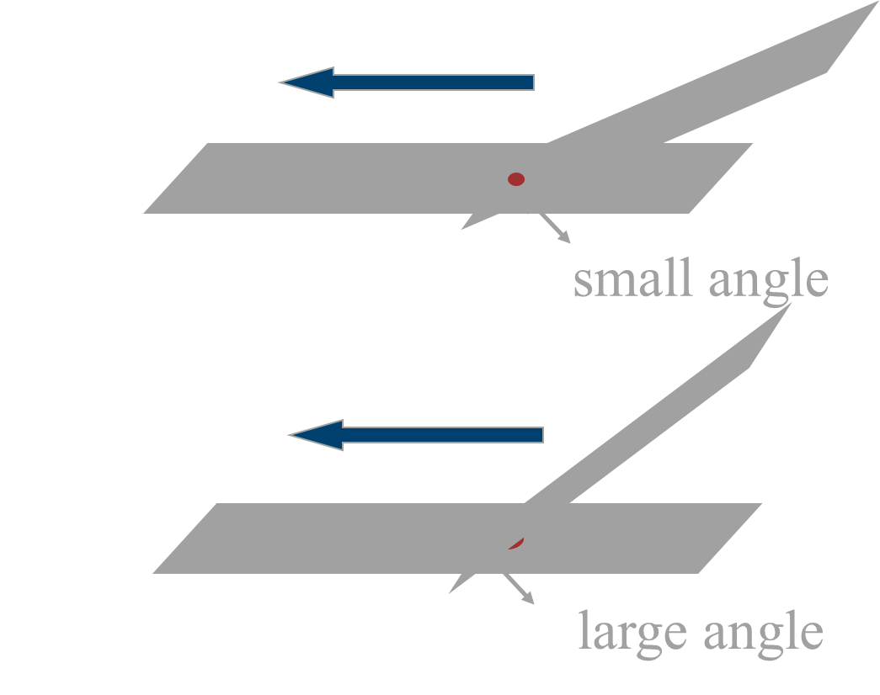

Slide 25
Characteristics of a good smear
The body of the blood film should be smooth .
The smear should be thickest at the origin and gradually thin out rather than having alternating thick and thin areas.
A good blood film should cover half to three – fourths the length of the slids.
Thin end of the smear should have tongue like edge

Slide 26
Slides should be made in one motion and immediately, drying of the drop will lead to uneven distribution of cells in the body of the film and the larger WBCS will accumulate at the end. rouleaux of RBCS and clumping of the platelets.

Slide 27
Common causes of a poor blood smear
Drop of blood too large or too small.
The smear is made too rapidly.
Angle of spreader not constant.
Spreader edge is uneven or dirty.
Blood film with vacuoles or bubbles result from the use of dirty slides or in some cases from an excess of fat in the specimen (specimen obtained after a fatty meal).

Slide 28
Spreader slide is pushed in a jerky manner
Failure to keep entire edge of spreader slide against the slide while making smear.
Failure to push spreader slide completely across.

Slide 29
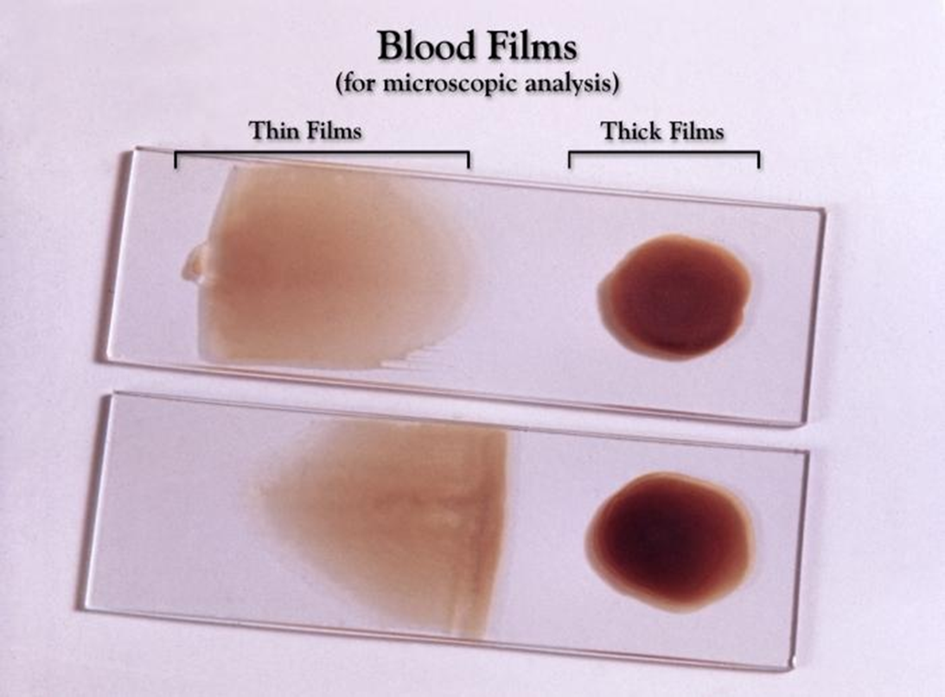

Slide 30
Examples of unacceptable blood smears?
Blood film contain thick and thin area.
Blood film contain vacuoles or precipitate (due to the use of dirty slides).
Blood film not cover half to three – fourths the length of the slides.
Thin end of the smear not have tongue like edge

Slide 31
Leishmans stain : Leishmans stain powder 0.6 gm Glycerin 15 ml Hot method Methanol q.s 300 ml
Methanol, as fixing agent (fixation of cells on slide), denaturation of proteins, and as a solvent to dissolve the stain.

Slide 32
Staining Protocol
Blood staining according to Leishman (covering technique)
Use smears that are as thin as possible and air-dried.
Fully cover the smears with Leishman’s Stain solution. Stain for 5 minute (fixation at air dry for at least 5 min).
Add same the amount of distilled water (Dilution). Incubate for at least 10-15 min.
Rinse thoroughly with distilled water or tap water.
Dry the slides using air-drying at room temperature.

Slide 33
Staining error
Washed – out apperance of all the cell is caused by overwashing , understaining or underfixing (air dry for at least 5 min to prevent) , leaving water on the slide or using improper stain. dirty slides, evaporation of stain solution, or uneven spread of stain
Large amounts of precipitated stain on the film result from either improper washing or using an old stain that has started to precipitate.
This may be corrected by ?

Slide 34
3 characteristics of a well-stained blood smear
Stain is not too dark or too pale
No stain precipitate is present on the smear
RBCs are appropriate color of reddish pink

Slide 35

Observing direction:

Slide 36
Observe one field and record the number of WBC according to the different type then turn to another field in the snake-liked direction
*Avoid repeat or miss some cells

Slide 37
Describe the characteristics of leukocyte in a well-stained smear.
Lymphocyte: dark purple nuclei
varying shades of blue cytoplasm.
Neutrophils: dark purple nuclei
reddish, granular cytoplasm.
Eosinophils: bright red/orange granules
Basophils: dark purple nuclei
granules

Slide 38
Monocyte: lighter purple nucleus
gray/blue cytoplasm

Slide 39


