Slide 1
Total Erythrocytes (RBC) Count Test

Slide 2
RBC Count Test
This test is almost always a part of a complete blood count (CBC) test. A CBC test measures the number of all types of components in the blood, including:
Red blood cells
White blood cells
Hemoglobin
Hematocrit
Platelets

Slide 3
Definition and Aim
A red blood cell count: is a blood test that used to find out how many red blood cells (RBCs) in blood. It’s also known as an erythrocyte count.
Aim: To measure or find out the number of red blood cells in one cubic millimeter of blood.

Slide 4
This test is important because RBCs contain hemoglobin, which carries oxygen to body’s tissues. The number of RBCs in blood can affect how much oxygen the tissues received, because tissues need oxygen to function effectively.

Slide 5
When is it ordered?
As part of a routine physical examination or as part of a pre-surgical workup.
When someone has signs and symptoms that associated with low RBS count, which can be seen in (anemia ), include:
Weakness or fatigue
Lack of energy
Paleness

Slide 6
Some signs and symptoms that may associated with a high RBC count (erythrocytosis) can be seen in (Polycythemia) include:
Disturbed vision
Headache, dizziness
Flushing
Enlarged spleen

Slide 7
This test may also be performed on a regular basis to monitor people who have been diagnosed with conditions such as:
Blood disorders (chronic anemia, and polycythemia.) , Kidney disease, and bleeding problems.
Chemotherapy or radiation therapy often decreases bone marrow production of all the blood cells. Thus, a CBC is typically ordered at regular intervals when monitoring people who are undergoing treatment for cancer.

Slide 8
Normal range for RBCs Count are as follows:
Women: 4.0-5.5 million/mm³
Men: 4.5-6.0 million/mm³
Newborn: 5.0-6.5 million/mm³
Pregnancy: Slightly lower than normal adult values
Children: 3.8 – 5.5 million/mm³

Slide 9
Abnormal results
If RBC count is higher than normal, is due to:
Cigarette smoking.
Congenital heart disease.
Dehydration.
Renal cell carcinoma, which is a type of kidney cancer.
Pulmonary fibrosis.
Polycythemia vera, which is a bone marrow disease that causes overproduction of RBCS and is associated with a genetic mutation.
Higher altitude, your RBC count may increase for several weeks because there’s less oxygen present in the air.
Certain drugs, such as gentamicin and methyldopa, can also increase RBC count.

Slide 10
Abnormal results
Lower-than-normal numbers of RBCs may be due to:
Anemia.
Bleeding.
Bone marrow failure (for example, from radiation, toxins, or tumor).
Deficiency of a hormone called erythropoietin (caused by kidney disease).
RBC destruction (hemolysis) due to transfusion, blood vessel injury.
Leukemia.
Malnutrition or nutrition deficiencies of (iron, copper, folic acid, vitamin B6, or vitamin B12).
Multiple myeloma (bone marrow cancer).
Overhydration
Pregnancy
Drugs that can decrease the RBC count as example: Chemotherapy drugs, Chloramphenicol, and Quinidine.

Slide 11
Principle
It consists of an accurate dilution of a measured quantity of blood with a fluid which is Isotonic with the blood and prevents coagulation.
Haemocytometer apparatus includes:
Neubauer’s slide
Cover slip
RBC pipette
WBC pipette

Slide 12
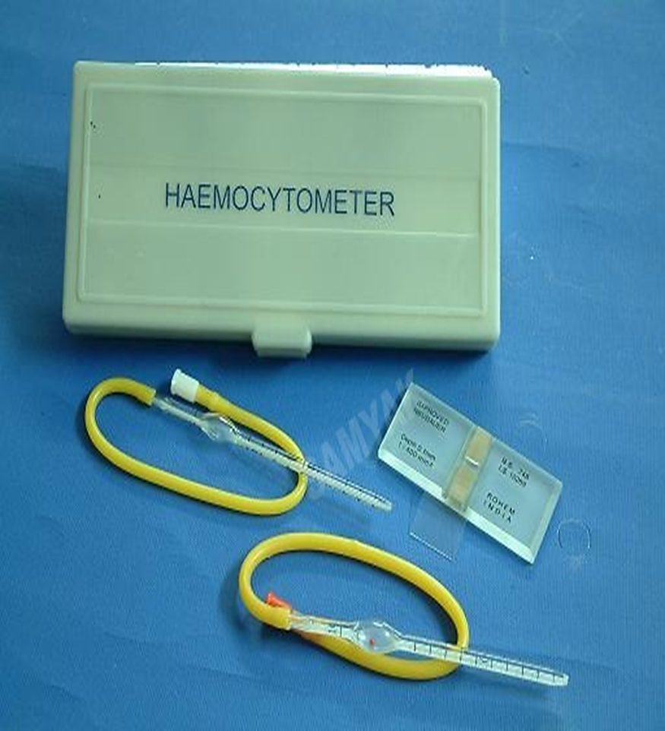

Slide 13
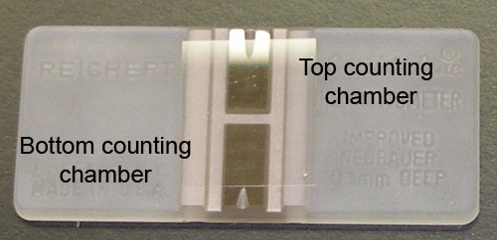

Slide 14
Differences between RBC and WBC pipettes
RBC pipette | WBC pipette
1-It has a red bead. | 1-It has a white bead.
2-It has graduations up to mark 101. | 2-It has graduations up to mark 11.
3-Size of bulb is larger | 3-Size of bulb is smaller.

Slide 15
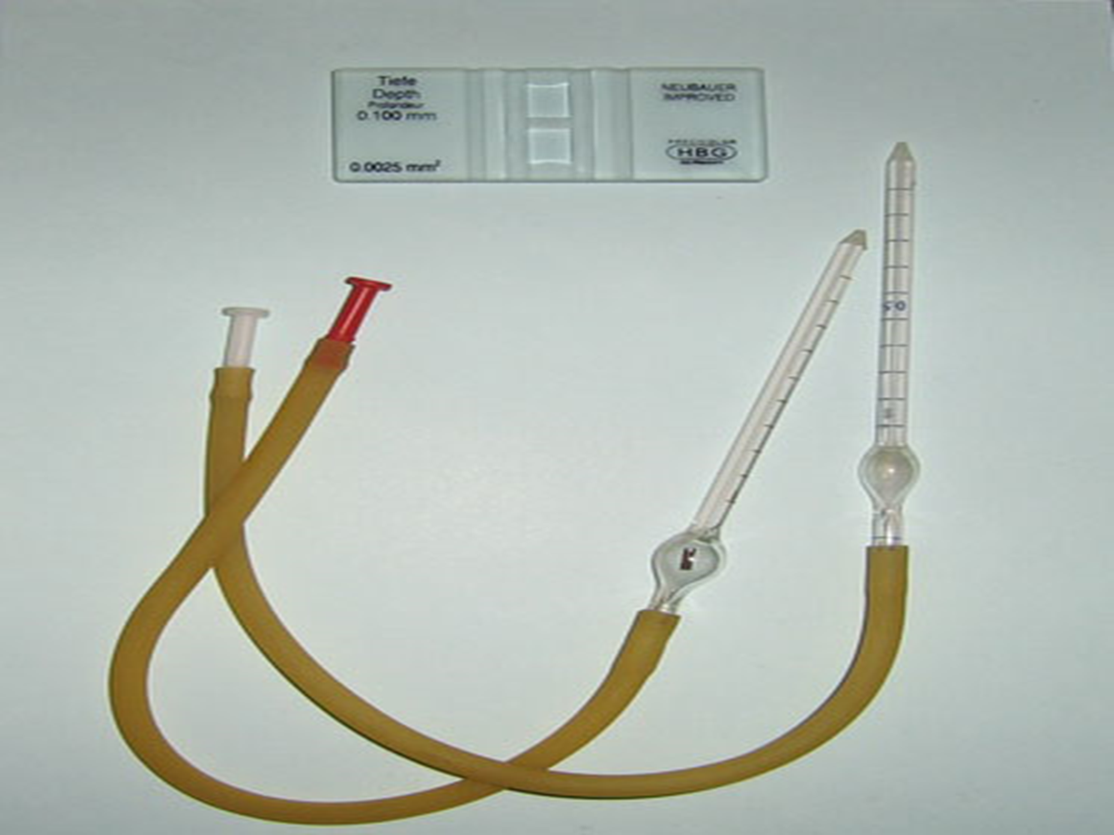

Slide 16
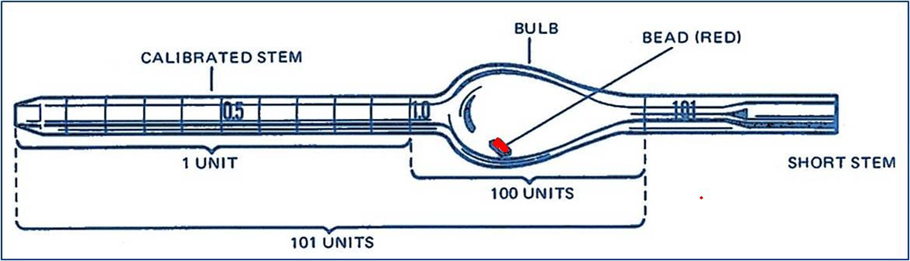
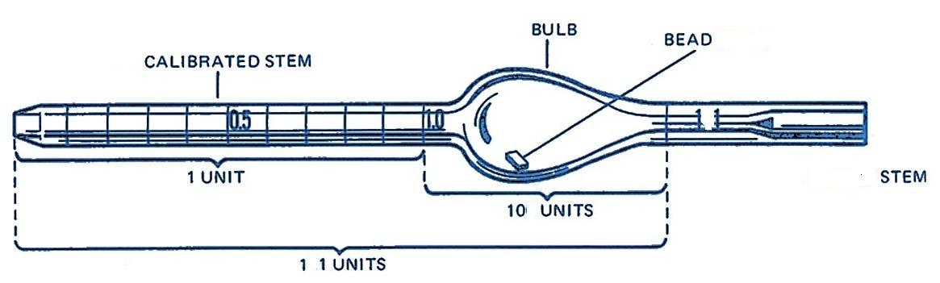
RBC PIPETTE
WBC PIPETTE

Slide 17
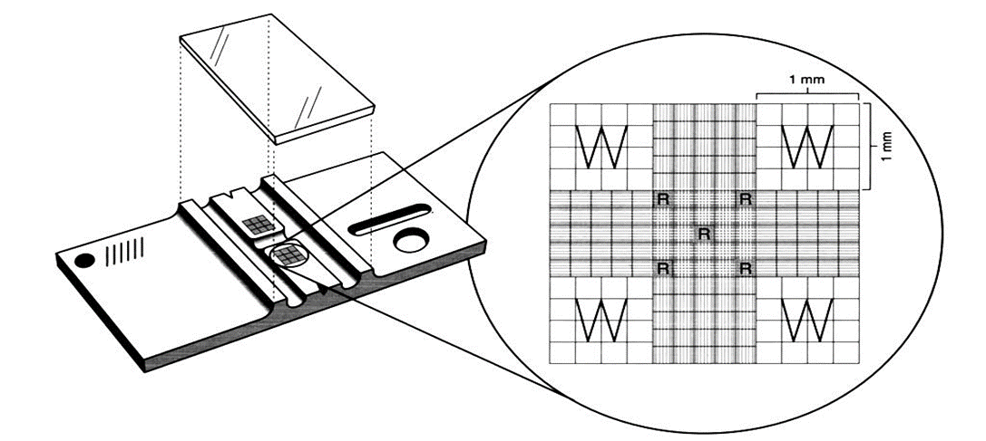
Haemocytometer or improved Neubauer

Slide 18
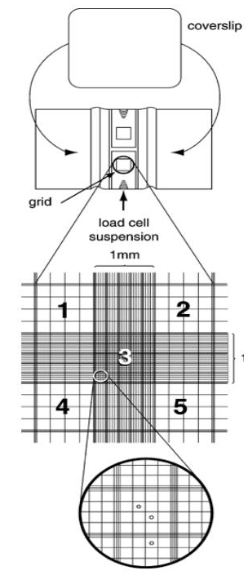
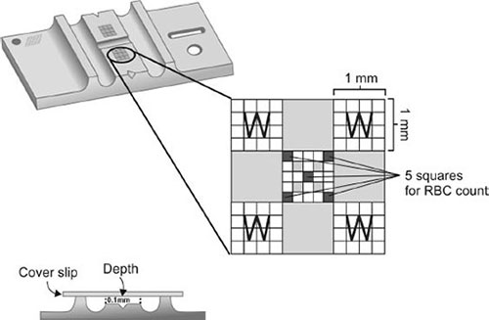

Slide 19
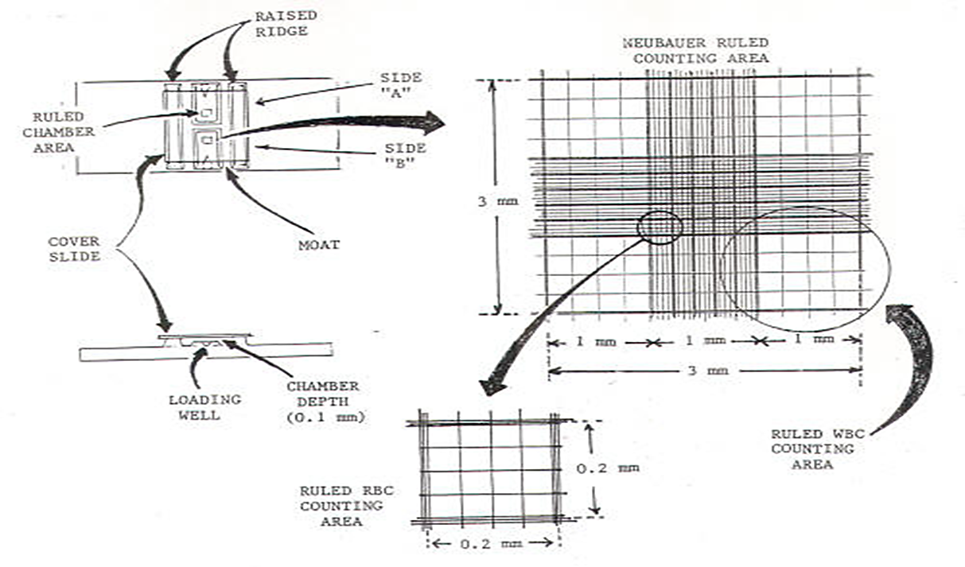

Slide 20
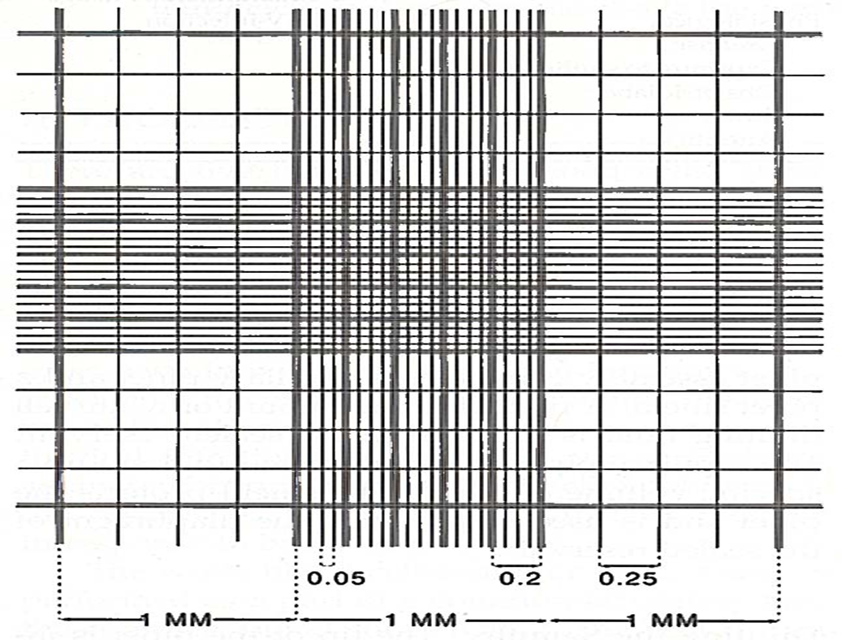

Slide 21
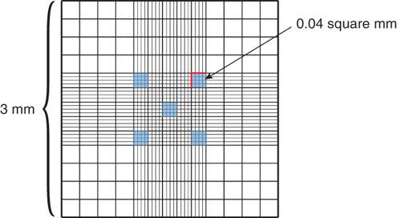

Slide 22
RBC Diluting Fluids
1- Hayem's Solution: (HgCl₂, NaCl, Na₂SO₄, H₂O)
Sodium sulphate (Na₂SO₄) 2.5 g
Sodium chloride (NaCl ) 0.5 g
Mercuric chloride (HgCl₂) 0.25 g
Distilled water (H₂O) 100 ml
2-Gower's Solution: (Na₂SO₄, Acetic Acid, and H₂O)

Slide 23
Sodium chloride and sodium sulphate together keeps the isotonicity of fluid.
Sodium sulphate also prevents clumping of red cells.
Mercuric chloride fixes the cells and acts as a preservative.

Slide 24
Procedure and Precautions
Counting chamber and pipette should be clean and dry.
Fingertip and pricking lancet should be sterile.
Blood should freely come out without squeezing.
Be careful to prevent clotting of blood inside the pipette.
While filling the pipette and charging the counting chamber, no air bubble should enter.
Blood should be taken only up to the 0.5 mark and diluting fluid sucked only up to 101 mark.

Slide 25
Blood should be properly mixed with the diluting fluid.
Discard first few drops before charging because it will not contain RBCs.
While charging the counting chamber, no air bubble should enter and over filling should be avoided.
Cells should be settled down and more or less evenly distributed before counting.
Count from Left to Right and avoid counting of the same cell.

Slide 26
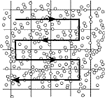
Counting Rule
Do not count cells touching:
Bottom or upper line
Right or left line
This is to avoid double counting.

Slide 27
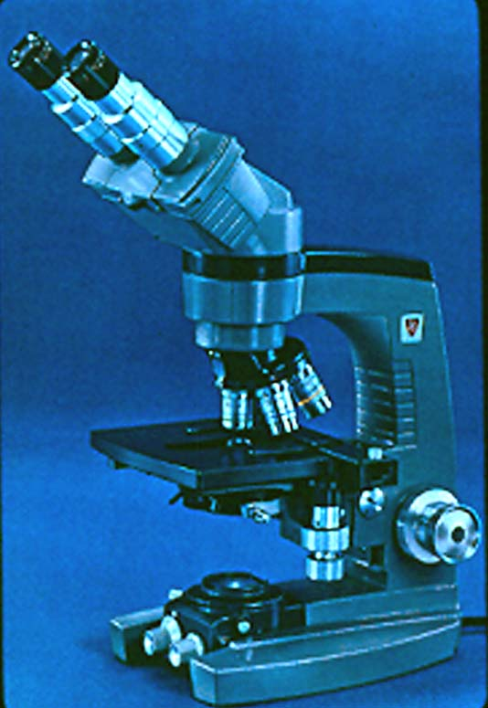
FOCUSING
4X to see the general formation of slide.
10X for WBC counting
40X for RBC counting

Slide 28
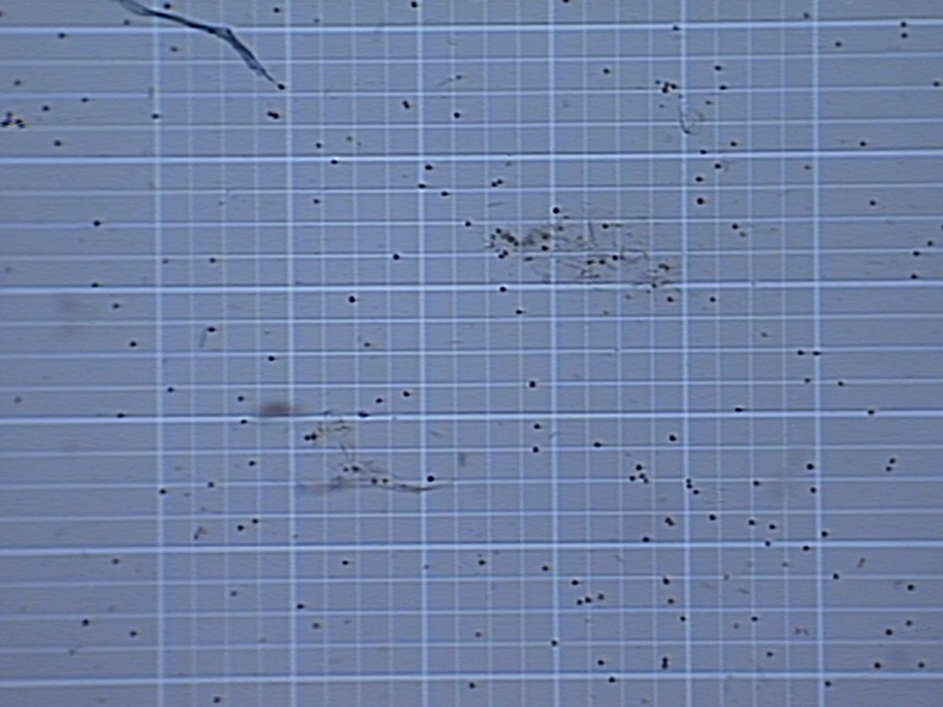
10x magnification

Slide 29
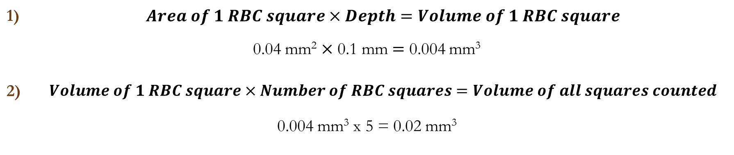

Calculations
$Dilution factor=\frac{Final volume}{Initial volume}$
$=\frac{101−1}{0.5}=200$
Determine the chamber factor :
1) | $$Area of 1 RBC square×Depth=Volume of 1 RBC square$$
0.04 mm² $×$ 0.1 mm $=$ 0.004 mm³ | 0.04 mm² $×$ 0.1 mm $=$ 0.004 mm³
2) | $$Volume of 1 RBC square×Number of RBC squares=Volume of all squares counted$$
0.004 mm³ x 5 = 0.02 mm³ | 0.004 mm³ x 5 = 0.02 mm³

Slide 30
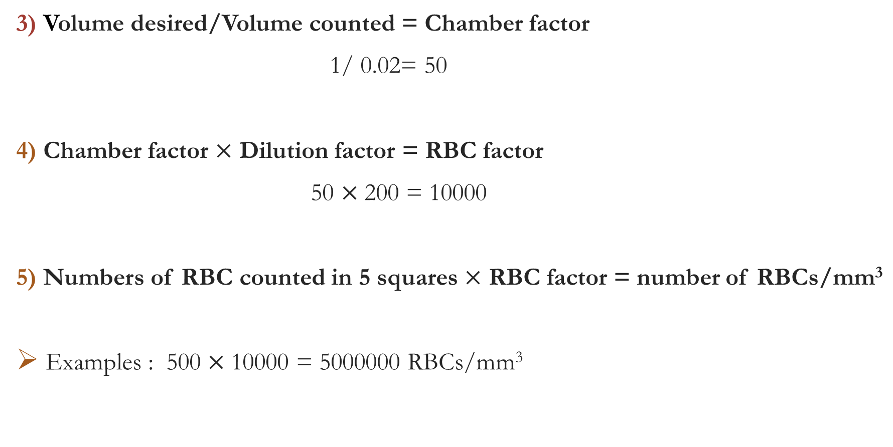
3) Volume desired/Volume counted = Chamber factor
1/ 0.02= 50
4) Chamber factor $×$ Dilution factor = RBC factor
50 $×$200 = 10000
5) Numbers of RBC counted in 5 squares $×$ RBC factor = number of RBCs/mm³
Examples : 500 $×$10000 = 5000000 RBCs/mm³

Slide 31
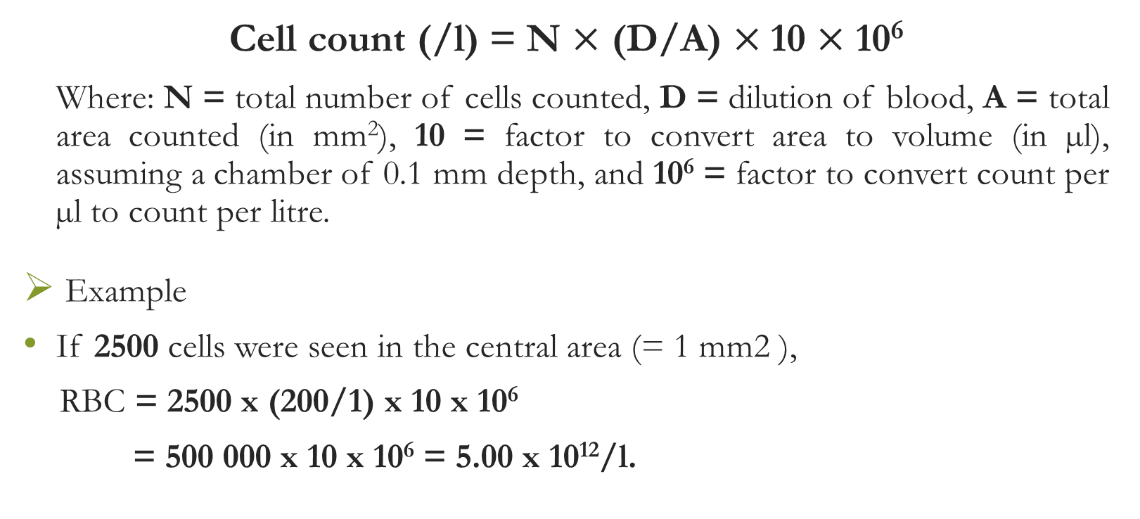
Calculations
Cell count (/l) = N $×$ (D/A) $×$10 $×$ 10⁶
Where: N = total number of cells counted, D = dilution of blood, A = total area counted (in mm²), 10 = factor to convert area to volume (in µl), assuming a chamber of 0.1 mm depth, and 10⁶ = factor to convert count per µl to count per litre.
Example
If 2500 cells were seen in the central area (= 1 mm2 ),
RBC = 2500 x (200/1) x 10 x 10⁶
= 500 000 x 10 x 10⁶ = 5.00 x 10¹²/l.

Slide 32
Errors in hemocytometry most frequently arise as a result of:
Apparatus
Personal technique

Slide 33
Home Work
What is erythropoietin , where is produced , what causes it to produced , and what effect does it have on red blood cell production? ( H.W)
Anemia (nutritional , renal , aplastic , hemolytic, megloblastic anemia) ( H.W)
Polycythemia ( H.W)

