Slide 1
Blood pressure

Slide 2
Definition
The pressure exerted by the blood against the inner walls of the blood vessels, especially the arteries. It varies with
The strength of the heartbeat,
The elasticity of the arterial walls,
The volume and viscosity of the blood,
and a person's health, age, sex and physical condition.

Slide 3
Cardiac Output
Cardiac output is the volume of blood pumped by the heart per minute (mL blood/min). Cardiac output is a function of heart rate and stroke volume.
The heart rate is simply the number of beats per minute.
The stroke volume is the volume of blood, in milliliters (mL), pumped out of the heart with each beat. Increasing either heart rate or stroke volume increases cardiac output.
Cardiac Output in mL/min = heart rate (beats/min) X stroke volume (mL/beat)
An average person has a resting heart rate of 70 beats/minute and a resting stroke volume of 70 mL/beat. The cardiac output for this person at rest is:
Cardiac Output = 70 (beats/min) X 70 (mL/beat) = 4900 mL/minute.
The total volume of blood in the circulatory system of an average person is about 5 liters (5000 mL)/min.

Slide 4
Peripheral vascular resistance(PVR)
refers to the resistance that produced by blood vessels and must be overcome to push blood through the circulatory system and create flow.
Systemic vascular resistance is used in calculations of blood pressure, blood flow, and cardiac function.

Slide 5
Total peripheral resistance (TPR) determined by diameter of the blood vessels and viscosity of blood.
Vasoconstriction (i.e., decrease in blood vessel diameter) increases SVR,
Whereas vasodilation (increase in diameter) decreases SVR.

Slide 6
Systolic pressure - the blood pressure during the contraction of the left ventricle of the heart
Diastolic pressure - the blood pressure after the contraction of the heart while the chambers of the heart refill with blood
Arterial pressure - the pressure of the circulating blood on the arteries; "arterial pressure is the product of cardiac output and peripheral vascular resistance"
Venous pressure - the pressure exerted on the walls of the veins by the circulating blood

Slide 7
objective
Measurement of blood pressure provide us with information on the heart pumping efficiency and the condition of the systemic blood vessels.
In general ,the systolic blood pressure indicates the force of contractions of the heart.
Whereas the diastolic blood pressure indicates the conditions of the systemic blood vessels.

Slide 8
Arterial adult blood pressure is considered normal at 120/80 where the first number is the systolic pressure and the second is the diastolic pressure (systolic/diastolic).
pulse pressure : the difference between the systolic and diastolic pressure. The normal value is 40 mmHg.
When the blood pressure 120/80, the pulse pressure= 120-80 = 40 mmHg.

Slide 9
In practice Mean arterial pressure(map) is the average arterial pressure during a single complete cardiac cycle.
Map= diastolic pressure + 1/3 ( systolic pressure - diastolic pressure).
Map= 80 + 1/3 (120 -80)= 93 mmHg.

Slide 10
The mean blood pressure is a functions of cardiac out put and total peripheral resistance.
Mean blood pressure= cardiac out put X total peripheral resistance .

Slide 11
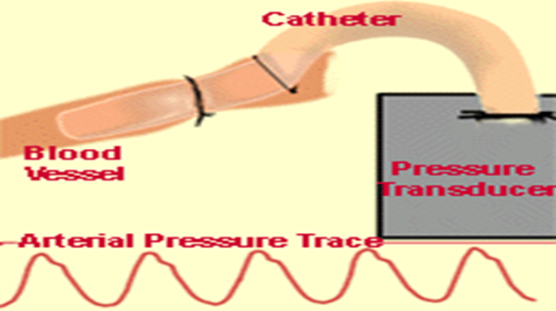
Measurement of blood pressure:
Blood pressure can be measured by several techniques :
1-The direct method (refer to the diagram below) involves directly inserting a tube or catheter into a blood vessel. The catheter is connected to a blood pressure transducer, which generates an electrical signal.

Slide 12
2- indirect methods involve:
The first method uses the sense of touch: it is thus called the palpatory method.
The second method uses the sense of hearing: it is thus called the auscultatory method.

Slide 13
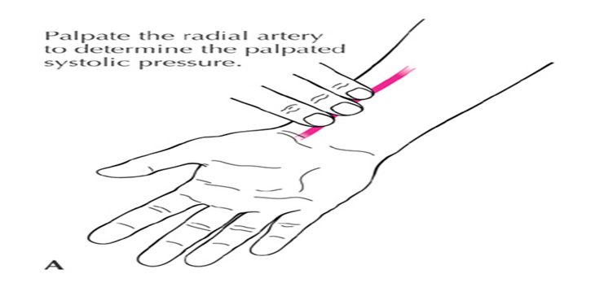
Determining the palpated systolic pressure and the maximum inflation level
While palpating the radial pulse, inflate the cuff until you feel the radial pulse disappear..
Note the pressure on the manometer at this point and rapidly deflate the cuff.

Slide 14
Do not leave the cuff inflated for more than 2 minutes, because it is uncomfortable and will cause a sustained increase in blood pressure.
* The systolic Bp recorded by the palpatory method is usually around 5 mmhg lower than that obtained by the auscultatory method.
* A major disadvantage of this method is that it can not measure the diastolic blood pressure.

Slide 15
A sphygmomanometer, an instrument that measures pressure, is needed in both methods.
Each sphygmomanometer consists of
a cuff (containing a "bladder"),
a rubber bulb for introducing air into the cuff
and the mercury for measuring the pressure in the cuff and valve.

Slide 16

In addition, a stethoscope is needed for the auscultatory method.
Note that the chestpiece of the stethoscope has both a bell and a diaphragm.

Slide 17


Slide 18
Correct positioning of the cuff
The center of the sphygmomanometer bladder should be placed over the brachial artery. Many cuffs have some sort of marking scheme so that placement over the brachial artery - under, or just medial to, the biceps tendon - is facilitated.
The lower border of the cuff should be ~2cm proximal to the antecubital fossa and the cuff should be firmly wrapped around the arm.

Slide 19
Several critical steps in measuring blood pressure
Selection of an appropriately sized cuff.
cuff placement.
Proper placement of the stethoscope.
Appropriate cuff deflation rate, and auscultation of appropriate Korotkoff sounds.

Slide 20
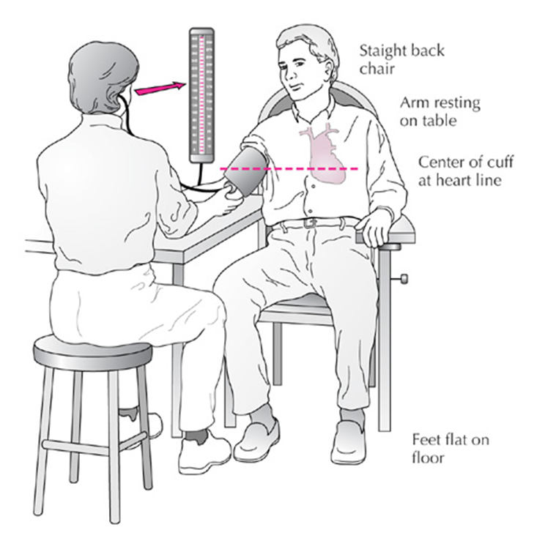
Measurement of BP in the clinic

Slide 21


Explanatory Notes
The laminar flow that normally occurs in arteries produces little vibration of the arterial wall and therefore no sounds. However, when an artery is partially constricted, blood flow becomes turbulent, causing the artery to vibrate and produce sounds.

Slide 22
When measuring blood pressure using the auscultation method, turbulent blood flow will occur when the cuff pressure is lesser than systolic pressure and greater than the diastolic pressure. The "tapping" sounds associated with the turbulent flow are known as Korotkoff sounds. Remember that these sounds are not to be confused with the heart sounds produced by the opening and closing of the heart valves.

Slide 23
The sounds heard during measurement of blood pressure are not the same as the heart sounds 'lub' and 'dub' that are due to closing of cardiac valves.

Slide 24
The blood pressure cuff was originally promoted as a tool to measure systolic blood pressure by the obliteration of the radial pulse. Palpation of the point at which the radial pulse was obliterated allowed for determination of the systolic blood pressure. In contrast, Korotkoff proposed listening for the appearance and disappearance of sounds to mark systolic and diastolic pressures.

Slide 25
Summary of the auscultatory method
Initially the cuff is inflated to a level higher than the systolic pressure. Thus the artery is completely compressed, there is no blood flow, and no sounds are heard. The cuff pressure is slowly decreased. At the point where the systolic pressure exceeds the cuff pressure, the Korotkoff sounds are first heard and blood passes in turbulent flow through the partially constricted artery. Korotkoff sounds will continue to be heard as the cuff pressure is further lowered. However, when the cuff pressure reaches diastolic pressure, the sounds disappear.

Slide 26
Korotkoff′s sounds
Sounds heared during the taking of a blood pressure using stethoscope and sphygmomanometer , originated by blood passage causing vibrations in the walls of the blood vessels.
No sounds; cuff pressure above systolic pressure artery completely occluded

Slide 27
Phase 1 : appearance of fairly sharp thudding sound that increases in intensity during the next 10 mmhg of drop in presssure. the pressure when the first sound appears is the systolic pressure.
Phase 2: the sounds become a softer murmur during the next 10-15mmhg of drop in pressure.
Phase 3 : the sounds become louder again and a sharpper thudding during the next 10-15 mmhg of drop in pressure.

Slide 28
Phase 4: the sound suddenly become muffled and reduce in intesity.
The pressure at this point is termed the diastolic pressure this muffled sound continues for another drop in pressure of 5 mmhg. after which all sound disappears. The point where the sound ceases completely is called the end diastolic pressure.

Slide 29
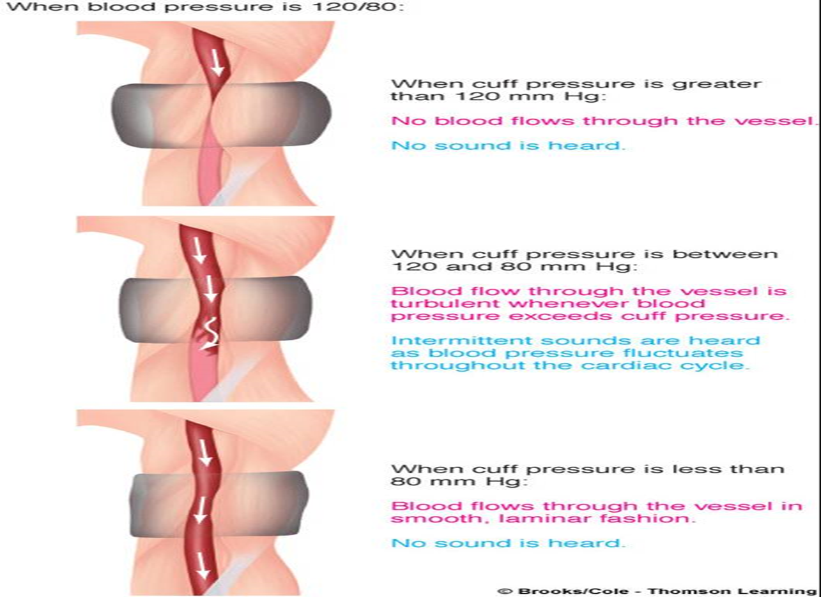

Slide 30
Errors in blood pressure readings:
The cuff is not of the proper size: if the cuff is too small the blood pressure readings may be artefactually high. If the cuff is too big, the readings may be artefactually low.
The cuff is positioned too loosely: the blood pressure may be artefactually high. The centre of the cuff bladder is not positioned over the brachial artery.
The cuff is inflated slowly: a slow inflation causes venous congestion, which in turn causes the Korotkoff sounds to be faint; this results in false readings with the systolic value being too low and the diastolic reading too high.

Slide 31
If the cuff is re-inflated immediately after an initial reading (trying to re-check the reading): a rapid re-inflation could cause venous distension, the Korotkoff sounds become more muffled. The initial Korotkoff sound may be missed so the systolic reading would be falsely low, and the diastolic reading would be falsely high because the last Korotkoff sounds could not be heard.

Slide 32
Classification of blood pressure in adults
Classification | Bp (mmHg)
Normal | Systolic: less than 120/Diastolic: less than 80
Prehypertension | 120-139/80-89
Stage I hypertension | 140-159/90-99
Stage II hypertension | equal or more than 160/equal or more than 100

Slide 33
Types of hypertension (H.W)
Primary hypertension ?
Secondary hypertension?
Complication?

Slide 34
Factors affecting blood pressure (H.W)
1- age and sex
2-habits
3-exercise
4-gravity

Slide 35


