Slide 1
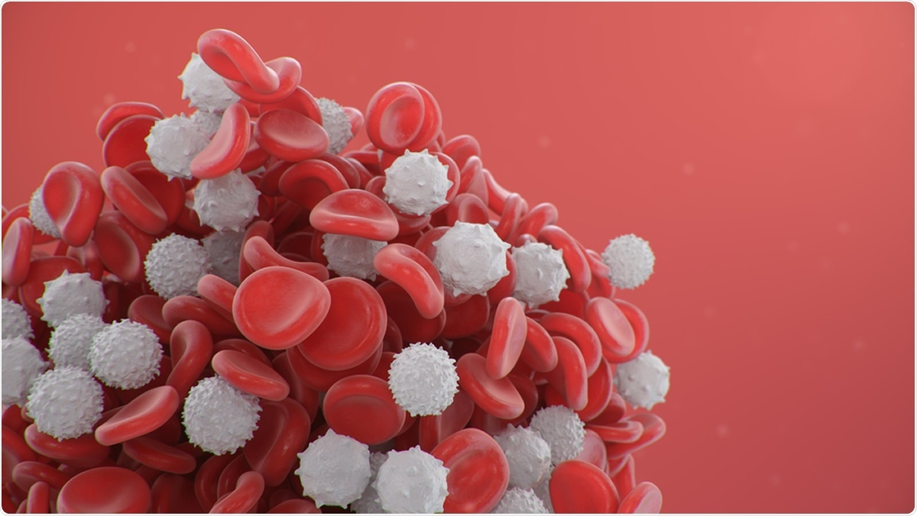
Total Leukocyte (WBC) Count Test
Assist. Lec. Rita F. Elia
2025

Slide 3
Hemocytometry
Total Leukocyte (WBC) Count Test
Hemocytometry is the procedure of counting the number of cells in a sample of blood; the red blood cells, the white blood cells, and the platelets being counted separately.

Slide 4
Definition of Total White Blood Cells Count:
Total Leukocyte (WBC) Count Test
A White Blood Cells WBC count is a blood test used to measure or find out the number of white blood cells (WBCs) in one cubic millimeter (mm³; μL) of blood.

Slide 5
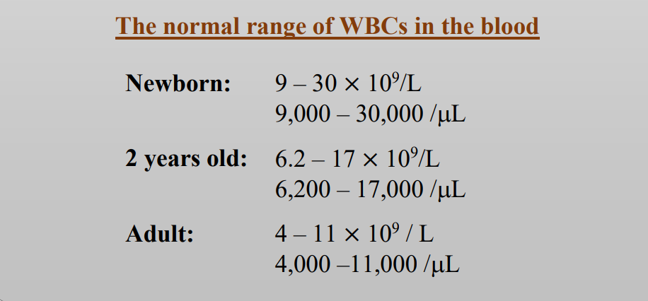
Total Leukocyte (WBC) Count Test

Slide 6
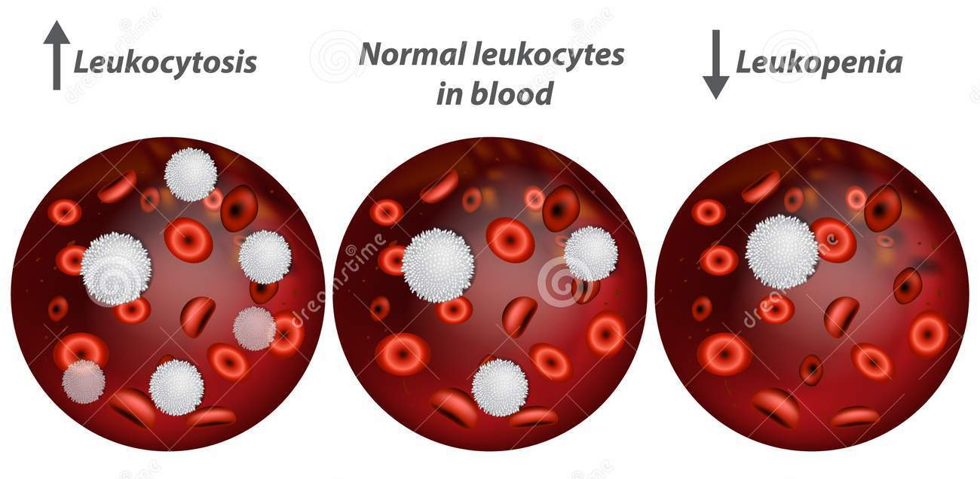
Abnormal Results
Total Leukocyte (WBC) Count Test

Slide 7
A high WBC count is called leukocytosis
(WBCs count beyond 11,000/μL)
Infections. Inflammation or inflammatory conditions such as rheumatoid arthritis and inflammatory bowel disease. Conditions that result in tissue death (necrosis) such as trauma, burns, surgery or heart attack. Allergic responses (e.g., allergies, asthma). Malignancies and leukemia.

Slide 8
A low WBC count is called leukopenia
WBC count below 4,000/μl
Primary bone marrow disorders: the bone marrow does not produce sufficient WBCs (e.g., aplastic anemia and malignancy). Bone marrow damage caused by: toxin, chemotherapy, radiation therapy, and drugs (e.g.: Chloramphenicol, cyclosporine, phenytoin). Lymphoma (cancer of lymphocyte) or other cancer that has metastasized to the bone marrow. Autoimmune disorders—the body attacks and destroys its own WBCs (e.g., Systemic lupus erythematosus). Diseases of the immune system, such as human immunodeficiency virus (HIV or AIDS) which destroy T- lymphocytes. Viral and some bacterial infections. Malnutrition: Deficiency of vitamin B₁₂ or folate, dietary deficiencies in certain minerals (e.g., copper and zinc.), and general malnutrition. Iron deficiency anemia.

Slide 9
The Total WBC Count Test
Total Leukocyte (WBC) Count Test

Slide 10
Principle
Total Leukocyte (WBC) Count Test
DILUTION
CHARGING
COMPUTATION
COUNTING
A sample of blood is diluted with a dilution fluid (Turk 's solution) which destroys the RBCs & stains the nuclei of WBCs. | Following adequate mixing, the specimen is introduced into a counting chamber | where the WBCs are counted in a counting chamber | and their number is computed.

Slide 11
The Total WBC Count Test
Total Leukocyte (WBC) Count Test
Apparatus, Equipments, and Reagents
Microscope.
Haemocytometer.
White-count diluting fluid (Turk's fluid).
Watch glasses.
Materials for a sterile finger prick (Alcohol swabs, sterile lancet, etc.).

Slide 12
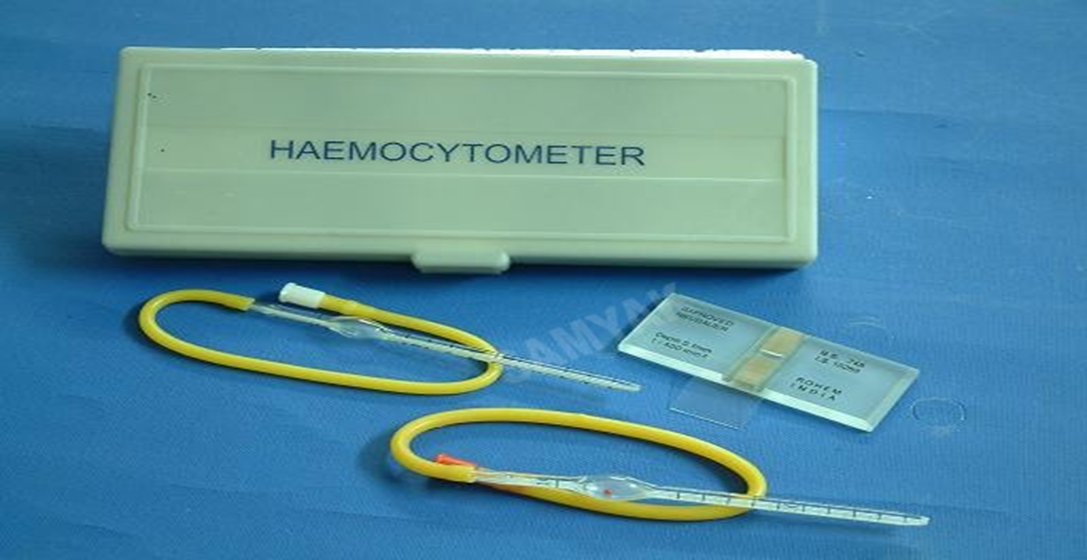
Haemocytometer
Total Leukocyte (WBC) Count Test

Slide 13
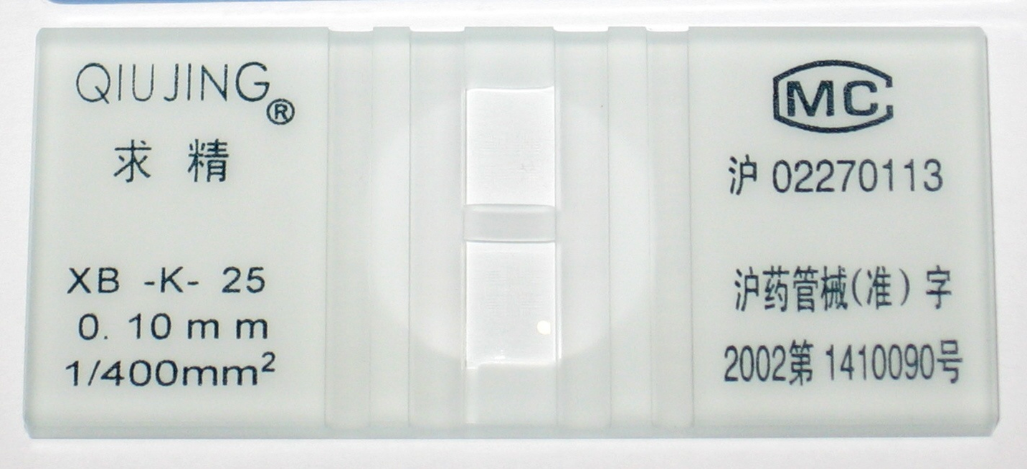
Improved Neubauer Haemocytometer
Total Leukocyte (WBC) Count Test

Slide 14
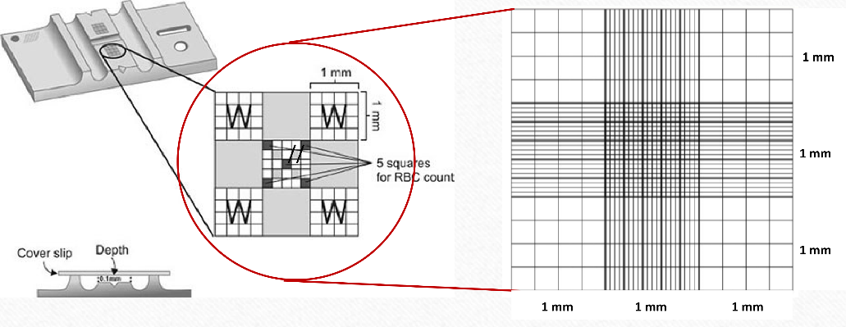
Improved Neubauer’s slide (two counting chambers)
Total Leukocyte (WBC) Count Test

Slide 15
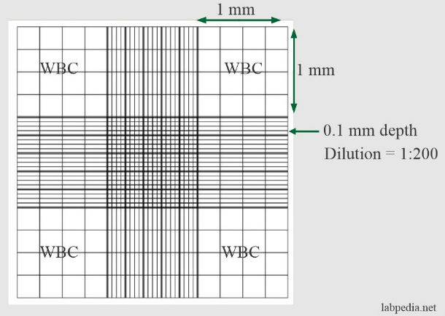
Improved Neubauer’s slide (two counting chambers)
Total Leukocyte (WBC) Count Test

Slide 16
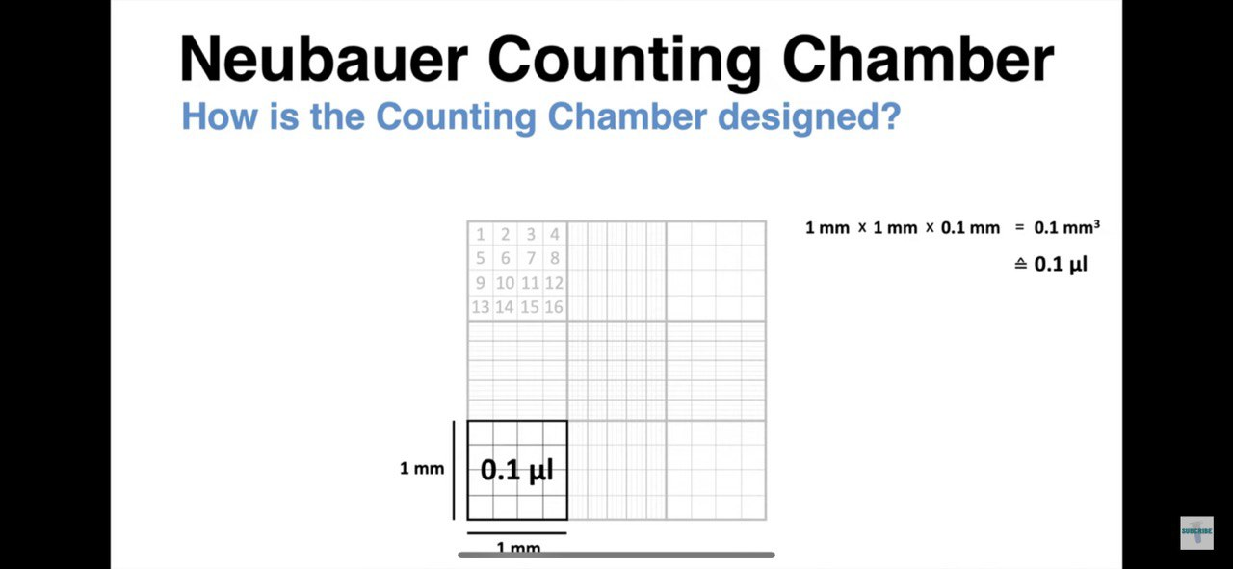
Total Leukocyte (WBC) Count Test

Slide 17
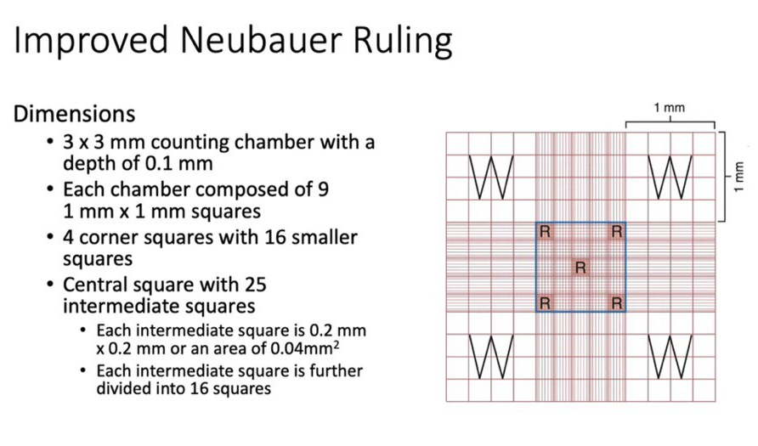
Total Leukocyte (WBC) Count Test

Slide 18
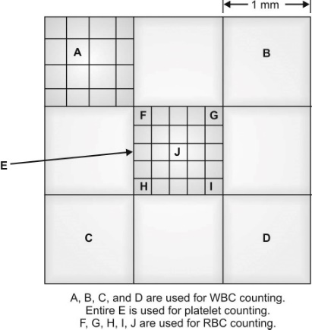
Improved Neubauer’s slide (two counting chambers)
Total Leukocyte (WBC) Count Test

Slide 19
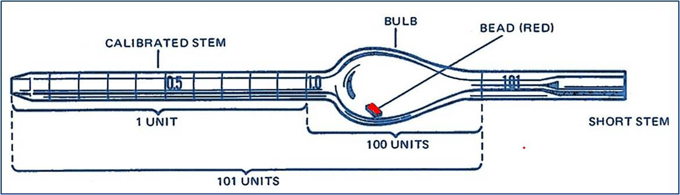
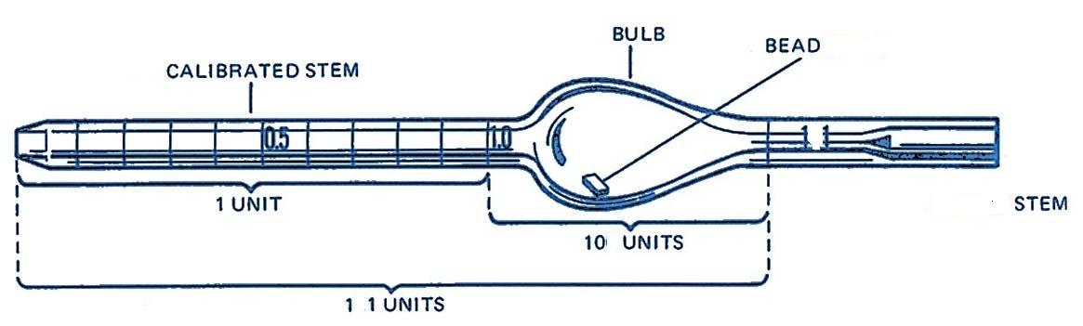
WBC-RBC PIPETTE
Total Leukocyte (WBC) Count Test
RBC PIPETTE
WBC PIPETTE

Slide 20
Differences between RBC and WBC pipette
Total Leukocyte (WBC) Count Test
 | RBC pipette | WBC pipette
 | 1-It has a red bead | 1-It has a white bead
 | 2-It has graduations up to mark 101 | 2-It has graduations up to mark 11
 | 3-Size of bulb is larger | 3-Size of bulb is smaller

Slide 21
Reagents (White-count diluting fluid)
Total Leukocyte (WBC) Count Test
2% of acetic acid (CH3COOH): Add 2 ml glacial acetic acid to a 100 ml volumetric flask. Dilute and complete the volume to the mark (100) with distilled water.
1% of hydrochloric acid (HCL): Add 1 ml hydrochloric acid to a 100 ml volumetric flask. Dilute and complete the volume with distilled water to 100 ml.
Turk 's solution:
Glacial acetic acid 0.5 ml
Gentian Violet 1.5 ml
Distilled water q.s. ad 150 ml

Slide 22
Procedure
Total Leukocyte (WBC) Count Test

Slide 23
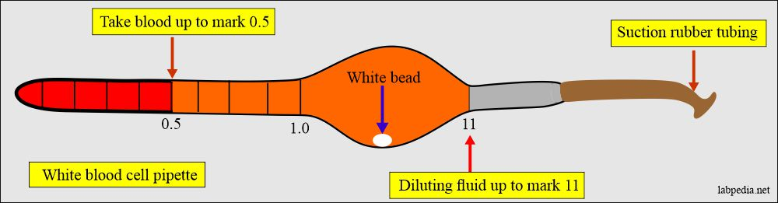
Procedure
Total Leukocyte (WBC) Count Test

Slide 24
Total Leukocyte (WBC) Count Test
Procedure: Continued
Mix the contents of the pipette for 3-5 minutes to ensure even distribution of cells, lysis of RBCs and staining the WBCs.
Expel unmixed and relatively cell-free fluid from the capillary portion of the pipette (usually 4 drops).
Place the forefinger over the top (short end) of the pipette, hold the pipette at a 45 angle, and touch the pipette tip to the junction of the cover glass and the counting chamber.
Allow the mixture to flow under the cover glass until the chamber is completely charged. Similarly, fill the opposite chamber of the hemacytometer.

Slide 25
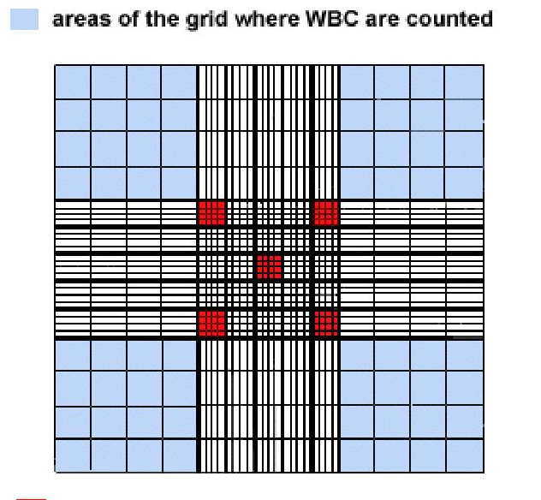
Total Leukocyte (WBC) Count Test
Procedure: Continued
Allow the cells to settle for about 3 minutes. Under low-power magnification and reduced light, focus on the ruled area and observe for even distribution of cells.

Slide 26
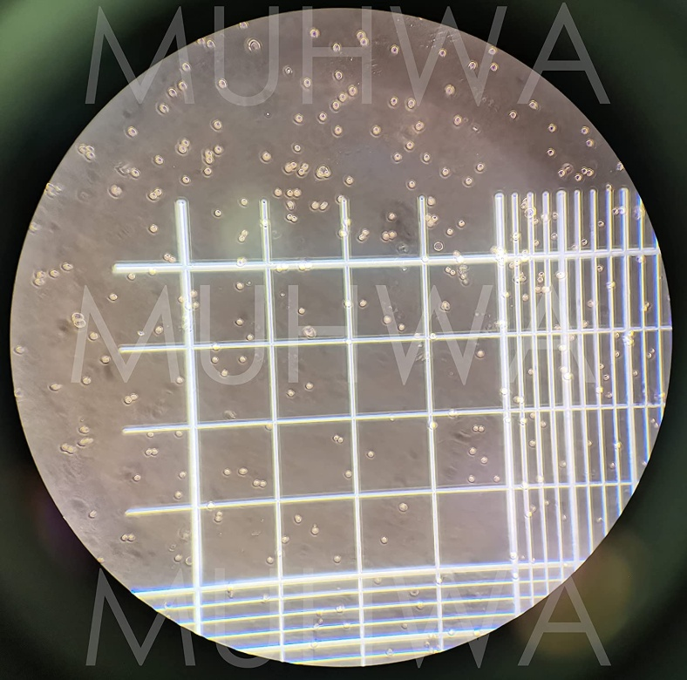
FOCUSING
Total Leukocyte (WBC) Count Test

Slide 27
FOCUSING
Total Leukocyte (WBC) Count Test
Scanning objective lens (4x): to see the general formation of slide.
Low power objective lens (10x): for WBC counting. The leukocytes appear as round, shiny, darkish dots, with a halo around them. These ‘dots’ represent the nuclei, which have been stained by gentian violet.
High power objective lens (40x): for RBC counting.

Slide 28
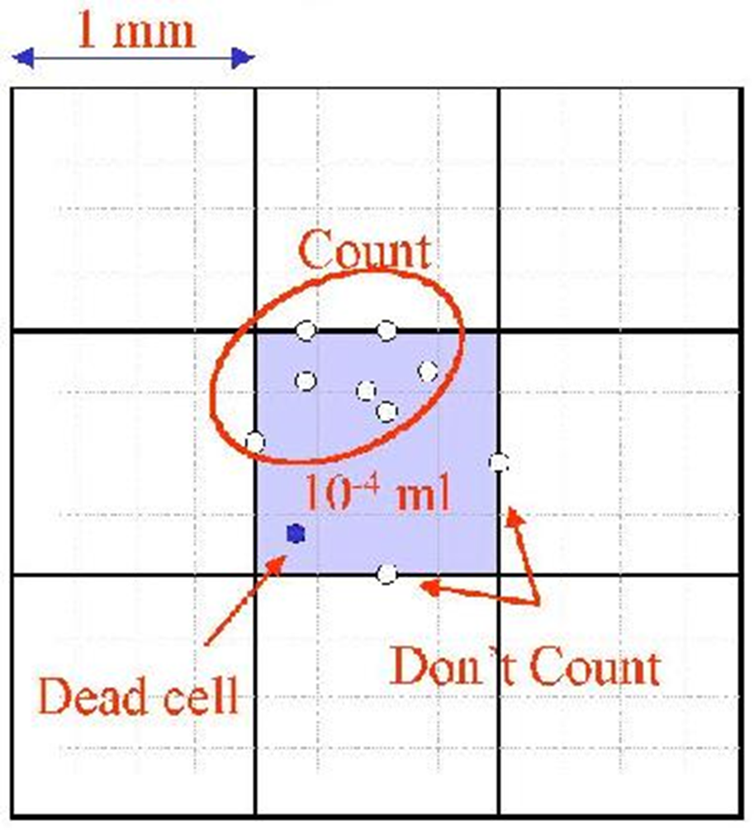
Total Leukocyte (WBC) Count Test
Procedure: Continued
Count all the white cells lying within the square and those touching the upper and left-hand center lines. The white cells that touch the right-hand and bottom lines are not to be counted. In each of the four areas, conduct the count as indicated by the "snake-like" line

Slide 29
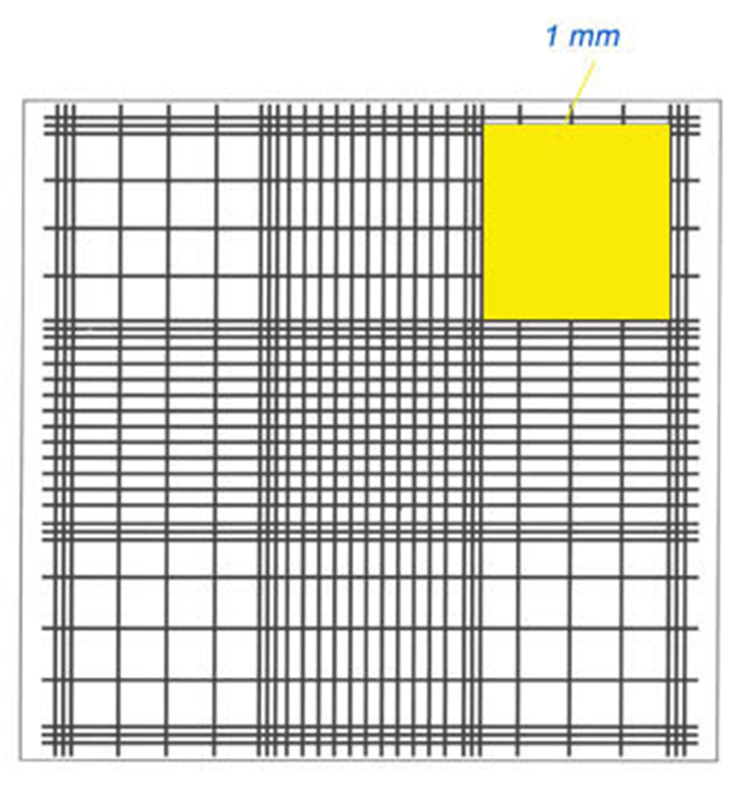



Total Leukocyte (WBC) Count Test
Procedure: Continued

Slide 30
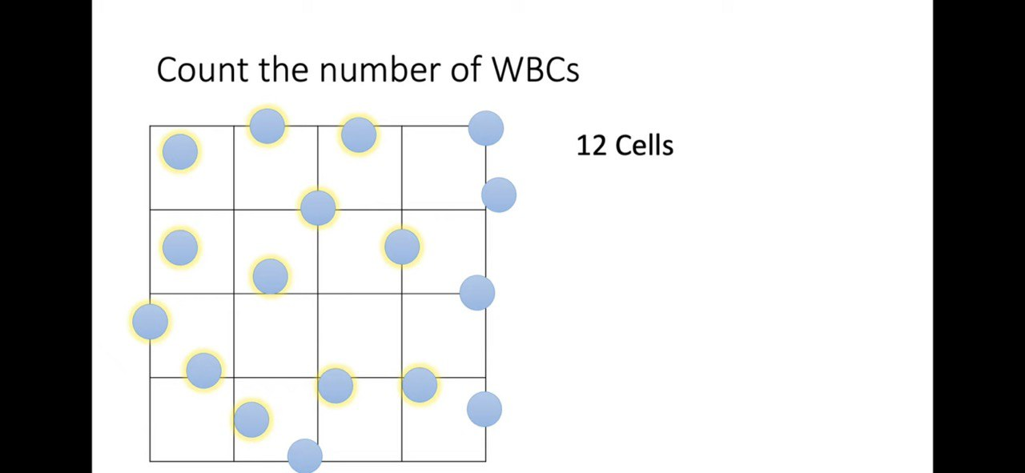
Total Leukocyte (WBC) Count Test

Slide 31
Total Leukocyte (WBC) Count Test
Procedure: Continued
NOTE: A variation of more than 10 cells between any of the large squares of WBC or a variation of more than 20 cells between sides of the hemocytometer (counted chambers) indicate uneven distribution and require that the procedure be repeated.

Slide 32
NOTE: If the mixture (blood sample and diluting fluid) overflows , or air bubbles occur, clean and dry the chambers, remix the contents of the pipette, and refill both chambers.
Total Leukocyte (WBC) Count Test
The chamber must be cleaned and the filling process repeated if any of the following defects occur:
The fluid(diluted sample) overflows or overfilling.
The chamber area is not completely filled.
Air bubbles occur anywhere in the chamber area.
Any debris appears in the chamber area.

Slide 33
Calculation of WBCs
Total Leukocyte (WBC) Count Test
In calculating total count per unit volume of blood 4 important facts must be considered:
Total number of cells counted in the four (1mm) squares.
Dilution of the blood sample
Area counted(depend on the number of used sq.)
Depth of counting chamber(0.1 mm).

Slide 34
Calculation
Total Leukocyte (WBC) Count Test
Routinely, blood is drawn to the 0.5 mark and diluted to the 11 mark with WBC diluting fluid. All the blood is washed into the bulb of the pipette (which has a volume of 10).
Therefore, 0.5 volumes of blood are contained in 10 volumes of diluting fluid.
Dilution factor = final volume / initial volume
= 11-1/0.5
= 20

Slide 35

For WBC Counting
Total Leukocyte (WBC) Count Test
0.5 part of blood is mixed in 10 parts of fluid So, 1 part of blood is in 20 parts of fluid Thus, dilution factor for WBC counting is 20.

Slide 36
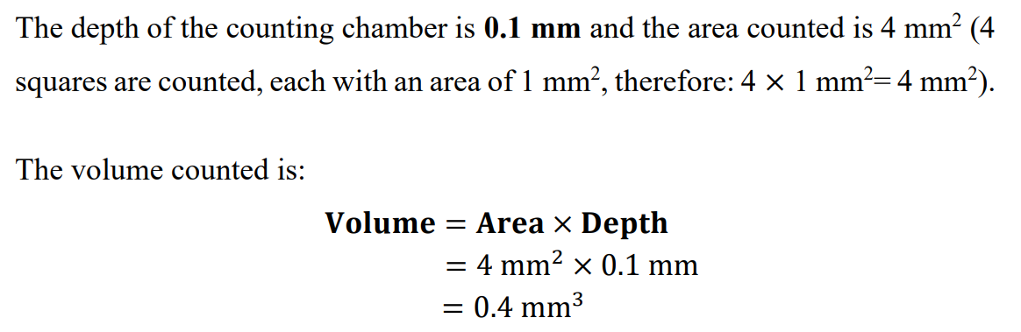
Total Leukocyte (WBC) Count Test

Slide 37

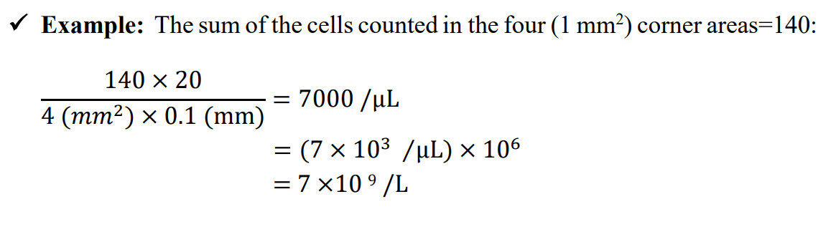
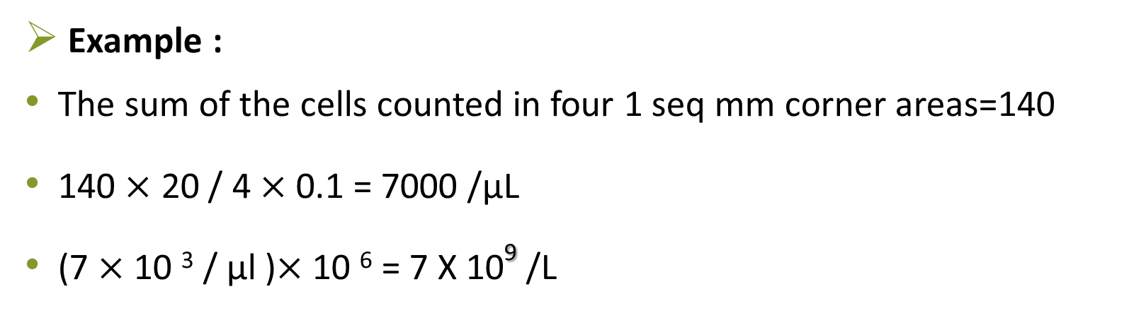
Total Leukocyte (WBC) Count Test

Slide 38
Total Leukocyte (WBC) Count Test
Where:
N : total number of cells counted.
D : dilution of blood.
A : total area counted (in mm²).
10 : factor to convert area to volume (in µl), assuming a chamber of 0.1 mm depth.
10⁶ : factor to convert count per µl to count per litre.

Slide 39
Example
Total Leukocyte (WBC) Count Test
If 200 cells were seen in the four large corner squares (= 4 mm² )
Count = 200 x (20/4) x 10 x 10⁶
= 1000 x 10 x 10⁶
= 10.0 x 10⁹/L

Slide 40
Errors in hemocytometry most frequently arise as a result of:
Total Leukocyte (WBC) Count Test
Apparatus
Technical errors
Chipped pipette tips
Obscure markings on pipettes
Dirty glassware
Inaccurate rulings on chamber
Not thoroughly mixing blood
Failure to discard first 4 drops
Not loading chamber properly or overfilling, trapped air bubbles
Counting cells inaccurately (counting cells twice, counting on wrong borders)
Calculation error

Slide 41
Exercise: Do the WBC count calculation by both rules:
Total Leukocyte (WBC) Count Test
First Chamber Cells counted in each square | Second Chamber Cells counted in each square
35 | 45
40 | 36
44 | 37
49 | 44
158 WBCs counted | 162 WBCs counted

Slide 42
-THANK YOU-

