Slide 1
Parts of a Microscope

Slide 2
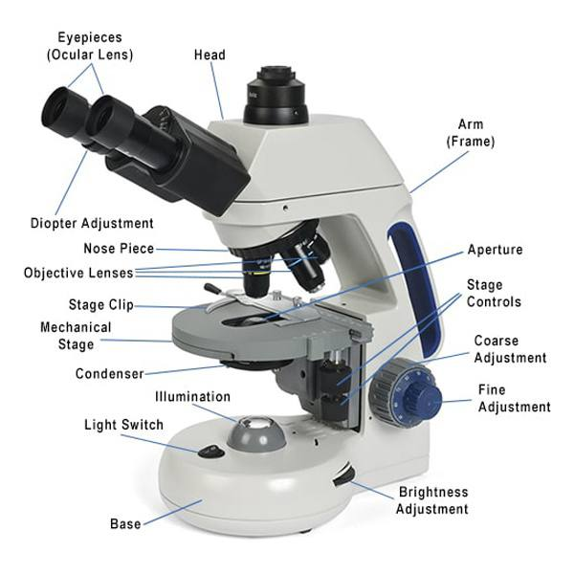

Slide 3
Eyepiece (Ocular lens)
The lens at the top that you look through, usually 10x or 15x power.
Body Tube Connects the eyepiece to the objective lenses.
Arm
Supports the tube and connects it to the base; used to carry the microscope.
Base
The bottom of the microscope, used for support.

Slide 4
Stage
The flat platform where the slide is placed.
Stage Clips
Holds the slide in place on the stage.
Revolving Nosepiece
Holds two or more objective lenses and can be rotated to change power.
Objective Lenses
Usually 3–4 lenses (e.g., 4x, 10x, 40x, 100x) that provide different magnifications.

Slide 5
Coarse Adjustment Knob
Moves the stage up and down for focusing.
Fine Adjustment Knob
Fine-tunes the focus and increases detail of the specimen.
Condenser
Focuses light onto the specimen.

Slide 6
Diaphragm (Iris)
Controls the amount of light reaching the specimen.
Illuminator
A light source that projects light upwards through the diaphragm.

Slide 7
Thanks

