Slide 1
Collecting and Transporting of Specimens
Clinical biochemistry laboratory
5th stage

Slide 2
Laboratory and diagnostic tests are tools give additional information about the patient .
These tests when used in conjunction with patients history and physical examination , provide valuable information about the patient status and response to therapy that not apparent from the history of patient and physical examination alone.
These tools involve blood, urine, stool, x-ray, nuclear scanning, ultrasound and endoscopy .

Slide 3
Several approaches had been considered to request specific lab tests
Basic screening
Establish diagnosis
Different diagnosis
Evaluation of current medical case management and outcomes
Evaluating disease severity
Monitoring course to illness and response to treatment
Testing related to specific events: certain sign &symptoms or drug screening

Slide 4
Patients factors
Incorrect pretest diet
Current drug therapy
Dehydration
Position at time of specimen collection
Time of day
Pregnancy
Age
Stress
Alcohol use

Slide 5
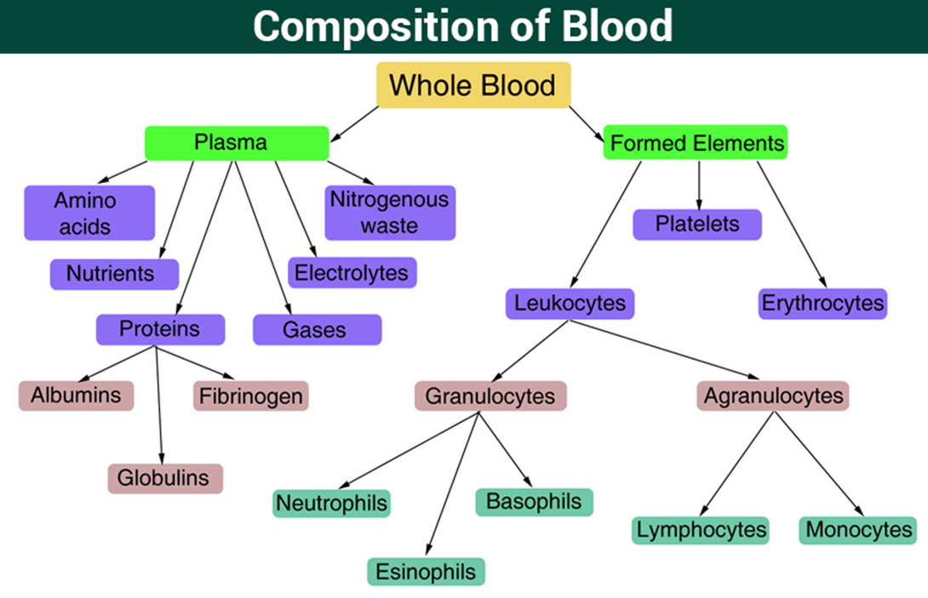

Slide 6
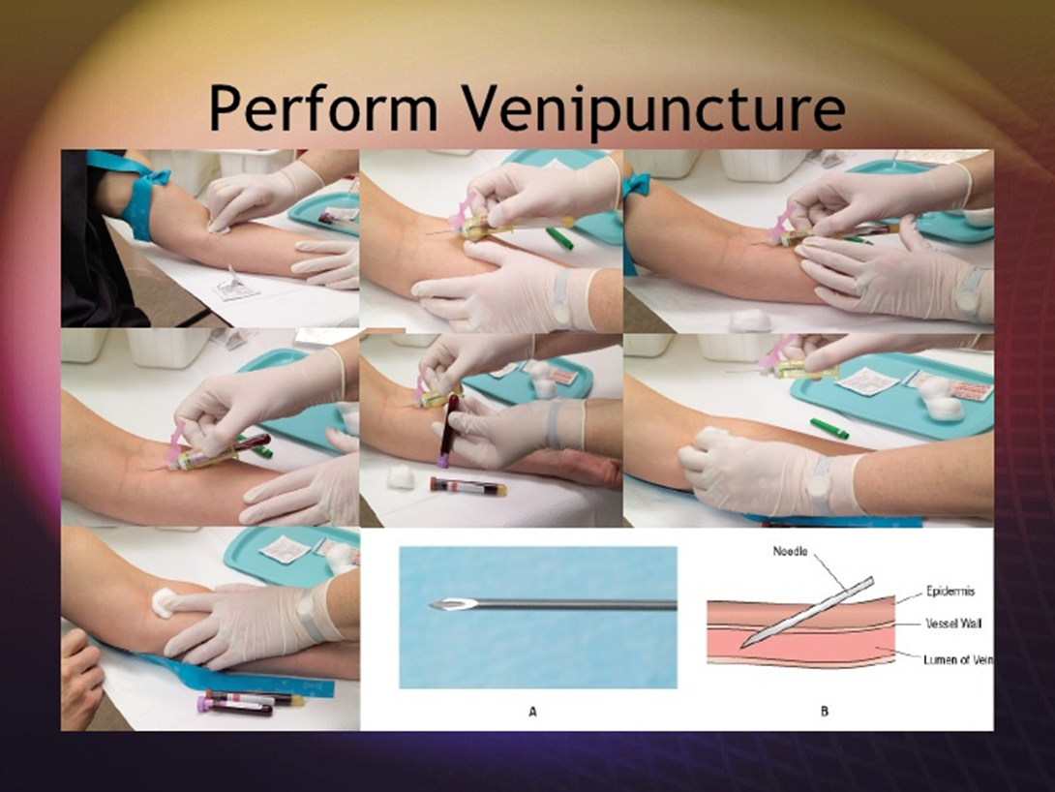
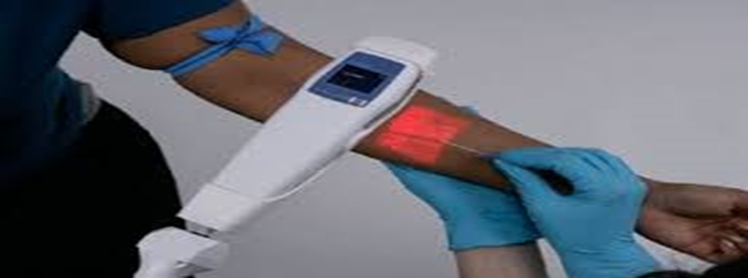
COLLECTION OF BLOOD
Blood sample is collected by:
a- Venipuncture

Slide 7
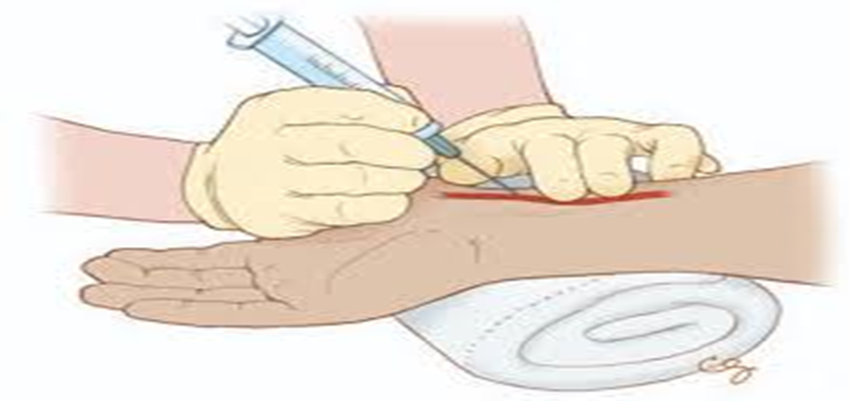
B-Arterial puncture

Slide 8
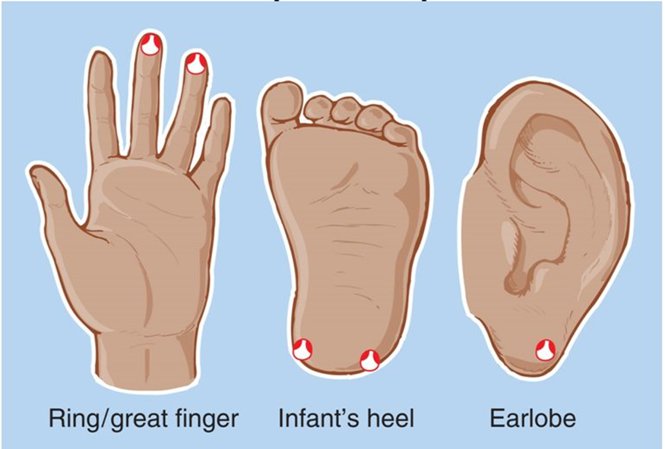
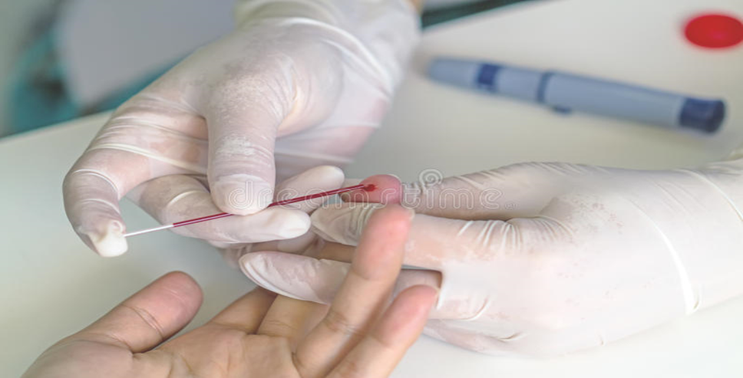
C- Capillary puncture or skin puncture

