Slide 1
Liver function test
Bilirubin
5th stage

Slide 2
Bilirubin
Bilirubin is an orange-yellow pigment, a waste product primarily produced by the normal breakdown of heme. Heme is a component of hemoglobin, which is found in red blood cells (RBCs). Bilirubin is ultimately processed by the liver to allow its elimination from the body.
Normal Value:
Total : 0.3 – 1 mg/dl
Indirect (unconjugated ) : 0.2 – 0.8 mg/dl
Direct (conjugated ) : o.1 – 0.3 mg/dl
Panic volume for neonatal bilirubin : ˃ 15 mg/dl ( mental retardation )

Slide 3
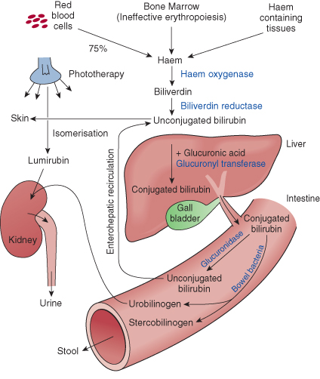
Metabolism

Slide 4
