Slide 1
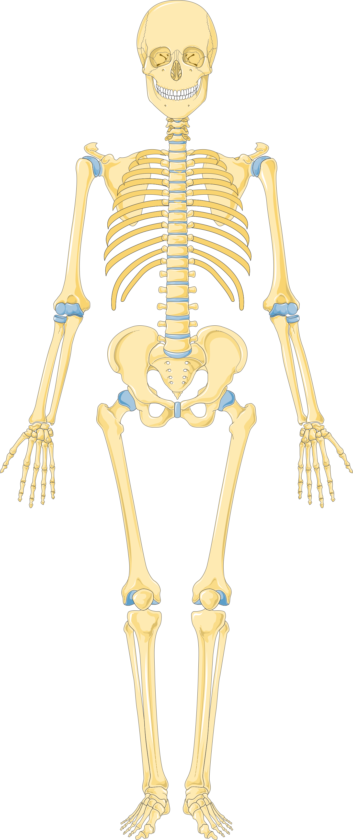
Human Anatomy
Skeletal System
Dr. Sarah Hashim

Slide 2
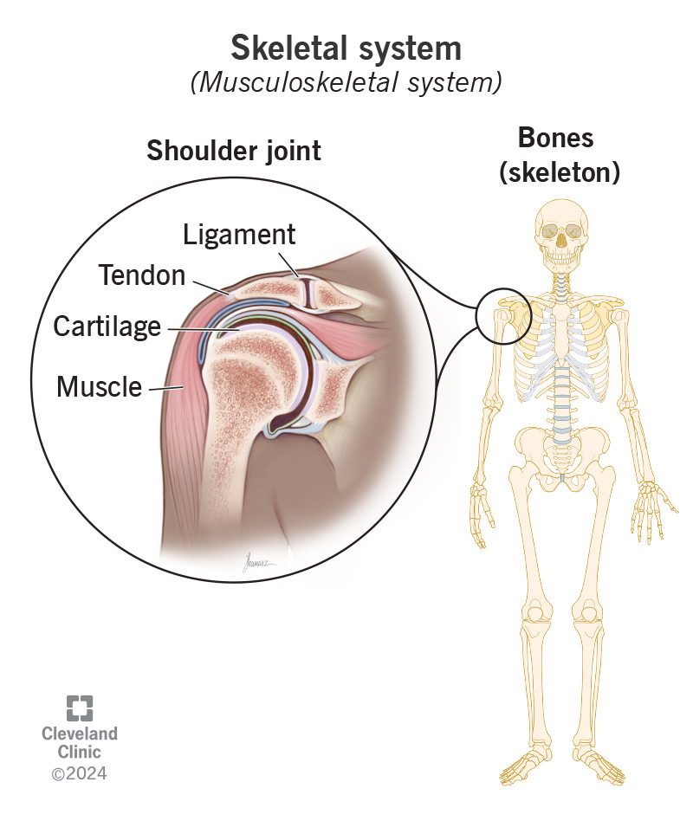
Skeletal system
Bones
Joints
Cartilage: is an avascular form of connective tissue consisting of extracellular fibers embedded in a matrix that contains cells localized in small cavities.
Ligaments : Ligaments are bands of tissue that connect bones to other bones.

Slide 3
Functions of skeletal system
Support – the skeleton keeps the body upright and provides a framework for muscle and tissue attachment.
Protection – the bones of the skeleton protect the internal organs and reduce the risk of injury on impact.
Movement – the skeleton allows movement of the body as a whole and its individual parts. The bones form joints and act as levers, allowing muscles to pull on them to produce movement.
Blood cell production – certain bones in the skeleton contain bone marrow which produces red blood cells, white blood cells and platelets. Examples of bones that contain marrow are the pelvis, sternum, humerus and femur.
Storage of minerals - the bones store minerals such as calcium, iron, potassium and phosphorous and release them into the blood when the body needs to use them.

Slide 4
Bones
Bone is a calcified, living, connective tissue that forms the majority of the skeleton. It consists of an intercellular calcified matrix, which also contains collagen fibers, and several types of cells within the matrix.
The bones are usually classified in three ways
A)according to the shape
B) According to the structure (structural classification)
C)according to the development (developmental classification)

Slide 5
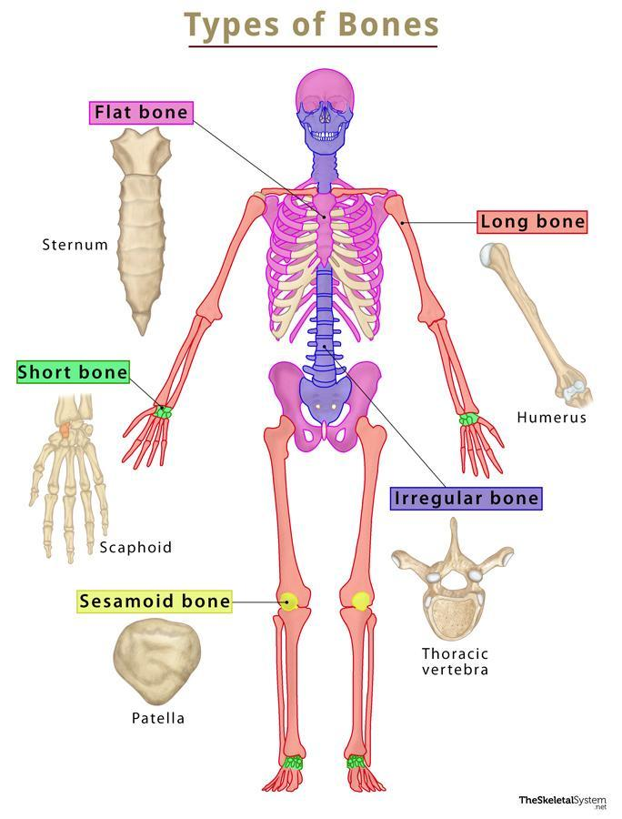
Classification of bones by shape

Slide 6
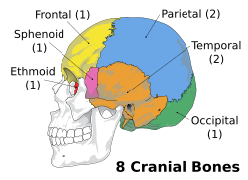
Axial Skeleton (80 bones)
1- Skull (28)
Cranial Bones
Parietal (2)
Temporal (2)
Frontal (1)
Occipital (1)
Ethmoid (1)
Sphenoid (1)

Slide 7
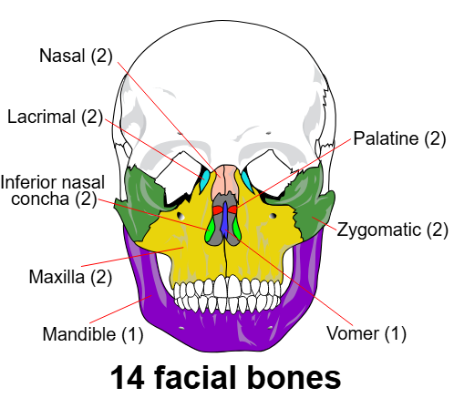
Facial Bones
Maxilla (2)
Zygomatic (2)
Mandible (1)
Nasal (2)
Platine (2)
Inferior nasal concha (2)
Lacrimal (2)
Vomer (1)

Slide 8
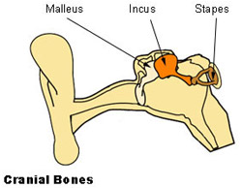
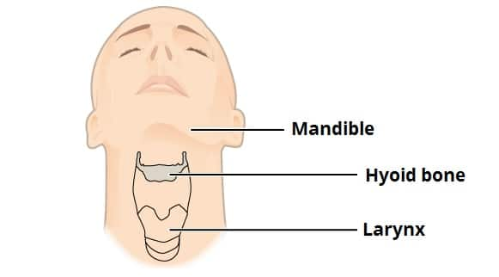
Auditory Ossicles
Malleus (2)
Incus (2)
Stapes (2)
Hyoid (1)

Slide 9
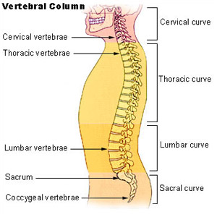
2- Vertebral Column
Cervical vertebrae (7)
Thoracic vertebrae (12)
Lumbar vertebrae (5)
Sacrum (1)
Coccyx (1)

Slide 10
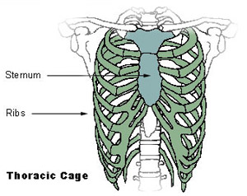
3-Thoracic Cage
Sternum (1)
Ribs (24)

Slide 11
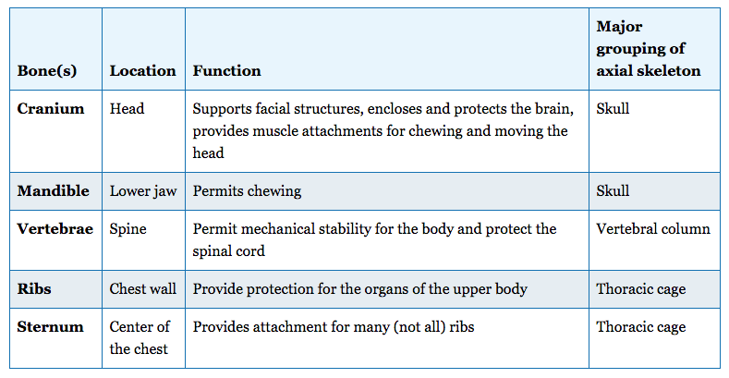

Slide 12


