Slide 1
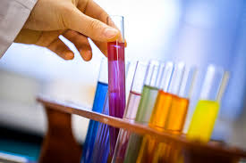
.
Uric acid

Slide 2
Uric acid is a end product of purine metabolism in human. It is nitrogenous compound circulate in the human RBC and plasma .its conc. In plasma twice than that of cells.
The normal value
In men 3.5-7.2mg/dl(0.21-0.42mmol/L)
In women 15-20% lower 2.6-6mg/dl(0.15-0.35mmol/l)
In man, uric acid is the principle end product of purine metabolism and excreted in urine, but in other mammals further oxidize the uric acid to allantoin (due to presence of uricase enzyme)
The purine basis is adenine and guanin formed in course of nucleic acid catabolism &free nucleotide undergo oxidation to uric acid .

Slide 3
Biosynthesis of uric acid
Synthesis is not known exactly although liver is essential for final conversion of purine to uric acid.
Bone marrow, GIT and liver are organs have high turnover of nucleoprotein and are the probable site of purine synthesis
The oxidation of purine ring can occur while it is still in nucleotide combination or nucleoside combination
Adenase enzyme is absent in human, instead the adenosine deaminase, it will convert the adenine to hypoxanthine.
An inborn deficiency or low levels of enzyme xanthine oxidase cause excretion of large amount of xanthine in urine(xanthin uria)
Lack of enzyme uricase allows this poor soluble substance to accumulate in body fluids

Slide 4
Gout
Is disease characterized by high level of uric acid which deposited in solid form (crystal) in joints tendon and bursae , capillaries and skin leading to causing painful condition (the deposits are called tophi) arthritis .
The concentration of uric acid reaches a certain level it cannot stay dissolved in the
blood (crystals). Lithium salts use in the treatment of gout due to it forms lithium salts (urate )which is more soluble

Slide 5
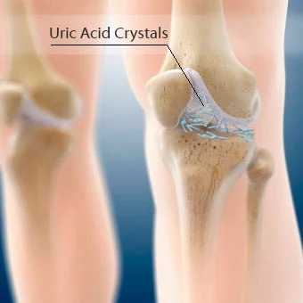
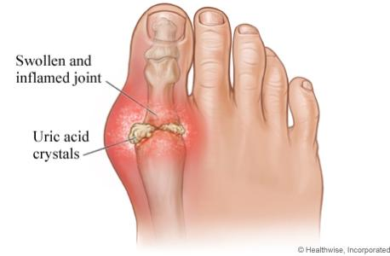
Gout

Slide 6
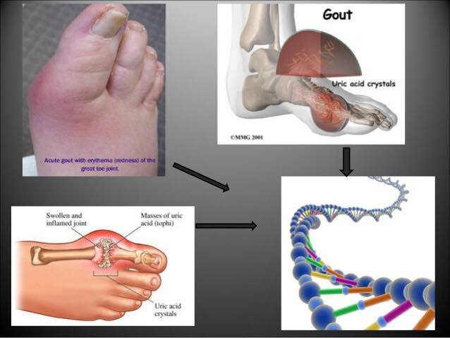
Uric acid crystals are tiny needle shaped crystals , between 5 _25 microns in length .

Slide 7
Estimation of uric acid by enzymtic colorimetric test
Reagent
R1:phosphate buffer, peroxydase, 4 aminoantipurene, uricase, DHBS(3,5 dichloro-2 hydroxy benzene sulfonic acid)
R2: Standard:6mg/dl

Slide 8
Principle of reaction
uricase
Uric acid+O2+2H2O Allantoine+CO2+H2O2
peroxidas
2H2O2+DHBS+ 4-aminoantipyrene
Red quinone+ H2O+ HCL

