Slide 1
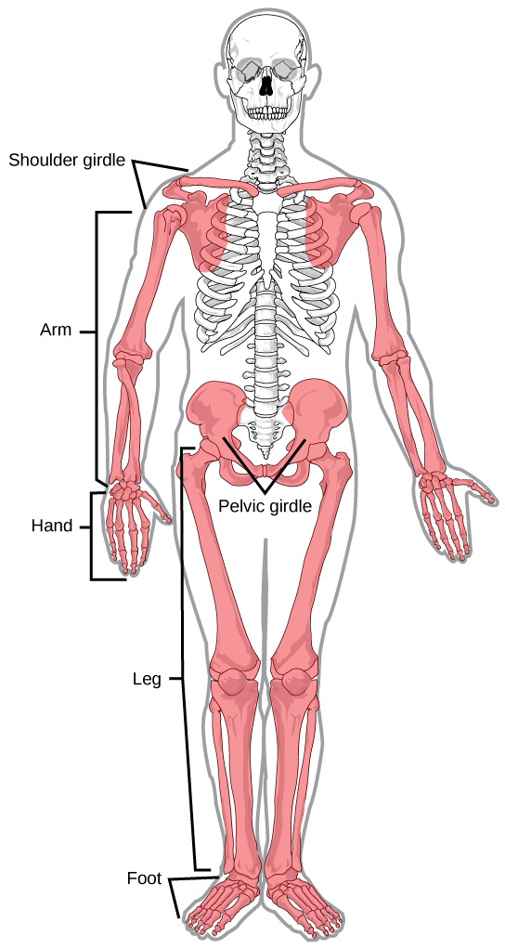
Human Anatomy Appendicular Skeleton
Dr. Sarah Hashim
Lecture 2

Slide 2
Appendicular Skeleton
The appendicular skeleton consists of:
126 bones
facilitate movement and provide shape to limbs, or arms and legs
The appendicular skeleton includes
The limbs
The supportive girdles
The Pectoral girdle with the upper limbs and the Pelvic girdle withthe lower limb.

Slide 3
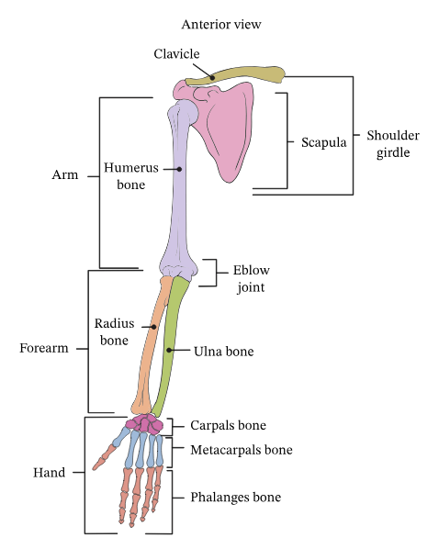
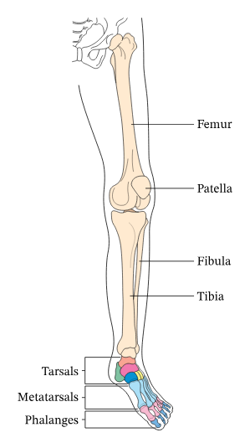

Slide 4
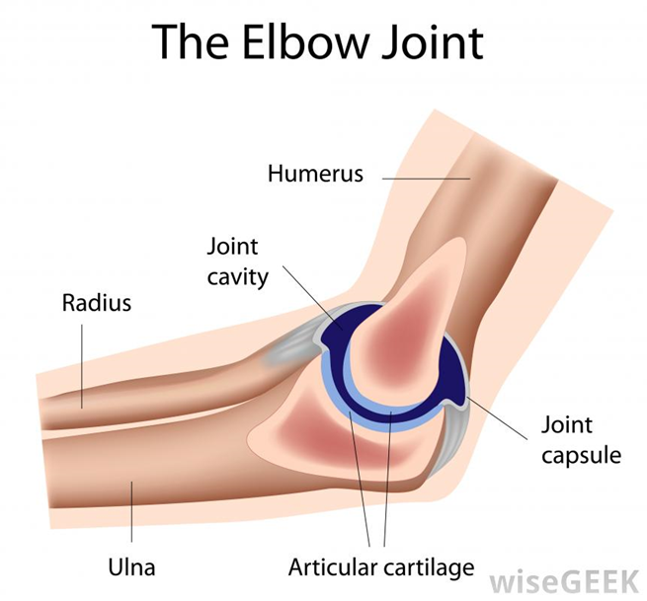
Joints
Joint: location where two or more bones make contact.
Joints allow movement and provide mechanical support.
There is a cartilage cushion in between the bones to keep them from touching directly
the skeletal elements are separated by a cavity (i.e., synovial joints); and there is no cavity and the components are held together by connective tissue (i.e., solid joints).
Blood vessels that cross over a joint and nerves that innervate muscles acting on a joint usually contribute articular branches to that joint.

Slide 5


