Slide 1
Hematology 4
Assist pro dr.Dina Saadoon

Slide 2
Hemoglobin (Hb)
The red, oxygen-carrying pigment in the red blood cells of vertebrates is hemoglobin
1-Is the iron containing coloring matter of red blood cell (RBC).
2-It is a chromo protein forming 95% of dry weight of RBC and 30% to 34% of wet weight.
3-Function of hemoglobin is to carry the respiratory gases, oxygen and carbon dioxide.
4-It also acts as a buffer. Molecular weight of hemoglobin is 68,000.
The polypeptides are referred to collectively as the globin portion of the hemoglobin molecule. There are two pairs of polypeptides in each hemoglobin molecule.
Types of normal hemoglobin :
adult hemoglobin – HbA
2. fetal hemoglobin – HbF

Slide 3
A derivatives closely associated with hemoglobin A that represent glycated hemoglobin. One of these, hemoglobin A1c (HbA1c), has a glucose attached to the terminal valine in each β chain and is of special interest because it increases in the blood of patients with poorly controlled diabetes mellitus.

Slide 4
STRUCTURE OF HEMOGLOBIN
Hemoglobin is a conjugated protein. It consists of a protein combined with an iron ­containing pigment. The protein part is globin and the iron­ containing pigment is hem . Hem also forms a part of the structure of myoglobin (oxygen ­binding pigment in muscles) and neuroglobin (oxygen ­binding pigment in brain.
IRON
It is present in ferrous (Fe2+) form. It is in unstable or loose form. In some abnormal conditions, the iron is converted into ferric (Fe3+) state, which is a stable form.
PORPHYRIN
The pigment part of heme is called porphyrin. It is
formed by four pyrrole rings (tetrapyrrole) called, I, II, III
and IV.
GLOBIN
Globin contains four polypeptide chains. Among the four
polypeptide chains, two are chains and two are α-chains

Slide 6
Structural Difference
In adult hemoglobin, the globin contains two α-chains and two β-chains. In fetal hemoglobin, there are two α chains and two γ-chains instead of β-chains.
Functional Difference
Functionally, fetal hemoglobin has more affinity for
oxygen than that of adult hemoglobin.
Synthesis Of Heme
Heme is synthesized from succinyl­CoA and the glycine.
The sequence of events in synthesis of hemoglobin:
1. First step in heme synthesis takes place in the mitochondrion. Two molecules of succinyl­CoA combine
with two molecules of glycine and condense to form
δ-aminolevulinic acid (ALA) by ALA synthase.
2. ALA is transported to the cytoplasm. Two molecules
of ALA combine to form porphobilinogen in the
presence of ALA dehydratase.

Slide 7
3. Porphobilinogen is converted into uroporphobilinogen
I by uroporphobilinogen I synthase.
4. Uroporphobilinogen I is converted into uropor phobilinogen III by porphobilinogen III cosynthase.
5. From uroporphobilinogen III, a ring structure
called coproporphyrinogen III is formed by
uroporphobilinogen decarboxylase.
6. Coproporphyrinogen III is transported back to the
mitochondrion, where it is oxidized to form protoporphyrinogen IX by coproporphyrinogen oxidase
7. Protoporphyrinogen IX is converted into protoporphyrin IX by protoporphyrinogen oxidase.
8. Protoporphyrin IX combines with iron to form heme
in the presence of ferrochelatase.

Slide 8
FORMATION OF GLOBIN
Polypeptide chains of globin are produced in the ribosomes. There are four types of polypeptide chains namely, alpha, beta, gamma and delta chains. Each of these chains differs from others by the amino acid sequence. Each globin molecule is formed by the combination of 2 pairs of chains and each chain is made of 141 to 146 amino acids. Adult hemoglobin contains two alpha chains and two beta chains. Fetal hemoglobin contains two alpha chains and two gamma chains.

Slide 9
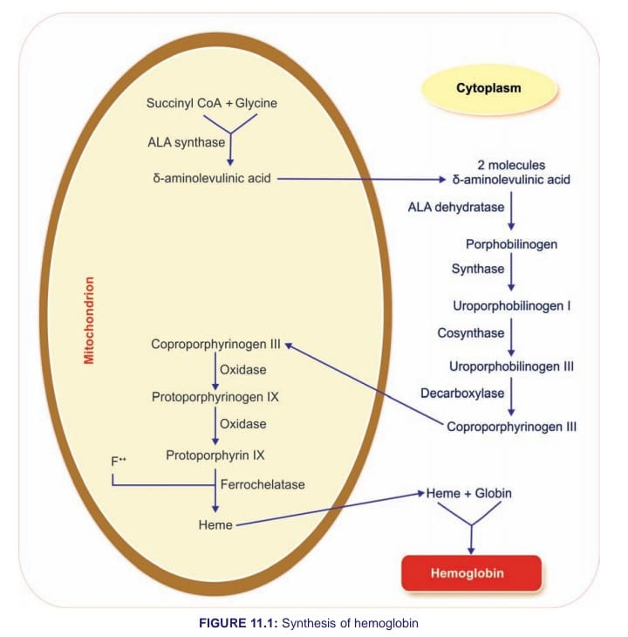

Slide 10
Destruction Of Hemoglobin
After the lifespan of 120 days, the RBC is destroyed in the reticuloendothelial system, particularly in spleen and the hemoglobin is released into plasma. Soon, the hemoglobin is degraded in the reticuloendothelial cells and split into globin and heme. Globin is utilized for the resynthesis of hemoglobin.
Heme is degraded into iron and porphyrin. Iron is stored
in the body as ferritin and hemosiderin, which are
reutilized for the synthesis of new hemoglobin. Porphyrin
is converted into a green pigment called biliverdin. In
human being, most of the biliverdin is converted into a
yellow pigment called bilirubin.
 Importance Of Iron
Iron is an essential mineral and an important component
of proteins, involved in oxygen transport. So, human body needs iron for oxygen transport. Iron is important
for the formation of hemoglobin and myoglobin. Iron is
also necessary for the formation of other substances
like cytochrome, cytochrome oxidase, peroxidase and
catalase

Slide 11
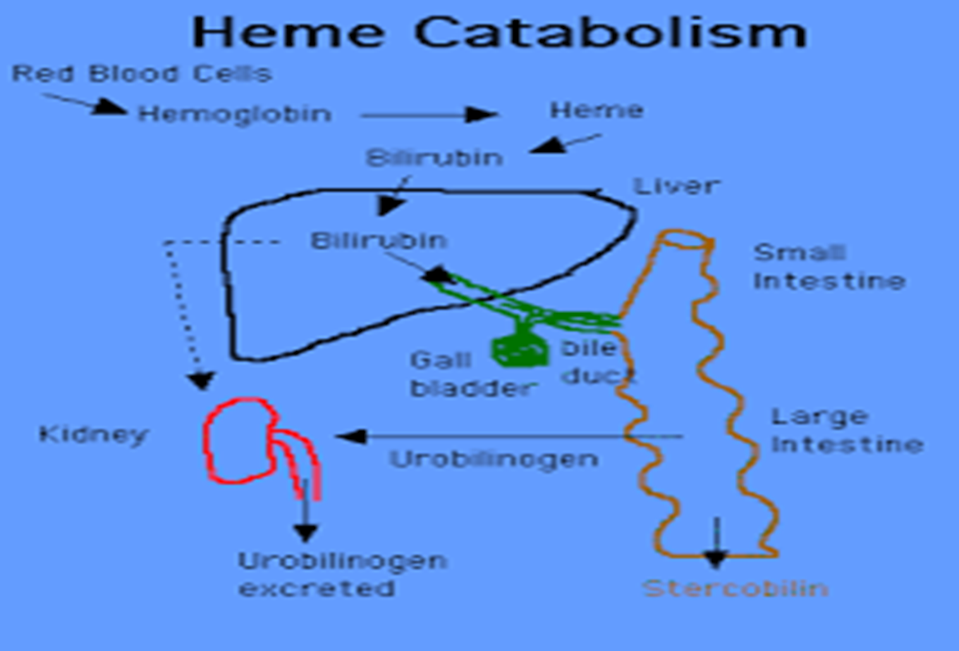

Slide 12
HEMOSTASIS Hemostasis is the process of forming clots in the walls of damaged blood vessels and preventing blood loss while maintaining blood in a fluid state within the vascular system. A collection of complex interrelated systemic mechanisms operates to maintain a balance between coagulation and anticoagulant.
STAGES OF HEMOSTASIS
1. Vasoconstriction
2. Platelet plug formation
3. Coagulation of blood.

Slide 13
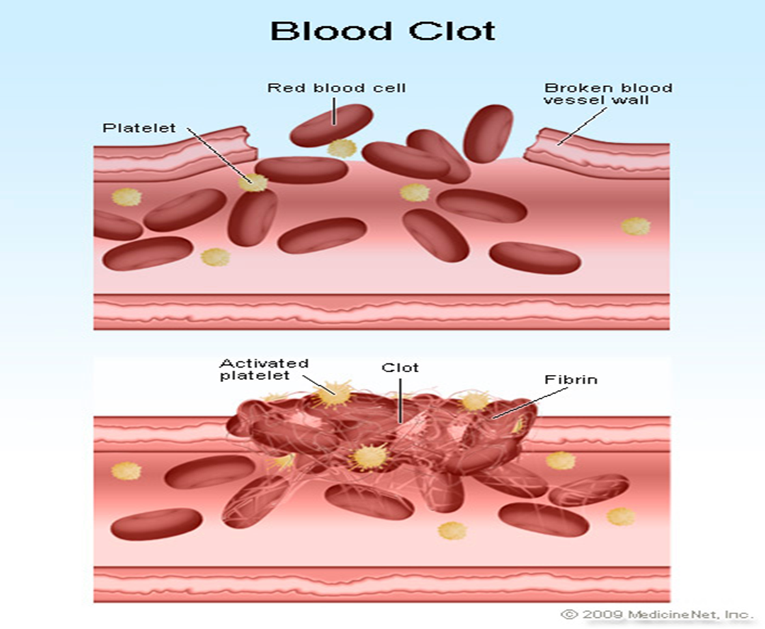

Slide 14
The Clotting Mechanism The loose aggregation of platelets in the temporary plug is bound together and converted into the definitive clot by fibrin. Fibrin formation involves a cascade of enzymatic reactions and a series of numbered clotting factors . The fundamental reaction is conversion of the soluble plasma protein fibrinogen to insoluble fibrin . The process involves the release of two pairs of polypeptides from each fibrinogen molecule. The remaining portion, fibrin monomer, then polymerizes with other monomer molecules to form fibrin. The fibrin is initially a loose mesh of interlacing strands. It is converted by the formation of covalent cross-linkages to a dense, tight aggregate (stabilization). This latter reaction is catalyzed by activated factor XIII and requires Ca2+. The conversion of fibrinogen to fibrin is catalyzed by thrombin. Thrombin is a serine protease that is formed from its circulating precursor, prothrombin, by the action of activated factor X. It has additional actions, including activation of platelets, endothelial cells, and leukocytes via so-called proteinase activated receptors, which are G protein-coupled. Factor X can be activated by either of two systems, known as intrinsic and extrinsic .

Slide 15
The initial reaction in the intrinsic system is conversion of inactive factor XII to active factor XII (XIIa). This activation, which is catalyzed by high-molecular-weight kininogen and kallikrein, can be brought about in vitro by exposing the blood to glass, or in vivo by collagen fibers underlying the endothelium. Active factor XII then activates factor XI, and active factor XI activates factor IX. Activated factor IX forms a complex withactive factor VIII, which is activated when it is separated from von Willebrand factor. The complex of IXa and VIIIa activate factor X. Phospholipids from aggregated platelets (PL) and Ca2+ are necessary for full activation of factor X. The extrinsic system is triggered by the release of tissue thromboplastin, a protein–phospholipid mixture that activates factor VII. Tissue thromboplastin and factor VII activate factors IX and X. In the presence of PL, Ca2+, and factor V, activated factor X catalyzes the conversion of prothrombin to thrombin. The extrinsic pathway is inhibited by a tissue factor pathway inhibitor that forms a quaternary structure with tissue thromboplastin (TPL), factor VIIa, and factor Xa.

Slide 16
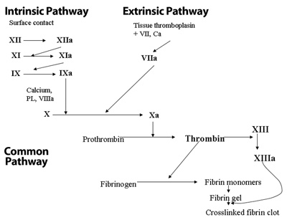

Slide 17
Anticlotting Mechanism In The Body
Under physiological conditions, intravascular clotting
does not occur. It is because of the presence of some
physicochemical factors in the body.
Physical Factors
2- chemical factors
Anticoagulants
Substances which prevent or postpone coagulation of
blood are called anticoagulants.
Anticoagulants are of three types:
1. Anticoagulants used to prevent blood clotting inside
the body.
2. Anticoagulants used to prevent clotting of blood that
is collected from the body.
3. Anticoagulants used to prevent blood clotting both inside and outside the body.

Slide 18
1. HEPARIN
2. COUMARIN DERIVATIVES
Coumarin derivatives prevent blood clotting by inhibiting
the action of vitamin K. Vitamin K is essential for the
formation of various clotting factors, namely II, VII, IX
and X.
 3. EDTA
Ethylenediaminetetraacetic acid (EDTA) is a strong
anticoagulant. It is available in two forms:
i. Disodium salt (Na2
EDTA).
ii. Tripotassium salt (K3
EDTA).
4. OXALATE COMPOUNDS
5. CITRATES
Sodium, ammonium and potassium citrates are used as
Anticoagulants.

Slide 19
LYMPH Lymph is tissue fluid that enters the lymphatic vessels. It drains into the venous blood via the thoracic and right lymphatic ducts. It contains clotting factors and clots on standing in vitro. In most locations, it also contains proteins that traverse capillary walls and return to the blood via the lymph. Its protein content is generally lower than that of plasma, which contains about 7 g/dL. Water-insoluble fats are absorbed from the intestine into the lymphatics, and the lymph in the thoracic duct after a meal is milky because of its high fat content . Lymphocytes enter the circulation principally through the lymphatic, and there are appreciable numbers of lymphocytes in thoracic duct lymph.

Slide 20
Hemophilia
Is a rare disorder in which the blood doesn't clot in the typical way because it doesn't have enough blood-clotting proteins (clotting factors). If you have hemophilia, you might bleed for a longer time after an injury than you would if your blood clotted properly. Hemophilia is almost always a genetic disorder. Treatment includes regular replacement of the specific clotting factor that is reduced. Newer therapies that don't contain clotting factors also are being used.
Thalassemia
Are inherited blood disorders characterized by decreased hemoglobin production. Symptoms depend on the type and can vary from none to severe. Thalassemia are genetic disorders inherited from a person's parents. There are two main types, alpha thalassemia and beta thalassemia.The severity of alpha and beta thalassemia depends on how many of the four genes for alpha globin or two genes for beta globin are missing. Diagnosis is typically by blood tests including a complete blood count, special hemoglobin tests, and genetic tests.

Slide 21
Treatment depends on the type and severity. Treatment for those with more severe disease often includes regular blood transfusions, iron chelation, and folic acid.

